Slide 1

The Human Brain: Its Structure and Function
Fintan Nagle

Slide 2
Lecture 1 Anatomical history of the brain

Slide 3

What is Psychology?
The Study of the Soul
“The brain, the masterpiece of creation,
is almost unknown to us.”
-Nicolaus Steno, 1669

Slide 4
What is Psychology?
The Study of the Soul
“The study of the human brain and its disease remains one of the greatest scientific and philosophical challenges ever undertaken.”
-Floyd E. Bloom, 2007

Slide 5
What is Psychology?
The Study of the Soul
“The brain is truly wonderful and complex, seamlessly and apparently effortlessly able to attend to multiple tasks at the same time. However, the human brain, via religion or science, art or technology, has yet to figure itself out.”
-John S. Allen, 2009

Slide 6
Early conceptions
Aristotle
“The modern geography of the brain has a deliciously antiquated feel to it -- rather like a medieval map with the known world encircled by terra incognita where monsters roam.”
-David Bainbridge

Slide 7
What is Psychology?
The Study of the Soul
“The seat of the soul and the control of voluntary movement - in fact, of nervous functions in general, - are to be sought in the heart. The brain is an organ of minor importance.”
-Aristotle, De motu animalium
4th century BC

Slide 8
Egyptian conceptions
The Edwin Smith papyrus
Purchased in 1862 by Edwin Smith, dates from
approx. 1500 BCE
The oldest known rational/scientific medical papyrus. There are others, but they are based in magic.
Describes 48 (typical) cases of injury and trauma. Believed to be a military surgical manual.
Scroll 4.7 metres in length with 469 lines in 22 columns.
Written in hieratic (cursive hieroglyphs) with further explanations in red
Likely origin Thebes; attributed by some to Imhotep

Slide 9

Egyptian conceptions
The Edwin Smith papyrus

Slide 10
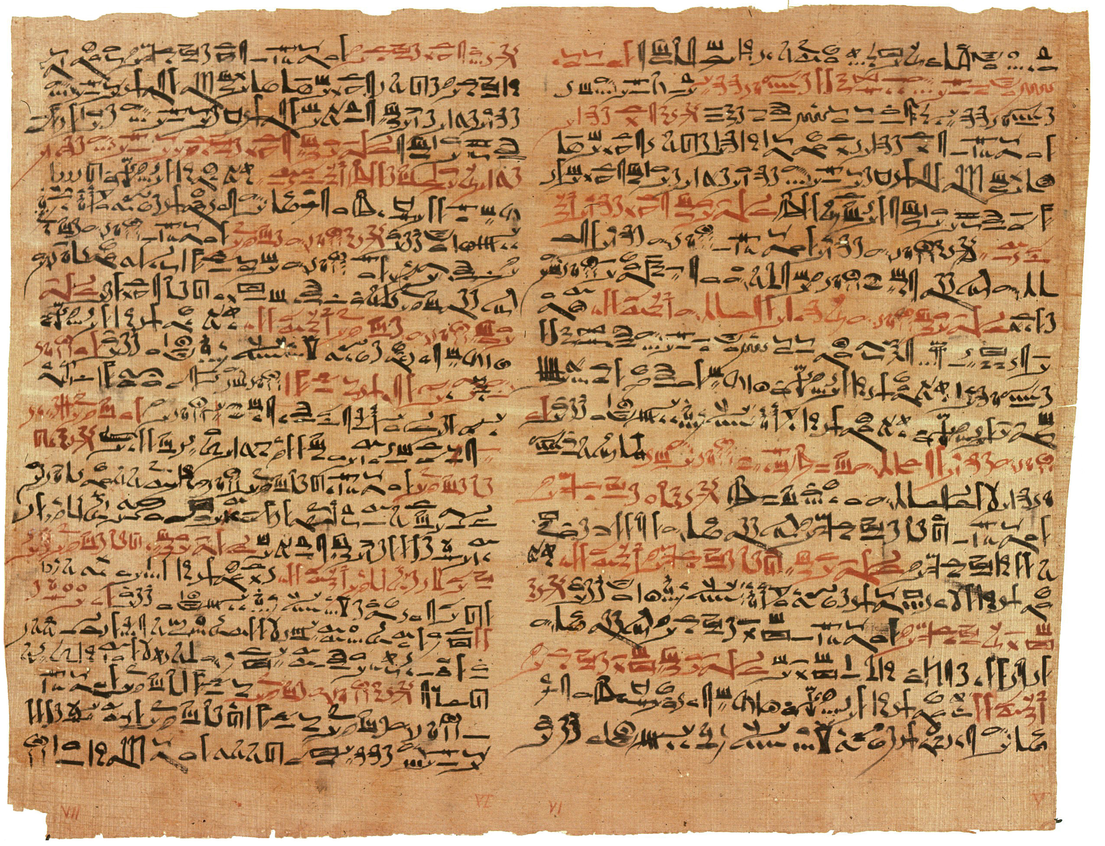
Egyptian conceptions
The Edwin Smith papyrus

Slide 11
Egyptian conceptions
The Edwin Smith papyrus
Each case details
nature of trauma
examination process
diagnosis and prognosis
to be treated or not (triage)
First known instance of the word “brain” in any language.
First known descriptions of
the cranial structures
cerebrospinal fluid
intracranial pulsations

Slide 12
Egyptian conceptions
The Edwin Smith papyrus
Case Six: Instructions concerning a gaping wound in his head, penetrating to the bone, smashing his skull, (and) rending open the brain of his skull.
Examination: If thou examinest a man having a gaping wound in his head, penetrating to the bone, smashing his skull, (and) rending open the brain of his skull, thou shouldst palpate his wound. Shouldst thou find that smash which is in his skull [like] those corrugations which form in molten copper, (and) something therein throbbing (and) fluttering under thy fingers, like the weak place of an infant's crown before it becomes whole-when it has happened there is no throbbing (and) fluttering under thy fingers until the brain of his (the patient's) skull is rent open-(and) he discharges blood from both his nostrils, (and) he suffers with stiffness in his neck...

Slide 13
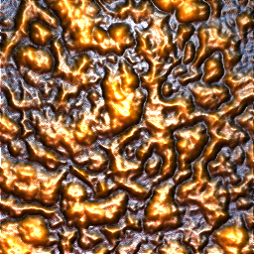

Egyptian conceptions
The Edwin Smith papyrus

Slide 14
Egyptian conceptions
The Edwin Smith papyrus
Diagnosis: [Thou shouldst say concerning him]: "An ailment not to be treated." Treatment: Thou shouldst anoint that wound with grease. Thou shalt not bind it; thou shalt not apply two strips upon it: until thou knowest that he has reached a decisive point.
As for: "Smashing his skull, (and) rending open the brain of his skull," (it means) the smash is large, opening to the interior of his skull, (to) the membrane enveloping his brain, so that it breaks open his fluid in the interior of his head....
Breasted, James Henry, ed. The Edwin Smith Surgical Papyrus: Published in Facsimile and Hieroglyphic Transliteration with Translation and Commentary in 2 Vol. University of Chicago Press, 1930.

Slide 15
Egyptian conceptions
The Edwin Smith papyrus
More advanced medical knowledge than Hippocrates (1000 years later!)

Slide 16
Egyptian conceptions
Mummification
Spiritually, mummification was meant to prepare the soul for the afterlife.
However, it usually entailed complete removal of most of the organs (to prevent rotting and the attention of pests) including the brain.
Brain removed through the nose with a hook; brain matter discarded.
Skull rinsed with chemicals to kill bacteria and remove rest of brain.
Flank incision
Removal of internal organs (optional preservation in jars)
Abdominal cavity rinsed and filled with herbs and spices
Body dehydrated in natron (naturally occurring salt) for 70 days
Washing and wrapping with bandages.
Herodotus

Slide 17
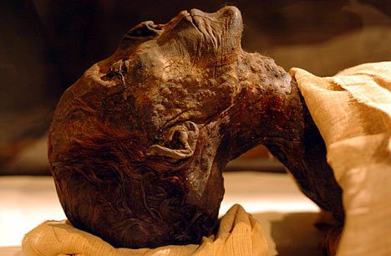
Egyptian conceptions
Mummification

Slide 18
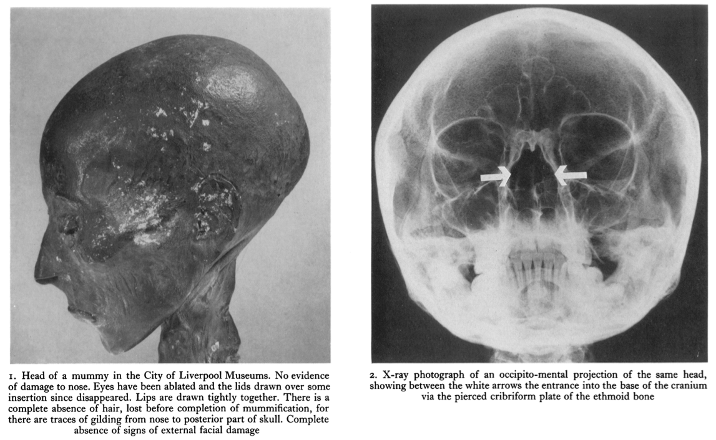
Egyptian conceptions
Mummification
Leek, F. Filce. "The problem of brain removal during embalming by the ancient Egyptians." The Journal of Egyptian Archaeology (1969): 112-116.

Slide 19
Egyptian conceptions
Mummification
Removal and discarding of the brain does not seem to fit with its modern role as seat of the soul.

Slide 20
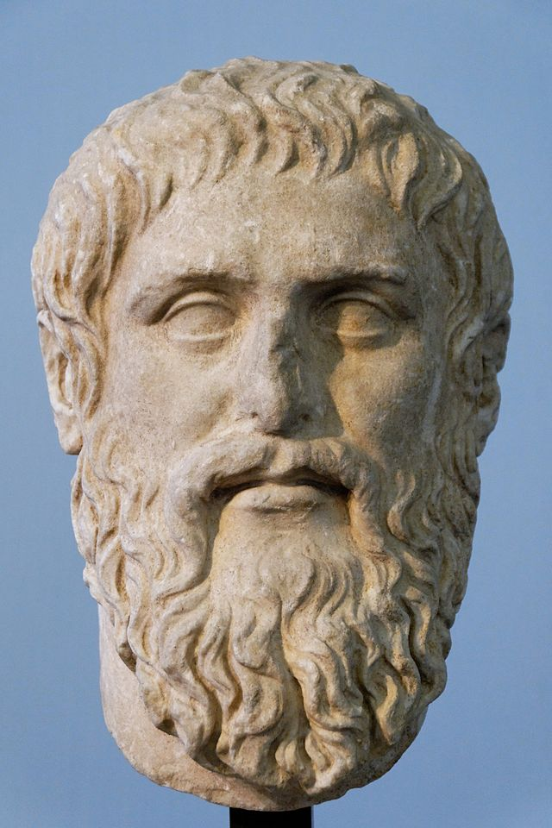
Greek conceptions
Plato
Plato
428 – 348 BCE

Slide 21
Greek conceptions
Plato
His dialogue, the Timaeus, distingishes the soul into three parts:
the perceiving localised to the brain
the courageous
the appetent

Slide 22
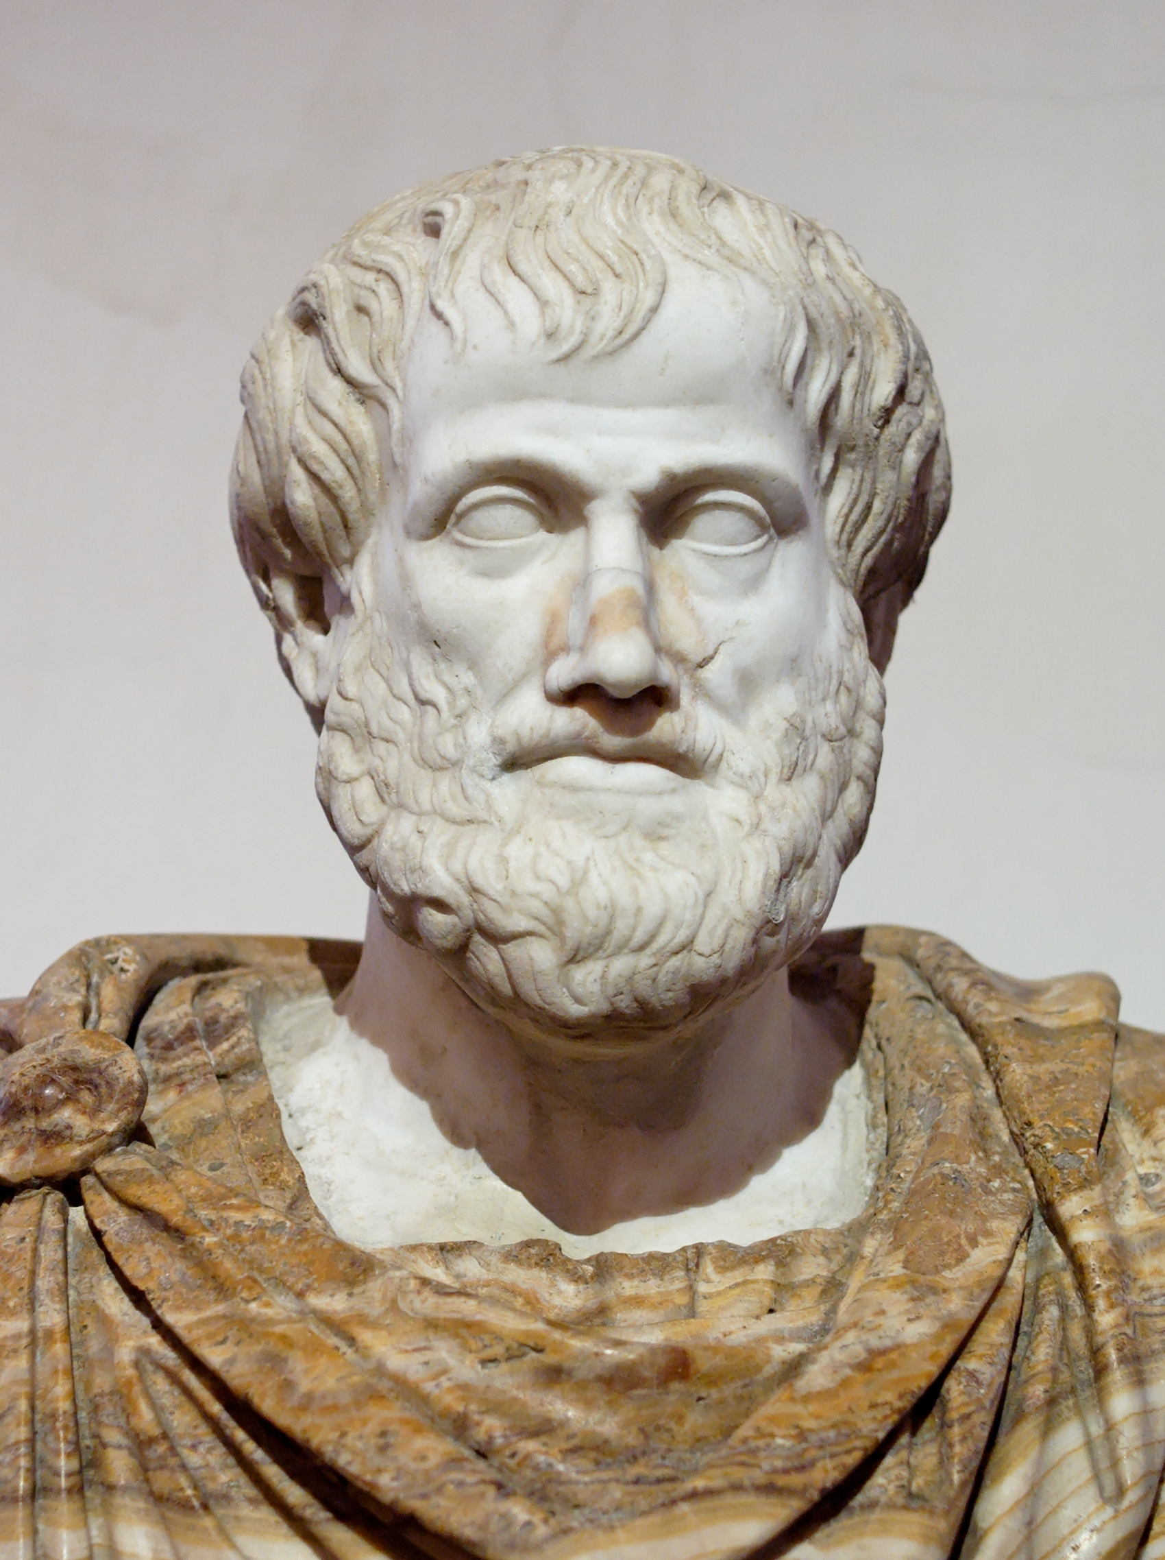
What is Psychology?
The Study of the Soul
Aristotle
384 – 322 BCE

Slide 23
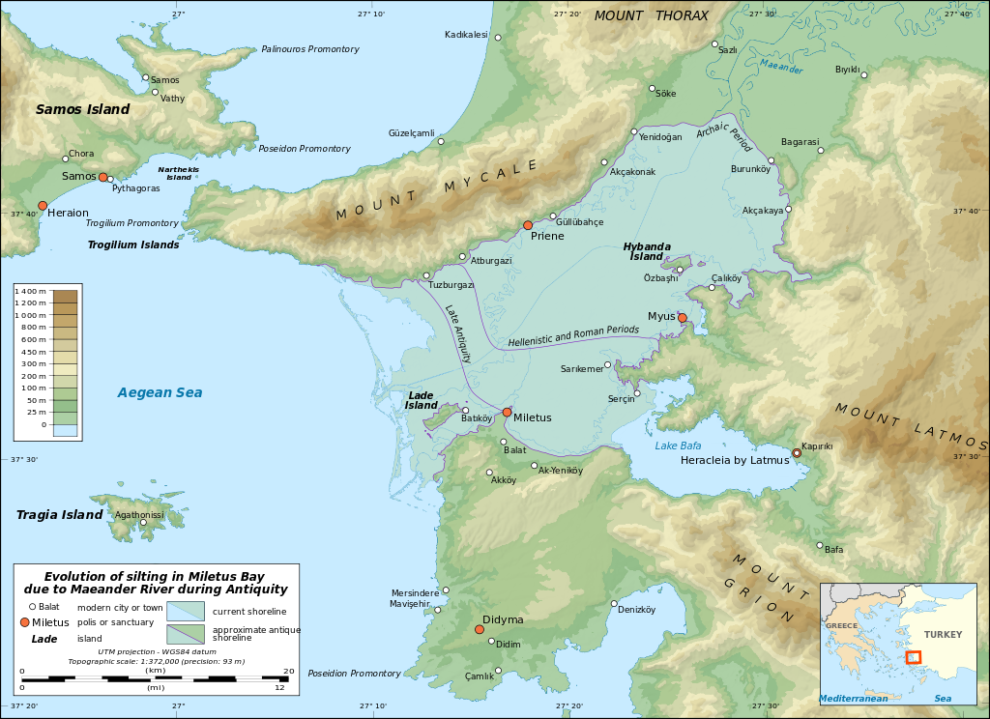
Early conceptions
Aristotle

Slide 24
Early conceptions
Aristotle
A student of Plato (428 – 348 BC)
The founder of comparative anatomy
The first serious student of animal behaviour
Tutor to Alexander the Great
Widely seen as the first genuine scientist

Slide 25
Early conceptions
Aristotle
Science: the idea that “the universe is a complicated mechanism working according to fixed lawas that could be understood through human reason.”
[Gross, Aristotle on the Brain, The Neuroscientist, 1995]
Pre-socratic philosopher-scientists:
Thales
Anaximander
Anaximenes
in 6th-century BC Miletus

Slide 26
Early conceptions
Aristotle
Observing that the brain did not react to touch or disturbance, and that it is cooler than the rest of the body, Aristotle inferred that its main function was cooling. He viewed the brain as a simple radiator.
Today, we know that in order to have a cooling effect, a radiator must be hotter than the rest of the body – but the Greeks were not so advanced in thermodynamics.

Slide 27
Early conceptions
Alcmaeon
Probably born around 510 BC
Early practitioner of dissection
Said to be the first to identify the Eustachian tubes
Suggested the idea that health is equilibrium between humours

Slide 28
Early conceptions
Alcmaeon
Dissected the optic nerves and claimed that they joined behind the eyes
Following experiences with phosphenes, proposed that the eyes contain fire, an idea which persisted well into modern times (only disproved in the middle of the 18th century [1])
[1] Grüsser, Otto-Joachim, and Michael Hagner. "On the history of deformation phosphenes and the idea of internal light generated in the eye for the purpose of vision." History of Ophthalmology. Springer Netherlands, 1990. 57-85.

Slide 29
Early conceptions
Democritus
Everything is made of of atoms.
They come in three types:
psyche (soul, mind) lightest, most spherical, fastest-moving
heart (emotion) slightly cruder
liver (lust and appetite) even more crude

Slide 30
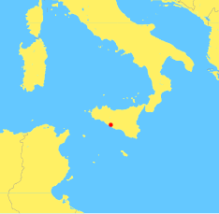
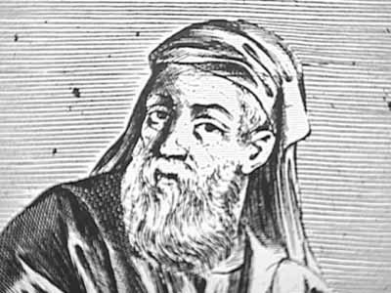
What is Psychology?
The Study of the Soul
Agrigentum,
Sicily
Empedocles
490– 430 BCE

Slide 31
Early conceptions
Empedocles
Blood is the medium of thought.
A person’s intelligence depends on the composition of their blood.
The heart is the central organ of intellect and emotion.

Slide 32
Early conceptions
The heart as the seat of intelligence
“I know you white men think with the brain. That accounts for your shortcomings. We red men think with the heart.”
-Native Pueblo chief, to C.G. Jung
This conception was shared among many early cultures:
Chinese (the role of the brain did not enter Chinese thought until 1595)
Egyptian
Mesopotamian
Babylonian
Indian
And modern non-literate cultures

Slide 33
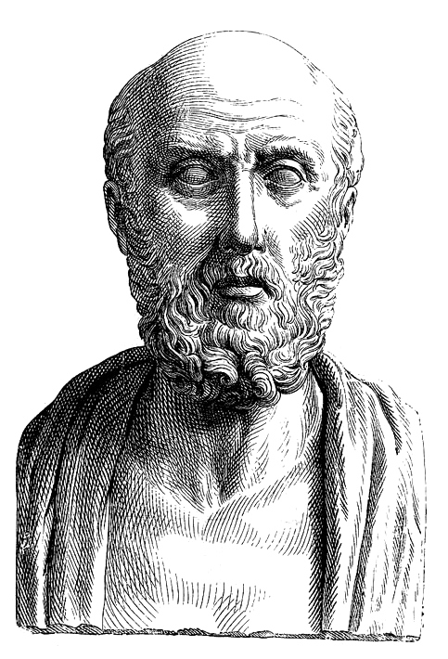
Greek conceptions
Hippocratic school
“The father of Western medicine.”
Founder of the Hippocratic School
(it is not precisely clear which of the Hippocratic writings are his own, and which his pupils’)
Gave his name to the Hippocratic Oath – but did not invent or back it
(later neo-Pythagorean sect)
Hippocrates
460 – 370 BCE

Slide 34
Greek conceptions
Hippocrates
The Hippocratic school, unlike Alcmaeon’s Croton school, did not practice dissection. They concentrated less on anatomy and more on function.
However, they did finally recognise the importance of the brain:
“It ought to be generally known that the source of our pleasure, merriment, laughter, and amusement, as of our grief, pain, anxiety and tears, is none other than the brain.
It is specifically the organ which enables us to think, see, and hear, and to distinguish, the ugly and the beautiful, the bad and the good, the pleasant and unpleasant...
It is the brain too which is the seat of madness and delirium, of the fears and frights which assail us, often by night, but sometimes even by day; it is there where lies the cause of insomnia and sleep-walking, of thoughts that will not come, forgotten duties, and eccentricities.”
[Hippocrates, On the Sacred Disease]

Slide 35
Greek conceptions
Hippocrates
In fact, he fully rejected the role of the heart (as well as the diaphragm):
“Neither of these organs takes any part in mental operations, which are completely undertaken by the brain.”

Slide 36
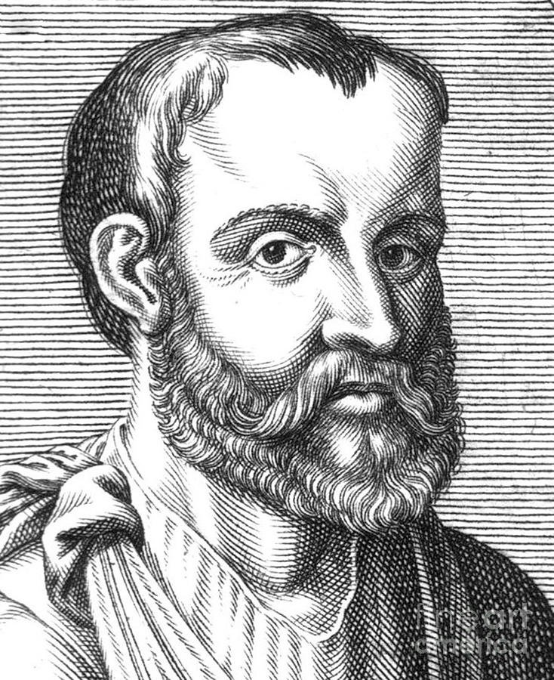
Roman conceptions
Galen
Galen
Aelius Galenus
130 – 200 AD

Slide 37
Roman conceptions
Galen’s ventricular theory
The brain’s ventricles are the site of intellect.

Slide 38
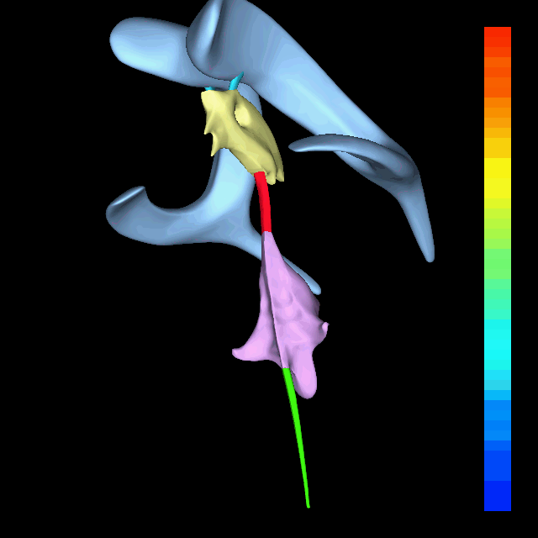

Roman conceptions
Galen’s ventricular theory

Slide 39
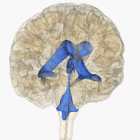

Roman conceptions
Galen’s ventricular theory

Slide 40
Roman conceptions
Galen’s ventricular theory
In reality, the ventricles produce and store CSF (cerebrospinal fluid).
CSF is the same density as the brain, allowing it to float and not rest on its ventral surface, which could cause nerve damage.

Slide 41
Roman conceptions
Ventricular system
Ventricle = cavity
Found all over the body, in varying sizes.
The brain has four main examples:
left and right lateral ventricles
third ventricle
fourth ventricle

Slide 42
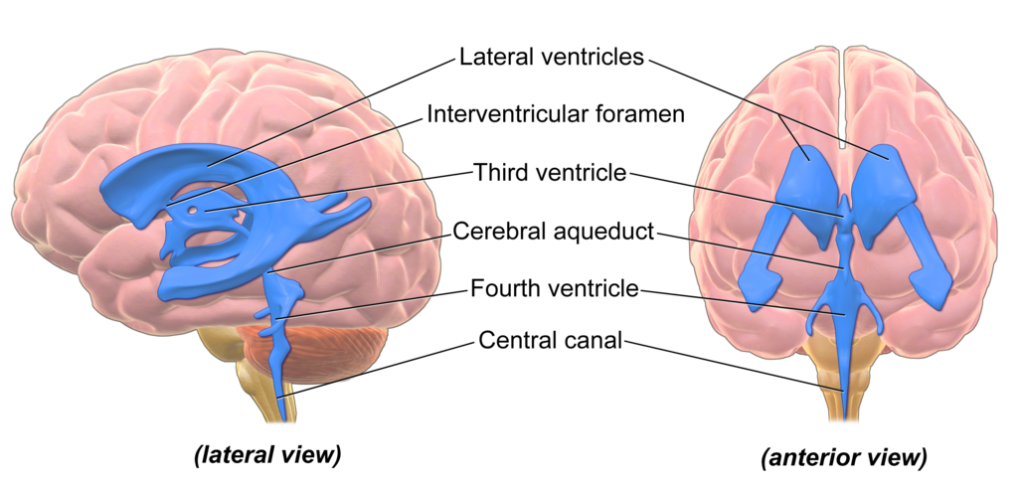
Roman conceptions
Ventricular system

Slide 43
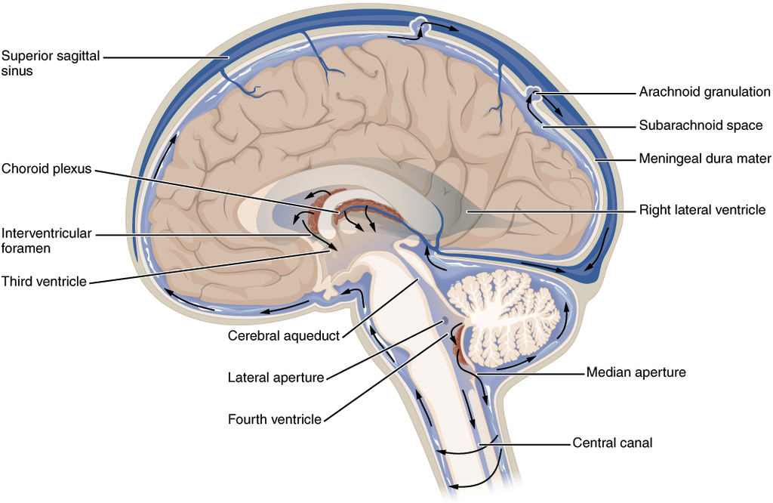
Roman conceptions
Ventricular system

Slide 44
Roman conceptions
Ventricular theory
The heart’s ventricles are central to its purpose of propelling blood, hydraulically, around the body, where it enables metabolism.
This led Galen to think that the brain’s ventricles were central to its purpose of hydraulically propelling a substance, the psychic pneuma, which similarly enabled thought.
For Galen, the ventricles were the only important parts of the brain. The white and grey matter was undifferentiated. Neither were the spinal cord and nerves.
His vocabulary:
encephalon equivalent to our cerebrum
parencephalis our cerebellum

Slide 45
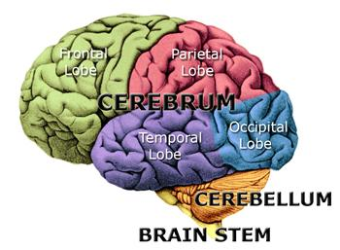
Roman conceptions
Ventricular theory

Slide 46
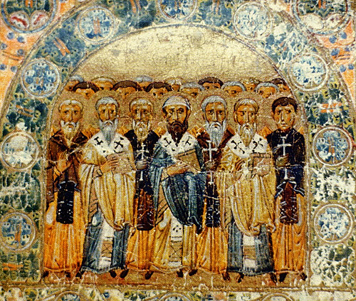
300-500 AD
The Early Church Fathers
Christian theologians, bishops and ecumenical officials.

Slide 47
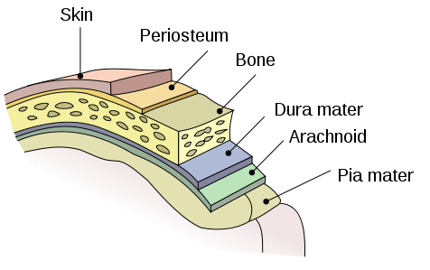
300-500 AD
The Early Church Fathers
1328: manuscript by Jehan Yperman, Flemish surgeon
the brain is divided into
pia mater
dura mater
cranium

Slide 48
300-500 AD
Cell doctrine: a series of cells or chambers in the brain, each responsible for a separate function, and connected in sequence.
Functional localisation:
front visual, gustatory and olfactory discrimination
middle intelligence and hearing (idea formation)
posterior memory

Slide 49
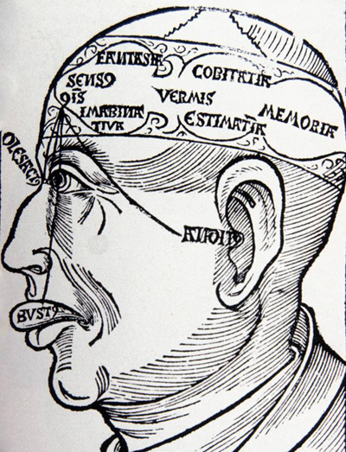
300-500 AD
Hieronymus Brunschwig,
1525

Slide 50
300-500 AD
At this stage we distinguish hardly any of the brain’s internal structures, apart from the covering layers and the ventricles.

Slide 51
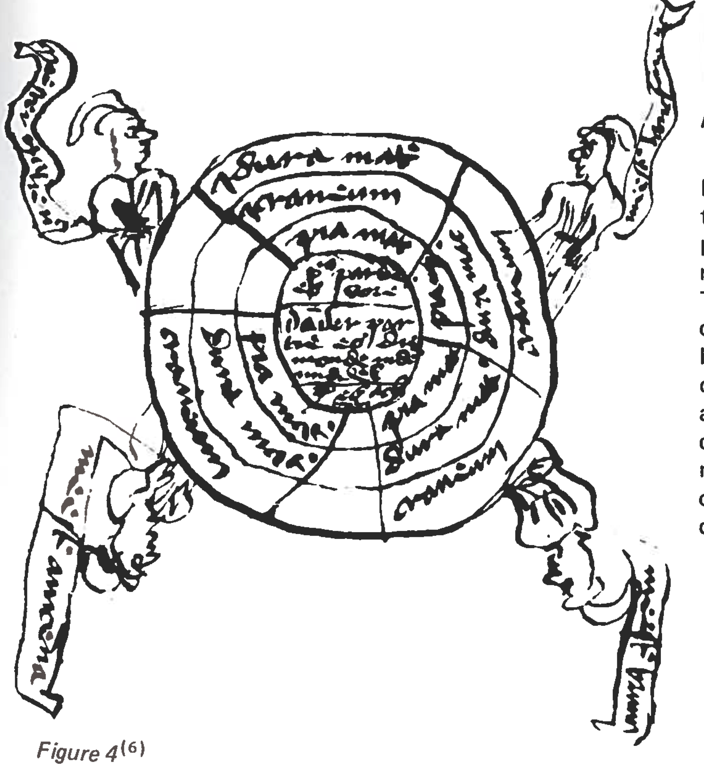
11th Century
1328
Nucleus:
Front part
Middle part
Third part
Surrounded by
Pia mater
Dura mater
Cranium

Slide 52
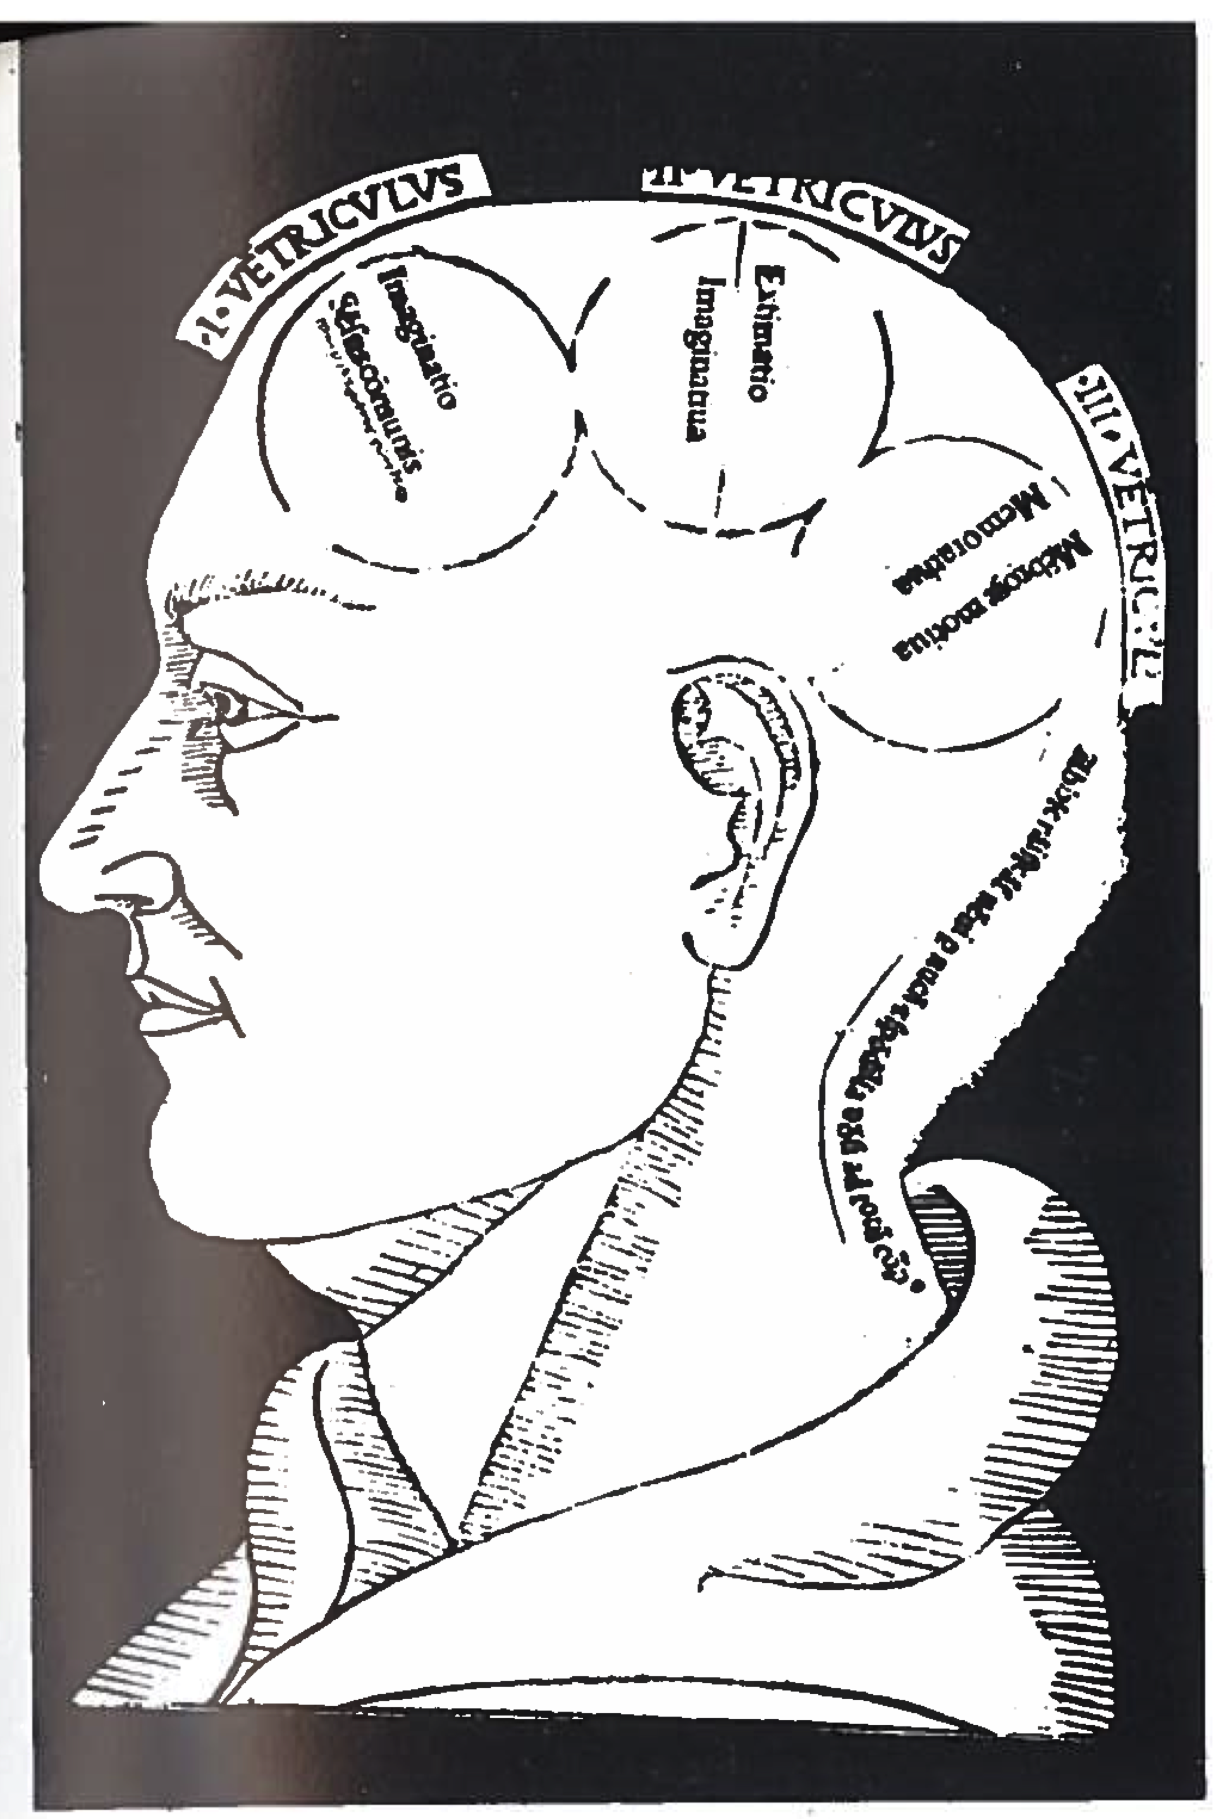
15th Century
c. 1490
We see the ventricles with standard functions
Imaginatio
Extimatio
Memorativa

Slide 53
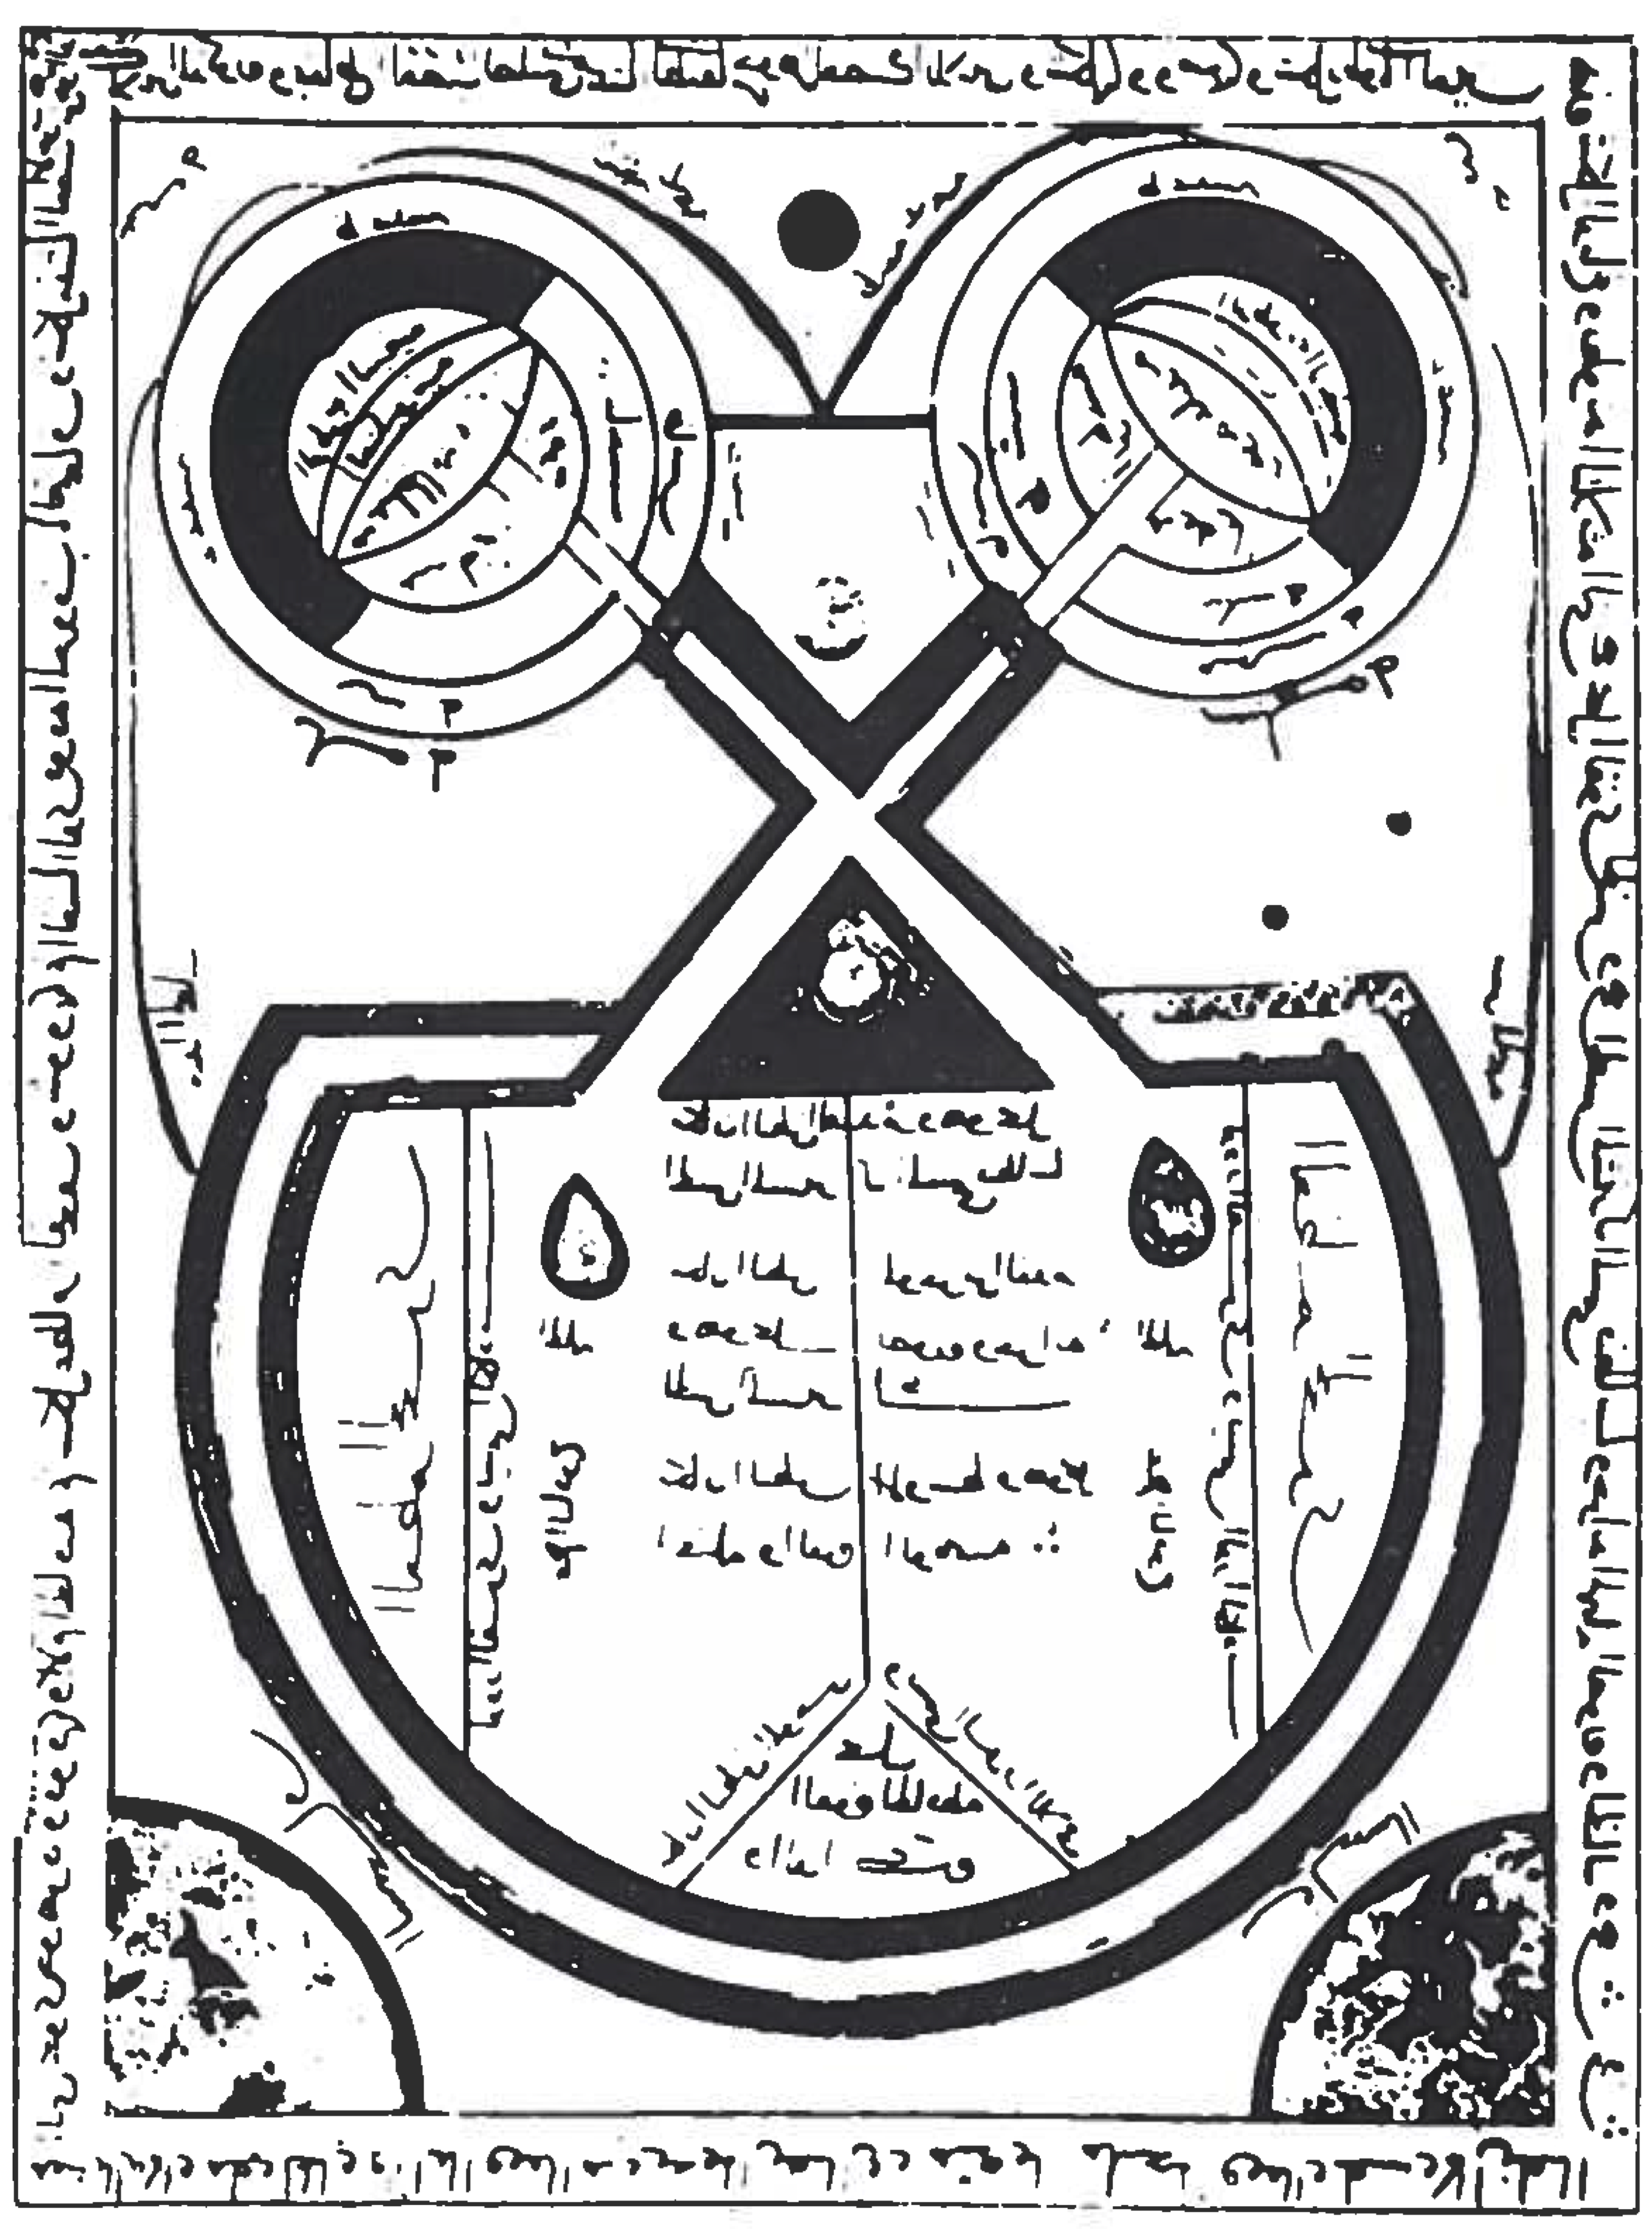
16th Century
1560 or before
Schematic due to religious restrictions
We see the optic chiasm and four ventricles

Slide 54
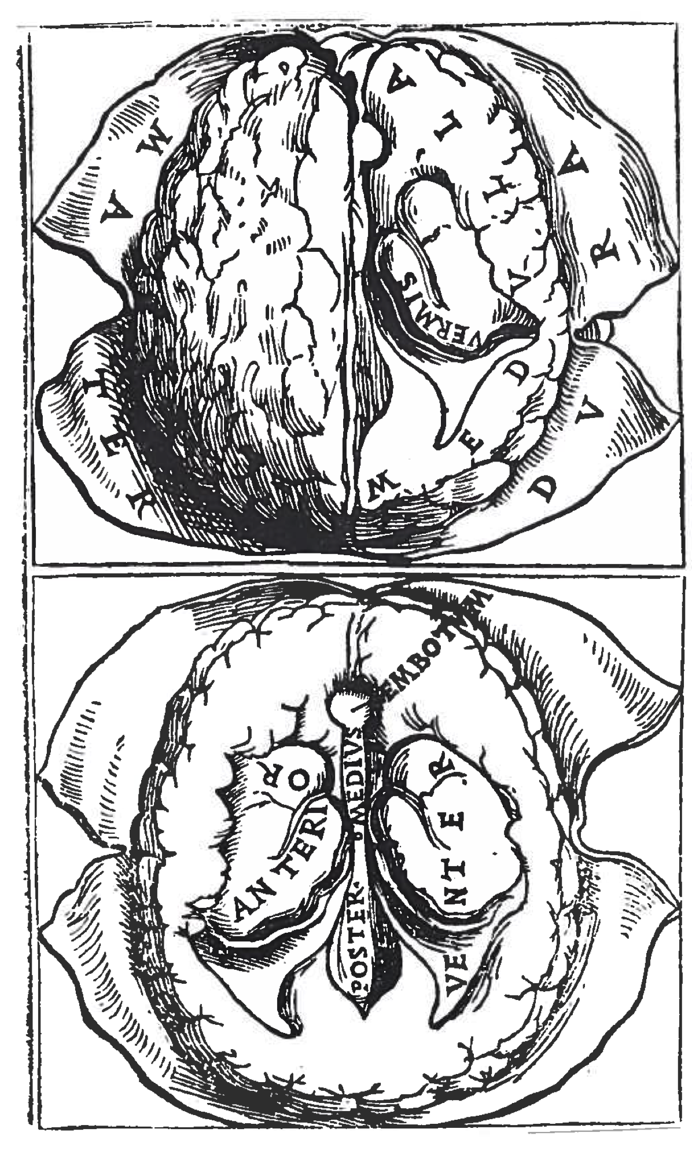
16th Century
1522: Berengario da Carpi
Perceptual anatomy still rare, in fact he justifies it
Vermis: choroid plexus, network of CSF-producing vessels
We see anatomical terms coming into use

Slide 55
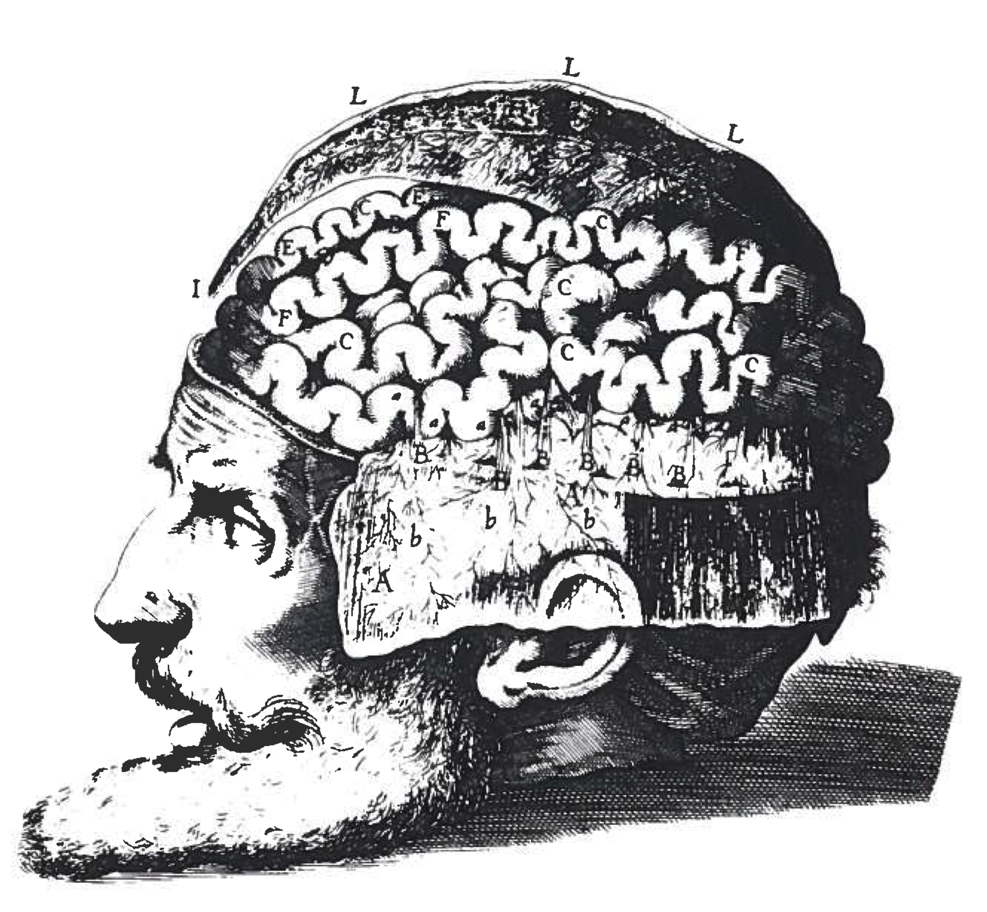
17th Century
1627: Giulio Casserio or his artist
Preconceived idea of morphology: the cortical convolutions are depicted like the gut

Slide 56
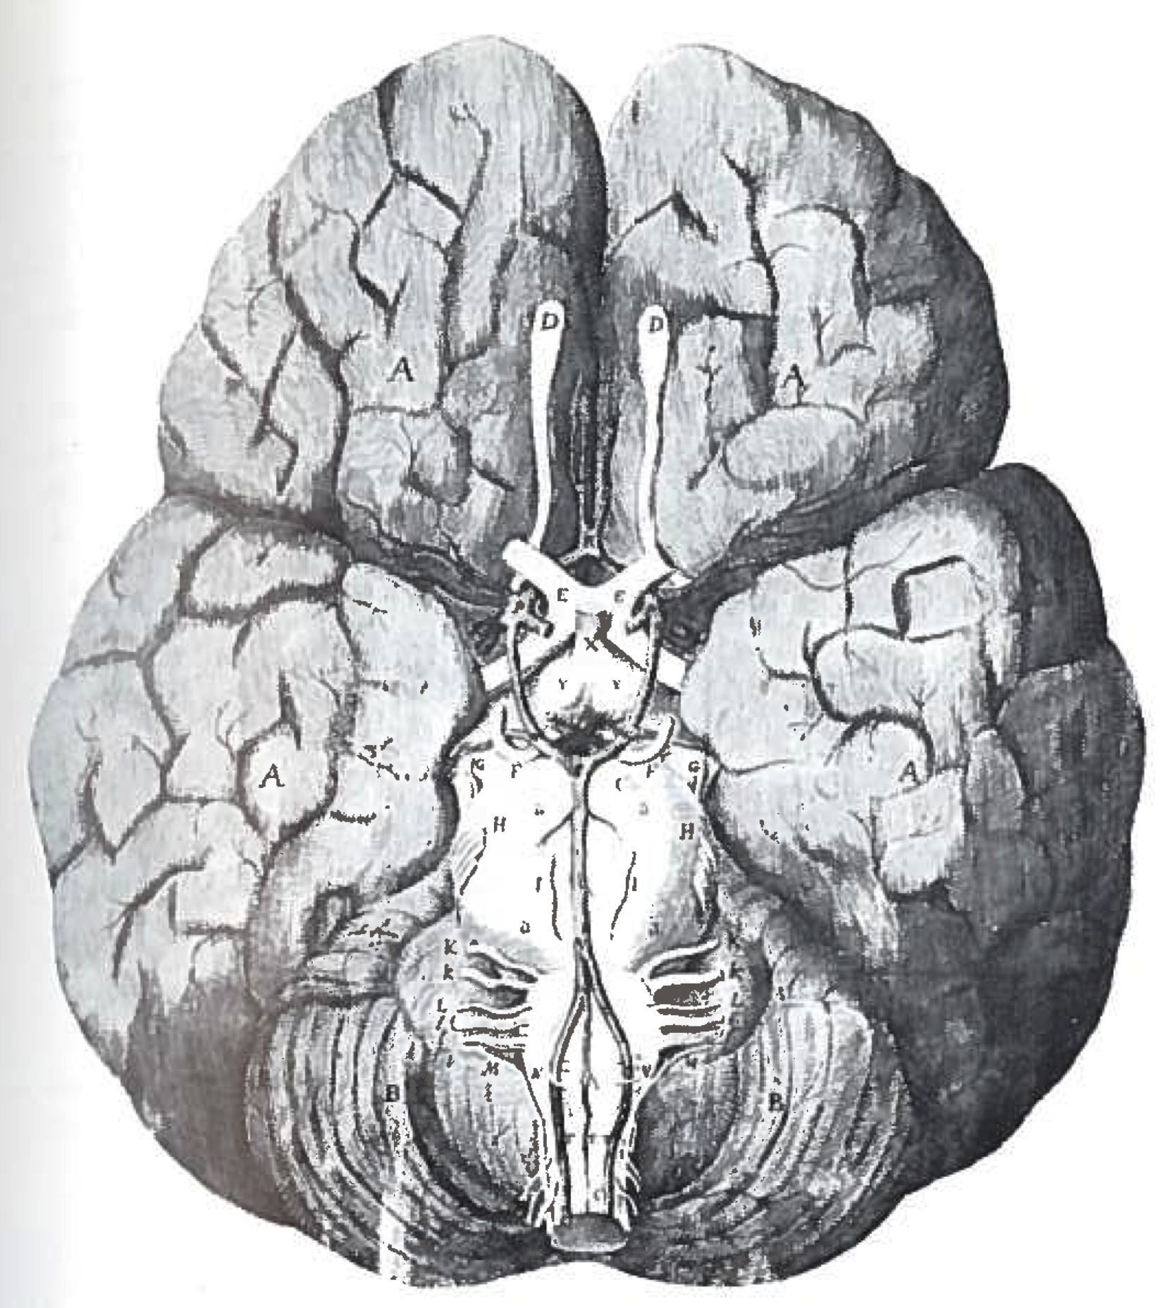
17th Century
Anatomy by Thomas Willis,
plate by Christopher Wren
Central structures accurate but cortical surface very badly depicted

Slide 57
17th Century
Return to the ventricles
13th century Syrian manuscript: notes the optic chiasm
(fig p42)

Slide 58
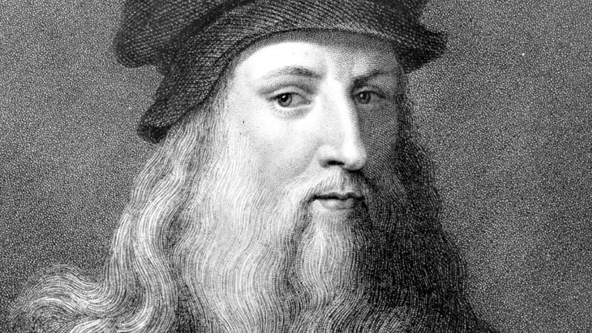
17th Century
da Vinci
Leonardo da Vinci
1452 – 1592 BC

Slide 59
17th Century
da Vinci
c. 1505: carried out wax injections of the ventricles of the ox.
We finally begin to see detailed, shaded, perceptual anatomical drawings.

Slide 60
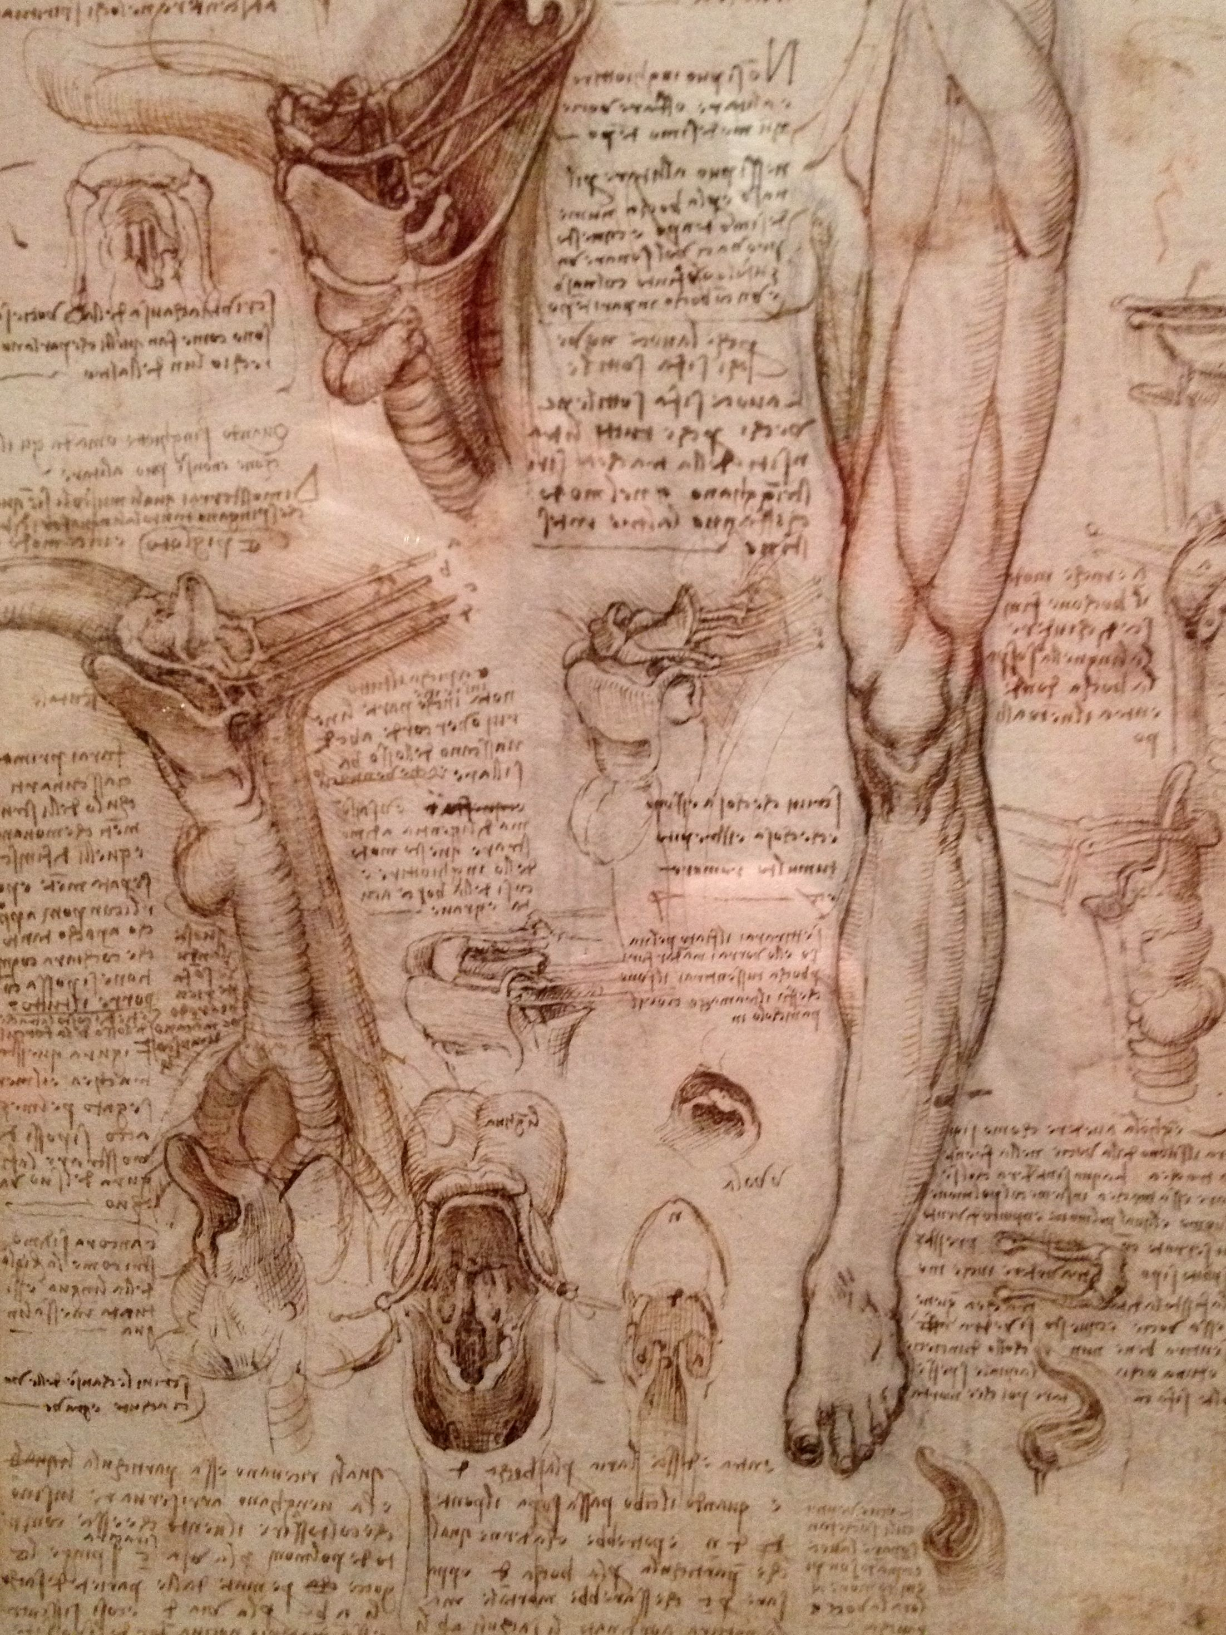
17th Century
da Vinci

Slide 61
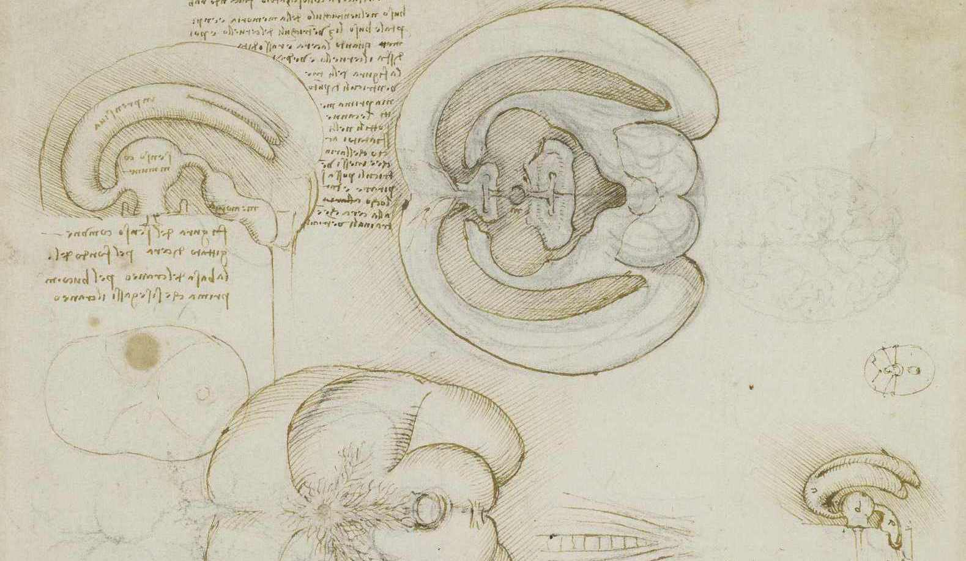
17th Century
da Vinci

Slide 62
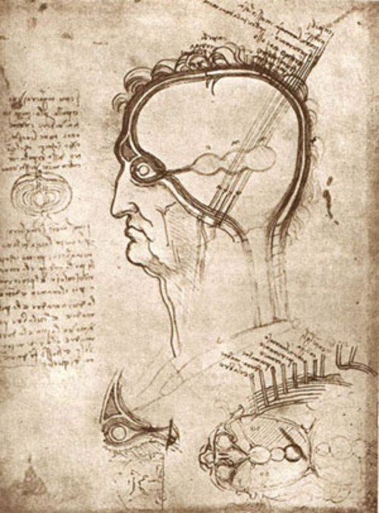
17th Century
da Vinci

Slide 63
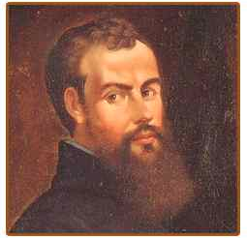
16th Century
Vesalius
Andreas Vesalius
1514 – 1564

Slide 64
17th Century
Vesalius
Still depicted the ventricles as reservoirs of animal spirit.
However, more anatomical structures begin to be named and discerned
(fig 69)

Slide 65
Aside
Ventriculograms
Pneumoencephalography:
draining of the cerebrospinal fluid (CSF) by a lumbar puncture,
replacement with air/oxygen/helium
Extremely painful, supplanted by less invasive types of neuroimaging.

Slide 66
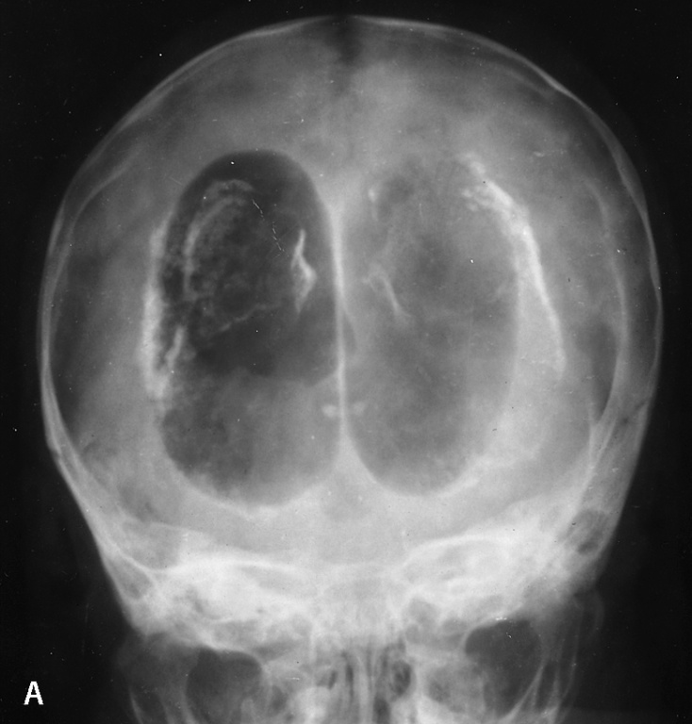
Aside
Ventriculograms

Slide 67
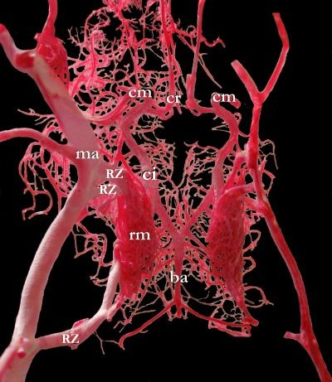
The rete mirabile
Latin, “wonderful net”
Appears in numerous locations across several species:
heat transfer in birds with webbed feet
oxygen exchange in fish
reabsorbtion of water after filtration in the mamalian kidney

Slide 68
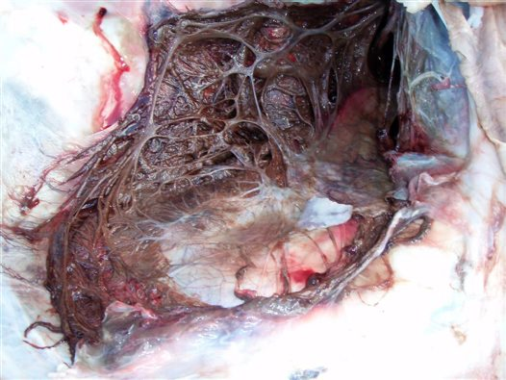
The rete mirabile
Galen described it in the pig and the ox, and assumed its presence in the human body.
Humans, monkeys or rodents do not actually possess this structure.
da Vinci drew this structure as well.
Persisted until 1664, when Thomas Willis considered that its presence in humans indicated subnormality.
Swim bladder rete mirabile of a Queensland Groper

Slide 69
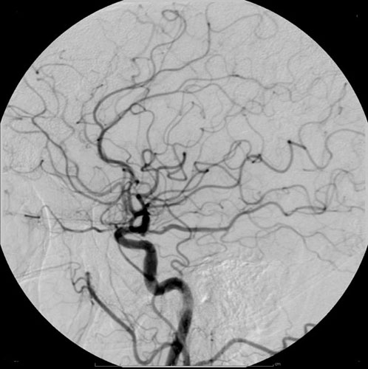
Aside
Angiograms
Usually, arteries are invisible to X-ray.
By injecting a dye which block X-rays, we can image them.

Slide 70
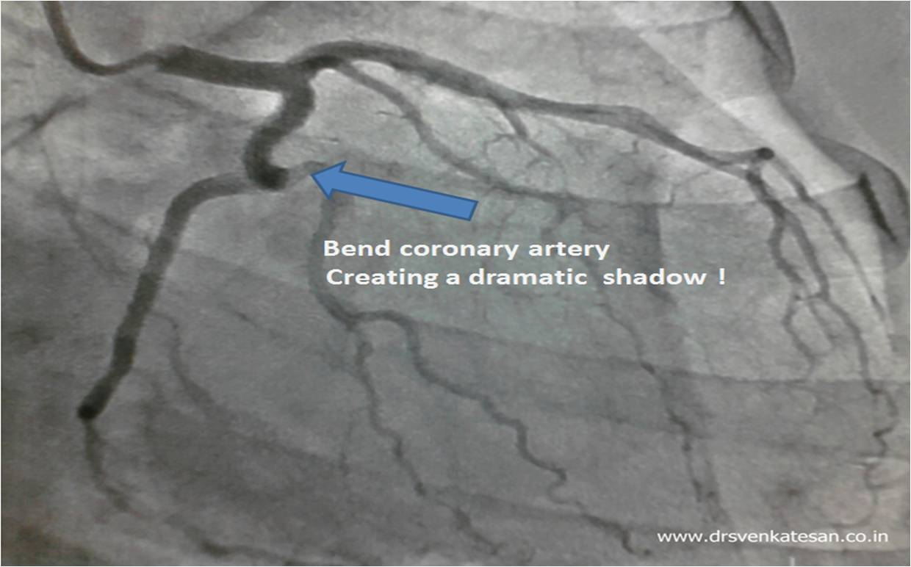
Aside
Angiograms

Slide 71
16th Century
The brain’s surface
The most easily visible part of the brain,
and, as it turns out, the most central to cognitive function,
was largely ignored until the beginning of the 19th century!
Erasistratus, 3rd century BC: noted the cortical surface resembled the coils of the small intestine.
However, Galen once again denied that they had anything to do with mental capacity or cognitive capability.

Slide 72
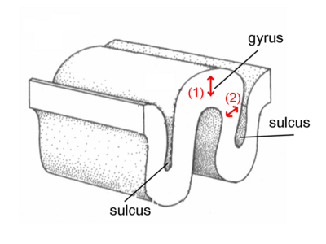
16th Century
The brain’s surface
Gyrus: ridge
Sulcus: fissure

Slide 73
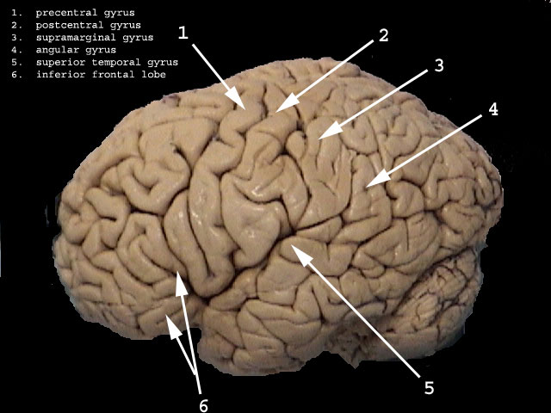
16th Century
The brain’s surface

Slide 74
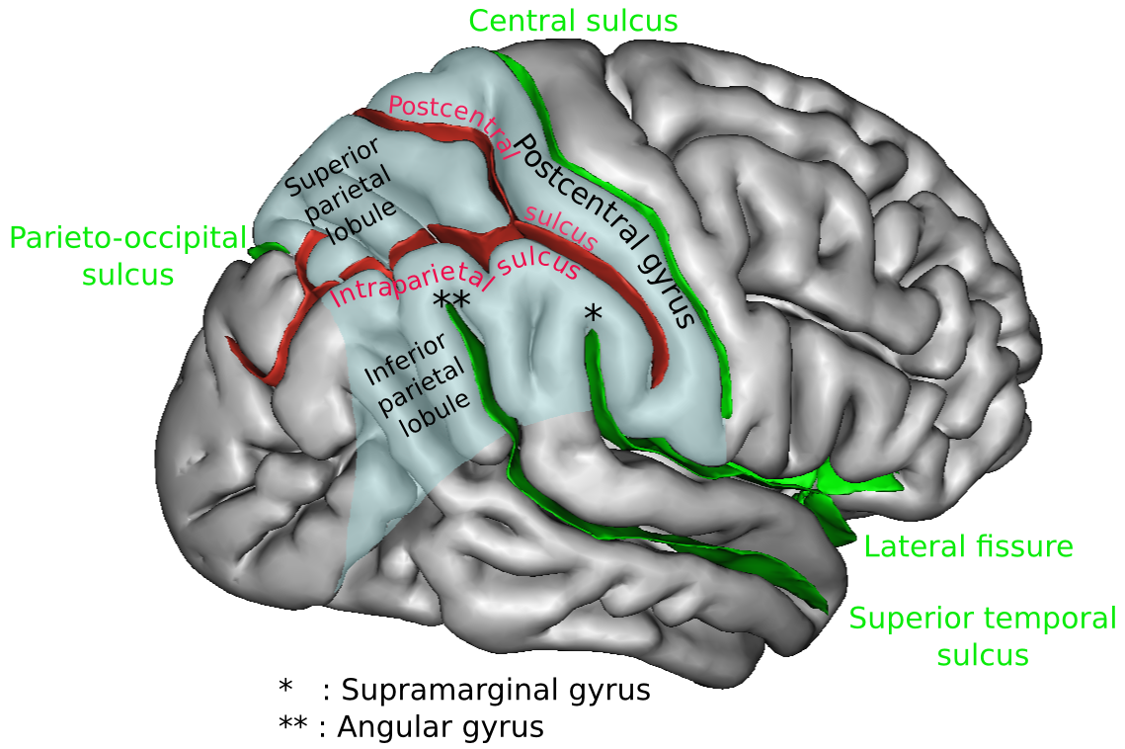
16th Century
The brain’s surface

Slide 75
16th Century
The brain’s surface
Anatomists would often instruct artists to lay out their drawings; in this case, we can see the preconceived similarity to the small intestine.
Anatomical drawings do not always reflect reality.
Until the 19th century only one part of the brain’s surface was given a name:
the fissure of Sylvius (1641, named by the Danish anatomist Bartholin)

Slide 76
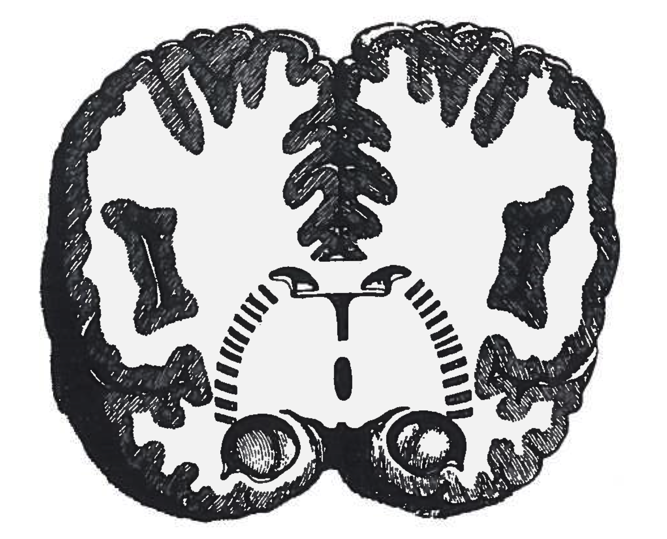
16th Century
The brain’s surface
Nicolas Steno, 1665
Reasonable depiction of the convolutions

Slide 77
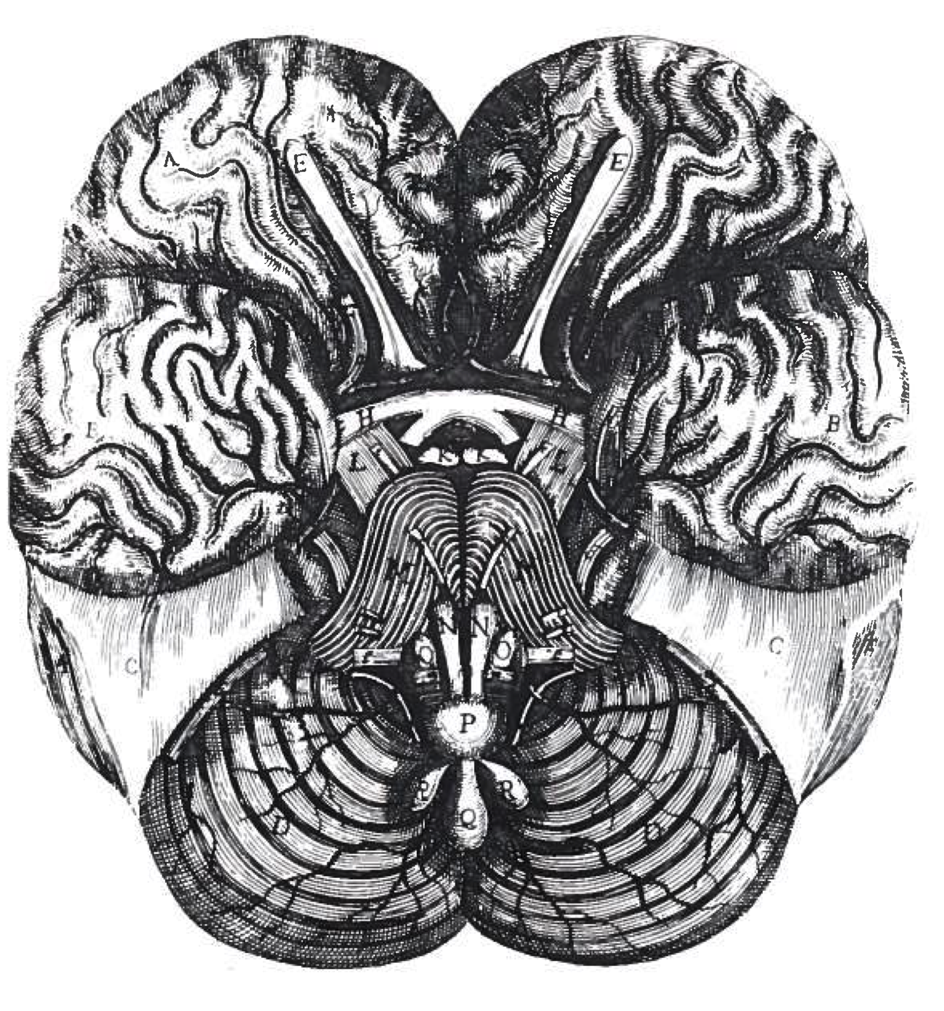
16th Century
The brain’s surface
Raymond de Vieussens, 1685
Good anatomy but no attention paid to the sulci and gyri.

Slide 78
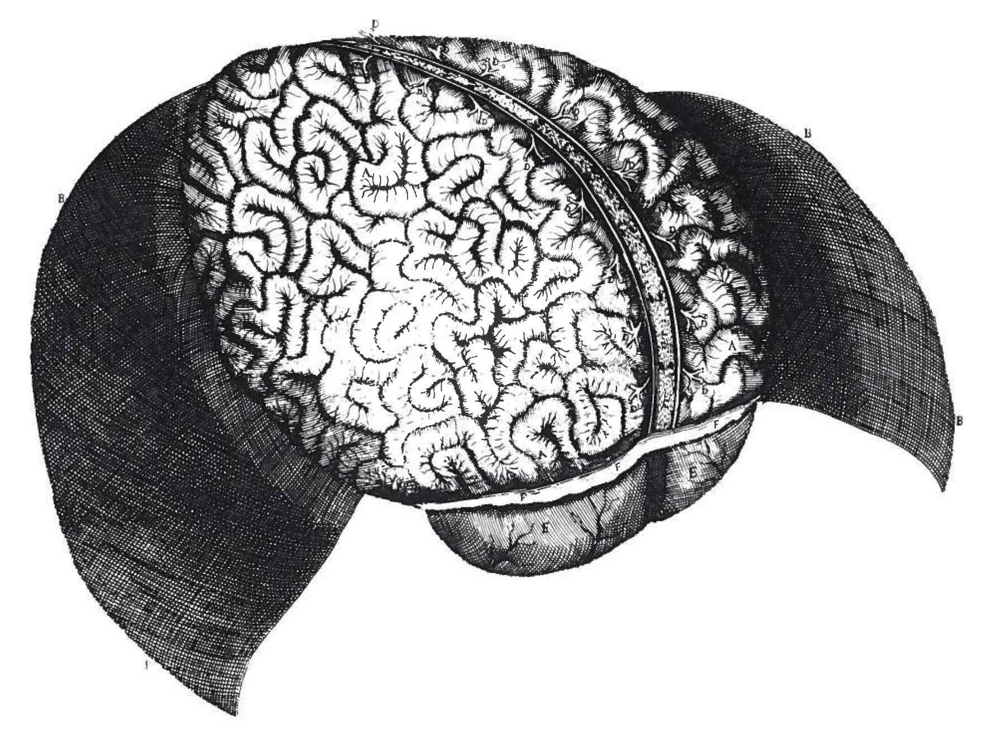
16th Century
The brain’s surface

Slide 79
17th Century
By this point the Cell Doctrine and the idea of the rete mirabile were no longer supported.
However, Greek tradition still highlighted the ventricular system.
Franciscus Sylvius and Thomas Willis independently proposed that the cortex had some specific functions.
From now on, neuroanatomy began to be led by function.

Slide 80
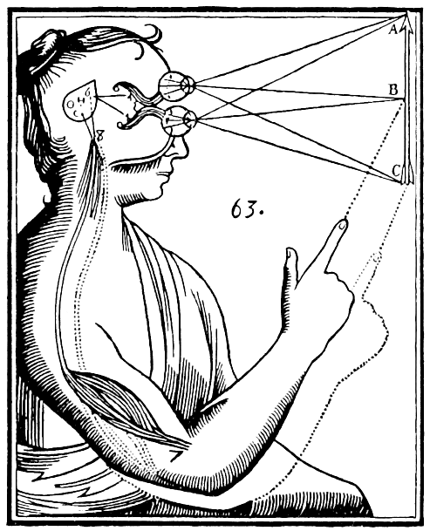
17th Century
Descartes
This diagram from 1662 (from the book De homine) demonstrates
the retina
the optic nerve
the ventricle
the pineal gland (H) initiating the motor stimulus

Slide 81
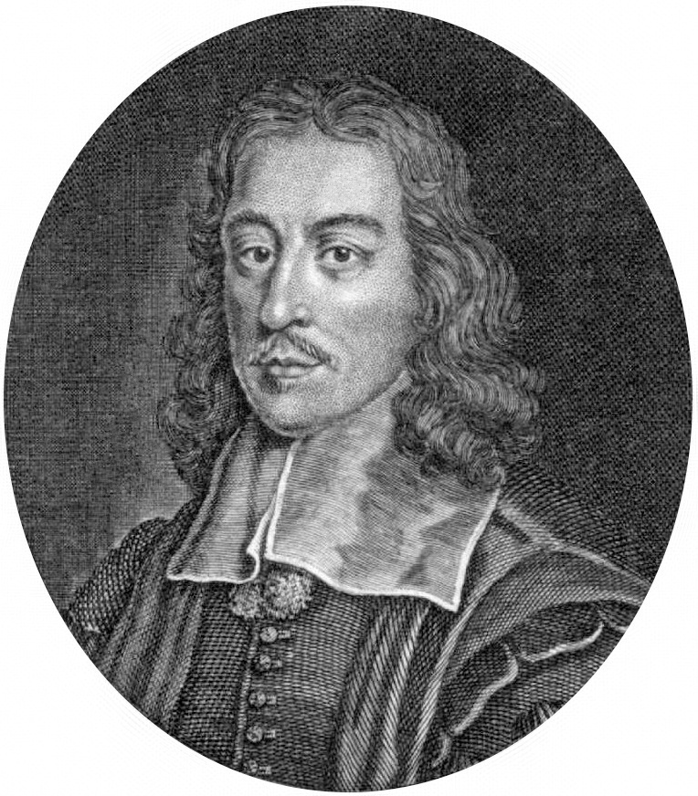
17th Century
Thomas Willis
English doctor, pioneer of anatomy, neurology and psychiatry.
Founding member of the Royal Society.
Many of his plates were drawn by Christopher Wren, architect of St. Paul’s.
Thomas Willis
1621 - 1675

Slide 82
17th Century
Willis: the end of the ventricular theory
Willis put an end to ventricular localisation of brain function.
He proposed three new structures:
corpus striatum sensus communis
corpus callosum imagination
cerebral cortex memory
He also depicted
the thalamus
the pineal gland

Slide 83
17th Century
Oriental conceptions
In the 17th century, Chinese science still considered the heart to be the central organ of emotion and reason.

Slide 84
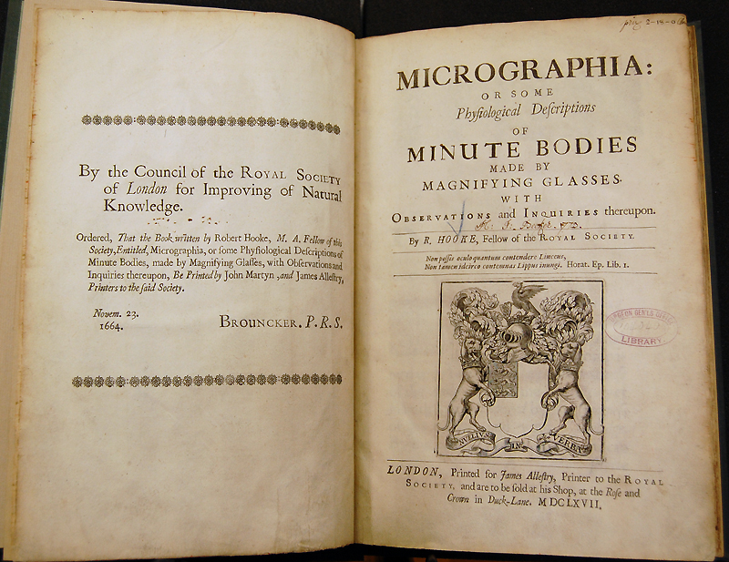
17th Century
The microscope
Micrographia, published in 1665 by the 30-year-old Robert Hooke.

Slide 85
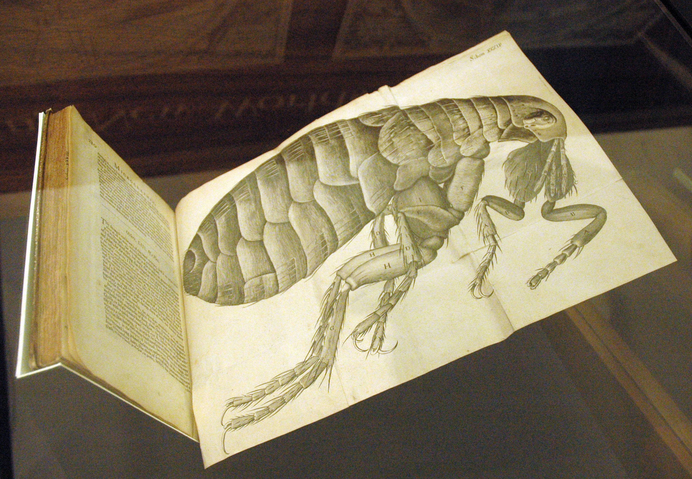
17th Century
The microscope
Micrographia, published in 1665 by the 30-year-old Robert Hooke.

Slide 86
17th Century
The microscope
Observation of the brain under the microscope produced several conflicting theories:
Marcello Malphigi: the cortex is made up of glands
Frederick Ruysch: of blood vessels
Anton van Leeuwenhoek: of “globules”
Malphigi and Leeuwenhoek’s entities were both artefacts. There was as yet no provision for staining or proper sectioning.
Histology: study of tissues under the microscope.

Slide 87
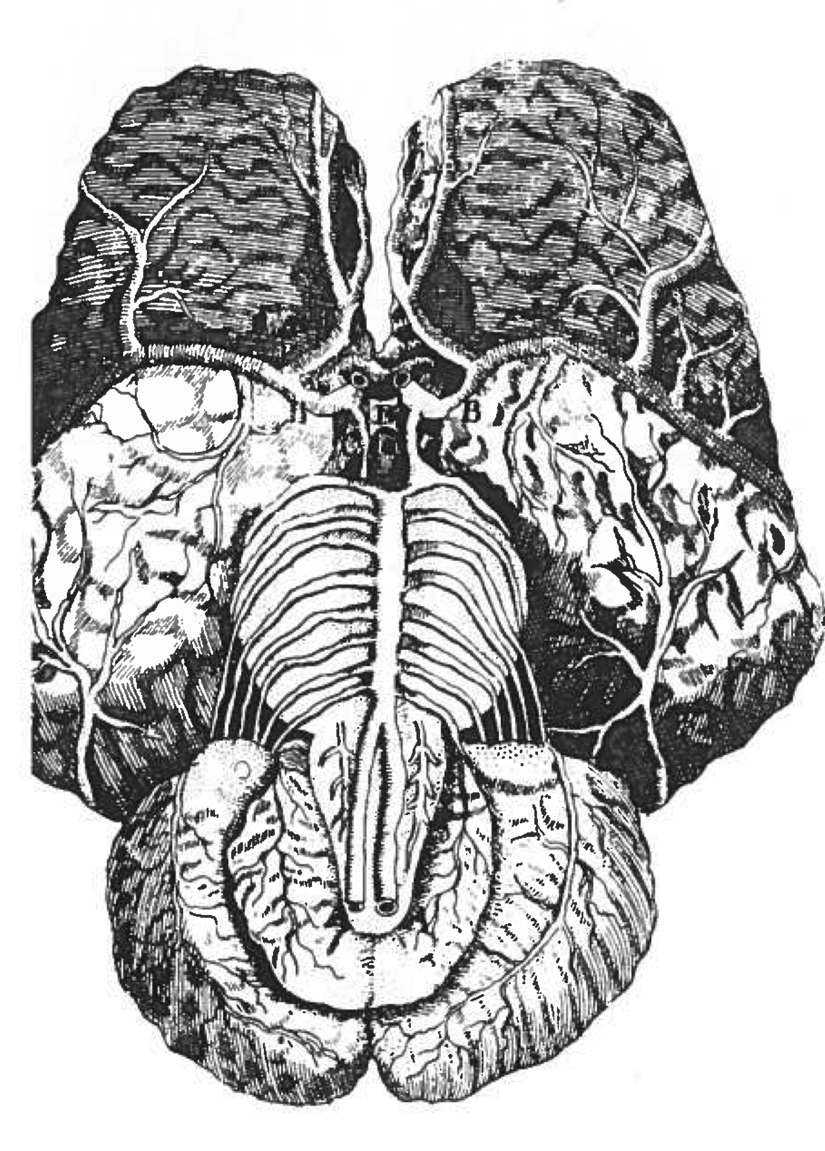
17th Century
The microscope
“wretchedly poor” [1]
[1] Clarke, Edwin, Kenneth Dewhurst, and Michael Jeffrey Aminoff. An illustrated history of brain function: imaging the brain from antiquity to the present. Norman Publishing, 1996.

Slide 88
17th Century
At the end of the 17th century, the cortex had taken its place as the seat of intellect.
However, the intellect was still described in terms of “animal spirits” or an equally hypothetical medium, “nerve fluid,” which was prepared in the brain and pumped throughout the nervous system in order to carry motor commands and sensations.
Some even regressed to the ventricular theory.
The gyri and sulci were not yet named.

Slide 89
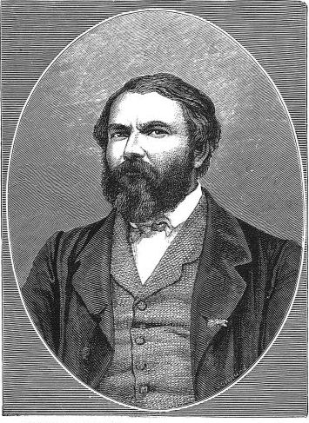
19th Century
Nomenclature
Louis Pierre Gratiolet
1815 - 1865

Slide 90
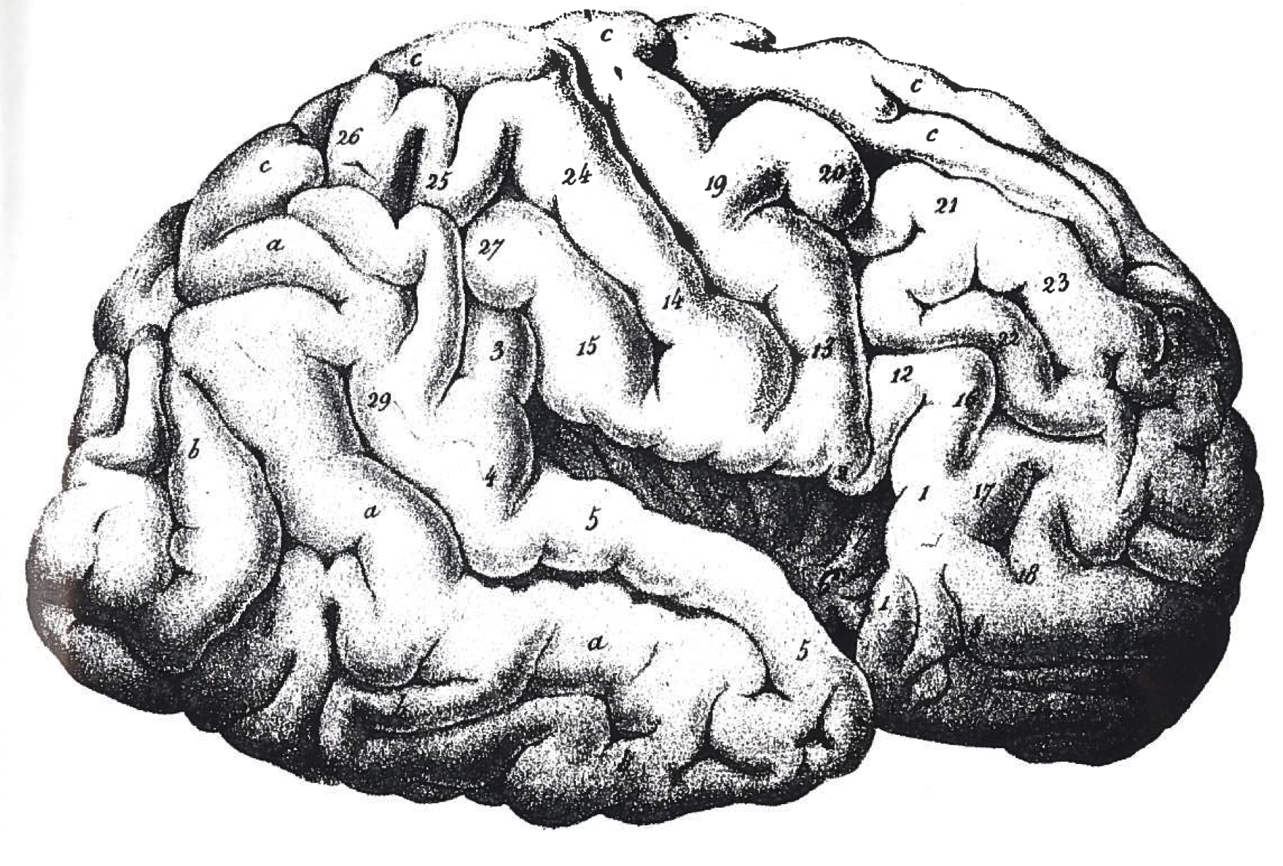
16th Century
The brain’s surface
Finally a mature depiction; Gratiolet, c. 1860

Slide 91
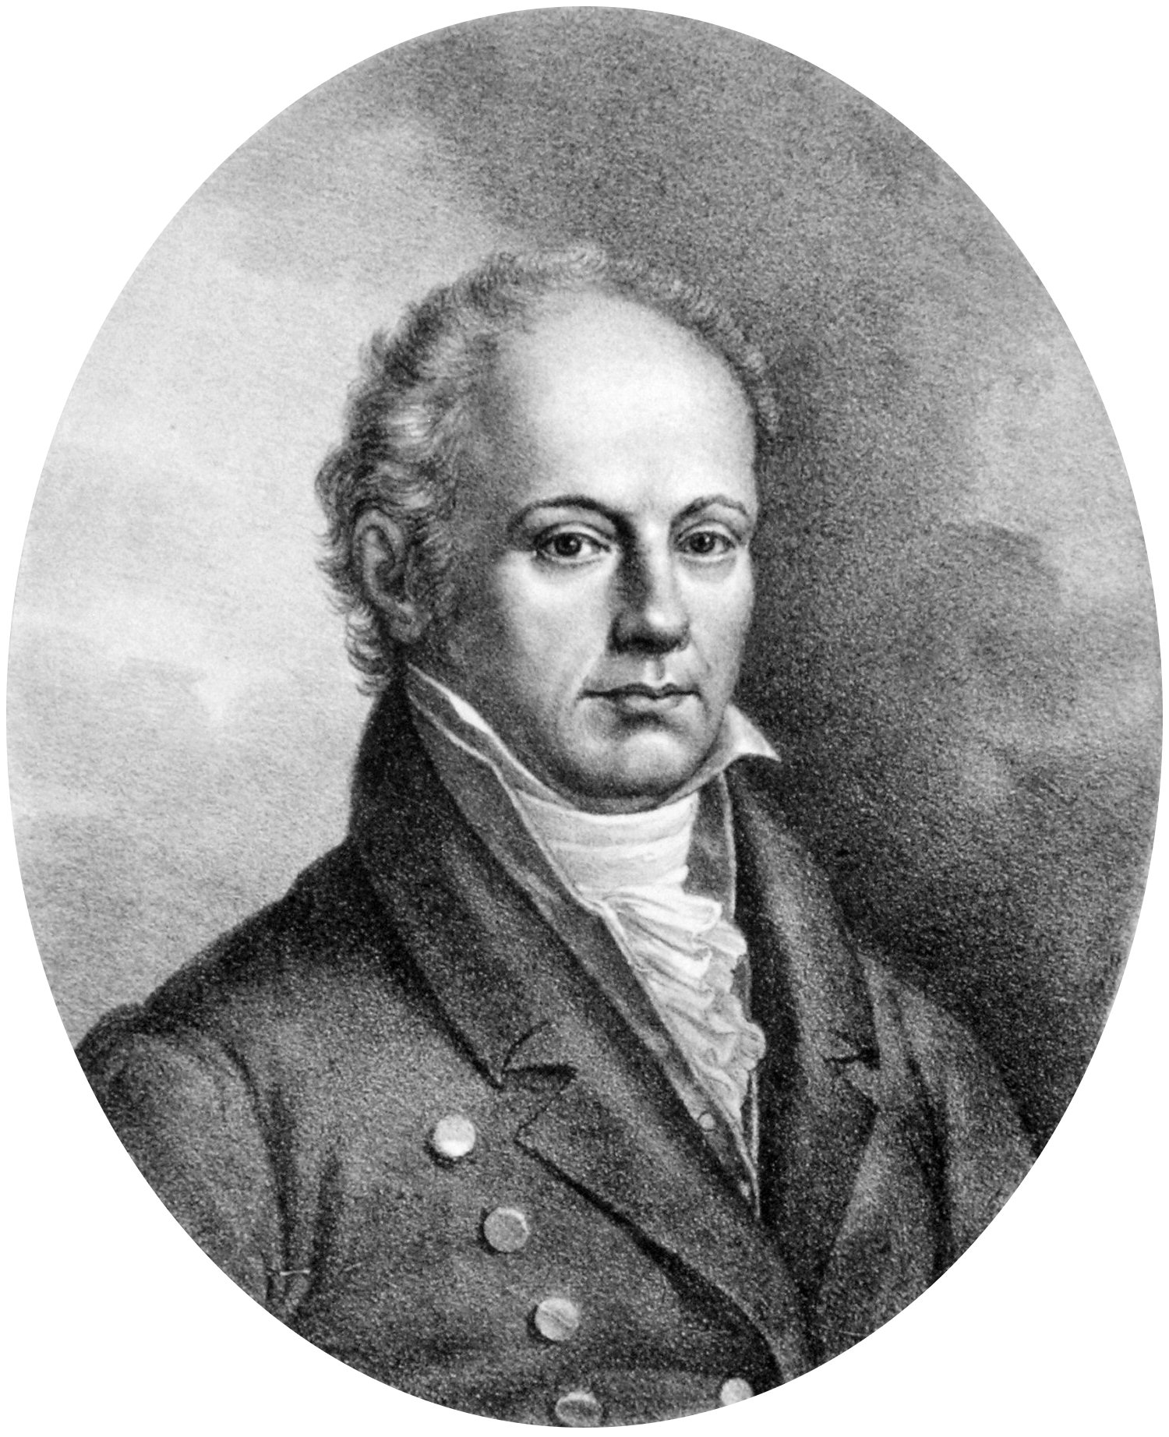
19th Century
Phrenology
The cortex is the seat of intellect.
Mental processes can be functionally localised to areas of cortex.
There is a mapping between capability and area size.
These size changes cause corresponding shape changes on the skull itself.
Gall actually called the technique “cranioscopy.”
Franz Joseph Gall
1758 - 1828

Slide 92
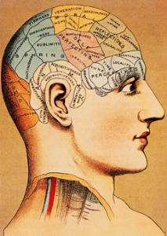
19th Century
Phrenology
Phrenology pointed us “away from the concept of the unsubstantiated Cartesian soul to the concept of the more material nerve function.”
“was wrong only in detail and in respect of the enthusiasm of its supporters.”
Boring, Edwin Garrigues. History of experimental psychology. Genesis Publishing Pvt Ltd, 1929.

Slide 93
19th Century
Cross-species comparisons
The comparison of the human and animal brain began with Willis.
It is perhaps surprising that more of this kind of work was not done earlier, but we must recall that the mores of the time placed animals on a completely separate level of existence than people. Such comparison could have seemed insulting.

Slide 94
19th Century
Naming a structure makes it an anatomical entity and gives it an independent existence. Historically, structures which were not named tended to be forgotten or glossed over.
Gratiolet clearly delineated the brain’s four lobes, first named by Arnold in 1838.

Slide 95

19th Century

Slide 96

18th Century
The Neuron Doctrine
Santiago Ramón y Cajal
1852-1934

Slide 97

Neurons

Slide 98

Neurons

Slide 99

Neurons

Slide 100

Neurons

