Slide 1
Lecture 10 Abnormal psychology

Slide 2

Psychopathology
sane vs. insane

Slide 3
Psychopathology
sane vs. types of pathology

Slide 4
Psychopathology
The wrong attitude

Slide 5
Psychopathology
The right attitude

Slide 6
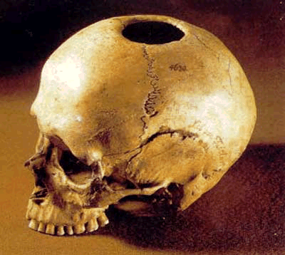
Trepanning

Slide 7
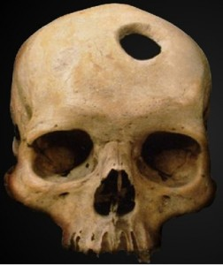
Trepanning

Slide 8
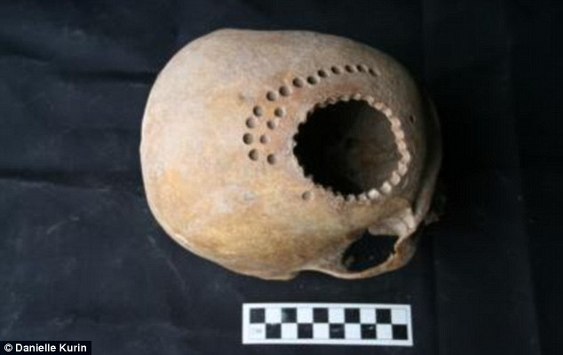
Trepanning
Peruvian

Slide 9

Treatment facilities

Slide 10
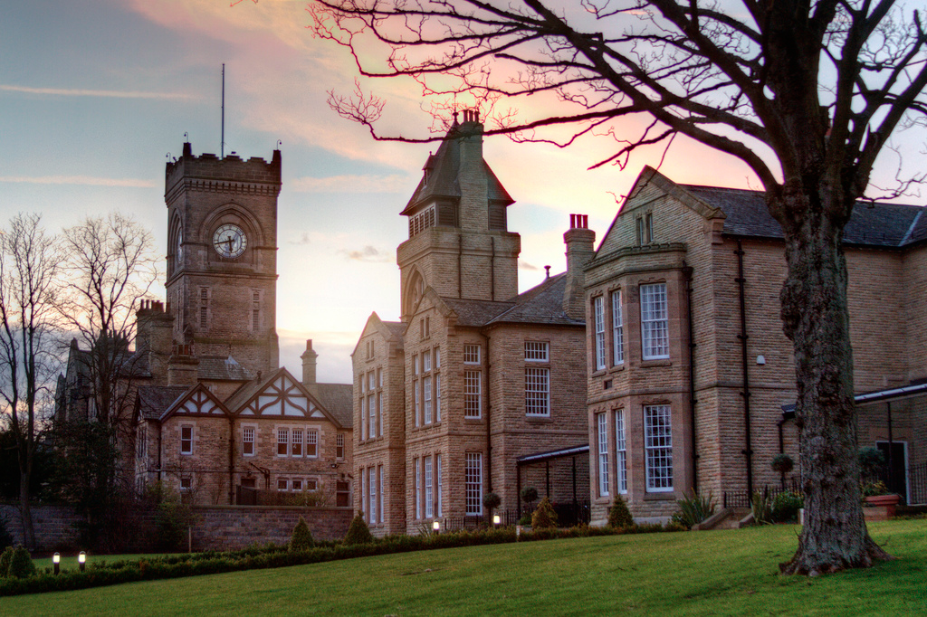
Treatment facilities

Slide 11
Treatment facilities
High Royds Hospital, West Yorkshire
Opened 1888, West Riding Pauper Lunatic Asylum
Closed 2003
Being reworked as a housing development

Slide 12
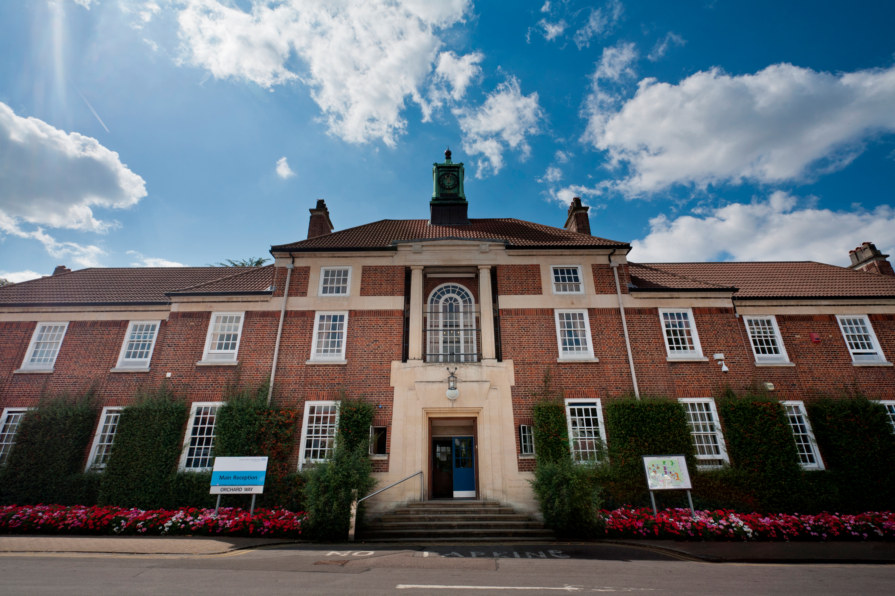
Treatment facilities

Slide 13
Treatment facilities
“A Church of Our Lady that is named Bedlam. And in that place be found many men that be fallen out of their wit. And full honestly they be kept in that place; and some be restored onto their wit and health again. And some be abiding therein for ever, for they be fallen so much out of themselves that it is incurable unto man.”
William Gregory
Lord Mayor of London
c. 1540

Slide 14
Treatment facilities
Bethlem Royal Hospital, Bromley
Europe’s oldest operating psychiatric hospital; founded 1247 (Henry III)
Bedlam from 1300s; the term became colloquial in the Jacobean era

Slide 15
Schizophrenia
Greek:
skhizein to split
phrēn mind
A broad diagnostic term for a wide range of related symptoms.
From confirmed self-reporting of a wide range of psychotic symptoms
to
hospitalisation with a diagnosis of schizophrenia.
Psychopathologies are much less tidy and clear than non-cognitive medical conditions.

Slide 16
Schizophrenia
Symptoms
Positive
hallucinations (auditory, visual, other senses)
disorganised thinking
disorganised speech
Negative
lack of emotion
flat expressions
poverty of speech
social isolation
lack of motivation
lack of ability to perform smooth pursuit

Slide 17
Schizophrenia
Symptoms
I have suffered from this serious mental illness for over 25 years. In fact, I can't think of a time when I wasn't plagued with hallucinations, delusions, and paranoia. At times, I feel like the operator in my brain just doesn't get the message to the right people. It can be very confusing to have to deal with different people in my head. When I become fragmented in my thinking, I start to have my worst problems. I have been hospitalized because of this illness many times, sometimes for as long as 2 to 4 months.
I had my own fantasy world and spent many days lost in it.
I had one particular friend. I called him the "Controller." He was my secret friend. He took on all of my bad feelings. He was the sum total of my negative feelings and my paranoia. I could see him and hear him, but no one else could.
The problems were compounded when I went off to college. Suddenly, the Controller started demanding all my time and energy. He would punish me if I did something he didn't like. He spent a lot of time yelling at me and making me feel wicked. I didn't know how to stop him from screaming at me and ruling my existence. It got to the point where I couldn't decipher reality from what the Controller was screaming. So I withdrew from society and reality. I couldn't tell anyone what was happening because I was so afraid of being labeled as "crazy." I didn't understand what was going on in my head. I really thought that other "normal" people had Controllers too.
Jordan, Janice C. "First person account: Schizophrenia—adrift on an anchorless reality." Schizophrenia Bulletin 21.3 (1995): 501.

Slide 18
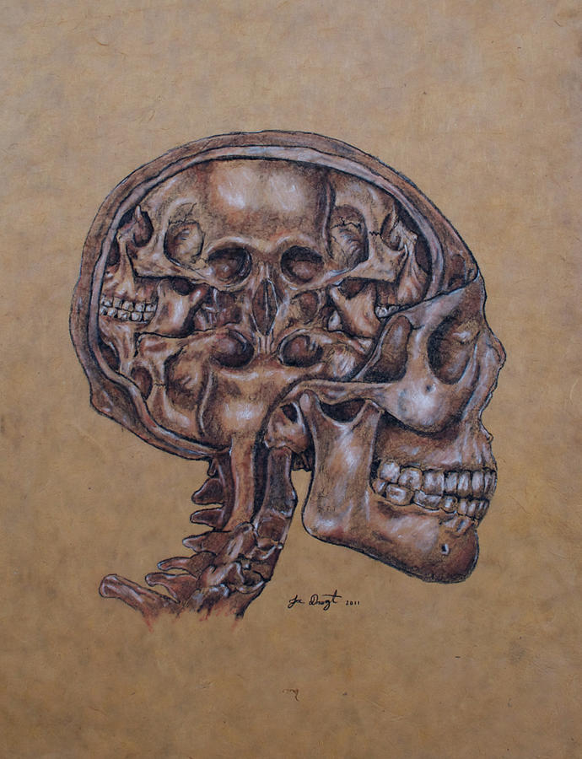
Schizophrenia
Symptoms

Slide 19
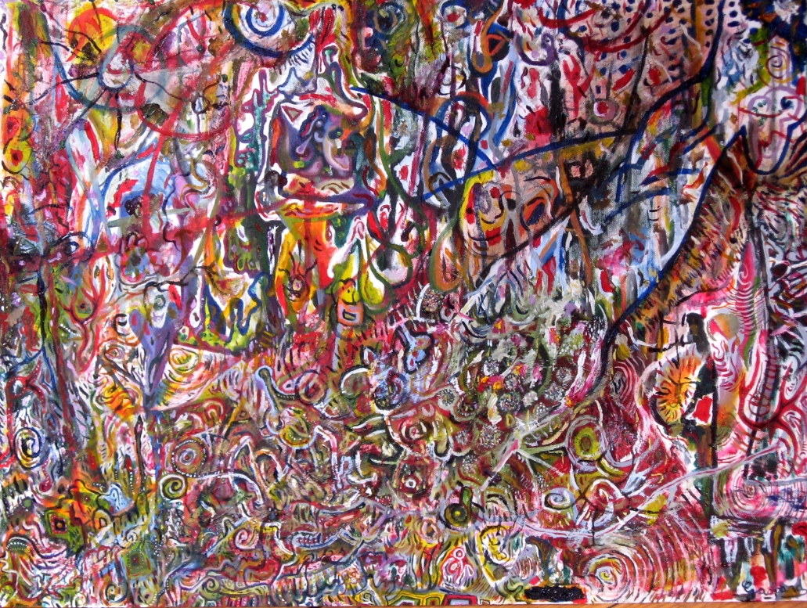
Schizophrenia
Symptoms

Slide 20

Schizophrenia
Symptoms

Slide 21
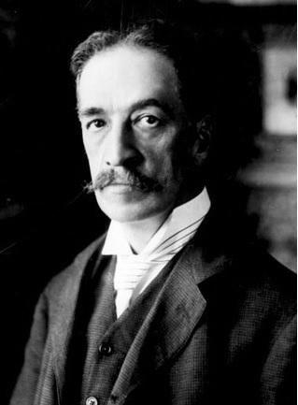
Schizophrenia
Symptoms
Louis Wain
1860 - 1939

Slide 22
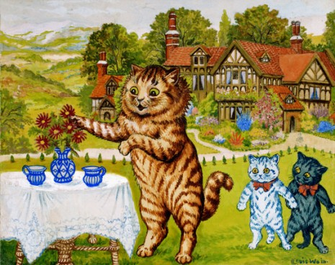
Schizophrenia
Symptoms

Slide 23
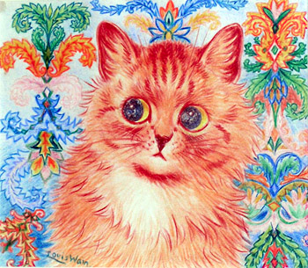
Schizophrenia
Symptoms

Slide 24
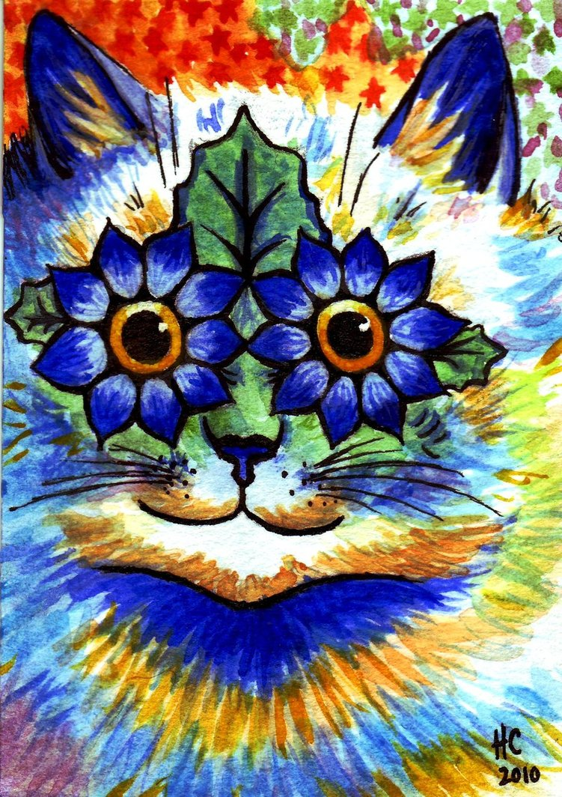
Schizophrenia
Symptoms

Slide 25
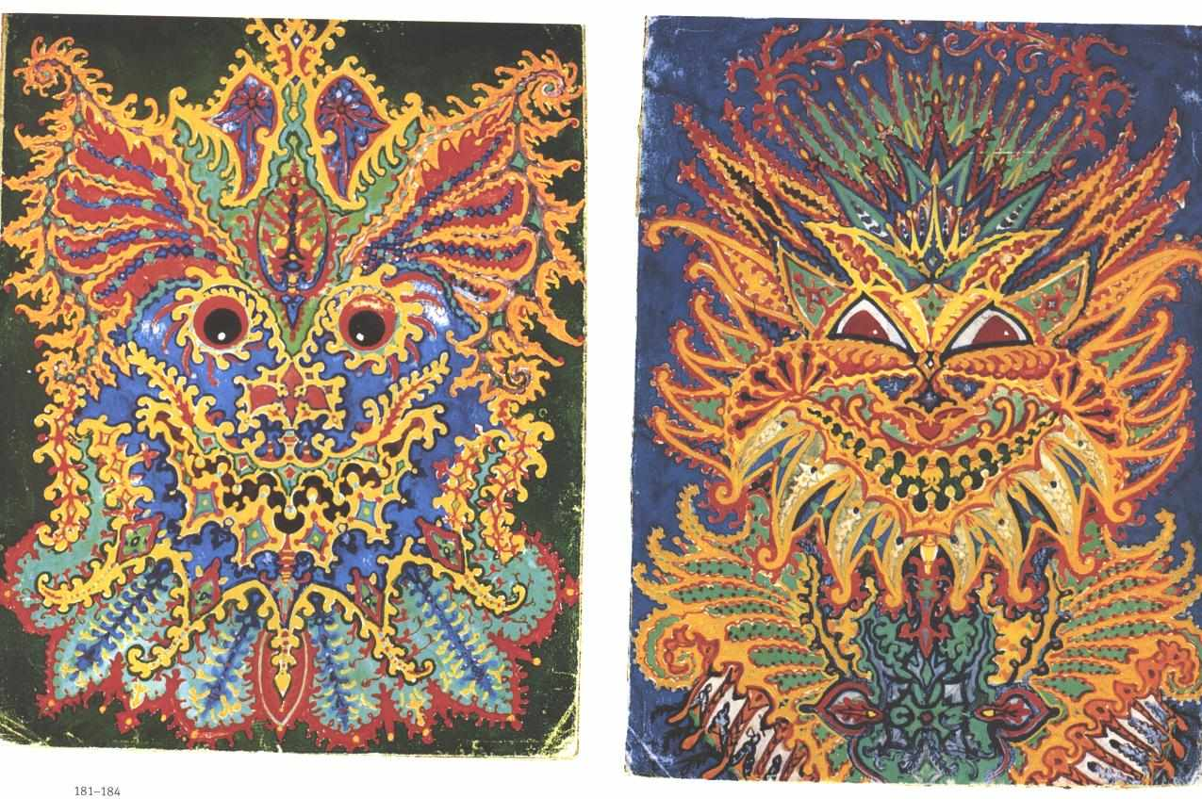
Schizophrenia
Symptoms

Slide 26
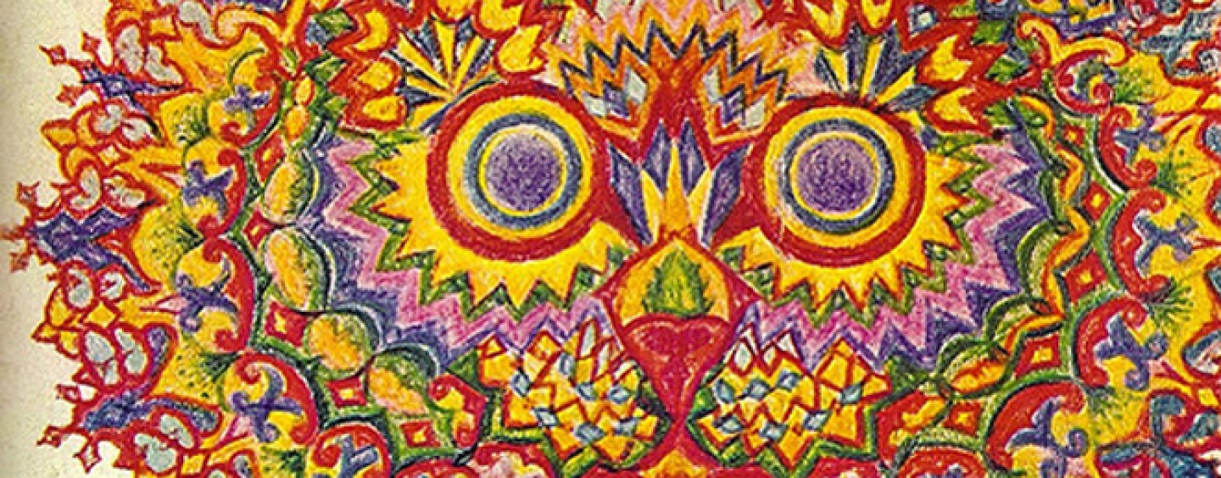
Schizophrenia
Symptoms

Slide 27
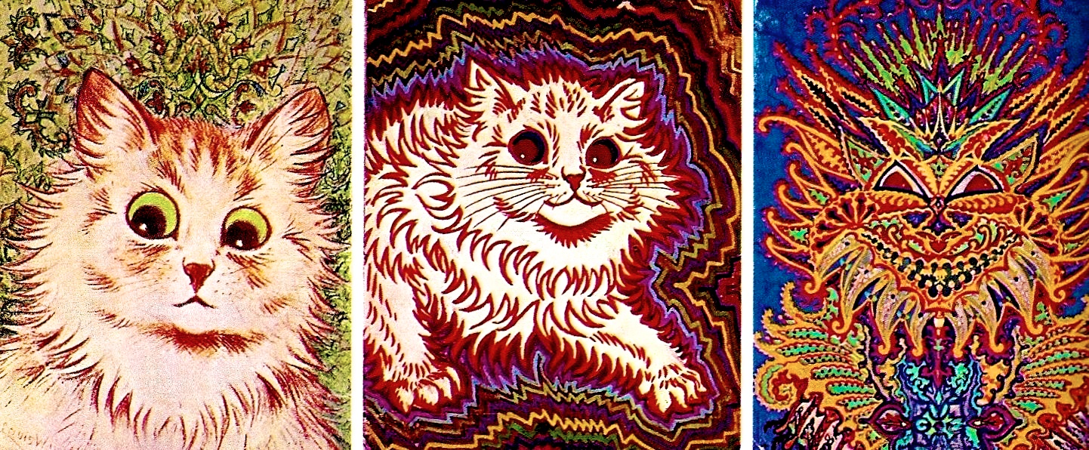
Schizophrenia
Symptoms

Slide 28
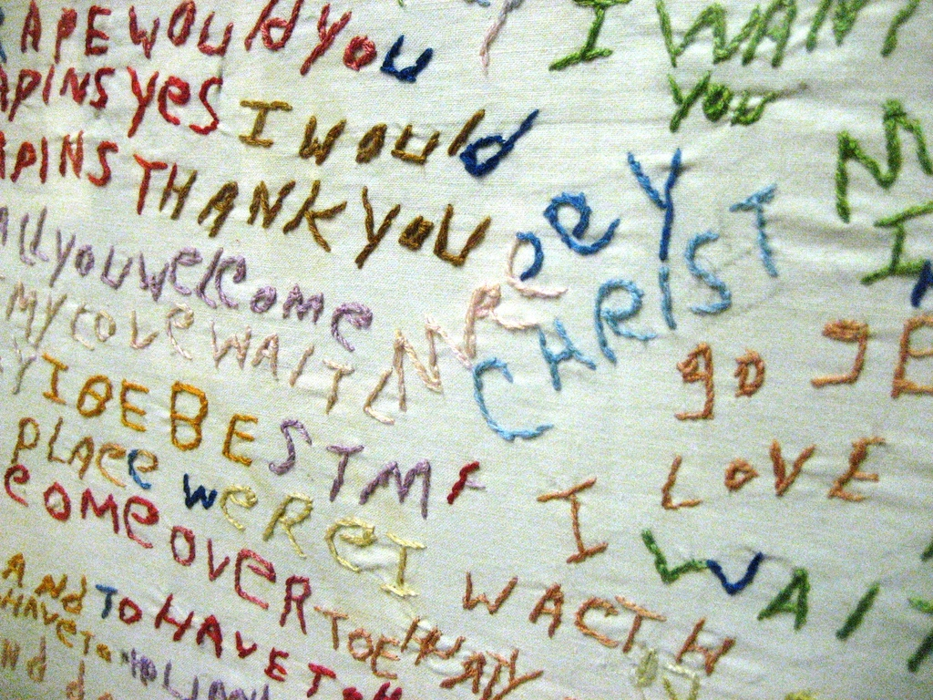
Schizophrenia
Symptoms

Slide 29
Schizophrenia
Symptoms
Prevalence: 1.1% of the population
approx. 51 million people worldwide
50% paranoid schizophrenia

Slide 30
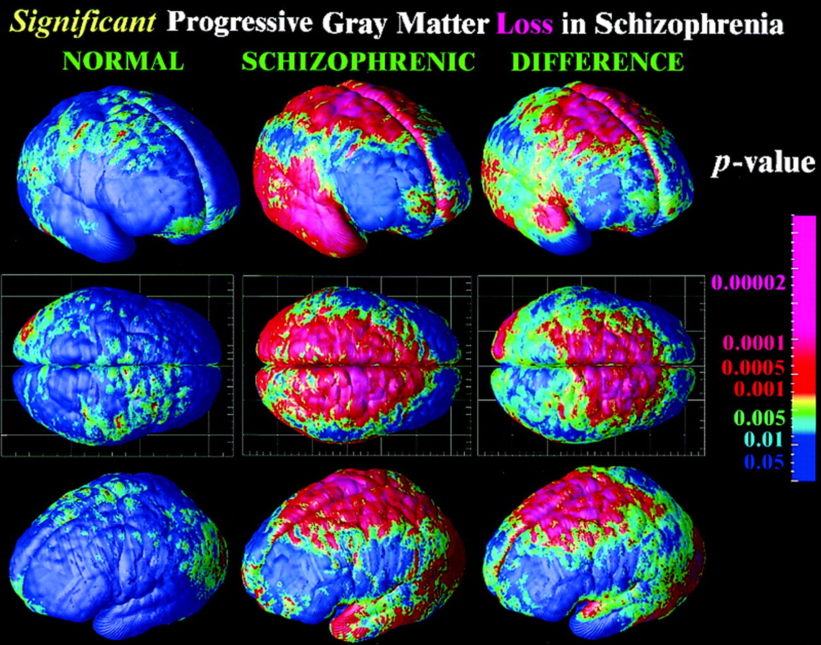
Schizophrenia
Symptoms

Slide 31
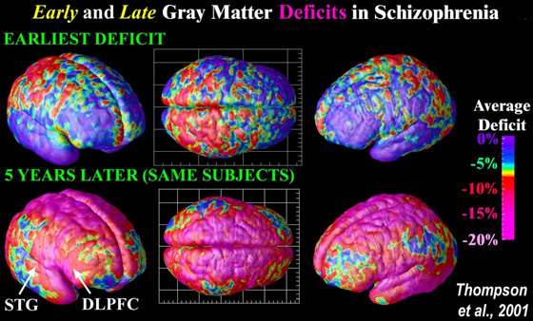
Schizophrenia
Symptoms

Slide 32
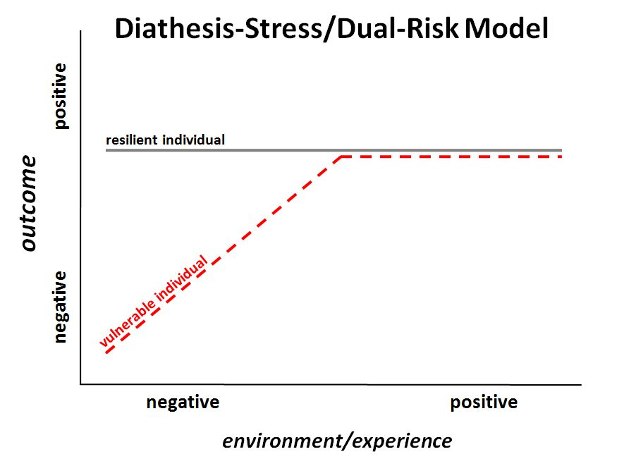
Schizophrenia
Causes
Diasthesis-stress model
diasthesis: disposition

Slide 33
Schizophrenia
Causes
Monozygotic concordance: 44%
Dizygotic concordance: 12%

Slide 34
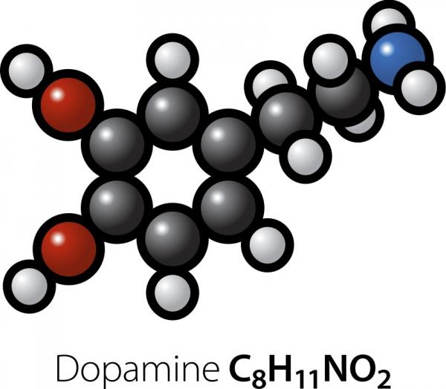
Schizophrenia
Dopamine
Neurotransmitter with diverse roles

Slide 35
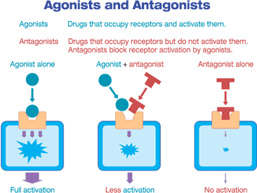
Schizophrenia
Dopamine hypothesis
Many antipsychotics are dopamine receptor antagonists.

Slide 36
Schizophrenia
Dopamine
Non-neural chemical messenger:
blood vessels: vasodilation
kidneys: increases urine output
pancreas: reduces insulin production
digestive system: reduces gastrointestinal motility
immune system: reduces lymphocyte activity
Neurotransmitter
Dopaminergic neurons:
pars compacta (substantia nigra)
ventral tegmental area
posterior hypothalamus
arcuate nucleus, periventricular nucleus (hypothalamus)
zone incerta

Slide 37
Schizophrenia
Dopamine
Dopaminergic neurons are rare (numbering 400,000) [1] but have widespread projections and powerful effects.
High-level roles:
motor control motivation, reward
Low-level roles:
lactation, sexual gratification, nausea
Dopamine cannot cross the blood-brain barrier.
Its effects on the brain and body are largely independent.
[1] Schultz W (2007). "Multiple dopamine functions at different time courses". Annu. Rev. Neurosci. 30: 259–88.

Slide 38
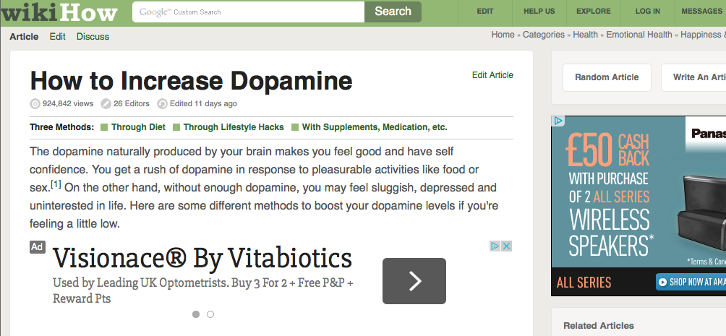
Schizophrenia
Dopamine

Slide 39
Schizophrenia
Dopamine hypothesis
An excess of dopaminergic signalling is thought to be related to schizophrenia.
Language representations from Broca’s area propagate to the auditory cortex.

Slide 40
Schizophrenia
Disconnnection hypothesis
The normally-functioning brain is a complicated and adaptive web of linked systems.
Abnormal links (or missing links) can induce abnormal behaviour and psychosis.

Slide 41
Schizophrenia
Attributional biases
Bias towards attributing negative life events to external causes.
Bias towards interpreting cognitive intrusions as threatening.
Bentall, Richard P., et al. "Persecutory delusions: a review and theoretical integration." Clinical psychology review 21.8 (2001): 1143-1192.

Slide 42
Schizophrenia
Causes – cannabis use
Lifetime instance of abuse of various substances: 50%.
Self-medication hypothesis
Other drugs hypothesis
Confounding factor
Interaction hypothesis
Etiological hypothesis
This is a good example of separating correlation from causation. Longditudinal studies, following individuals through their lives, are required.

Slide 43
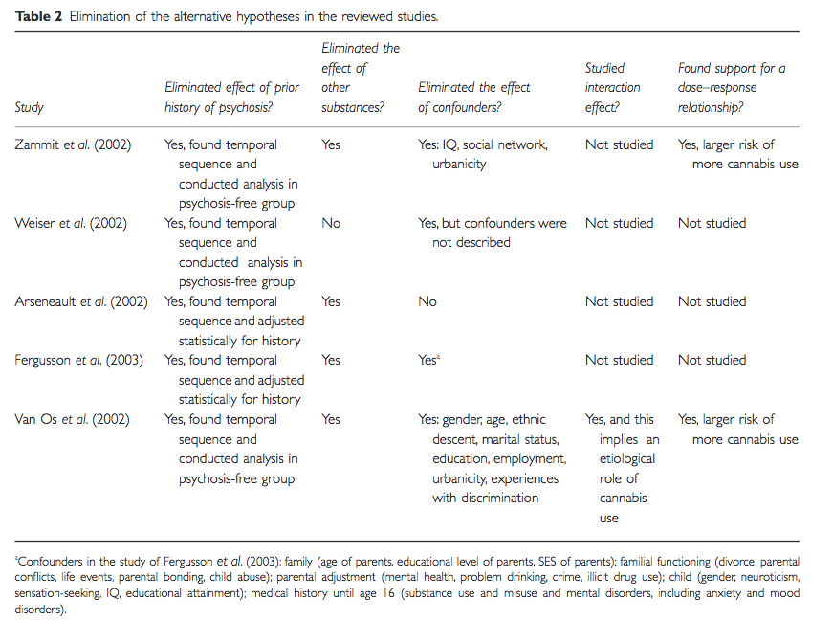
Schizophrenia
Causes – cannabis use

Slide 44
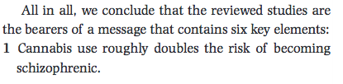
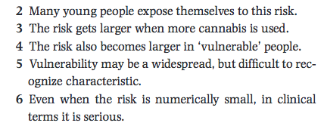
Schizophrenia
Causes – cannabis use
Smit, Filip, Linda Bolier, and Pim Cuijpers. "Cannabis use and the risk of later schizophrenia: a review." Addiction 99.4 (2004): 425-430.

Slide 45
Schizophrenia
Treatment
Antipsychotics aka neuroleptics (neuron, nerve & lepsis, seizure):
drugs designed to manage psychosis (psyche, mind & -osis, abnormal condition)
Psychosis (a very broad term) is defined as
an abnormal mental condition
a loss of contact with reality
hallucinations
delusions
catatonia (profound agitation, waxy flexibility)
loosening of associations, word salad

Slide 46
Autism spectrum disorders
Overview
DSM-IV:
(Diagnostic and Statistical Manual of Mental Disorders, American Psychiatric Association)
Autism
Asperger’s syndrome
Pervasive developmental disorder not otherwise specified (PDD-NOS)

Slide 47
Autism spectrum disorders
Overview
DSM-IV:
(Diagnostic and Statistical Manual of Mental Disorders, American Psychiatric Association)
Autism
Asperger’s syndrome
Pervasive developmental disorder not otherwise specified (PDD-NOS)

Slide 48
Autism
Symptoms
Infants may be
averse to being held
unwilling to reach out to be picked up
hard to console
more likely to quiet when left alone
averse to eye contact
Despite this profile, the condition is often not noticed until children are old enough to show language delays.
Onset is usually gradual, but 30% may develop “normally” and then regress.

Slide 49
Autism
Symptoms
Core symptoms:
Impairments in
social interaction
communication
Restricted interests
Repetitive behaviour
There is a blurred line between the autistic profile and the neurotypical profile.

Slide 50
Autism
Symptoms
Play: toys are aligned, sorted or thrown,
but not used for creative play or re-enactments of social situations.

Slide 51
Autism
Symptoms
Communication:
unwillingness to communicate with others
inability to “read people”

Slide 52
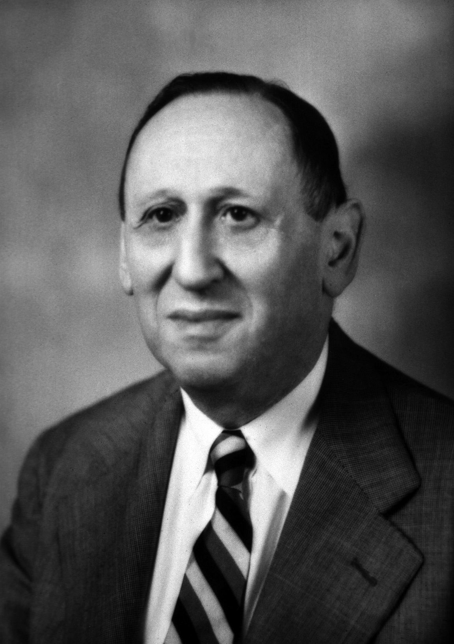
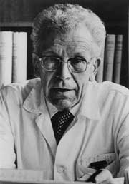
Autism
History
Leo Kanner
1896 - 1981
Hans Asperger
1906 - 1980

Slide 53
Autism
Causes
There is a clear genetic basis for autism, but the precise mechanisms are unclear.
1980s: twin studies showed heritability of 0.85 to 0.92.
Miles, Judith H. "Autism spectrum disorders—a genetics review." Genetics in Medicine 13.4 (2011): 278-294.

Slide 54
Autism
Prevalence
Diagnosis with autism is becoming more and more prevalent.
Prevalance per 10,000:
before 1990: 4 to 5
1990s: Japan, England, Sweden 21 to 31

Slide 55
Autism
Prognosis
In adults aged 22-46 in the US:
Half of individuals “functioned quite well”
Half employed in paying jobs
12% lived independtly, 56% lived with parents.

Slide 56
Neurotypicality
Defined negatively.
Can we define it positively?

Slide 57
Clinical depression

Slide 58
Clinical depression
“The overwhelming sadness. To me – it’s my menace. My menace was with me in the shower, on the phone, in class. Everywhere, I would become lost in a thoughtless stretch or blank – where distraction to nothing in particular would take over. Consumed by nothing – thinking of nothing, but my mind was locked down – stuck – paralysed. Studying was difficult if not impossible. I was becoming overwhelmed, and not understanding what I was dealing with – no relatable experience – made things almost intolerable. A good day was sleeping until 10 – getting up – maybe going to a morning lecture. Taking another nap in the afternoon – skipping class - reading books to pass the time that seems inescapable. Your mind gets into internal conflicts. Plenty of time for that. Time seems to always stretch in front of you – you can’t bear thinking of doing anything to fill the time, but are beaten up by the fact that the routine will exist the next day, and the next day, and the next, and why at all bother? What is it all for?”
Davey, Graham. Psychopathology: Research, assessment and treatment in clinical psychology. Oxford: BPS Blackwell, 2008.

Slide 59
Clinical depression
Depression and creativity
Depression appears to be related to creativity.
Post, Felix. "Verbal creativity, depression and alcoholism. An investigation of one hundred American and British writers." The British Journal of Psychiatry 168.5 (1996): 545-555.
...and to schizophrenia.
(Differences in divergent thinking)
De Manzano, Örjan, et al. "Thinking outside a less intact box: thalamic dopamine D2 receptor densities are negatively related to psychometric creativity in healthy individuals." PLoS One 5.5 (2010): e10670.

Slide 60
Clinical depression
Causes
Among people who have dealt with stressful life events, those with a particular gene have a higher chance of developing depression.
The gene codes for the serotonin transporter molecule (SERT or 5-HTT).
Caspi A, Sugden K, Moffitt TE (2003). "Influence of life stress on depression: Moderation by a polymorphism in the 5-HTT gene". Science 301 (5631): 386–89.
Heritability appears to be close to 40% for women and 30% for men.
Kendler KS, Gatz M, Gardner CO, Pedersen NL (2006). "A Swedish national twin study of lifetime major depression". American Journal of Psychiatry 163 (1): 109–14.

Slide 61
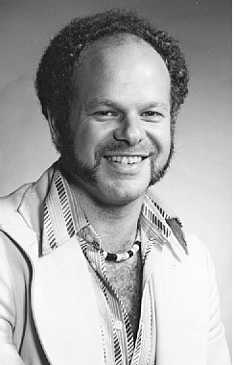
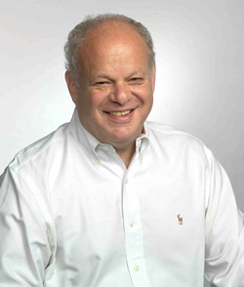
Clinical depression
Causes – learned helplessness
Martin Seligman
1942 - present

Slide 62
Clinical depression
Causes – learned helplessness
Seligman’s three-group dog experiment
Maier, Steven F., and Martin E. Seligman. "Learned helplessness: Theory and evidence." Journal of experimental psychology: general 105.1 (1976): 3.
Watson and Ramey’s two-group infant experiment
Watson, J. & Ramey, C. Reactions to response-contingent stimulation in early infancy. Revision of paper presented at biennial meeting of the Society for Research in Child Development. Santa Monica. California, March 1969.
Learned helplessness interferes with the ability to learn positive behaviours.

Slide 63
Clinical depression
Antidepressants
Cognitive behavioural therapy
Top-down, self-controlled therapy involving learning to alter harmful or maladaptive thought patterns.
Some research suggests CBT performs as well or better than antidepressants

Slide 64
Clinical depression
Antidepressants
Effectiveness
A meta-analysis has indicated that ADs work 18% better than placebos. This difference is statistically significant, but “not meaningful for people in clinical settings.”
Method of action
ADs range from the hardly-understood...

Slide 65

Clinical depression
Antidepressants
St John’s
wort
...to the fairly
well-understood...

Slide 66
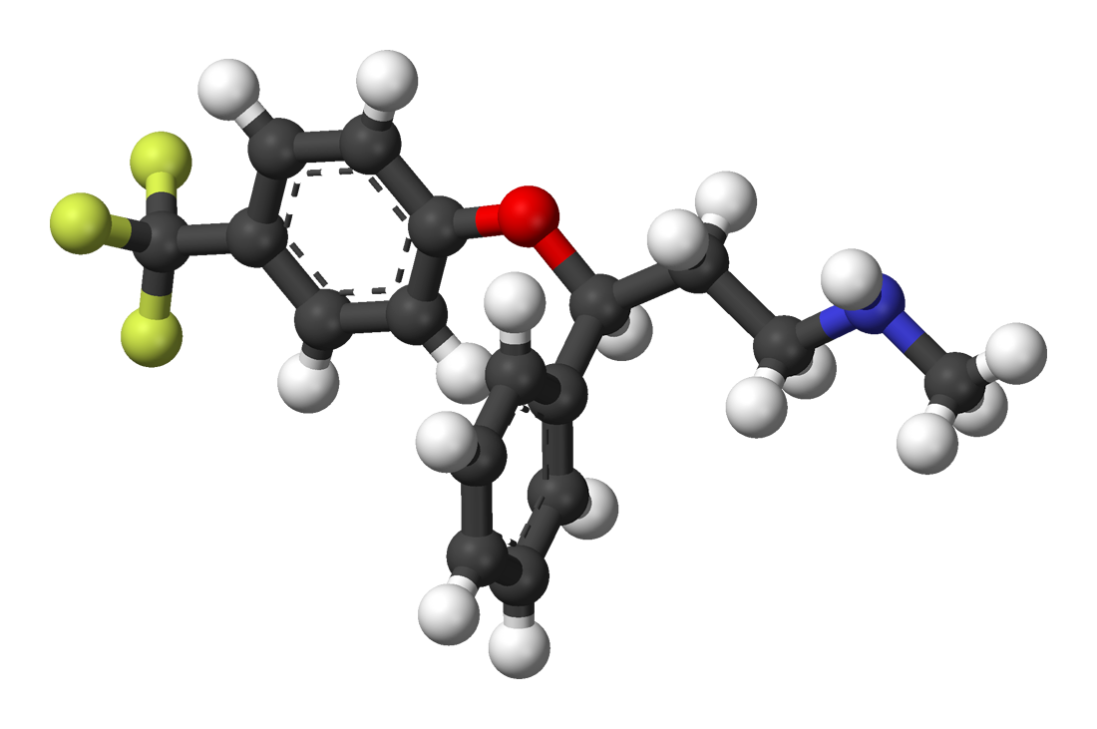
Clinical depression
Antidepressants
Fluoxetine (Prozac)
Selective serotonin reuptake inhibitor

Slide 67
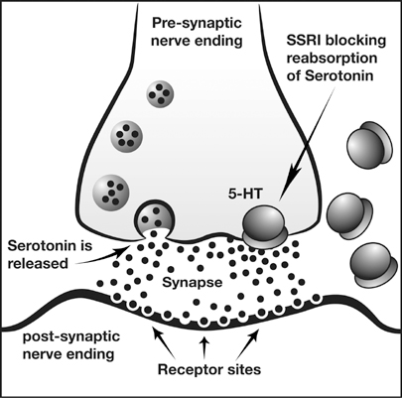
Clinical depression
Antidepressants

Slide 68
Clinical depression
Antidepressants
SSRIs were designed by looking at the receptor and attempting to design a molecule which fit it.
The first instance of rational drug design in psychotropic drugs.

Slide 69
Clinical depression
Therapies
Cognitive behavioural therapy
Top-down, self-controlled therapy involving learning to alter harmful or maladaptive thought patterns.
Some research suggests CBT performs as well or better than antidepressants

Slide 70
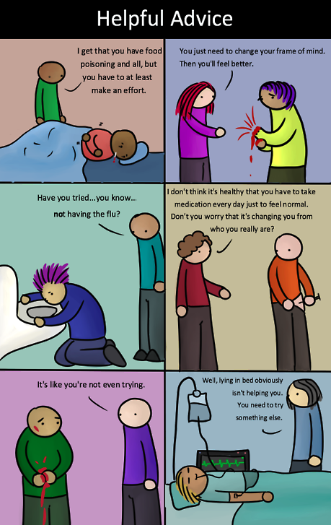
Clinical depression
Attitude change

Slide 71
Bipolar disorder
Symptoms
Typical depression is often characterised as “unipolar.”
Also:
bipolar depression
manic depression

Slide 72
Bipolar disorder
Symptoms
Manic phase (mania or hypomania) hypos - below
Unconnected thoughts
Energy
Reduced social barriers
Inappropriate interactions
Attempts to calm met with annoyance

Slide 73
Bipolar disorder
Symptoms
Depression
“I doubt completely my ability to do anything well. It seems as though my mind has slowed down and burned out to the point of being virtually useless... I am haunted with the total, the desperate hopelessness of it all. Others say, “it’s only temporary, it will pass, you can get over it, “ but of course they haven’t any idea of how I feel, although they are certain they do. Id I can’t feel, move, think or care, then what on Earth is the point?”
Davey, Graham. Psychopathology: Research, assessment and treatment in clinical psychology. Oxford: BPS Blackwell, 2008.

Slide 74
Bipolar disorder
Symptoms
Hypomania
“At first when I’m high, it’s tremendous... ideas are fast... like shooting stars you follow until brighter ones appear... All shyness disappears, the right words and gestures are suddenly there... uninteresting people, things become intensely interesting. Sensuality is pervasive; the desire to seduce and be seduced is irresistible. Your marrow is infused with unbelievable feelings of ease, power, well-being, omnipotence, euphoria... you can do anything... but, somewhere, this changes.”
Davey, Graham. Psychopathology: Research, assessment and treatment in clinical psychology. Oxford: BPS Blackwell, 2008.

Slide 75
Bipolar disorder
Symptoms
Mania
“The fast ideas become too fast and there are far too many ... overwhelming confusion replaces clarity... you stop keeping up with it – memory goes. Infectious humour ceases to amuse. Your friends become frightened... everything is now against the grain... you are irritable, angry, frightened, uncontrollable, and trapped.”
Davey, Graham. Psychopathology: Research, assessment and treatment in clinical psychology. Oxford: BPS Blackwell, 2008.

Slide 76
Bipolar disorder
Prevalence
In the UK, depression is the third most common reason for visiting a doctor.
Lifetime prevalence:
Japan 3%
US 17%
Overall 8-12%
UK annual prevalence: 5%
More common among women after 14 years.
Two main peaks:
30s
50s

Slide 77
Bipolar disorder
Treatment
There is controversy about whether AD use can increase the rate of enduring recovery.
Nivoli, Alessandra, et al. "New treatment guidelines for acute bipolar depression: a systematic review." Journal of affective disorders 129.1 (2011): 14-26.

Slide 78
OCD

Slide 79
ADHD
Attention deficit / hyperactivity disorder

Slide 80
Addiction
Overview
Compulsive engagement in rewarding stimuli,
despite adverse consequences (for oneself or others).
Addiction can take many forms:
substances
activities
thoughts
drugs (DSM-5)
food
sex
exercise
gambling (DSM-5)
video gaming
internet

Slide 81
Addiction
The “pleasure centre”
1950s: Olds and Milner set up an experiment in which parts of rats’ brains were stimulated electrically when they visited a specific corner of their cage. Later, they equipped the cages with a lever which the rats could press.
“In septal area preparations, the control exercised over the animal’s behavior by means of this reward is extreme, possibly exceeding that exercised by any other reward previously used in animal experimentation.”
Olds, James, and Peter Milner. "Positive reinforcement produced by electrical stimulation of septal area and other regions of rat brain." Journal of comparative and physiological psychology 47.6 (1954): 419.

Slide 82
Addiction
The “pleasure centre”
Similar devices have also been implanted in people:
"He was permitted to wear the device for 3 hours at a time: on one occasion he stimulated his septal region 1,200 times, on another occasion 1,500 times, and on a third occasion 900 times. He protested each time the unit was taken from him, pleading to self-stimulate just a few more times... ”
Moan, Charles E., and Robert G. Heath. "Septal stimulation for the initiation of heterosexual behavior in a homosexual male." Journal of Behavior Therapy and Experimental Psychiatry 3.1 (1972): 23-30.

Slide 83
Addiction
Causes
ΔFosB
variant of FOSB.
FBJ murine osteosarcoma viral oncogene homolog B
Protein and the gene that encodes it
Has been shown to play a crucial (necessary and sufficient) role in addiction.
Genetic contribution appears to be about 50%.
Addictive personality or addictive genome?
Robison, Alfred J., and Eric J. Nestler. "Transcriptional and epigenetic mechanisms of addiction." Nature reviews neuroscience 12.11 (2011): 623-637.

Slide 84
Addiction
Causes
Nucleus accumbens (next to the septum)
Activated by stimuli or pursuits that promote evolutionary fitness of the organism.
Evolutionary locus of the reward signal

Slide 85
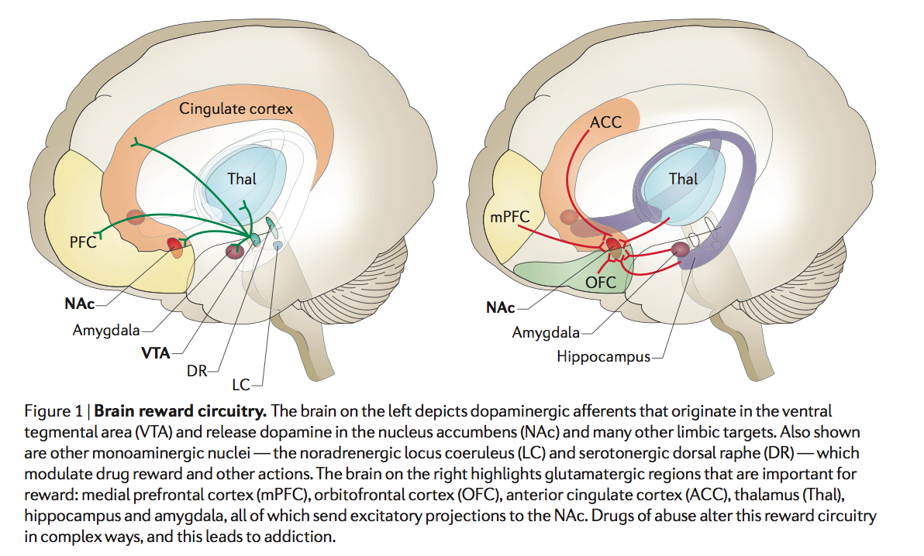
Addiction
Causes

Slide 86
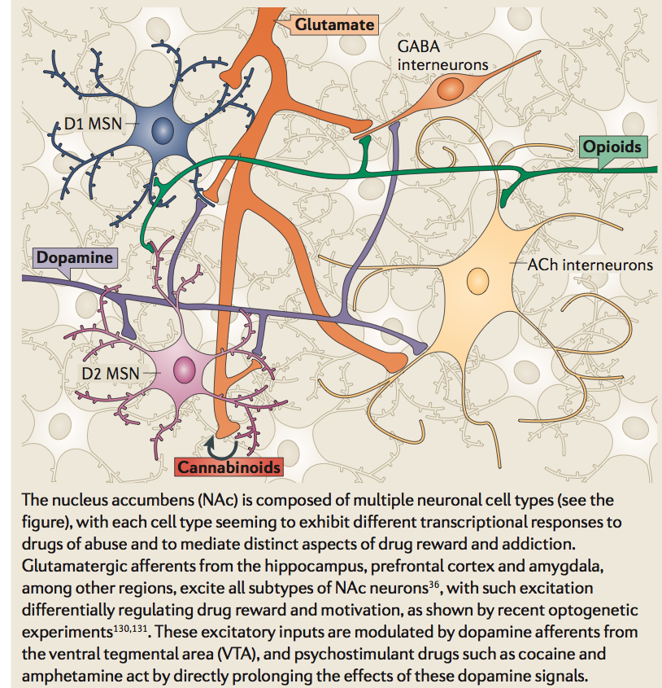
Addiction
Causes

Slide 87
Causes of psychopathology
Involved factors may be
Genetic
Social
Environmental
Biochemical
Structural
Are they really causes, or merely correlations?
The presence of a disorder is not a discrete, defined fact, like an everyday event.

Slide 88
No one is neurotypical.

Slide 89
We are all slightly pathological.

Slide 90
General conclusions
Psychopathologies are much less well-defined, clear-cut, mechanistically explainable and diagnosable than non-cognitive medical conditions.
There is a rule-following diagnostic component, and a social component
Stereotyping and outgroup discrimination are rife.
Mental health treatment throughout the world is seriously insufficient.

