Slide 1
Lecture 2 Functional history of the brain

Slide 2

Brain function
What is function?

Slide 3
Brain function
What is form?

Slide 4
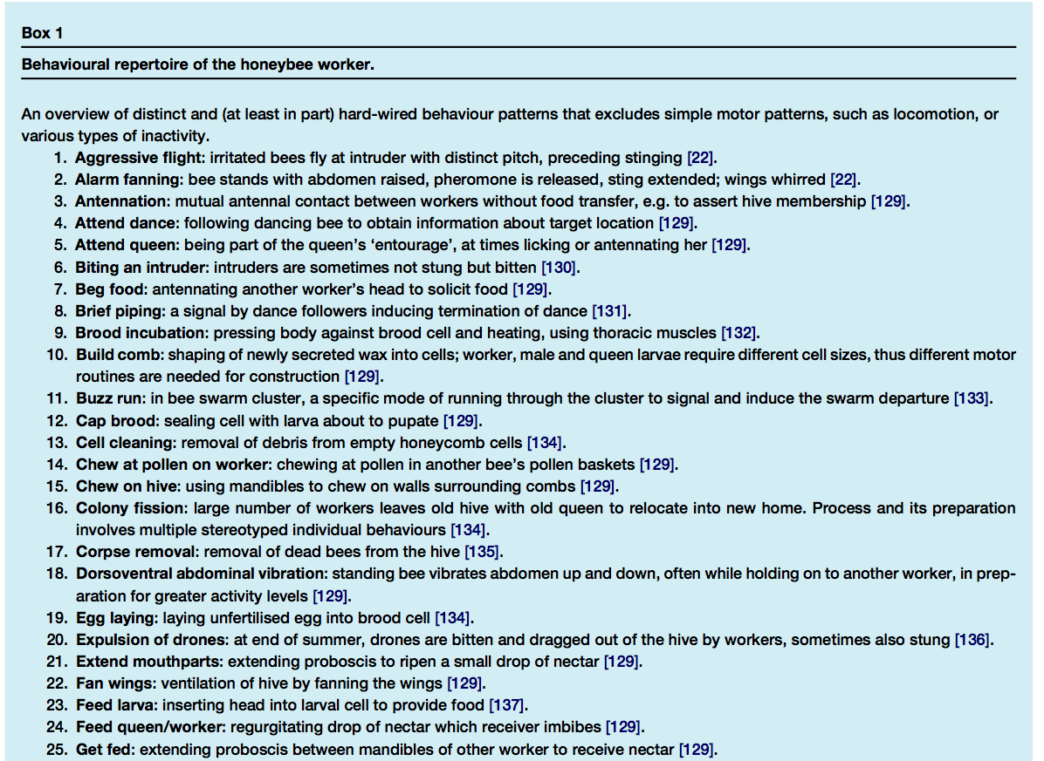
Greek views
Democritus

Slide 5
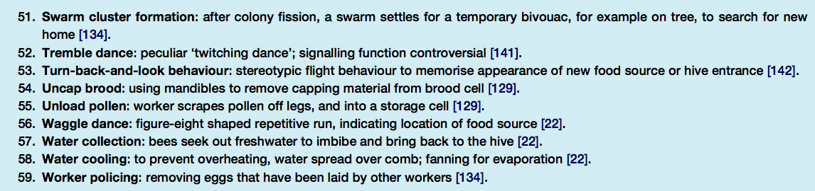
Brain function

Slide 6
What is function?
Anatomy
Function
Localisation

Slide 7
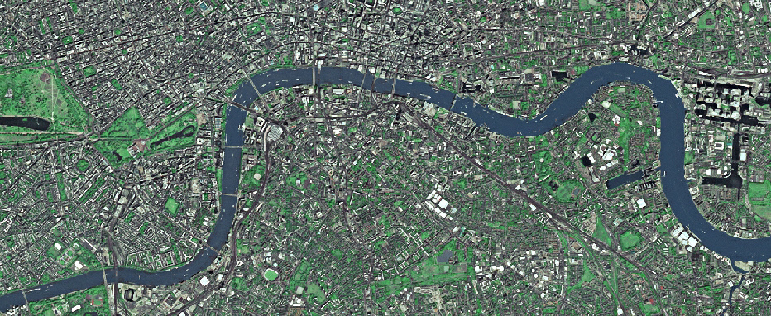
What is function?

Slide 8

What is function?

Slide 9
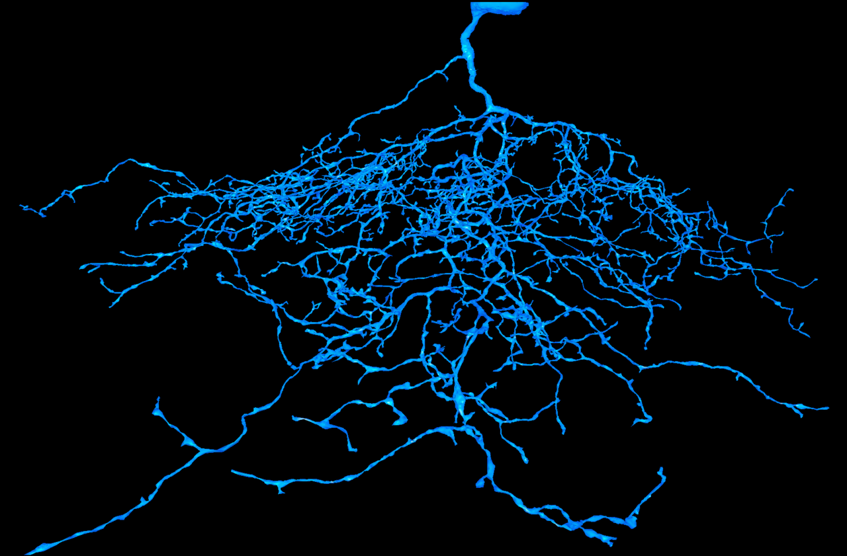
What is function?

Slide 10

What is function?

Slide 11
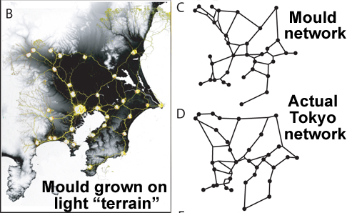
What is function?
Tero et al. 2010. Rules for Biologically Inspired Adaptive Network Design. Science 10.1126/science.1177894

Slide 12
Pre-classical views
Where does function start?
Really, we mean a description of function.

Slide 13
Greek views
Plato
Tripartite theory of soul:
λογιστικόν (logical),
θυμοειδές (high-spirited)
ἐπιθυμητικόν (appetitive).
(also corresponded to three parts of society)
The Republic, book IV, 380 BC

Slide 14
Greek views
Plato
The Greek Cardinal Virtues:
Prudence (φρόνησις, phronēsis): also described as wisdom, the ability to judge between actions with regard to appropriate actions at a given time.
Justice (δικαιοσύνη, dikaiosynē): also considered as fairness, the most extensive and most important virtue.
Temperance (σωφροσύνη, sōphrosynē): also known as restraint, the practice of self-control, abstention, and moderation tempering the appetition.
Courage (ἀνδρεία, andreia): also named fortitude, forbearance, strength, endurance, and the ability to confront fear, uncertainty, and intimidation.
[Wikipedia]

Slide 15
Greek views
Hippocrates
“It ought to be generally known that the source of our pleasure, merriment, laughter, and amusement, as of our grief, pain, anxiety and tears, is none other than the brain.
It is specifically the organ which enables us to think, see, and hear, and to distinguish, the ugly and the beautiful, the bad and the good, the pleasant and unpleasant...
It is the brain too which is the seat of madness and delirium, of the fears and frights which assail us, often by night, but sometimes even by day; it is there where lies the cause of insomnia and sleep-walking, of thoughts that will not come, forgotten duties, and eccentricities.”
[Hippocrates, On the Sacred Disease]

Slide 16
Greek views
Hippocrates
“It ought to be generally known that the source of our pleasure, merriment, laughter, and amusement, as of our grief, pain, anxiety and tears, is none other than the brain.
It is specifically the organ which enables us to think, see, and hear, and to distinguish, the ugly and the beautiful, the bad and the good, the pleasant and unpleasant...
It is the brain too which is the seat of madness and delirium, of the fears and frights which assail us, often by night, but sometimes even by day; it is there where lies the cause of insomnia and sleep-walking, of thoughts that will not come, forgotten duties, and eccentricities.”
[Hippocrates, On the Sacred Disease]

Slide 17
Greek views
Hippocrates
“It ought to be generally known that the source of our pleasure, merriment, laughter, and amusement, as of our grief, pain, anxiety and tears, is none other than the brain.
It is specifically the organ which enables us to think, see, and hear, and to distinguish, the ugly and the beautiful, the bad and the good, the pleasant and unpleasant...
It is the brain too which is the seat of madness and delirium, of the fears and frights which assail us, often by night, but sometimes even by day; it is there where lies the cause of insomnia and sleep-walking, of thoughts that will not come, forgotten duties, and eccentricities.”
[Hippocrates, On the Sacred Disease]

Slide 18
Greek views
Hippocrates
“It ought to be generally known that the source of our pleasure, merriment, laughter, and amusement, as of our grief, pain, anxiety and tears, is none other than the brain.
It is specifically the organ which enables us to think, see, and hear, and to distinguish, the ugly and the beautiful, the bad and the good, the pleasant and unpleasant...
It is the brain too which is the seat of madness and delirium, of the fears and frights which assail us, often by night, but sometimes even by day; it is there where lies the cause of insomnia and sleep-walking, of thoughts that will not come, forgotten duties, and eccentricities.”
[Hippocrates, On the Sacred Disease]

Slide 19
Greek views
Hippocrates
“It ought to be generally known that the source of our pleasure, merriment, laughter, and amusement, as of our grief, pain, anxiety and tears, is none other than the brain.
It is specifically the organ which enables us to think, see, and hear, and to distinguish, the ugly and the beautiful, the bad and the good, the pleasant and unpleasant...
It is the brain too which is the seat of madness and delirium, of the fears and frights which assail us, often by night, but sometimes even by day; it is there where lies the cause of insomnia and sleep-walking, of thoughts that will not come, forgotten duties, and eccentricities.”
[Hippocrates, On the Sacred Disease]

Slide 20
300-500 AD
The Early Church Fathers
Classification of mental functions:
sensus communis common sense
imaginativa imagination
fantasia fantasy
aestimativa judgement
cogitativa thought
ratio reason
motiva motion
memory

Slide 21
300-500 AD
The Early Church Fathers
sensus communis
imaginativa/fantasia:
“faculty which is the reservoir of appearances perceived and things not perceived”
estimativa/cogitativa
“which from things perceived elicits the appearances of things not perceived and composes and separates them precisely, which fantasia cannot do”
memory
“which preserves the appearances of things perceived and not perceived, which imagination and fantasy cannot do”
[source: diagram from 15th Century]

Slide 22
300-500 AD
The Early Church Fathers
Cell doctrine
Arrangement with the ventricles:
first cell images created by the senses
second cell manipulation of images (reasoning)
third cell stored whatever was left over (memory)
Compared with the process of digestion
We see, overall, a pattern of comparison with other processes in the body.

Slide 23
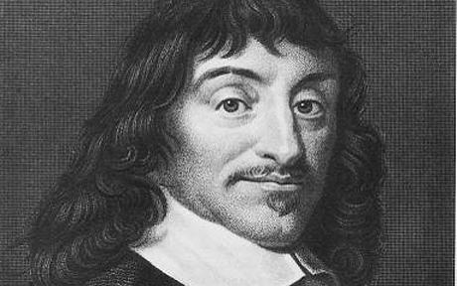
17th Century
Descartes
René Descartes
1596 - 1650

Slide 24
17th Century
Descartes
Born in the south of France, spent some time in the Dutch State Army, lived in the Netherlands for 20 years and accomplished most of his scientific work there.

Slide 25
17th Century
Descartes
Cogito, ergo sum
I think, therefore I am

Slide 26
17th Century
Descartes’ worldview
Cartesian dualism posits three types of “substance”:
res extensa extended thing
res cogitans thinking thing
God
(ontologically proven)
Descartes defines a substance as “something which can exist without the existence of any other substance.”
We, however, define it as a physical thing.
One modern view is that only form is substance and all function is insubstantial. Descartes goes against this by lifting function into the realm of substance (Cartesian meaning).

Slide 27
17th Century
Descartes’ worldview
The Wax Argument:
We assume a piece of wax is defined by its sensory percepts.
However, when we move the wax, these all change.
Therefore, it cannot be defined by its effects on the senses, but on something separate and more complex.
(An ancestor of the modern theory of high- and low-level percepts)
His view: perception is unreliable. Only deduction is reliable.

Slide 28
17th Century
Afference and efference
Descartes, in his study of reflexes, popularised the idea that brain function can be split into afferent (incoming) and efferent (outgoing) components.

Slide 29
17th Century
Descartes’ view on emotion
"Descartes said that he did not believe that one must refrain from tears to prove oneself a man."
The Story of Civilization: Par VII, the Age of reason Begins. New York: Simon and Schuster. p. 638.

Slide 30
17th Century
Separating the mind from the world

Slide 31
17th Century
Thomas Willis
Put forward an influential theory of function:
sensus communis corpus striatum
imagination corpus callosum
memory cerebral cortex
voluntary motion cerebrum
vital actions cerebellum

Slide 32
17th Century
Willis and religion
Willis was a devout Christian. His Cerebri Anatome (1664) was dedicated to the Archbishop of Canterbury, mentioning that science could be seen as
“a certain schoolhouse and mystery of Atheism”
Willis proposed that humans have two souls:
a corporeal soul or “soul of brutes” (the lower functions)
an immortal rational soul (the higher functions)
This allowed him to deconstruct the corporeal soul without interfering with the theological sphere, or proposing mechanistic explanations for religious phenomena.

Slide 33
19th Century
Phrenology
Although phrenology made the completely false assumption that the shape of the cortex influences the shape of the skull, it did pioneer the idea that functions can be localised to particular parts of the brain.
It also provides a snapshot of functional thinking at the time. The following list is from
Combe, George (1851). A System of Phrenology. Boston: Benjamin B. Mussey and Company.

Slide 34
19th Century
Phrenology
Propensities
Adhesiveness
Alimentiveness
Amativeness
Acquisitiveness
Causality
Cautiousness
Combativeness
Concentrativeness
Constructiveness
Destructiveness
Ideality
Love of life
Philoprogenitiveness (love of offspring)
Secretiveness

Slide 35
19th Century
Phrenology
Sentiments
Lower sentiments: these are common to man and animal.
Cautiousness
Love of Approbation
Self-esteem
Truthfulness
Superior sentiments: these produce emotion or feeling lacking in animals.
Benevolence
Conscientiousness
Firmness
Hope
Ideality
Imitation
Veneration
Wit or Mirthfulness
Wonder

Slide 36
19th Century
Phrenology
Intellectual faculties
Coloring
Eventuality (memory for facts and events)
Form
Hearing
Individuality
Language
Locality
Number
Order
Sight
Size
Smell
Taste
Time
Touch
Tune
Weight

Slide 37
19th Century
Phrenology
Reflecting faculties
“These produce ideas of relation or reflect they minister to the direction and gratification of all the other powers.”
Causality
Comparison

Slide 38
A sea change
The computational viewpoint
Function is like a computer program
Function has been programmed

Slide 39
Modern conceptions
Senses

Slide 40
Modern conceptions
Feelings and emotions

Slide 41
Modern conceptions
Memory

Slide 42
Modern conceptions
Prediction

Slide 43
Modern conceptions
Time

Slide 44
Modern conceptions
Perception

Slide 45
Modern conceptions
Representation

Slide 46
Modern conceptions
Imagination

Slide 47
Modern conceptions
Creation

Slide 48
Modern conceptions
Analogy / metaphor

Slide 49
Modern conceptions
Cognition

Slide 50
Modern conceptions
Planning, choice and decision-making

Slide 51
Modern conceptions
Consciousness

Slide 52
Modern conceptions
The sense of self
Personal development and self-actualisation

Slide 53
Modern conceptions
High and low levels
The first meaning:
High-level thoughts/concepts/representations:
complex, bound
Low-level thoughts/concepts/representations:
simpler, unbound

Slide 54
Modern conceptions
High and low levels
The second meaning:
High-level thoughts/concepts/representations:
conscious, introspectable, willed
Low-level thoughts/concepts/representations:
unconscious, non-introspectable, automatic

Slide 55
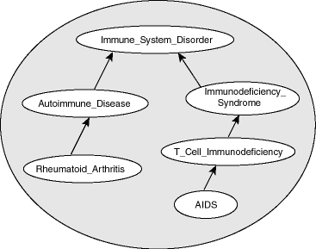
Modern conceptions
Ontology

Slide 56
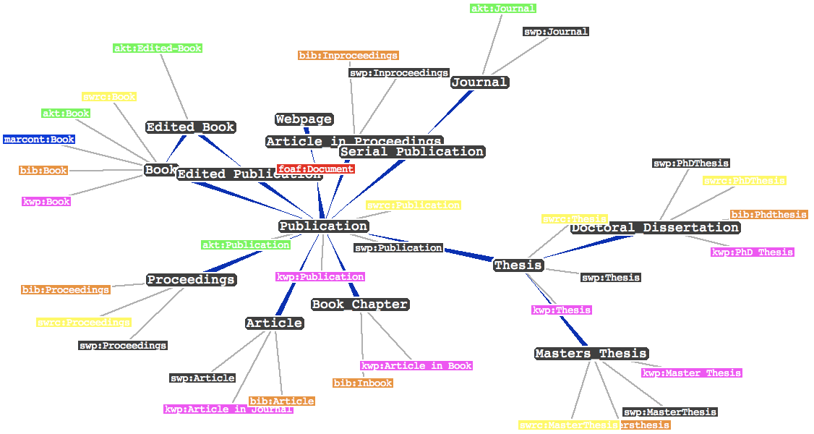
Modern conceptions
Ontology

Slide 57
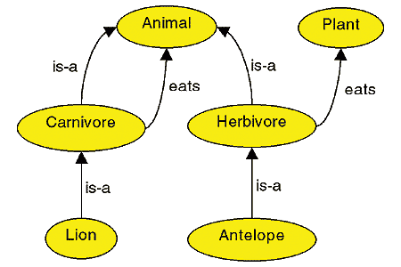
Modern conceptions
Ontology

Slide 58
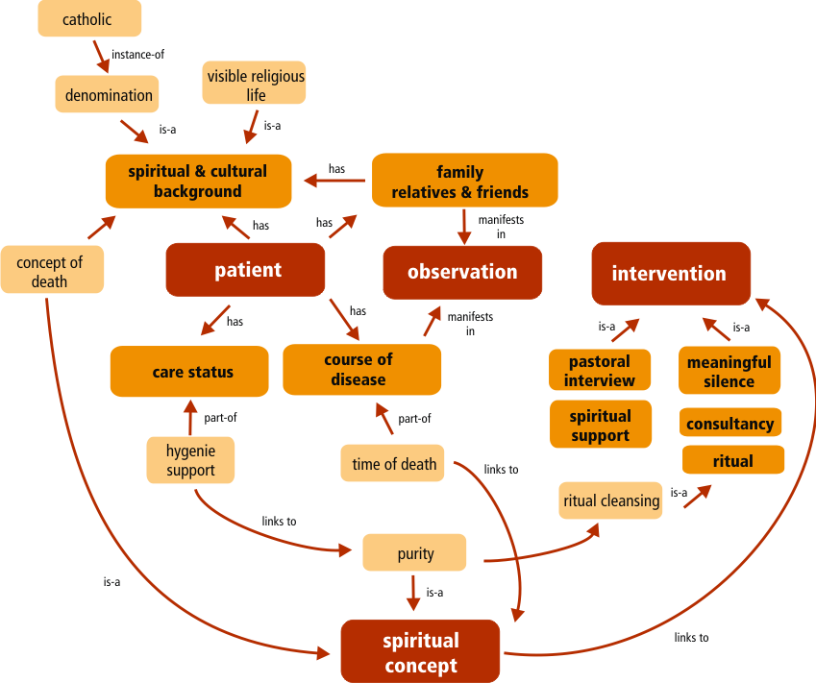
Modern conceptions
Ontology
[Andreas Schmidt]

Slide 59
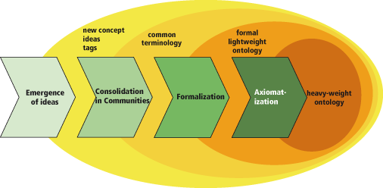
Modern conceptions
Ontology

Slide 60
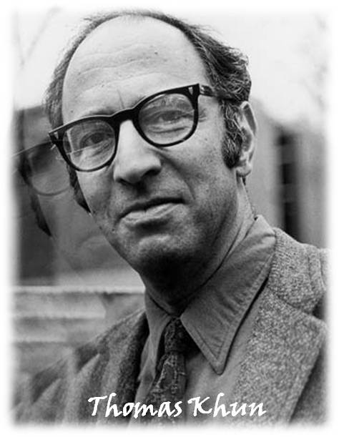
Modern conceptions
Ontology
1922 - 1996

Slide 61
Conclusions
Function is more complex than form (anatomy).
Anatomy is static, but function describes temporal change.
While anatomy can carve the world up into an ontology, function cannot do this.
Generally, we describe function by 1. Establishing entities 2. Describing relationships between them
Function presents different ways of looking at what the brain does – but they are incommensurable.
Our conception of function defines (and is defined by) the way we look at the world.

Slide 62
Questions
Does the world view we grow up with (e.g. Eastern vs. Western) affect our conception of brain function?

