Slide 1
Lecture 2 The History of Psychology

Slide 2

Conclusions
What made these papers so famous?
They tell good stories
Unexpected results
Wide-ranging effects on society (note circular reasoning)

Slide 3
Conclusions
Paper structure
Context
Methods
Results
Discussion
Every paper is a balance between storytelling and rationality.

Slide 4
Conclusions
The scope of psychology
Psychology uses experiments to ask questions about mind and behaviour.
It studies diverse areas of interpersonal behaviour:
Obedience
Exclusion
as well as intrapersonal behaviour:
Vision
Abnormal cognitive function
using diverse experimental paradigms:
PET and fMRI scanning
EEG
Behavioural experiments: accuracy
reaction time
general observations

Slide 5
Conclusions
Psychology and society
Psychology has a great effect on society, as well as on our conception of the self (the internal life).
Many of the constructs we use to describe and understand ourselves come from psychology:
nervous breakdown
paranoid
the subsconscious
identity crisis
reverse psychology
inner child
left/right brain
emotional intelligence
Freudian slip
dysfunctional

Slide 6
Conclusions
A network of sciences
Psychology is closely related to
psychiatry
neuroscience
neurology
cognitive science
cognitive neuroscience
vision science
generally: brain science
biology
sociology
philosophy

Slide 7
Conclusions
Lectures
2: History of psychology
3: Seeing, feeling and remembering
4: Awareness and consciousness
5: Development and lifelong change
6: Individual differences
(reading week)
7: The individual in society
8: Research techniques and challenges
9: Abnormal psychology
10: How psychology influences society
Seminars
Essay

Slide 8
Lecture 2 The History of Psychology

Slide 9
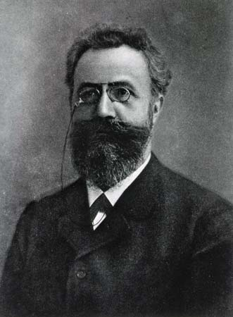
Beginnings
“Psychology has a short history, but a long past.”
Ebbinghaus, 1908

Slide 10
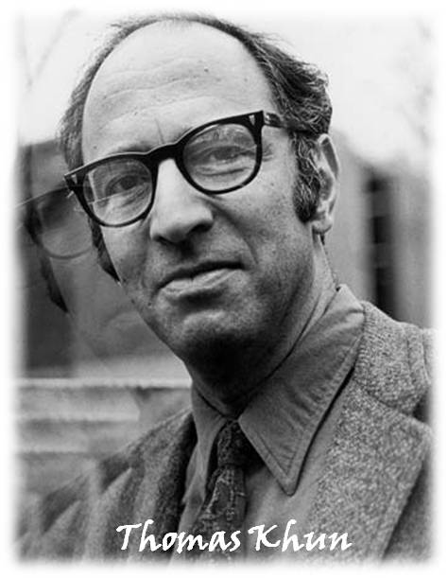
How does science proceed?
Scientific revolutions
What’s the overall point of science?
To get things done?
To understand the world?
To answer questions?
To dispatch them?
Kuhn’s theory of scientific revolutions:
normal periods
crisis periods
In what other science do we study the same instruments we use (the mind?)
1922-1996

Slide 11
How does science proceed?
Scientific revolutions
How does science proceed?
Two strata:
Experiments
Hypotheses
Theories

Slide 12
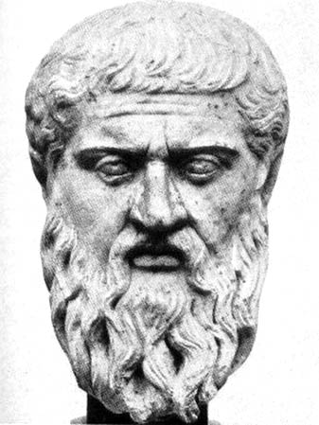
Pre-psychology
Greek thought
c. 550 BC
Thales
Plato and his teacher Socrates
Phaedrus - Plato 370 BC
eros desire, feminine stomach
thumos emotion/anger, masculine chest
logos mind or reason head
The Republic - Plato 380 BC
nous intellect
thumos passion
epithumia appetite
Plato
428-348 BC

Slide 13
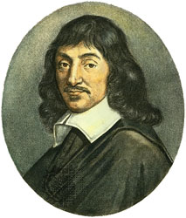
Pre-psychology
Enlightenment thought
Descartes is widely seen as the father of modern philosophy.
His “Meditations on First Philosophy,” published 1641 in Latin, presents his attempt to strip down and rebuild the human world view.
Rationalist.
Methodological skepticism: rejecting ideas, then re-establishing certainties.
Also responsible for Cartesian coordinates.
“I think, therefore I am.”
Pioneer of dualism: viewing the mind and body as two separate interacting systems.
René Descartes
1596-1650

Slide 14
Pre-psychology
Under the guise of philosophy
Psychology slowly begins to differentiate itself from anatomy, medicine and biology.
Before its unification as a field, psychological thought was often the domain of philosophers.

Slide 15
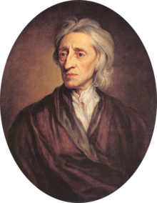
Pre-psychology
Locke
“Father of Classical Liberalism”
Part of the British empiricist movement.
The self:
"that conscious thinking thing, (whatever substance, made up of whether spiritual, or material, simple, or compounded, it matters not) which is sensible, or conscious of pleasure and pain, capable of happiness or misery, and so is concerned for itself, as far as that consciousness extends.”
Locke’s mind is a tabula rasa shaped by experience.
His “associations of ideas” gave rise to associationism- “negative associations.”
Association is closer to the experimental level – we can search for a biological mechanism for it.
John Locke
1632-1704

Slide 16
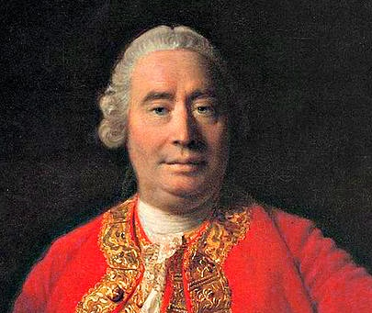
Pre-psychology
Hume
Another British Empiricist.
Attended the University of Edinburgh at 12 (14 normal at the time).
Main work “A treatise of human nature” – 1738
Focussed on
induction
causation and association
bundle theory
David Hume
1711-1776

Slide 17
Pre-psychology
Hume
"Nature, by an absolute and uncontroulable necessity has determin'd us to judge as well as to breathe and feel.”
"I never asserted so absurd a proposition as that something could arise without a cause.”
David Hume
1711-1776

Slide 18

Pre-psychology
Hume

Slide 19
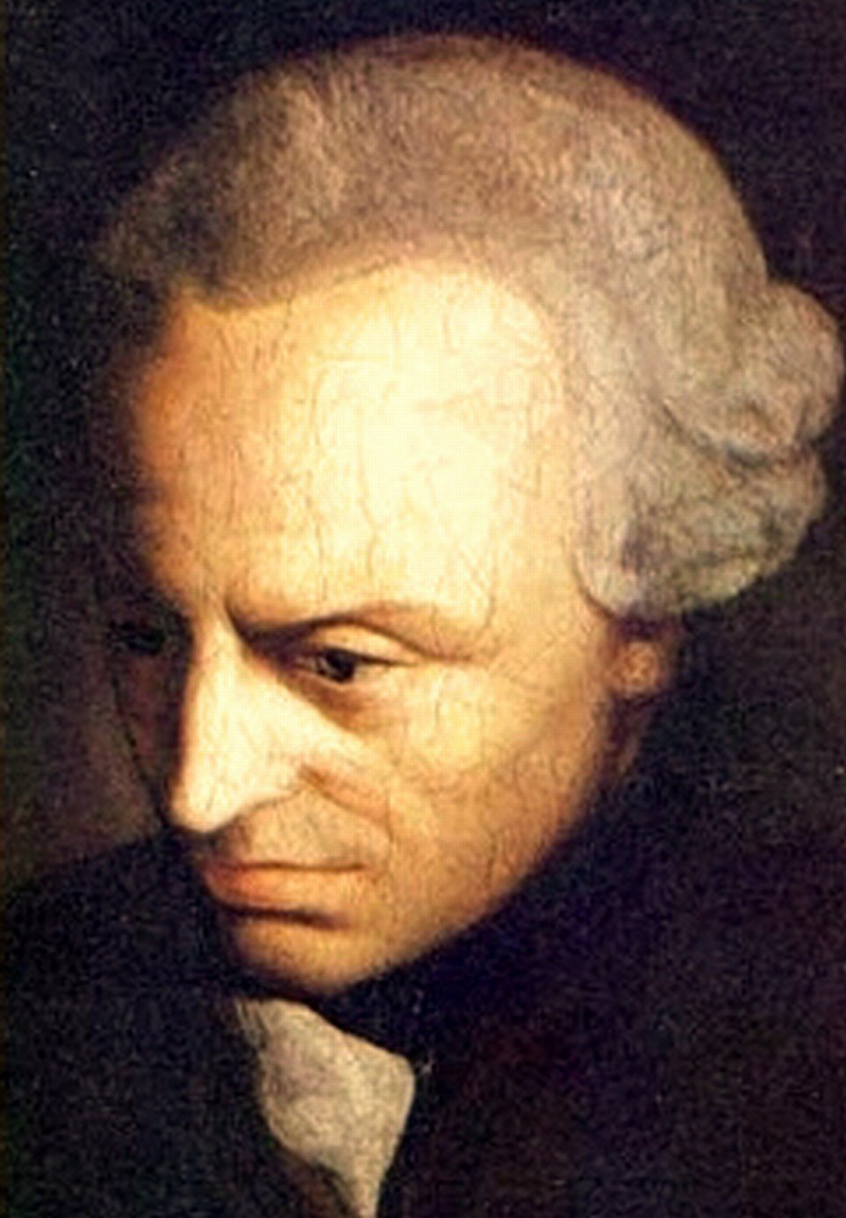
Pre-psychology
Under the guise of philosophy
The Critique of Pure Reason (1781)
Empiricism: experience creates knowledge
Rationalism: reason creates knowledge
Kant: they work together. Experience is processed by reason.
Two systems (Kahneman)
Psychological phenomena cannot be measured or quantified; it will thus never become a “proper” natural science.
This was true at the time!
Immanuel Kant
1724-1804

Slide 20
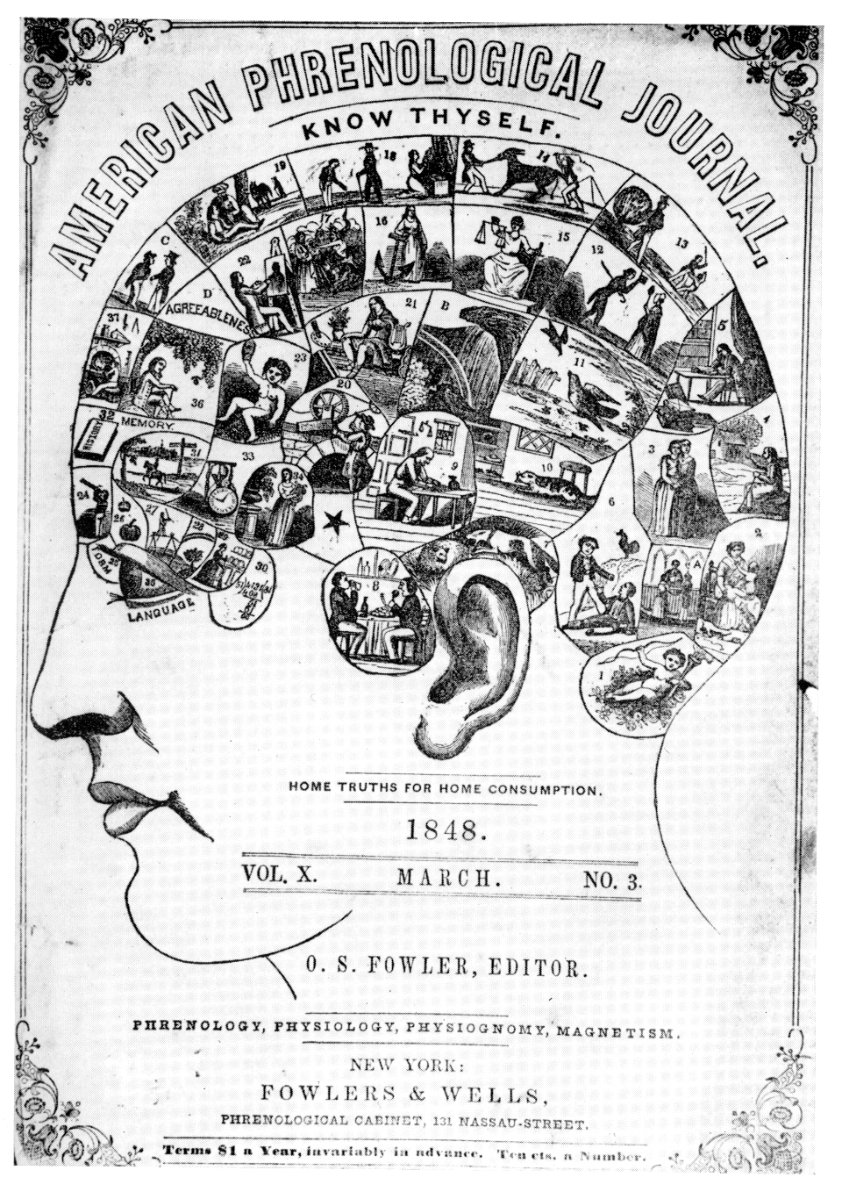
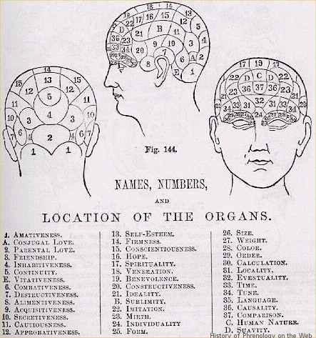
Pre-psychology
Phrenology

Slide 21
Pre-psychology
Phrenology

Slide 22
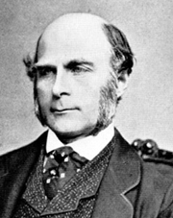
Early psychology
Galton
Victorial polymath.
Statistics:
correlation
questionnaires
Eugenics (coined the term):
coined “nature versus nurture”
Founded
psychometrics
differential psychology
fingerprint analysis
scientific meteorology
Francis Galton
1822 - 1911

Slide 23
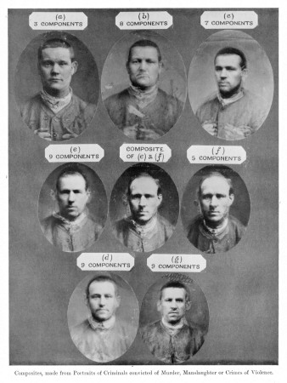
Early psychology
Galton

Slide 24
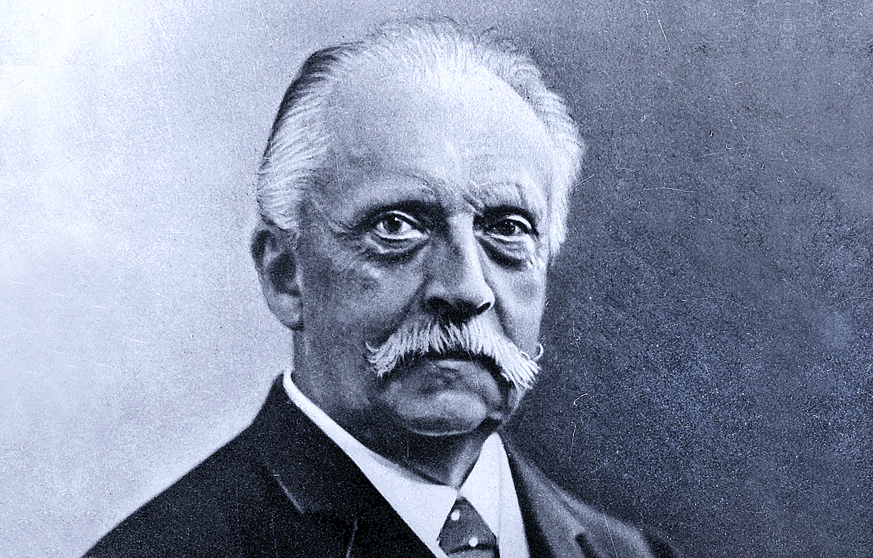
The early psychologists
Helmholtz
Physician and physicist:
optics
colour vision
electrodynamics
thermodynamics
conservation of energy
Often called the greatest scientist in history.
Measured nerve impulse transmission speed using a frog’s sciatic nerve.
Hermann von Helmholtz
1821-1894

Slide 25
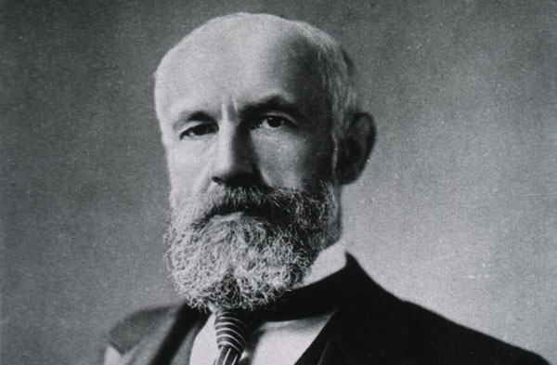
Philosophical Positions in Psychology
Wundt
Wilhelm Wundt
1832-1920

Slide 26
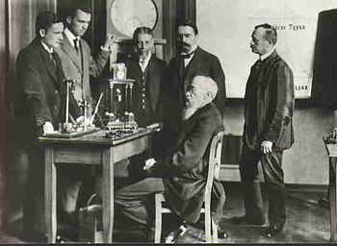
Philosophical Positions in Psychology
Wundt
Wundt’s laboratory in Leipzig,
opened in 1879

Slide 27
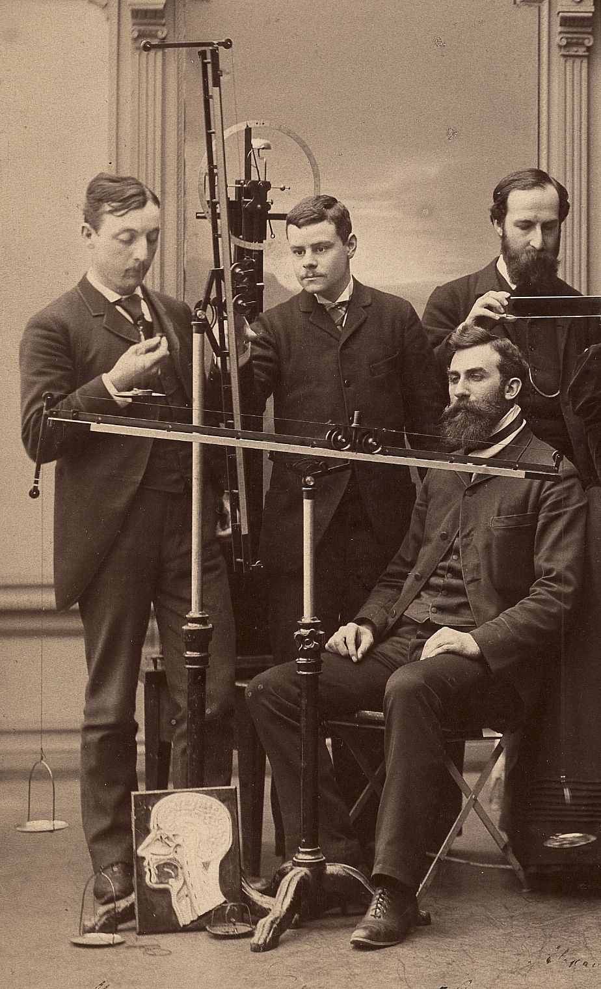
Early psychology
Experimental techniques

Slide 28
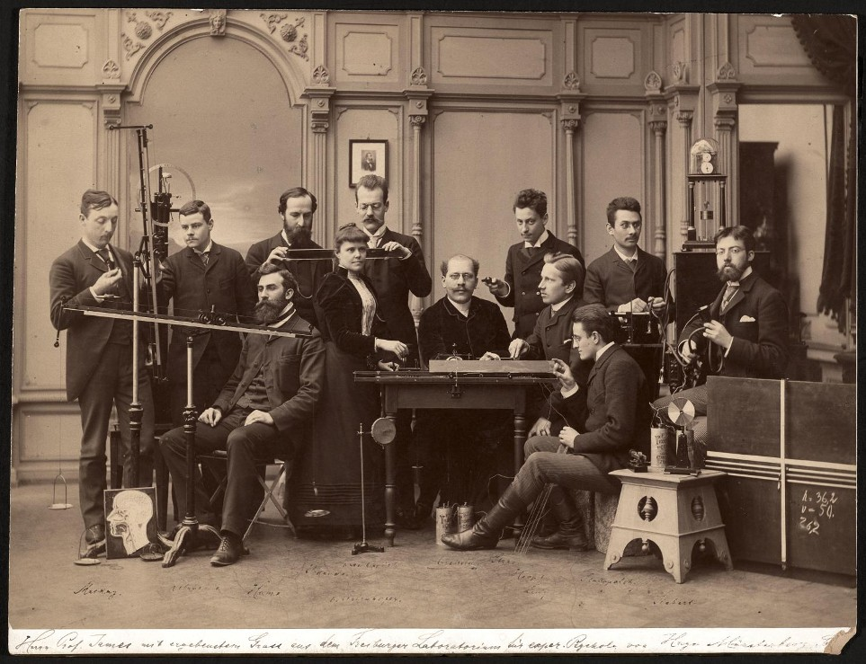
Early psychology
Experimental techniques

Slide 29
Early psychology
Experimental techniques
Weight
Galvanic element
Instrument for investigating the power of the eye to comapre lengths
Photograph of Wundt
Small distance apparatus
Apparatus for the investigation of the muscular sense
Hipp chronoscope
Starting pistol

Slide 30
Gestalt movement
Gestalt: shape, form, configuration (German)
Theory of mind of the Berlin school of experimental psychology.
The components of thought form a unified whole.
This whole is organised according to particular rules and tendencies.
Gestalt effect – the capacity of the brain to generate whole forms.
“The whole is other than the sum of the parts.”
-Kurt Koffka

Slide 31


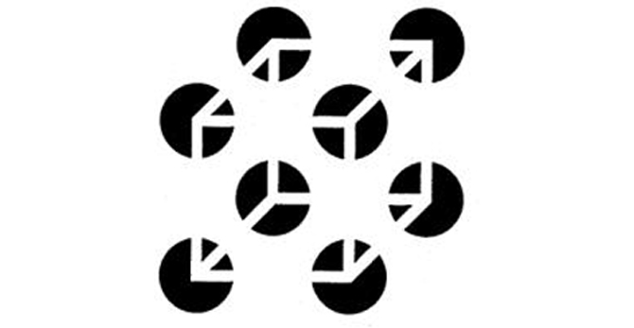
Gestalt movement

Slide 32
Structuralism
Theory of consciousness due to Wundt and his pupil Titchener.
Attempts to break the mind down into parts and study their interaction.
Titchener rejected the unobservable:
“It is true, nevertheless, that observation is the single and proprietary method of science, and that experiment, regarded as scientific method, is nothing else than observation safeguarded and assisted.”
But relied on introspection:
“The state of consciousness which is to be the matter of psychology ... can become an object of immediate knowledge only by way of introspection or self-awareness.”
What’s the difference between an introspective report and an experimental report?

Slide 33
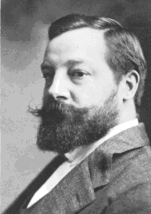
Structuralism
Edward B. Titchener
1867 - 1927

Slide 34
Structuralism
Theory of consciousness due to Wundt and his pupil Titchener.
Attempts to break the mind down into parts and study their interaction.
Titchener rejected the unobservable:
“It is true, nevertheless, that observation is the single and proprietary method of science, and that experiment, regarded as scientific method, is nothing else than observation safeguarded and assisted.”
But relied on introspection:
“The state of consciousness which is to be the matter of psychology ... can become an object of immediate knowledge only by way of introspection or self-awareness.”
What’s the difference between an introspective report and an experimental report?
More than one person can perceive and agree upon the experimental report.
But do they really agree?
Is the divergence not simply higher-level?

Slide 35
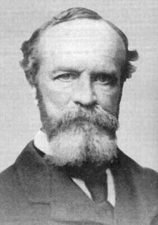
The early psychologists
William James
Principles of Psychology (1890)
A landmark early psychology textbook.
The first lecturer to teach a course on psychology in the US.
Philosophy:
pragmatism (thought is a tool for prediction)
Psychology:
functionalism
William James
1842-1910

Slide 36
Functionalism
A philosophical viewpoint opposing structuralism.
Late 19th/early 20th century.
University of Chicago:
Dewey – educational psychologist (levelling children)
Herbert Mead
Sees the mind as a function adapted to the environment.
Focusses on the purpose (or function) of the mind rather than its elements.
Emphasised individual differences.

Slide 37
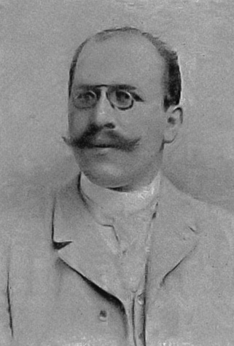
Early psychology
Experimental techniques
German-American pioneer of applied psychology: translating psychological research to real-world settings.
Hugo Münsterberg
1863-1916

Slide 38
Early psychology
Experimental techniques
"The lawyer alone is obdurate. The lawyer and the judge and the juryman are sure that they do not need the experimental psychologist . . . They go on thinking that their legal instinct and their common sense supplies them with all that is needed and somewhat more . . . Just in the line of the law it therefore seems necessary not to rely simply on the technical statements of scholarly treatises, but to carry the discussion in the most popular form possible before the wider tribunal of the general reader"

Slide 39
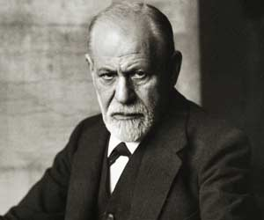
Philosophical Positions in Psychology
Freud
Sigmund Freud
1856-1939

Slide 40
Philosophical Positions in Psychology
Freud
Originally a doctor of medicine (Vienna 1881) investigating cerebral palsy and aphasia.
Sigmund Freud
1856-1939

Slide 41
Freud
Psychoanalysis
1885: Freud took a fellowship to Paris with Charcot, working on hypnosis. In 1886 Freud set up a private practice and began using hypnosis clinically.
One patient, Anna O (paralysis, hallucinations), was invited to talk about her symptoms.
Patient of Josef Breuer, a mentor to Freud.
It is currently thought that she suffered from complex partial seizures worsened by drug dependence, or epilepsy.

Slide 42
Freud
Psychoanalysis
Childhood has a great influence on adult personality.
Thought is largely influenced by irrational drives, which are unconscious.
Attempts to inspect or become aware of these drives find resistance: defence mechanisms.
Conflicts between the conscious and the unconscious cause mental and emotional disturbances.
Through skilled guidance, unconscious material can be made conscious and its negative effects mitigated.
Metaphorically, a battle between the patient’s unconscious and the analyst.
Heavily criticised in modern times, but remains a strong influence in psychiatry.

Slide 43
Freud
Personal life
Freud suffered from
heart irregularities
depression
addiction
which prompted much self-analysis. He attributed his symptoms to the death of his father in 1896.

Slide 44
Philosophical Positions in Psychology
Freud’s psychoanalysis
A clinical method for treating psychopathology through dialogue between patient and psychoanalyst.
Defined techniques:
free association
And mental processes:
transference
Oedipus complex
libido
death drive
repression
Much debate about the utility of psychoanalysis.

Slide 45
Freud
The unconscious
The philosophers Brentano (Freud’s tutor) and Lipps discussed perception, introspection, the unconscious, and empathy.

Slide 46
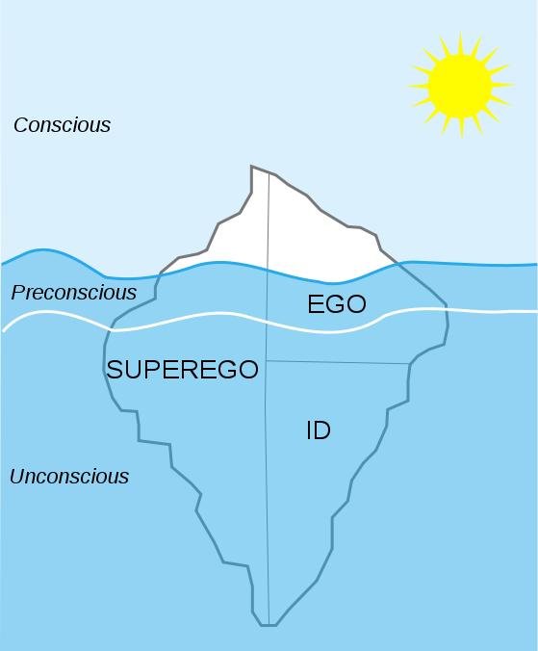
Freud
The unconscious
Conscious
Preconscious
Unconscious
Ego: conscious mind. Latin for “I.”
Superego: internalisation of cultural rules. Conscience. Aims for perfection.
Id: contains a person’s basic, instinctual drives. Latin for “it.” Unconscious by definition.

Slide 47
Freud
The unconscious
In Freud’s view, the ego seeks to “mediate between id and reality,” to control and channel the id in ways that will benefit in the long term.
Freud contrasts the reality principle and the pleasure principle.
The super-ego, constantly monitoring, rewards or punishes the behaviour of the ego.
Freud: "The ego is that part of the id which has been modified by the direct influence of the external world. ... The ego represents what may be called reason and common sense, in contrast to the id, which contains the passions ... in its relation to the id it is like a man on horseback, who has to hold in check the superior strength of the horse; with this difference, that the rider tries to do so with his own strength, while the ego uses borrowed forces."
Defense mechanisms: coping mechanisms which reduce anxiety generated by unacceptable or negative impulses.
Repression, rationalisation, regression, projection, reaction formation (reacting oppositely to the unconscious drive), sublimation (acceptable expression).

Slide 48
Freud
The unconscious
What are these parts?
Do they really exist?
Do they have physical meaning?
Do any of the other concepts we use in everyday life have physical meaning?

Slide 49
Freud
Criticism
The mechanisms Freud proposed seem to involve situations similar to those he experienced in early life. Was he himself projecting?

Slide 50
Freud
W. H. Auden’s tribute
“In Memory of Sigmund Freud”
He wasn’t clever at all: he merely told
the unhappy Present to recite the Past
like a poetry lesson till sooner
or later it faltered at the line where
long ago the accusations had begun
...
to us he is no more a person
now but a whole climate of opinion
under whom we conduct our different lives:

Slide 51
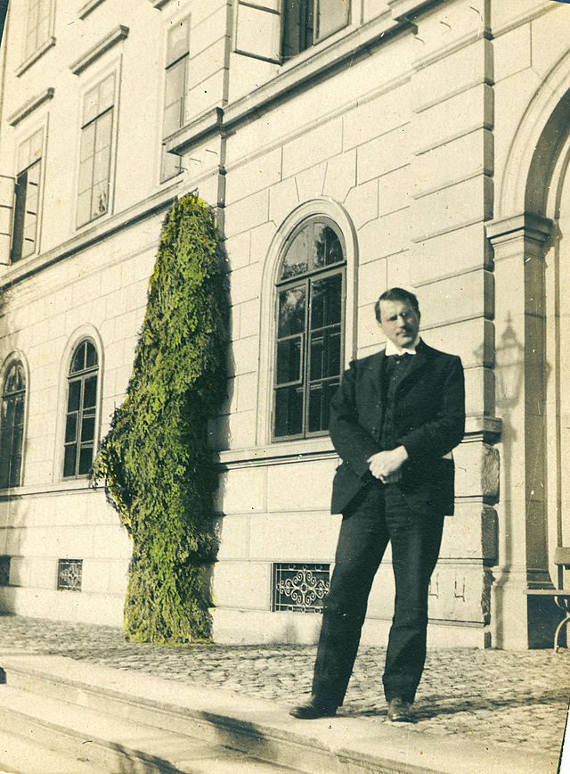
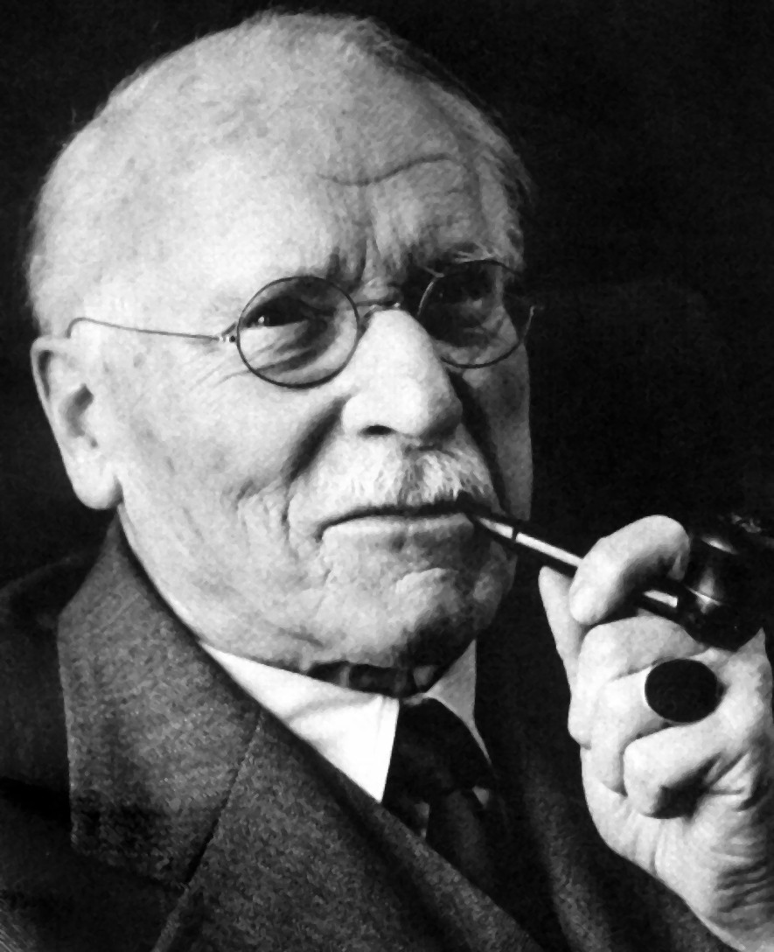
Philosophical Positions in Psychology
Jung
Carl Gustav Jung
1875-1961

Slide 52
Jung
Born 1875 in Switzerland.
A solitary and introverted child; saw himself as possessing two personalities.
Following an incident in which he was pushed to the ground by another boy, Jung fainted whenever he applied himself to schoolwork. Upon overhearing his father discussing his future inability to support himself, he realised the need for academic excellence.
1895: studied medicine at the University of Basel. Dissertation: “On the Psychology and Pathology of So-Called Occult Phenomena.”
1906: Met Freud; they talked unceasingly for 13 hours. Freud sent Jung a collection of essays. Freud: “my adopted eldest son, my crown prince and successor.”
1909: Travelled with Freud to the United States, attended an important conference publicising psychoanalysis.

Slide 53
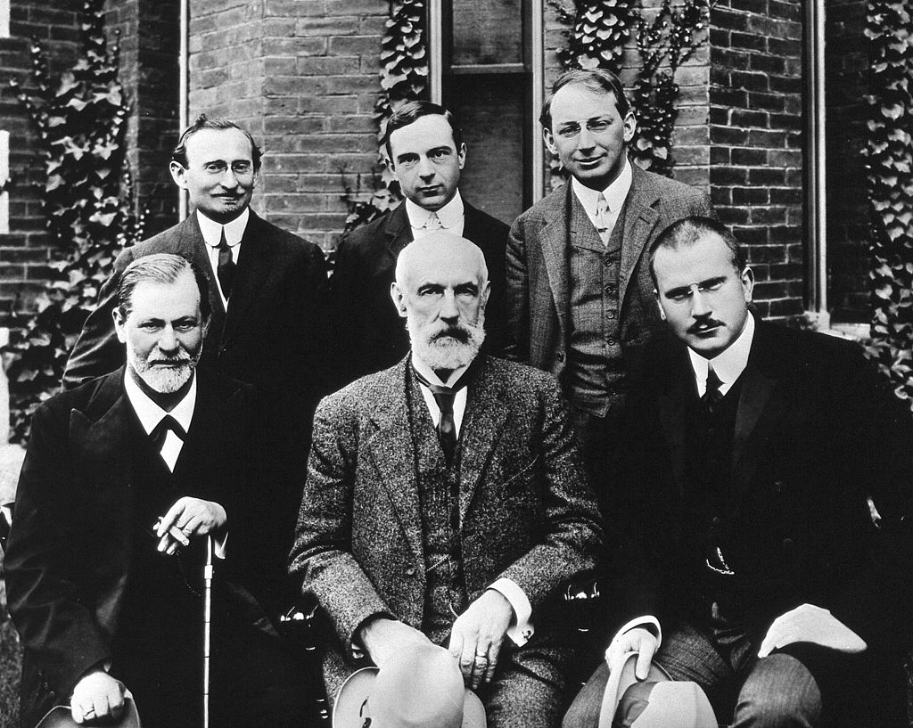
Jung
Clark University, 1909

Slide 54
Jung
Developed analytical psychology and the concepts of
extraversion & intraversion
archetypes
the collective unconscious
the complex
synchronicity
psychological types; Myers-Briggs Type Indicator (MBTI)
Published extensively on alchemy in his later years.
Recommended spirituality as a cure for addiction. Seen as a major influence of Alcoholics Anonymous.

Slide 55
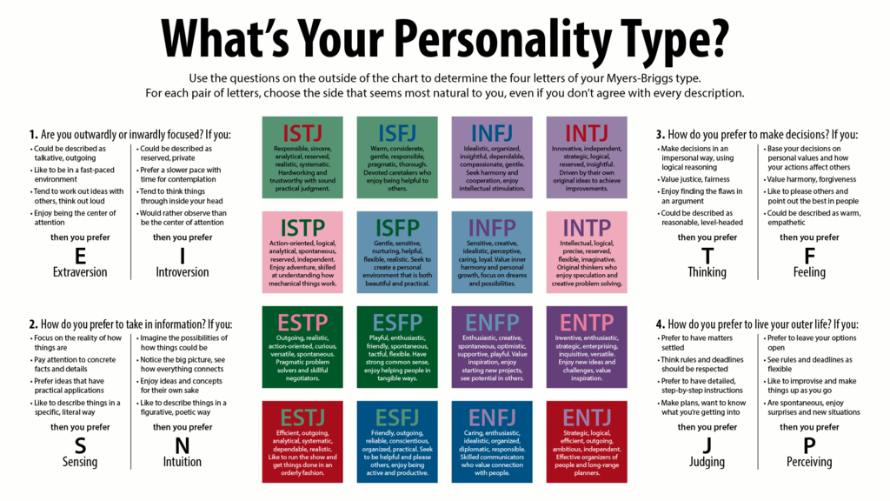
Jung

Slide 56
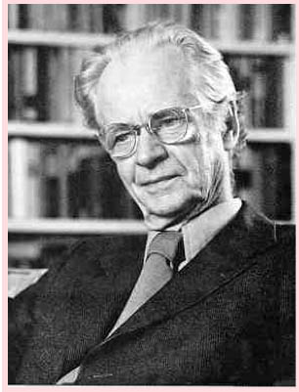
Behaviourism
Burrhus Frederic Skinner
1904 - 1990

Slide 57
Behaviourism
A reaction to introspective, mentalistic psychology, full of untestable predictions.
Concerns itself with stimuli and responses.
Behaviourists regarded the mind as a unmeasurable construct that should not be treated. Experiments and theories should treat behaviours: stimuli and responses.
A rejection of “the study of mental events.”
Ivan Pavlov
B.F. Skinner
John B. Watson
Edward Thorndike

Slide 58
Behaviourism
Operant response: a response programmed by a pattern of reward.
Operant conditioning: training by reward or punishment.
Behaviourism explains how to reward random actions – but not how to creatively generate new actions which are likely to work.
Skinner’s Verbal Behaviour attempted a stimulus-response view of language.

Slide 59
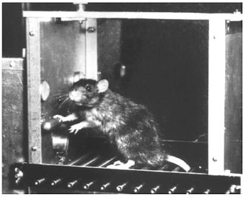
Behaviourism
The operant conditioning chamber, or Skinner box:

Slide 60
Humanistic psychology
Response to behaviourism and psychoanalytic theory.
Emphasis on therapy and the rehabilitation/integration of the individual, rather than on mechanical descriptions of brain function.
A holistic approach to life which embraces internal phenomena:
free will
creativity
potential

Slide 61
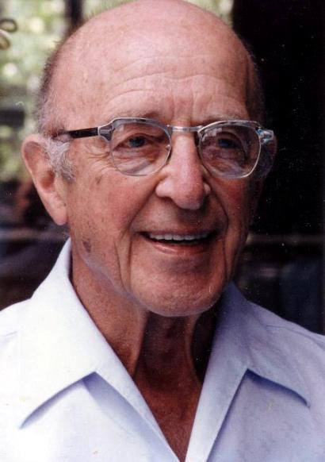
Humanistic psychology
Sixth most cited/recognised psychologist of the 20th century. Clinically, second only to Freud.
Studied Agriculture at Wisconsin-Madison; nearly entered religious ministry.
Completed doctoral work in child psychology.
Counselling centre at the University of Chicago.
In late life: travelled and mediated social conflicts
Protestant/Catholic
black/white
healthcare consumers/providers
Carl Rogers
1902 - 1987

Slide 62
Humanistic psychology
Rogers’ theories describe the development of an individual from an undifferentiated self to a fully functioning person.
Self Concept:
“the organized consistent conceptual gestalt composed of perceptions of the characteristics of 'I' or 'me' and the perceptions of the relationships of the 'I' or 'me' to others and to various aspects of life, together with the values attached to these perceptions. It is a gestalt which is available to awareness though not necessarily in awareness. It is a fluid and changing gestalt, a process, but at any given moment it is a specific entity.”
(Rogers, 1959)
Carl Rogers
1902 - 1987

Slide 63
Humanistic psychology
Rogers’ processes of “the good life”:
A growing openness to experience
An increasingly existential lifestyle (“living each moment fully” and not distorting it)
Increasing trust in own judgement to choose appropriate behaviour
Freedom of choice
Creativity
Reliability and constructiveness
A full rich life
“This process of the good life is not, I am convinced, a life for the faint-hearted. It involves the stretching and growing of becoming more and more of one's potentialities. It involves the courage to be. It means launching oneself fully into the stream of life.”
(Rogers 1961)
How evidence-based?
How do we measure quality of life?

Slide 64
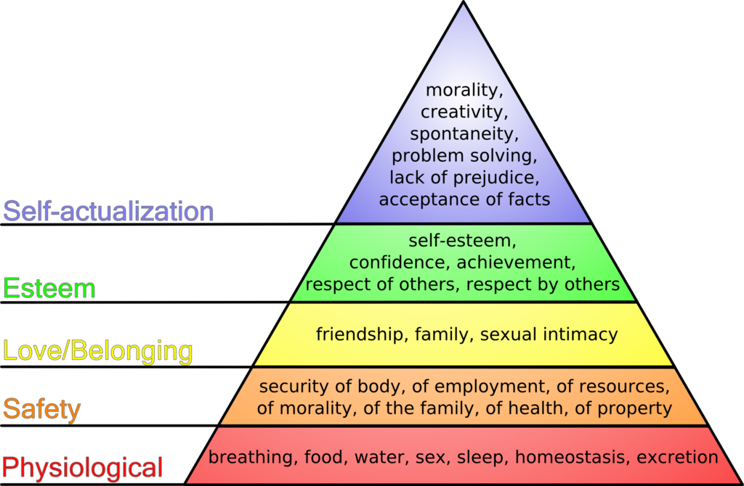
Humanistic psychology

Slide 65
Humanistic psychology
The three “main forces” in 20th century psychology:
psychoanalysis
behaviourism
humanistic psychology

Slide 66
Mental events
Mental events differ from physical events.
They cannot be directly seen or touched
Mental entities or “mental objects” differ from real objects:
They are not separate and self-contained (spatially disjoint)
They do not have a particular shape
We do not interact with them by moving them around or moving their components, as we interact with most objects
Are mental processes different from physical processes?

Slide 67
The cognitive revolution
The 1950s saw the cognitive revolution in psychology
Psychology began to benefit from and link with other sciences.
Anthropology
Linguistics
Computer science
Neuroscience
Artificial intelligence
The reverse engineering approach.
By the 1970s, behaviourism was an obsolete paradigm.
By the 1980s, the cognitive approach was dominant.

Slide 68
The cognitive revolution
Steven Pinker (The Blank Slate, 2002) proposed 5 key ideas of the cognitive revolution:
The mental world can be grounded in the physical world by the concepts of information, computation, and feedback.
The mind cannot be a blank slate because blank slates don't do anything.
An infinite range of behavior can be generated by finite combinatorial programs in the mind.
Universal mental mechanisms can underlie superficial variation across cultures.
The mind is a complex system composed of many interacting parts.

Slide 69
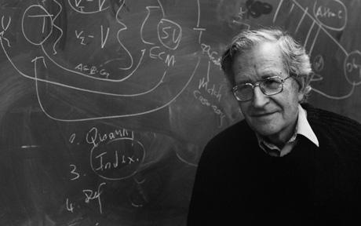
Cognitivism
Noam Chomsky
Noam Chomsky
1928 - present

Slide 70
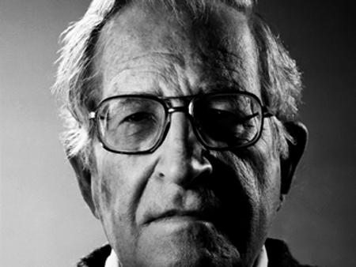
Cognitivism
Noam Chomsky
Noam Chomsky
1928 - present

Slide 71
Cognitivism
Noam Chomsky
Between 1980 and 1992 in arts and humanities, Chomsky was cited more often than any other living scholar.
Linguist, philosopher and cognitive scientist.
Has influenced
artificial intelligence
mathematics
music theory
political science
as well as psychology and cognitive science
Enrolled at the University of Pennsylvania in 1945 aged 16; got his PhD in 1655 aged 26.
Politically anarcho-syndicalist and libertarian socialist.

Slide 72
Cognitivism
Noam Chomsky
Chomsky’s views on language:
Across cultures, children attain competence in widely diverse languages
in very short periods of time
with very little evidence
They accomplish this with a Universal Grammar: a common, innate linguistic apparatus, which only needs to be trained.
Where is the Universal Grammar? Is it in our minds, or in the culture which surrounds us?

Slide 73
Cognitivism
Noam Chomsky
Chomsky’s views on politics:
Unjustified authority is illegitimate.
A modern industrial society should be based on libertarian socialism.
Strong criticism of US foreign policy.

Slide 74
Philosophical Positions in Psychology
Psychology and society
The effect of psychology changes: it becomes less a niche science, the preserve of philosophers, and more an experimental science with medical and ethical applications

Slide 75
Modern psychology
A network of sciences
Fields within psychology:
abnormal psychology
biopsychology
clinical psychology
cognitive psychology
comparative psychology
developmental psychology
educational psychology
experimental psychology
forensic psychology
social psychology
sports psychology
economic psychology
legal psychology
psychotherapy

Slide 76
Modern psychology
A sea of different disciplines, often seen as lacking unification, diverging in different directions.
Concepts cannot be thrown out or done away with as easily as in other sciences, because they are more imaginary and less concrete.
It is thus important to know the history of psychology in order to avoid re-inventing old ideas.

Slide 77
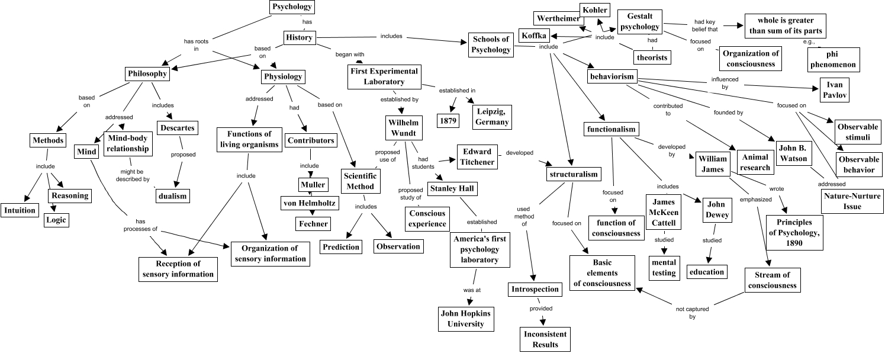
Modern psychology

Slide 78
Philosophical Positions in Psychology
Empiricism
Philosophy
philo-sophia, love of wisdom
Epistemology
How we know what we know
Ontology
The structure of what we do know

Slide 79
Philosophical Positions in Psychology
Introspection
The idea that useful information concerning the function of the mind can be observed or deduced by looking at one’s own thoughts.
What can we introspect?
Causality?
Memory of the past?
Intentions

Slide 80
Philosophical Positions in Psychology
Rationalism
The view that all knowledge can be deduced from observations.
Contrasted with empiricism (experience versus deduction) but not mutually exclusive.
Proponents: Descartes, Leibniz, Spinoza

Slide 81

Philosophical Positions in Psychology
Realism
There exists a conception of the world outside our representations and interpretations, and we perceive this.
Direct (naive) realism): we perceive objects as they really are.
Illusions form a persuasive counter-example.
Indirect realism: we perceive only our representations of the world (similar to dualism).

Slide 82
Philosophical Positions in Psychology
Materialism
Everything, including consciousness, is made of matter.

Slide 83
Philosophical Positions in Psychology
Epiphenomenalism
Consciousness is not really a phenomenon, but rather an epiphenomenon.
Epiphenomenon: something which appears in parallel to another phenomenon, but does not cause it. It may appear, erroneously, to be the cause.

Slide 84
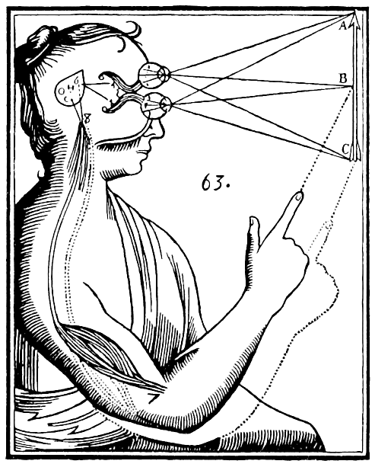
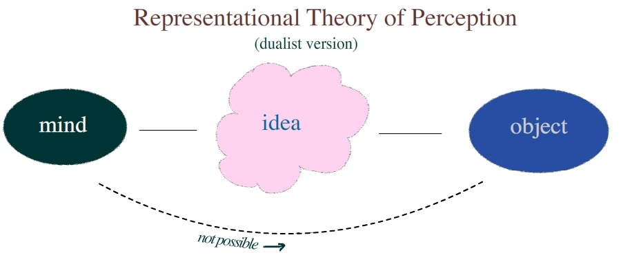
Philosophical Positions in Psychology
Dualism
The mind and the body are not identical.
Closely related to the agency problem, the mind-body problem and the question of consciousness.
Descartes’ view of the visual sense informing the immaterial spirit

Slide 85
Philosophical Positions in Psychology
Animism
Animisi (hyperphenomenalism): material substances are determined by the spirit
The opposite of materialism

Slide 86
Philosophical Positions in Psychology
Spiritualism
Everything is determined spiritually; there is no material world at all.

Slide 87
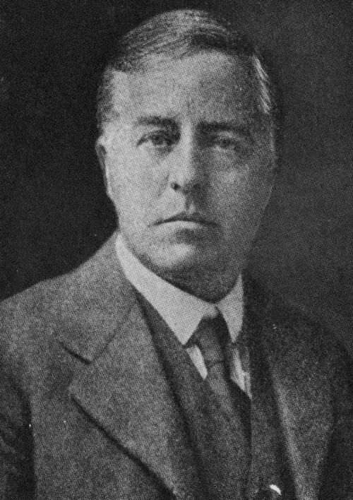
Philosophical Positions in Psychology
Idealism
Reality is fundamentally mentally constructed: it is our representation.
James Jeans (1877-1946):
“The Universe begins to look more like a great thought than a great machine.”
Psychological movements:
Introspection
Subjective consciousness

Slide 88
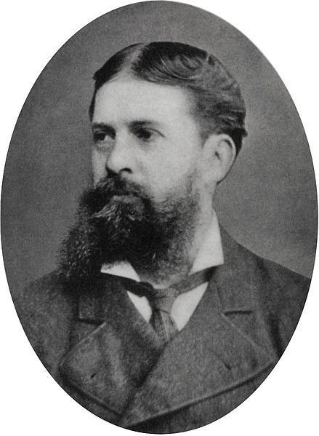
Philosophical Positions in Psychology
Pragmatism
Philosophy and psychology are useful for making predictions and performing useful acts, not deriving a perfect theoretical formula to explain reality (which may be impossible).
A rejection of the idea that the function of thought is to describe, represent, or mirror reality. Instead, pragmatists develop their philosophy around the idea that the function of thought is as an instrument or tool for prediction, action, and problem solving.
Charles Sanders Peirce (1839-1914)

Slide 89
Philosophical Positions in Psychology
Eliminative materialism
The constructs which we use to understand the world (thought, will, knowledge, time, intention) are approximate cognitive approximations.

Slide 90
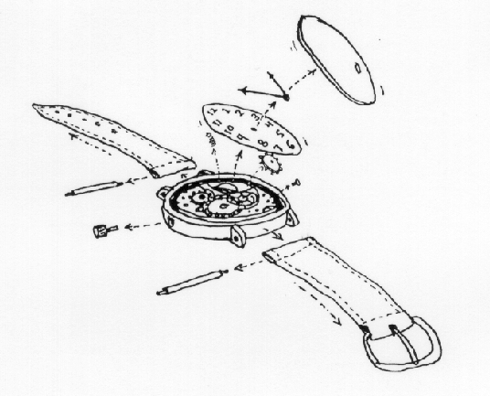
Philosophical Positions in Psychology
Reductionism
A complex system can be understood by dividing it into parts and understanding its parts.

Slide 91
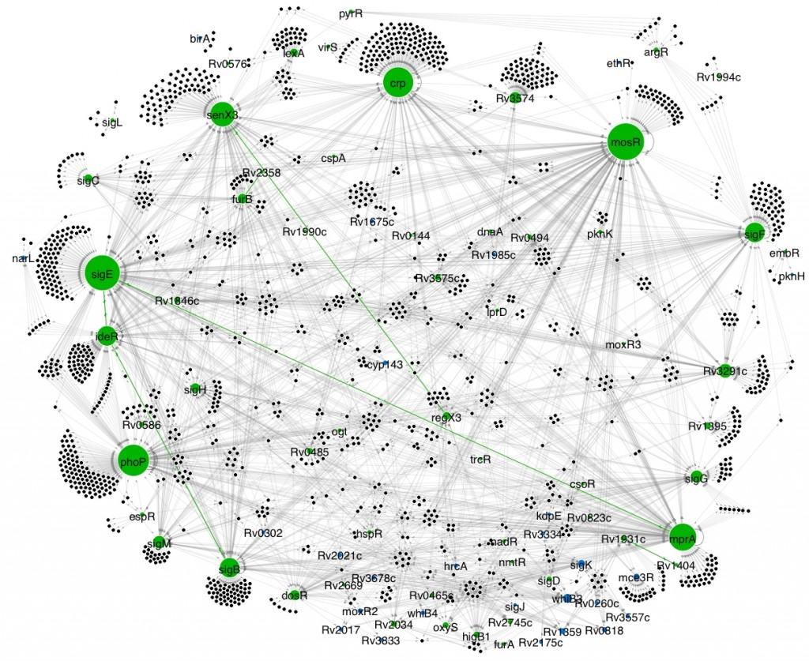
Philosophical Positions in Psychology
Systems thinking
Complexity science, systems biology.
A complex system is more than the sum of its parts; behaviours will appear which we could not predict by understanding the parts independently (emergent properties).

Slide 92
Conclusions
Psychology is still changing.
It is not a static science.
Many “new ideas” have been developed before under a different guise. Check history.
Psychology concerns itself with the development of new primitives, new entities and new theories which a) explain the mind b) permit therapy.

