Slide 1
Lecture 3 Lesion studies

Slide 2

Basic localisation
The most basic method of functional localisation:
just look for it.
Areas in the brain may have an obvious function.

Slide 3
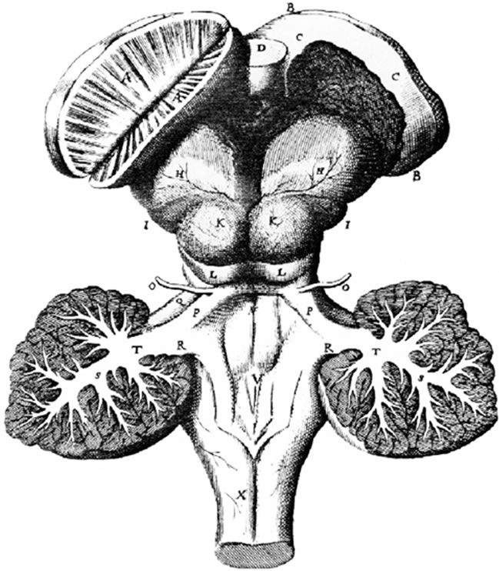
Basic localisation
Thomas Willis:
The corpus striatum looks like it contains many channels allowing the passage of animal spirits which permit motion.
corpus striatum

Slide 4
Basic localisation
“For as often as I have opened the bodies of those who died of a long Palsie, and mose grievious resolution of the Nerves, I have found these bodies less firm than others in the Brain, discoloured like filth or dirt, and many chamferings obliterated.”
“Further, in Whelps newly littered, that want their fight, and hardly perform the other faculties of motion and sense, these streaks or chamferings, being scarcely wholly formed, appear only rude.”
-Thomas Willis, Cerebri anatome, 1664

Slide 5
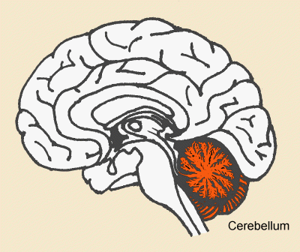
Basic localisation

Slide 6
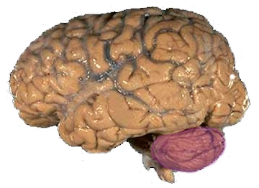
Basic localisation

Slide 7
Basic localisation
Willis observed the cerebellum was common in form to Man and many of the lower animals.
He inferred it must thus fulfil quite a basic function.

Slide 8
Basic localisation
Willis also noted that injuries to the cerebellum affected the heartbeat and breathing. He therefore attributed basic, involuntary functions (the autonomic functions) to it.

Slide 9
Broca
1861: Aubertin observes the case of a dying man who had deliberately shot himself in the head, exposing the brain.
When a particular portion of the exposed cortex was depressed with a spatula,
“During the interrogation the blade of a large spatula was placed on the anterior lobes; by means of light pressure speech was suddenly stopped; a word that had been commenced was cut in two. The faculty of speech reappeared as soon as the compression ceased.”
[Broca]

Slide 10
Broca
Not all were convinced by localisation:
Pierre Gratiolet:
“I do not hestitate to conclude that all attempts at localisation, which up to now have been tried, lack any foundation. They are no doubt great efforts, titanic efforts! But when one attempts to grasp the truth at the height of these bables, the edifice crumbles.”

Slide 11
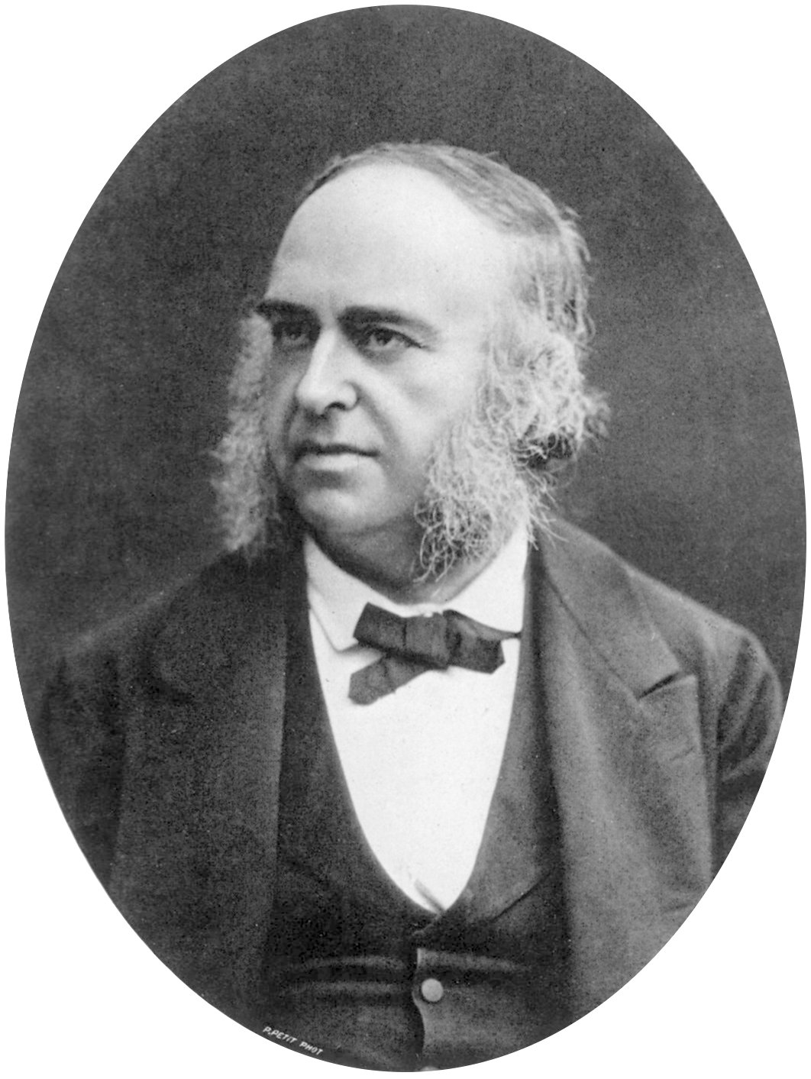
Broca
Originally a physician: discovered that cancer cells can spread through the blood.
Paul Broca
1824 - 1880

Slide 12
Paul Broca
1861: patient (Mr Leborgne) who could only produce one syllable: “tan”
A turning point in the history of neuroscience.

Slide 13
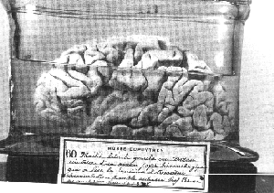
Paul Broca

Slide 14
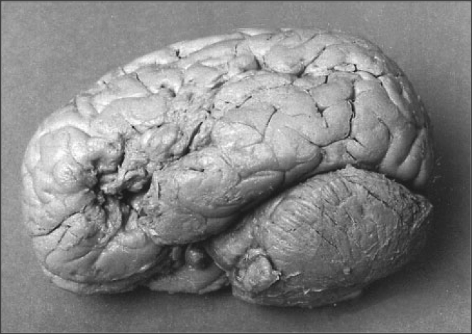
Paul Broca

Slide 15
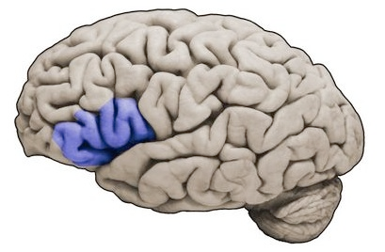
Broca’s area

Slide 16
Broca’s area
Broca’s area is usually located in the left hemisphere, although occasionally in the right.
This observation prompted theories of cerebral lateralisation.

Slide 17
Broca’s aphasia
Broca’s aphasia or expressive aphasia:
Slow, laborious, non-fluent speech
Often limited to short utterances
aphasia: impairment of speech or language
a + phasis (Greek, “speech”)
Speech understanding and reading relatively intact
Limited writing

Slide 18
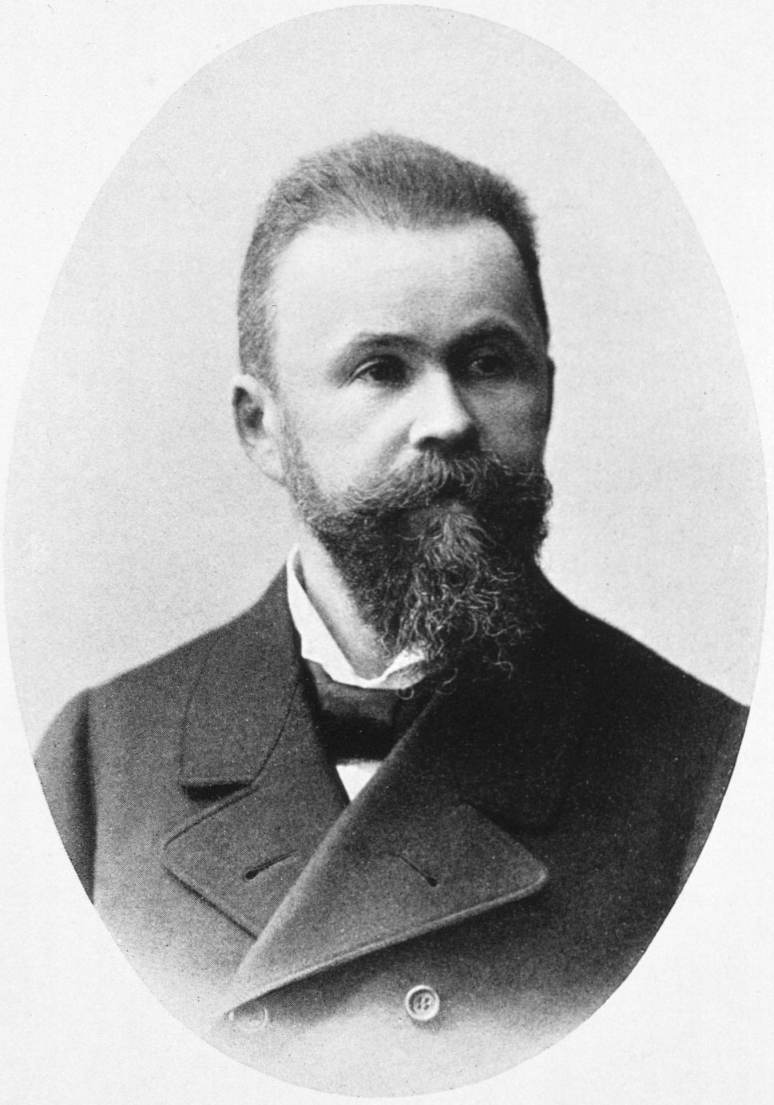
Wernicke
Carl Wernicke
1848 - 1905

Slide 19
Wernicke’s aphasia
Wernicke’s aphasia or receptive aphasia:
the ability to form sentences with proper grammar, intonation and phraseology (syntax)
but with completely random meaning (semantics)
Logorrhea
Impaired understanding of speech, impaired reading

Slide 20
Broca’s aphasia
Broca’s aphasia (non-fluent aphasia):
Ah ... Monday ... ah Dad and Paul [patient’s name] ... and Dad ... hospital. Two ... ah doctors ..., and ah ... thirty minutes ... and yes ... ah ... hospital. And, er Wednesday ... nine o’clock. And er Thursday, ten o’clock ... doctors. Two doctors ... and ah ... teeth. Yeah, ..., fine.
(Goodglass, 1976)

Slide 21
Wernicke’s aphasia
Wernicke’s aphasia (fluent aphasia):
Examiner: What kind of work did you do before you came into the hospital?
Patient: Never, now mista oyge I wanna tell you this happened when happened when he rent. His - his kell come down here and is - he got ren something. It happened. In thesse ropiers were with him for hi - is friend - like was. And it just happened so I don’t know, he did not bring around anything. And he did not pay it. And he roden all o these arranjen from the pedis on from iss pescid.
(Kertesz, 1981)

Slide 22
Wernicke’s aphasia
Wernicke’s aphasia (fluent aphasia):
Examiner: What kind of work did you do before you came into the hospital?
Patient: Never, now mista oyge I wanna tell you this happened when happened when he rent. His - his kell come down here and is - he got ren something. It happened. In thesse ropiers were with him for hi - is friend - like was. And it just happened so I don’t know, he did not bring around anything. And he did not pay it. And he roden all o these arranjen from the pedis on from iss pescid.
(Kertesz, 1981)

Slide 23
Wernicke-Lichtheim model
Wernicke-Lichtheim model:
“When we want to speak, we formulate what we are going to say in Wernicke’s area, which then transmits our plan of speech to Broca’s area, where the plan of speech is carried out.”
[ex-Wikipedia]

Slide 24
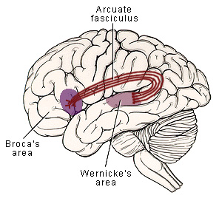
Arcuate fasciculus

Slide 25
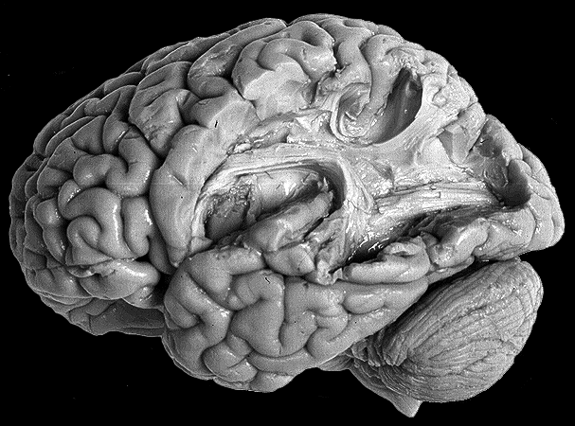
Arcuate fasciculus

Slide 26
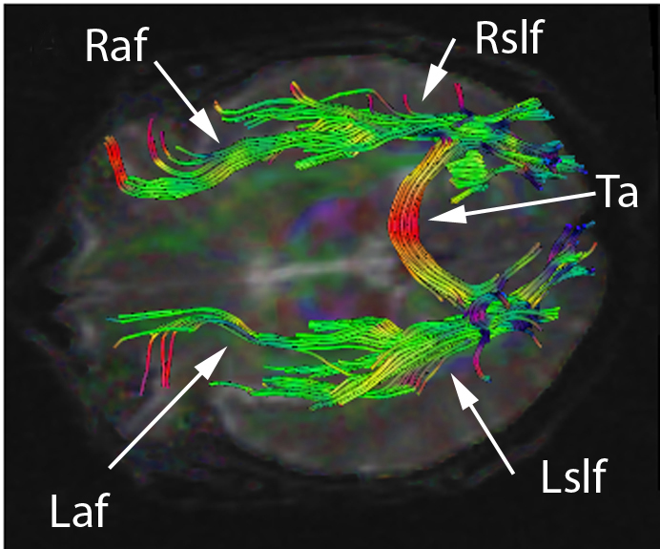
Arcuate fasciculus

Slide 27
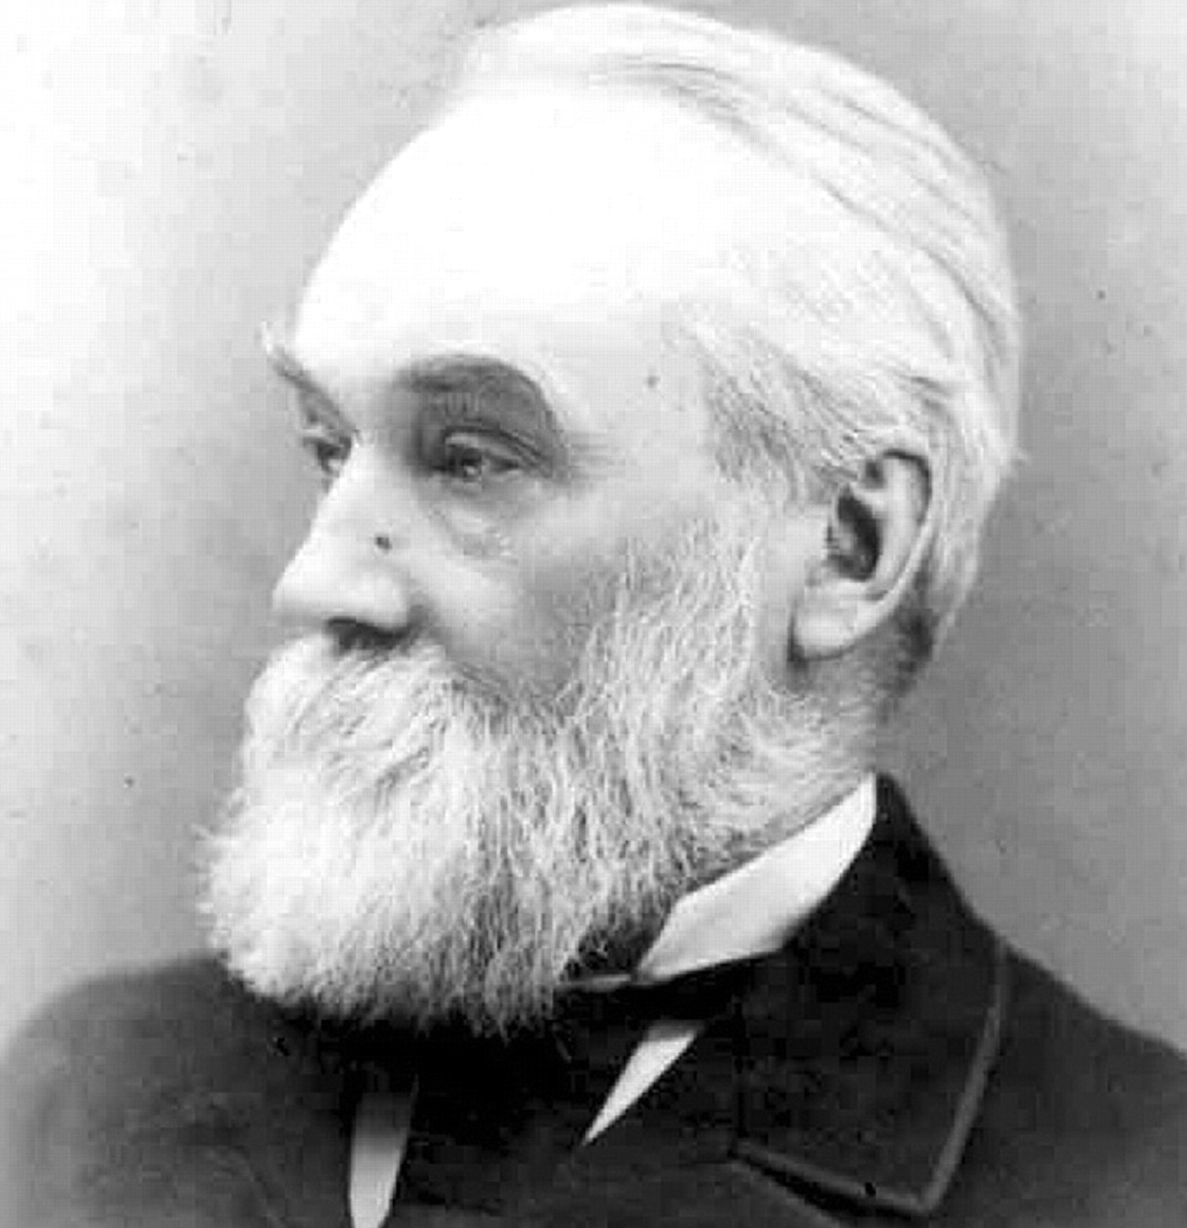
Basic localisation
John Hughlings Jackson
1835 - 1911

Slide 28
Left and right hemispheres
Jackson observed a patient who had lost her ability to navigate, even in simple and familiar locations.
Autopsy revealed her to have a large tumour in the posterior part of her right temporal lobe.

Slide 29
Left and right hemispheres
1875: the theme of “dual minds” can be seen in society (Jekyll and Hyde).
We see the beginnings of scientific legitimisation of fiction about the mind and brain.

Slide 30
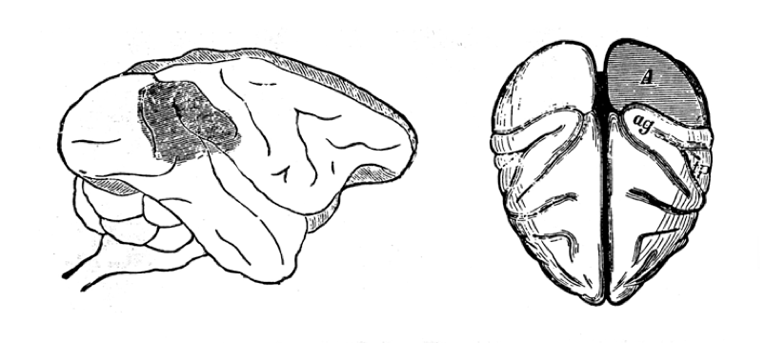
Where is the visual cortex?
Parietal lobe Occipital lobe

Slide 31
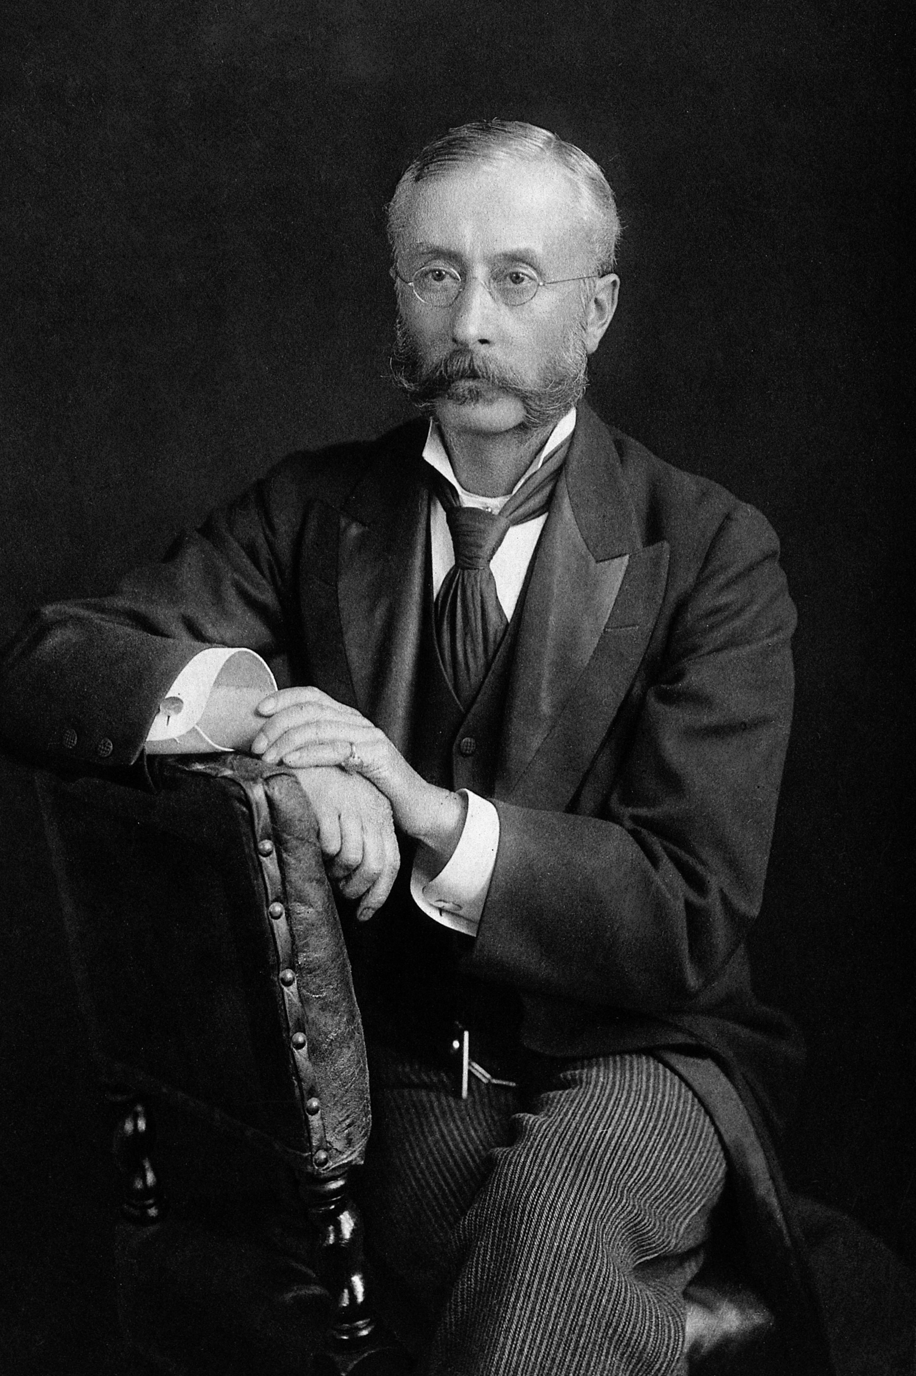
Where is the visual cortex?
David Ferrier
1843 - 1928

Slide 32
Where is the visual cortex?
Ferrier believed visual cortex occupied the parietal lobe.

Slide 33
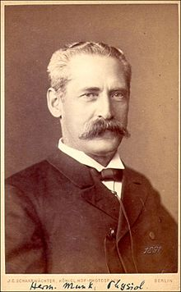
Where is the visual cortex?
Hermann Munk
1839 - 1912

Slide 34
Where is the visual cortex?
Munk thought visual cortex was to be found in the occipital lobe.
He observed hemianopsia in monkeys.

Slide 35
Where is the visual cortex?
Hemianopsia: anopsia (blindness, an-opsia) in half of the visual field of each eye.

Slide 36
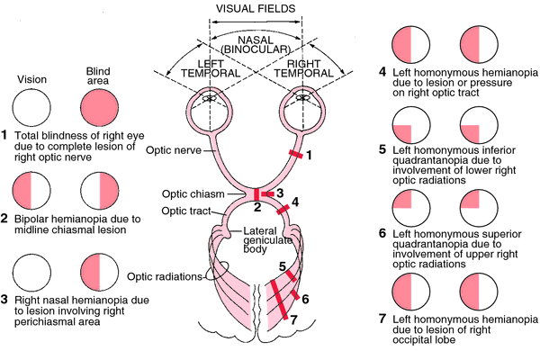
Where is the visual cortex?

Slide 37
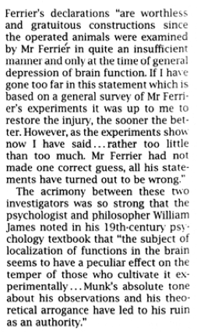
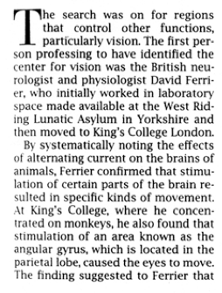
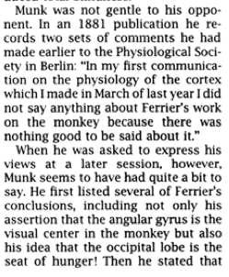
Where is the visual cortex?

Slide 38
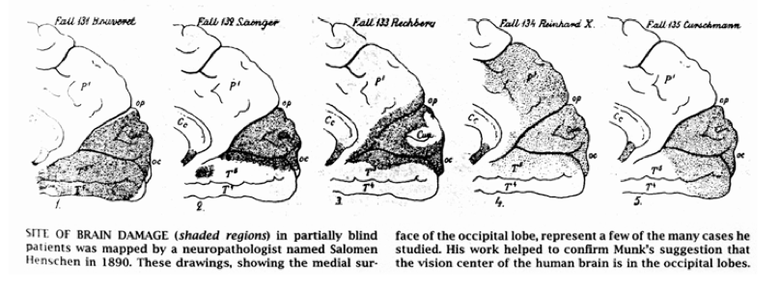
Where is the visual cortex?
[Glickstein, The discovery of visual cortex]

Slide 39
Where is the visual cortex?
Tatsuji Inouye
1880-1976

Slide 40
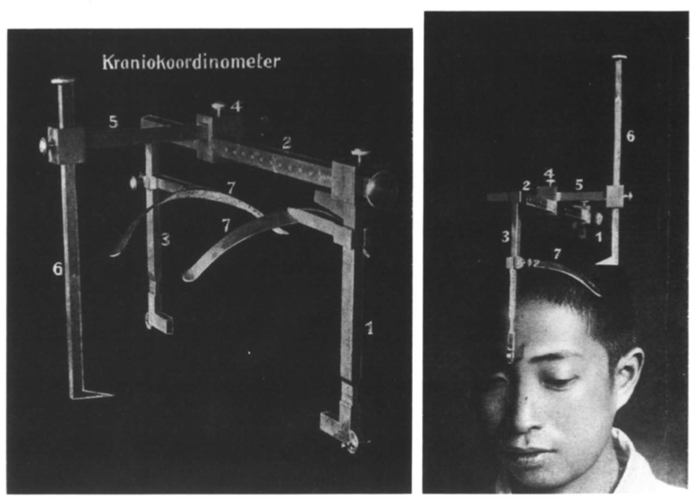
Where is the visual cortex?
[Glickstein, The discovery of visual cortex]
Inouye’s cranio-coordinometer

Slide 41
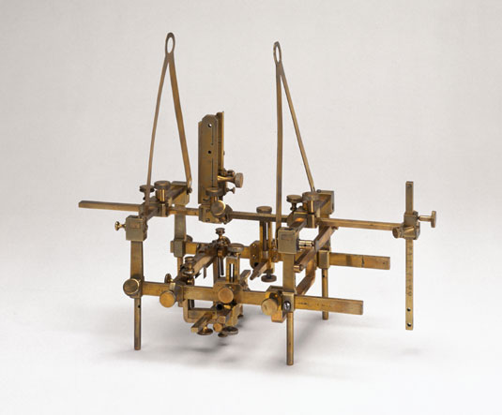
Where is the visual cortex?
Horsley-Clarke stereotaxic instrument

Slide 42
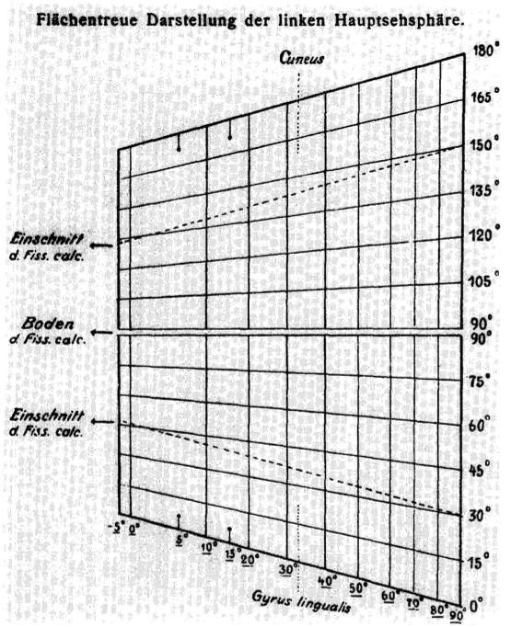
Where is the visual cortex?
Tatsuji Inouye
1880-1976

Slide 43
Where is the visual cortex?
This is one of the first instances of a visual field map.
A map is an area of the brain where changing the location you probe changes some property of the environment.
Visual field map:
Retinotopic space (up/down, left/right) is represented as a map on the cortical surface. Moving a probe on the cortical surface allows us to record information coming from different areas of the retina.
Auditory map: a property of the audio environment is mapped onto the cortex.
Tonotopic map: frequency is mapped.

Slide 44
Where is the visual cortex?
Maps use a different assumption to perform localisation:
If it’s easy to measure information from a certain part of the environment, from a certain part of cortex, and the two change together, then this area of cortex constitutes a map.

Slide 45
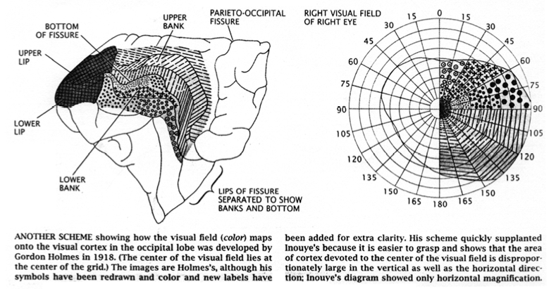
Where is the visual cortex?

Slide 46
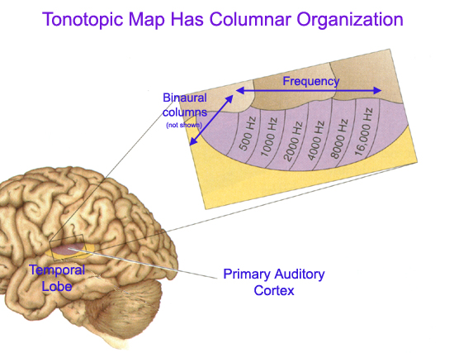
Where is the visual cortex?

Slide 47
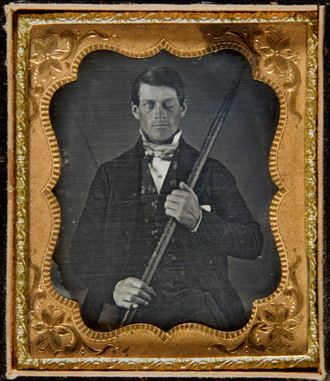
Phineas Gage

Slide 48
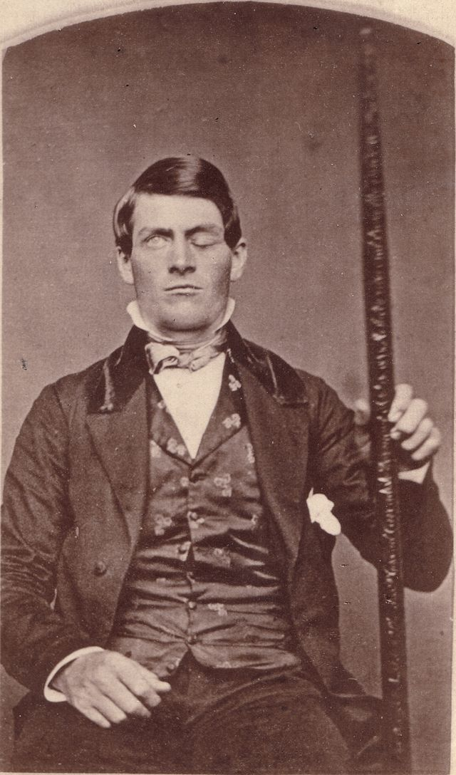
Phineas Gage

Slide 49
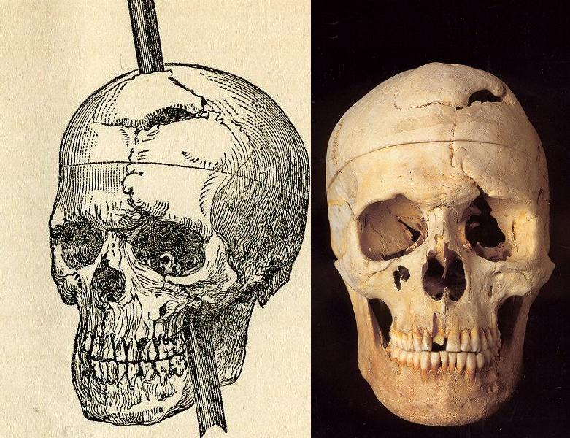
Phineas Gage

Slide 50
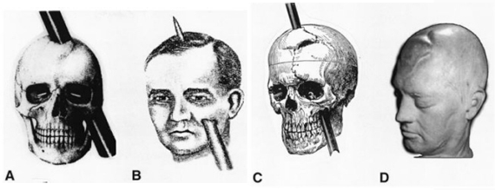
Phineas Gage

Slide 51
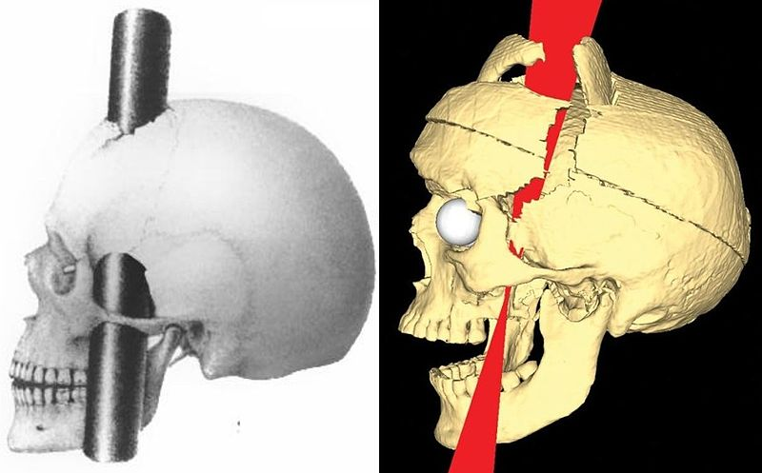
Phineas Gage

Slide 52
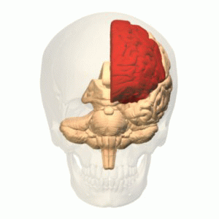

Phineas Gage

Slide 53
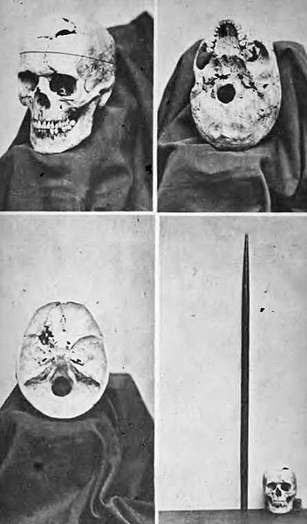
Phineas Gage

Slide 54
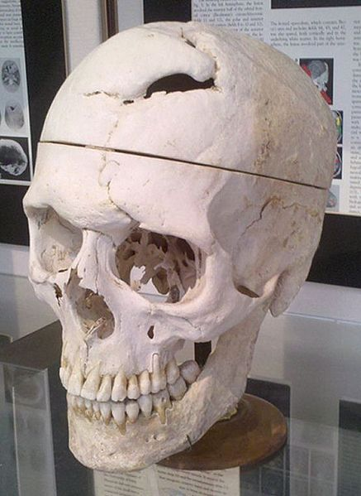
Phineas Gage

Slide 55
An overview of localisation
Localisation methods:
lesion observation
active lesioning
visual identification of structures
histology
fMRI
MEG
DTI
EEG
electromagnetic impairment

Slide 56
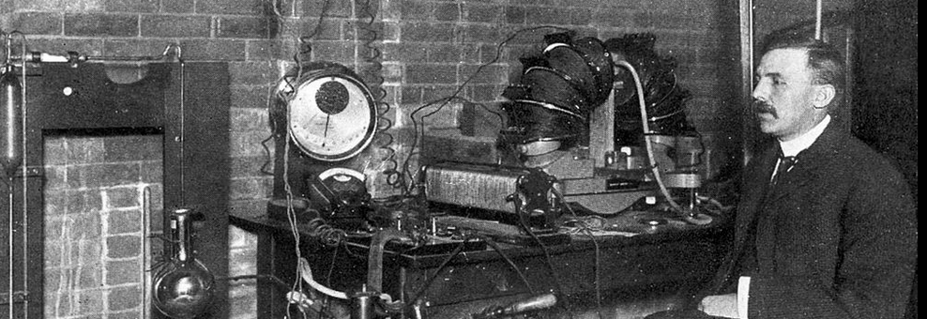
How important is localisation?
“All science is either physics or stamp collecting.”
-Rutherford

Slide 57
How important is localisation?
It is plausible to imagine a brain which performs the same functions as ours, but whose architecture is completely different.
Is localisation really vital, or is it just stamp collecting?

Slide 58
The principle of lesioning
If a patient without area A can’t perform function X,
function X must depend on area A.

Slide 59
The principle of lesioning
If patients without area A can’t perform function X,
function X must depend on area A.

Slide 60
The principle of lesioning
If a patient without area A can’t perform function X,
function X must be localised to area A.

Slide 61
The principle of lesioning
If patients without area A can’t perform function X,
function X must be localised to area A.

