Slide 1
Lecture 8
Life as a psychologist

Slide 2

Social psychology
Research
Professonal psychological practice

Slide 3
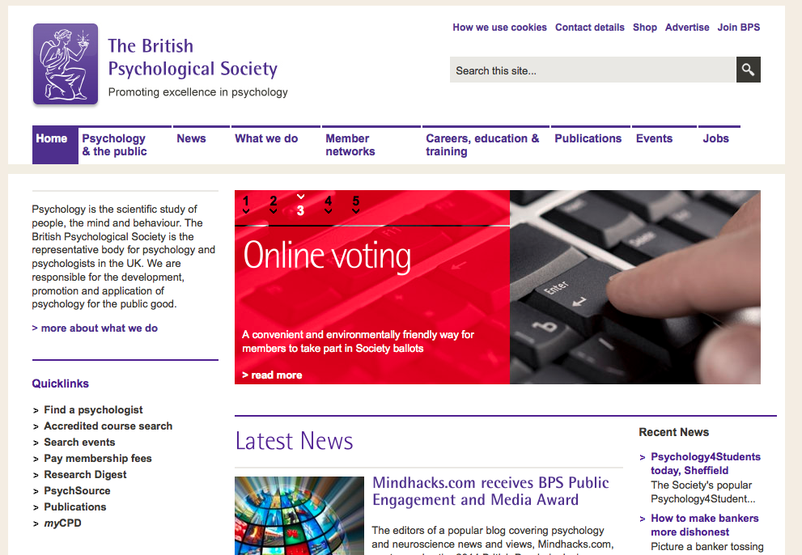
Training

Slide 4

Training
British Psychological Society (BPS)
Founded 1901 at University College London
C. 50,000 members in 2012
Keeps the Register of Chartered Psychologists
Letters: C.Psychol.
Fellow: FBPsS
Monthly magazine: The Psychologist
Publishes 11 journals

Slide 5
Clinical psychology
Training
British Psychological Society accredited psychology degree
or BPS qualifying examination
or accredited postgraduate qualification
or accredited conversion course
Work experience: volunteering or assisting
3 years postgraduate study:
Doctorate in Clinical Psychology
6:1 applicant to place ratio
fully funded by NHS
applicant mean age 26
Eligible for Health & Care Professions Council (HCPC) register, which enables you to practice as a clinical psychologist (protected title)

Slide 6
Clinical psychology
Counselling
Course accredited by the British Association for Counselling and Psychotherapy (BACP)
No degree/HND required
100 hours supervised counselling practice

Slide 7
Clinical psychology
Psychotherapy
Individual client meetings (30 mins to one hour)
Group sessions
Therapies:
cognitive behavioural therapy
psychoanalysis/psychodynamics
humanistic/integrative psychotherapies
hypno-psychotherapy
Training:
Relevant degree
Masters in psychotherapy
Qualification accredited by the UK Council for Psychotherapy (UKCP)
various types
Courses are oversubscribed

Slide 8
Clinical psychology
Neuropsychology
Psychological assessment and therapy of patients with neurological injuries (traumatic brain injury, brain cancer...)
Training:
Doctorate in psychology or neuropsychology
Clinical work experience (clinical portfolio)
Clinical supervisor
BPS Qualification in Clinical Neuropsychology (QiCN)

Slide 9
Practicing psychology
Child psychotherapy
Training:
Honours degree
Considerable experience working with children
Course accredited by the Association of Child Psychotherapists (ACP)
Around six years
Pre-clinical training (2yrs): infant observation
Doctoral-level clinical training scheme (4yrs) in NHS Child and Adolescent Mental Health Services (CAMHS)

Slide 10
Clinical psychology
Forensic psychology
Assessment and treatment of criminal behaviour, mainly within HM Prison Service
BPS-accredited psychology degree or conversion course
BPS-accredted Masters in forensic psychology
BPS Qualification in Forensic Psychology
Two years of supervised practice
Often completed while working as a trainee forensic psychologist
Fierce competition, work experience required
bail hostels (Approved Premises)
drug/alcohol treatment centres
secure hospitals/rehabilitation units
youth offending services
Employers:
HM Prison Service
NHS
police
social services

Slide 11
Practicing psychology
Educational psychology
Training:
BPS-accredited undergrad or conversion
BPS-accredited Doctorate in educational psychology
Work experience required
Teaching experience allows exemption from part of the doctorate
Funding available if you undertake to work for an LEA after graduation
Registration with HCPC (Health and Care Professions Council)

Slide 12
Practicing psychology
Occupational psychology
BPS areas:
Human-machine interaction
Design of work environments
Personnel selection and assessment
Performance appraisal and career development
Counselling and personal development
Training
Employee relations and motivation
Organisational development and change
Training:
BPS-accredited psychology undergrad or conversion course
BPS-accredited Masters in Occupational Psychology
BPS Doctorate in Occupational Psychology (QOccPsych)
Employers:
Industry
Civil Service

Slide 13
Practicing psychology
Continuing development
All practising psychologists must ensure continued professional development by keeping abreast of the field.
Attending conferences, reading clinical and theoretical journal articles.

Slide 14
Research in psychology
Fields
Brain science:
Psychology
Cognitive science
Neuroscience

Slide 15
Research in psychology
Career routes
Psychology undergraduate (not essential)
Masters course
PhD course
Postdoctoral researcher
or
fellowship
Reader or Lecturer
Senior Lecturer
Assistant Professor
Professor
Tenured Professor (mainly United States)
Along the way:
Research assistant

Slide 16
Research in psychology
Activities
Reading papers
Formulating theories
Performing experiments
Analysing data
Interpreting results
Writing papers
Presenting at conferences
Teaching
Outreach and public engagement
Writing grants
Networking
Much of this applies to other academic fields too...

Slide 17
Research in psychology
Masters degree
1 year (2 part-time)
Generally 6 months tuition, 6 months research dissertation

Slide 18
Research in psychology
PhD degree
3 years (6 part-time)
philosophiae doctor (Latin)
After 1 year: upgrade dissertation (5-10k words)
After 3 years: PhD dissertation (30k-100k words)
Publication of papers is helpful in the current climate, but not required.

Slide 19
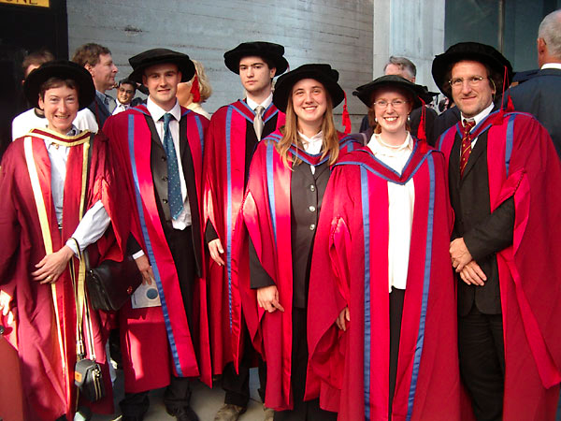
Research in psychology
PhD degree

Slide 20

Research in psychology
Reading papers

Slide 21

Research in psychology
Reading papers

Slide 22

Research in psychology
Reading papers

Slide 23

Research in psychology
Reading papers

Slide 24

Research in psychology
Reading papers

Slide 25
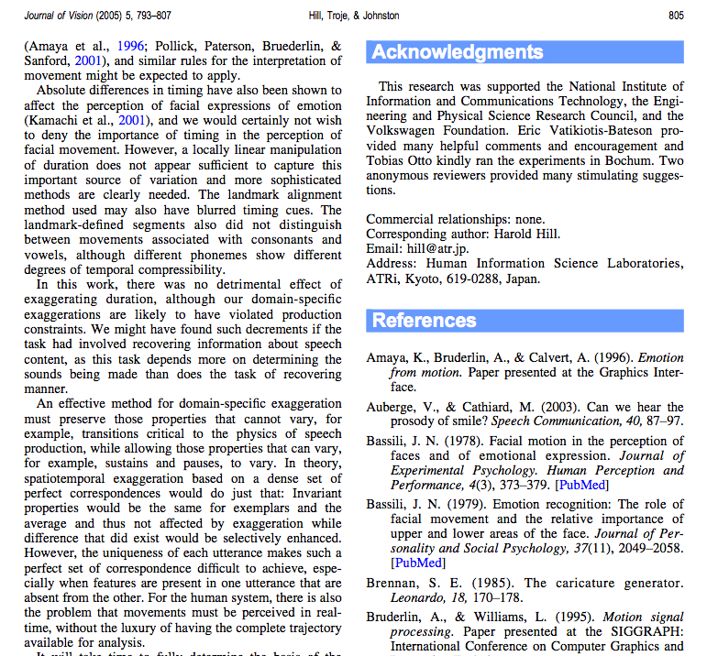
Research in psychology
Reading papers

Slide 26
Research in psychology
Finding papers
Many papers are behind a paywall; hopefully your institution has a subscription. Life is much more difficult if you do not belong to a large institution.
Google Scholar
Web of Science

Slide 27
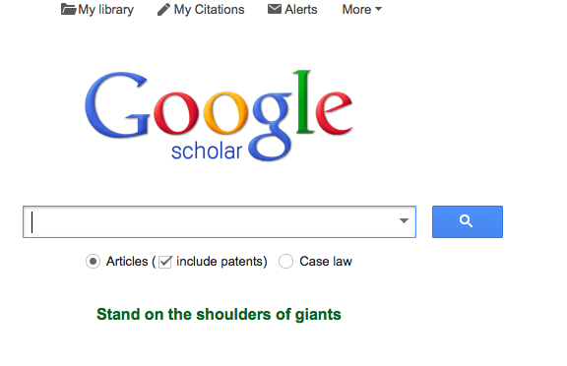
Research in psychology
Finding papers

Slide 28
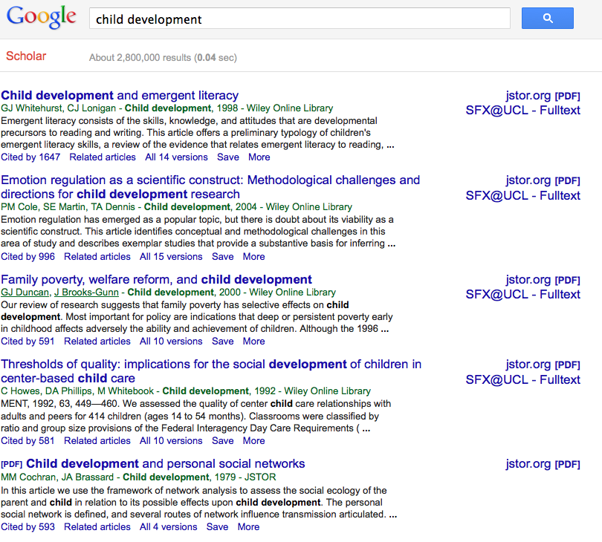
Research in psychology
Finding papers

Slide 29
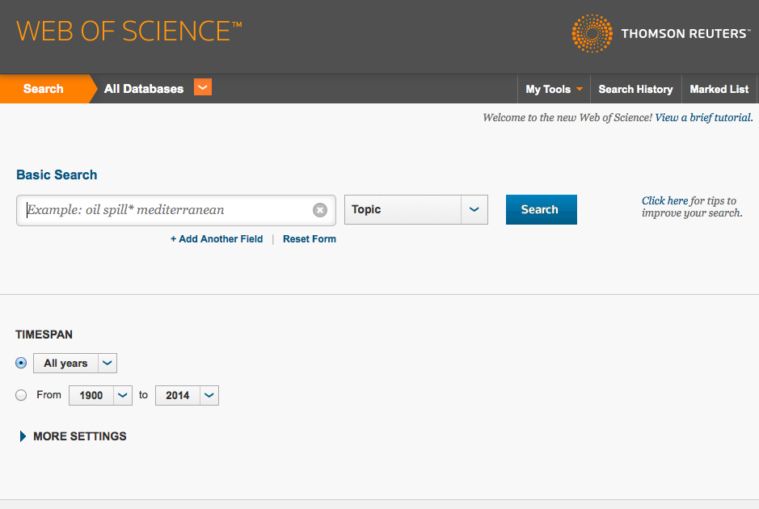
Research in psychology
Finding papers

Slide 30
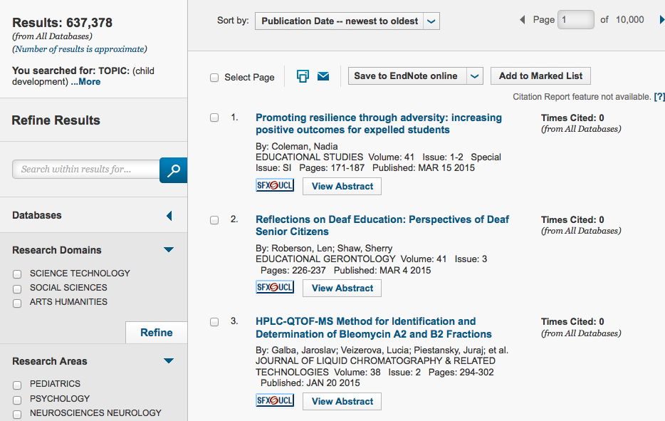
Research in psychology
Finding papers

Slide 31
Research in psychology
Finding papers
Follow the links in a bibliography!
Breadth-first or depth-first search
To print out or not to print out?

Slide 32
Research in psychology
Holding on to papers
Save the PDFs!
Having to sign in or perform several clicks to access a PDF will make you much less likely to read it again. Keep them within easy reach.
Save your references in a library:
Spreadsheet
Mendeley
Papers
Zotero
EndNote
And save your notes on papers somewhere.

Slide 33
Research in psychology
Writing papers
Similar to writing an essay.
Audience: informed academics
depends on specific journal
Structure:
Zoom, motivation, research questions
Methods
Results
Discussion
Hopefully answers the research question, or clarifies it slightly

Slide 34
Research in psychology
Writing papers
Once submitted for publication, peer review takes several months.
Outcomes:
reject
accept with modifications
recommend modifications and send for re-review
Some journals allow rebuttals.
Once accepted, there is usually an embargo on publication until the journal is released.
The same article must not be submitted for publication in separate journals-
though quite similar articles can.

Slide 35

Research in psychology
The publication industry
One of the earliest journals:
Philosophical Transactions of the Royal Society, established 1665
The idea that science requires transparency and communication was not yet mature!
Newton, Leibniz and others would often announce discoveries as anagrams, proving their precedence.

Slide 36
Research in psychology
The publication industry
Many high-quality journals used to be published by non-profit academic groups. In the 1970s, commercial publishers began an acquisition programme.
Demand for journals is relatively inelastic, so prices could be raised virtually arbitratily.
1986-2005:
consumption increased by 1.9% per year on average
expenditure increased by 7.6% per year on average!
What are they charging for?
typesetting
organising the peer review process
selecting good papers
Combined with university budget cuts, this creates the serials crisis.

Slide 37
Research in psychology
Publication reform
Peer review
good papers are often rejected
anonymity is often transparent
in-fighting, grudges and nepotism persist
confirmation bias

Slide 38
Research in psychology
The open-access movement
Charging for publication, but nor for access.
Since April 2013, all research funded by UK research councils (including psychology) must be fully open access.

Slide 39

Research in psychology
The open-access movement

Slide 40

Research in psychology
The open-access movement

Slide 41
Research in psychology
The file-drawer problem
Ted Sterling, 1959: 97% of published papers were underpinned by statistically significant effects
Sterling, 1995: the same problem.

Slide 42
Research in psychology
The replication crisis
Ted Sterling, 1959: 97% of published papers were underpinned by statistically significant effects
Sterling, 1995: the same problem.

Slide 43
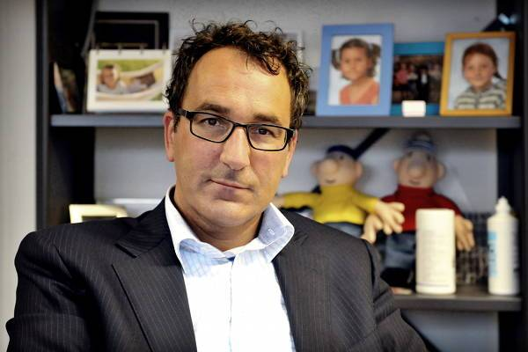
Research in psychology
Falsification of data
Diederik Stapel
1966 - pres

Slide 44
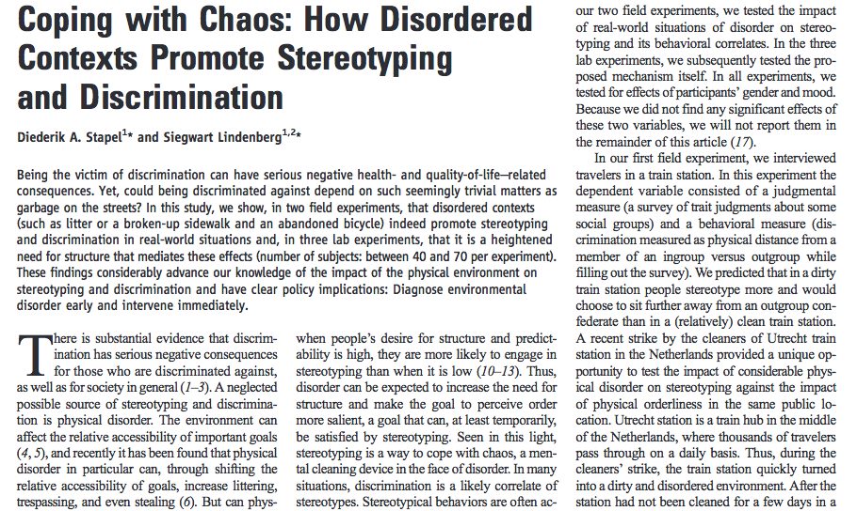
Research in psychology
Falsification of data

Slide 45
Research in psychology
Falsification of data
University of Amsterdam 1993 – 1999 (doctoral qualification 1997)
University of Groningen 2000 – 2006 (professor)
Tilburg University 2006 – 2011
2011: Along with three graduate students, published a paper claiming that thoughts of meat-eating are correlated with anti-social behaviour.
The data looked too perfect.
Stapel supplied it to the students without letting them participate in actual collection. Statistical tests showed that it was falsified; the students went t the Dean of the university.
A committee was set up to investigate the rest of Stapel’s work, finding that the falsification went back years.

Slide 46
Research in psychology
Falsification of data
"I have manipulated study data and fabricated investigations. I realise that via this behaviour I have left my direct colleagues stunned and angry and put my field, social psychology, in a poor light."
"it's important to me to underline that the mistakes I made weren't for selfish reasons.”
-Stapel
His explanation: he loved social psychology, but was frustrated by the messiness of the data! Journals are biased towards good-looking results.
2013: settled with the prosecution. 120 hours of community service, loss of employment benefits equivalent to 1.5 years of salary.
No longer a PhD.

Slide 47
Research in psychology
Falsification of data
We are all Stapel to a certain degree.

Slide 48
Research in psychology
Performing experiments
Ask a general research question
Find hypotheses that test it
Design experiments to test each of the hypotheses
Interpret each of the results
Draw the results together
Discuss
Conclude?

Slide 49
Research in psychology
Performing experiments
Theories
High-level and general i.e. “we recognise the 3D shape of an object before classifying it” vs. “we classify the parts of an object before recognising its 3D shape.”
Hypotheses
“Objects will be recognised faster if they are formed of simple parts”
Experiments
A task in which people recognise objects with varying parts, and their reaction times are measured.

Slide 50
Research in psychology
Performing experiments
Theories
“Autistic children lack a theory of mind” vs. “autistic children are generally impaired.”
Hypotheses
“Autistic children will do worse on the boxes test, but no worse on general intelligence tests.”
Experiments
Performing the actual boxes test and general intelligence tests on children.

Slide 51
Research in psychology
Performing experiments
Theories
“The brain decides to make a decision before we’re aware of it” vs “we are aware of decisions as they are made.”
Hypotheses
“Decisions will show up on EEG before they show up via introspection.”
Experiments
Libet’s clock-face experiment

Slide 52
Research in psychology
Performing experiments
Instantiation
Deriving a hypothesis from a theory, or an experiment from a hypothesis. We have to make things more concrete, more specific, less general.
Generalisation
The reverse operation. Generating a hypothesis from an experiment, or a theory from a hypothesis.
Comparison
Comparing two hypotheses to check how well they match an experiment, or two theories to check how well they match the hypotheses.

Slide 53
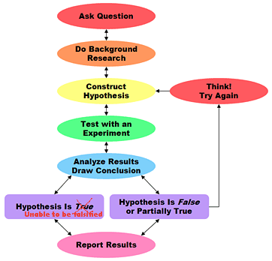
Research in psychology
Performing experiments

Slide 54
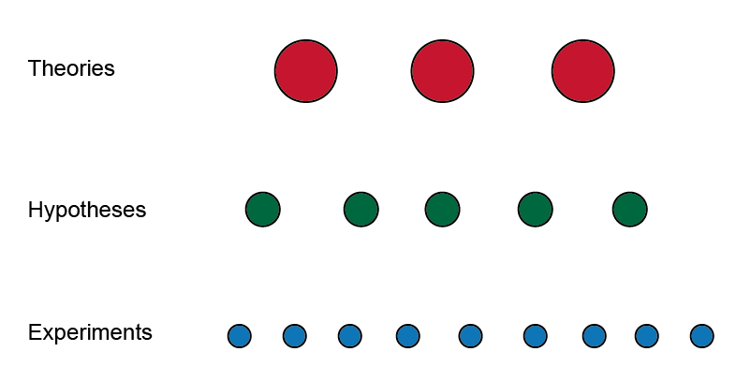
Research in psychology
Performing experiments

Slide 55
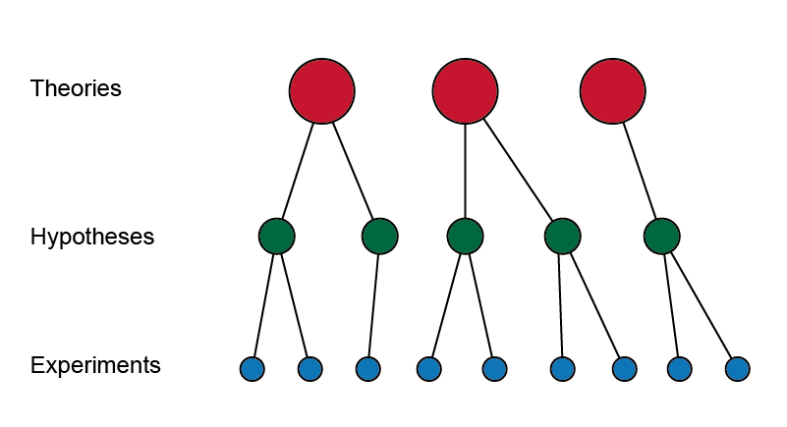
Research in psychology
Performing experiments

Slide 56
Research in psychology
Experimental design
Independent variables:
the parts of the experiment we select, choose, or decide.
Dependent variables:
the parts of the experiment we have no control over, but which we can measure.

Slide 57
Research in psychology
Experimental design
The key concept in experimental design is the factor.
A factor is a choice we make when setting up the conditions for a part of the experiment.
We look at the effect setting the factor has on the results.
Examples:
Whether the child is autistic or not
Race
Background
Treatment
Type of music played
Within a particular factor, each choice is called a level.

Slide 58
Research in psychology
Experimental design
Getting the result
The dependent variable (what we measure to judge our experiment) is the metric or measure.
One experiment may give several metrics:
reaction time
accuracy
skin conductance
time spent looking
ratings of affect
verbal reports
EEG data
fMRI data

Slide 59
Research in psychology
Experimental design
One-factor experiments
Do warm-coloured rooms make people more or less altruistic?
Factor: colour of room
Levels: 10 colours from white to red
What is the smallest noticeable intensity of a flash of light?
Factor: light level
Levels: continuous
Will children eat more M&Ms if the mug is labelled negatively?
Factor: mug labelling
Levels: positive, negative

Slide 60
Research in psychology
Experimental design
Two-factor experiments
How long do we need to see a face for in order to recognise it? Does orientation affect this:
Factor 1: display duration (10 levels from 0.1 s to 1 s)
Factor 2: inversion (levels: upright, inverted)
Does alcohol affect mutual gaze duration? Is there a gender difference?
Factor 1: gender of conversation partner (levels: M,F)
Factor 2: alcohol dosage (5 levels from 10 to 100 ml)
Is there an interaction between age and gender in speeding?
Factor 1: age
Factor 2: gender

Slide 61
Research in psychology
Experimental design
Two-factor experiments
A condition is a choice of both factors (i.e. male gender and age 40-50).
Once we know what condition we are in, we have all the information necessary to perform some trials.

Slide 62
Research in psychology
Experimental design
Trials
Easily repeatable, short parts of the experiment. One trial produces one data point.
Trials are often split into blocks of equal length, to break up the experiment.

Slide 63
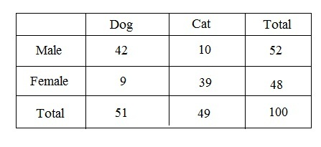
Research in psychology
Experimental design
Contingency tables

Slide 64
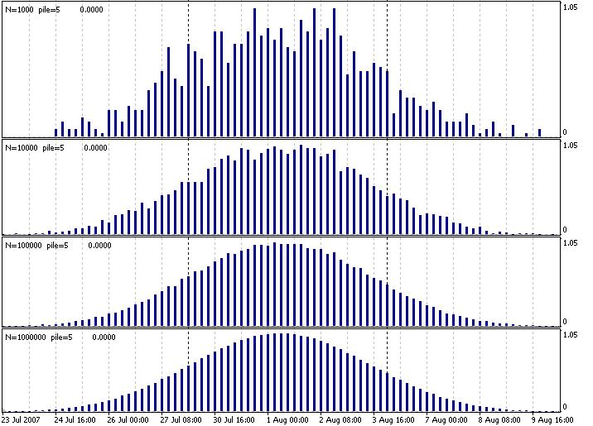
Research in psychology
Statistical analysis

Slide 65
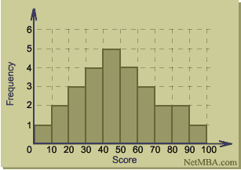
Research in psychology
Statistical analysis

Slide 66
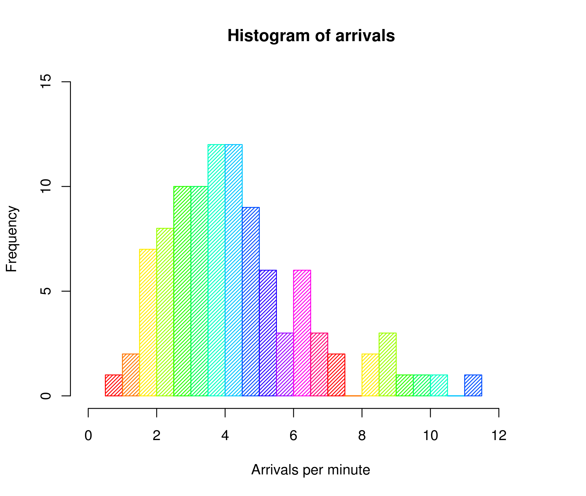
Research in psychology
Statistical analysis

Slide 67
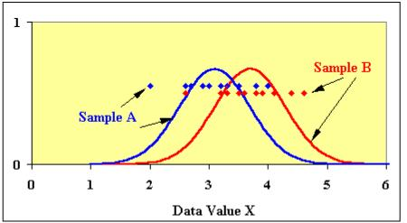
Research in psychology
Statistical analysis

Slide 68
Research in psychology
Statistical analysis
Student’s t-test

Slide 69
Research in psychology
Statistical analysis
listA, listB → t-test → p-value
p-value: the probability that the distributions have different means
In other words, the probability that we can reject the null hypothesis.

Slide 70
Research in psychology
Statistical analysis
ANOVA
ANalysis Of VAriance

Slide 71
Research in psychology
Statistical analysis
listFactor1, listFactor2, listFactor3
→ ANOVA
→ list of p-values and interactions
p-values: the probability that each factor has an effect
interactions: the probability that two factors are dependent

Slide 72

Research in psychology
Conferences

Slide 73
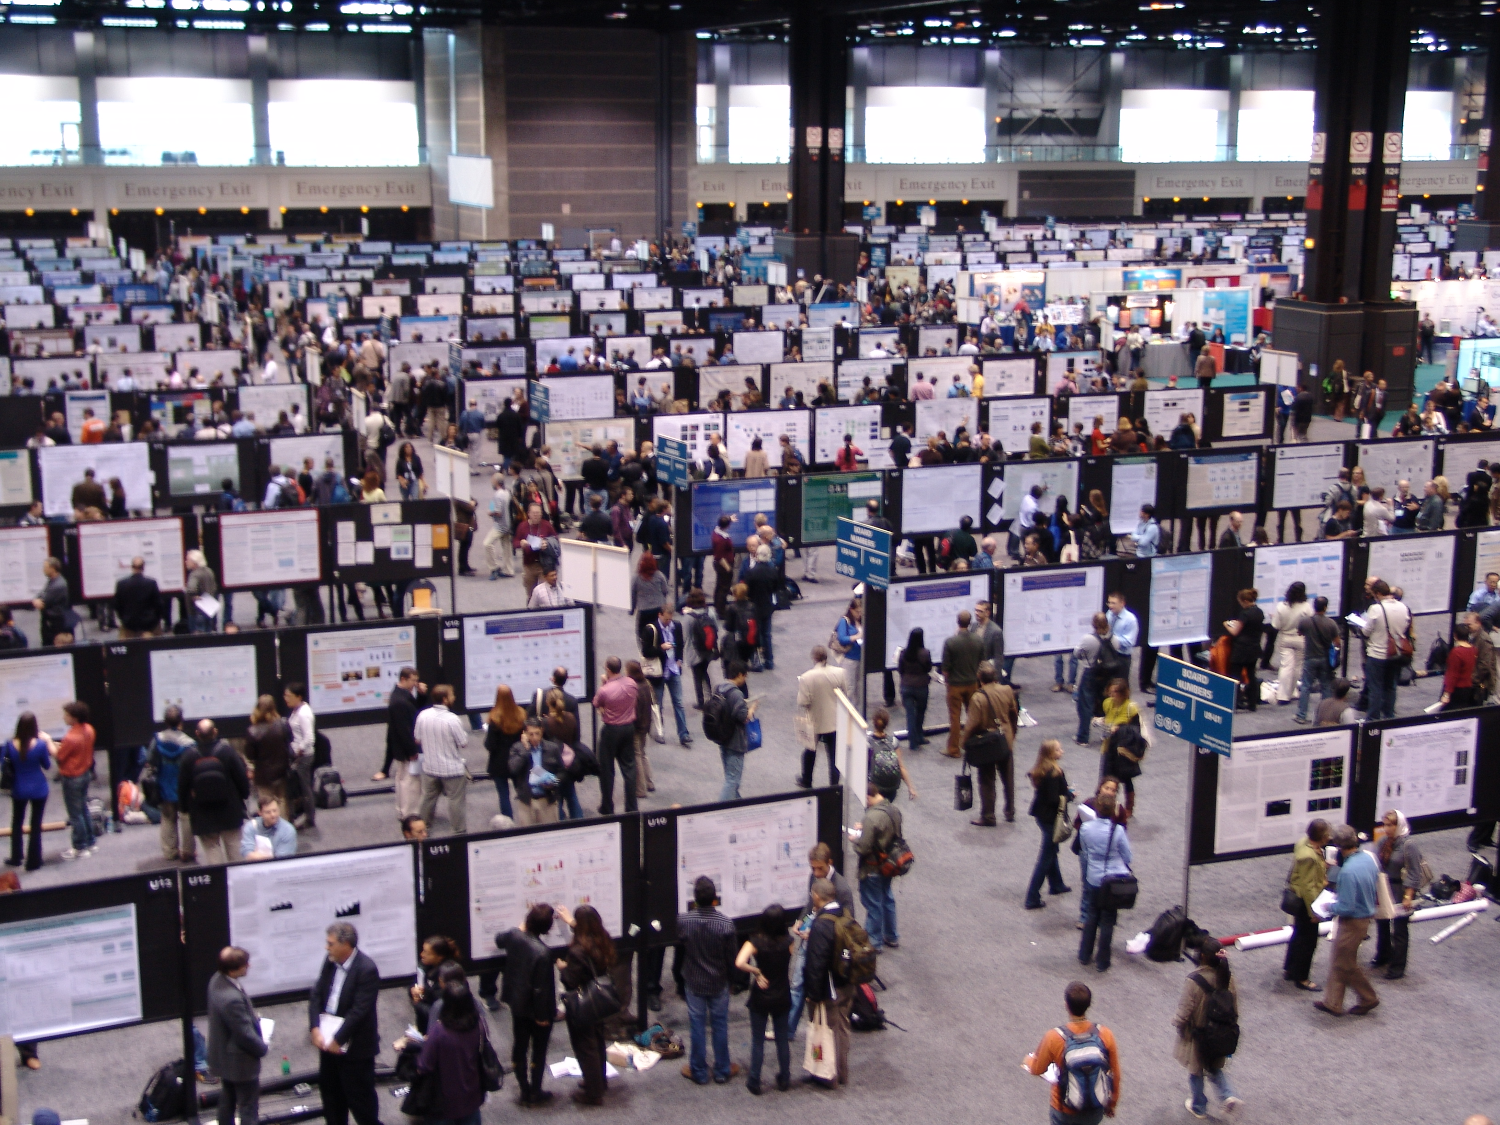
Research in psychology
Conferences

Slide 74

Research in psychology
Conferences

Slide 75
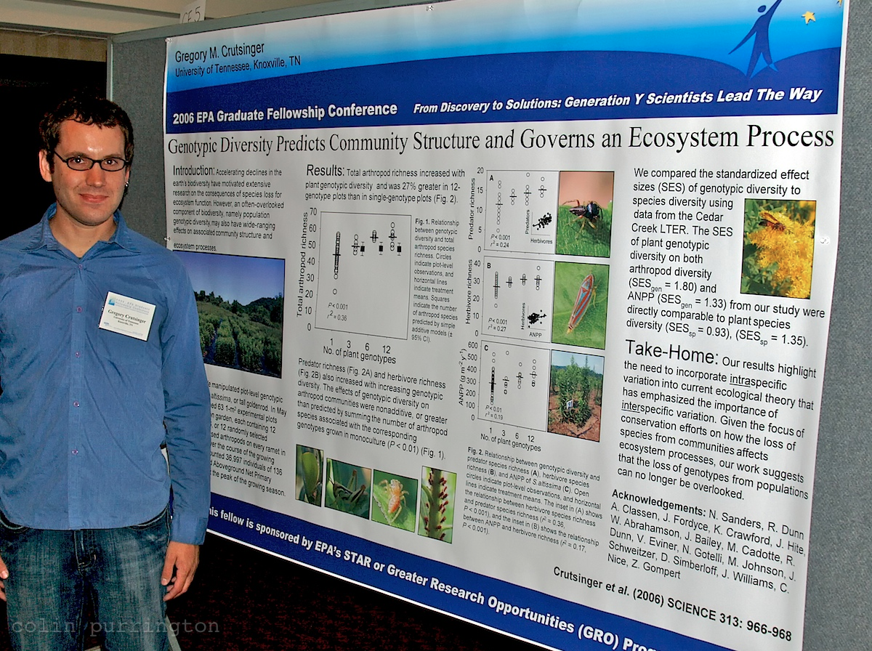
Research in psychology
Conferences

Slide 76
Research in psychology
Writing grants
Science budget: 5.8 billion (2015-2016)
Gross domestic product: 2.52 trillion
Budget expenditure: 750 billion
Military budget: 40 billion

Slide 77
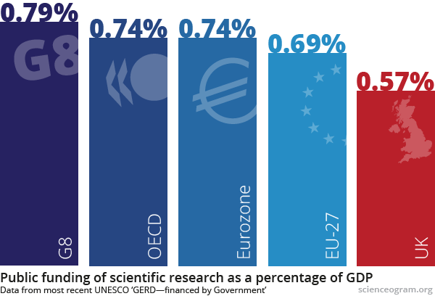
Research in psychology
Writing grants

Slide 78


Research in psychology
Writing grants

Slide 79
Essay feedback

Slide 80
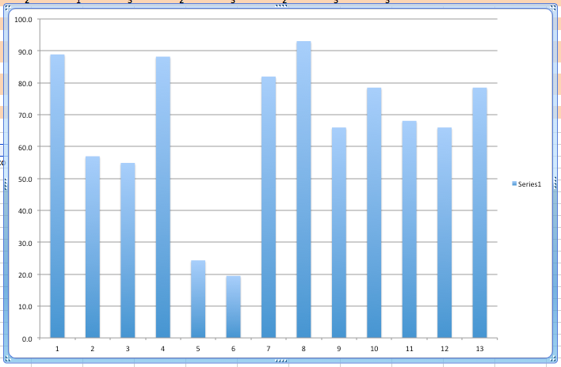
Essay marking
Min: 19
Max: 93
Mean: 66

Slide 81
Essay marking
Did you attack the question posed in the title? 3
Did you cover the question in enough depth? 3
Is your essay relevant to psychology 3
Does your essay develop logically and flow well? 2
Does your essay demonstrate original and creative thought? 4

Slide 82
Essay marking
0 Very much below standard
1 Below standard
2 Good
3 Excellent

Slide 83
Essay marking
Understanding psychological ideas 3
Explaining psychological ideas clearly and concisely 3
Criticising psychological ideas 6
Comparing psychological ideas 6

Slide 84
Essay marking
Structure: does your essay have clearly defined sections? 2
Does the introduction contextualise and introduce the problem? 3
Does the conclusion sum up arguments and tie up the essay nicely? 3

Slide 85
Essay marking
Spelling 1
Grammar 1
Sentence structure 1
Paragraphs of appropriate length 1

Slide 86
Essay marking
Referencing - using a clear and consistent referencing style 1
Referencing - using references of a high enough level 1
Referencing - finding your own references 1

Slide 87
Essay marking
Max number of points: 120
Grade is a percentage of this
(Before application of any other penalties)

Slide 88

Essay marking

Slide 89
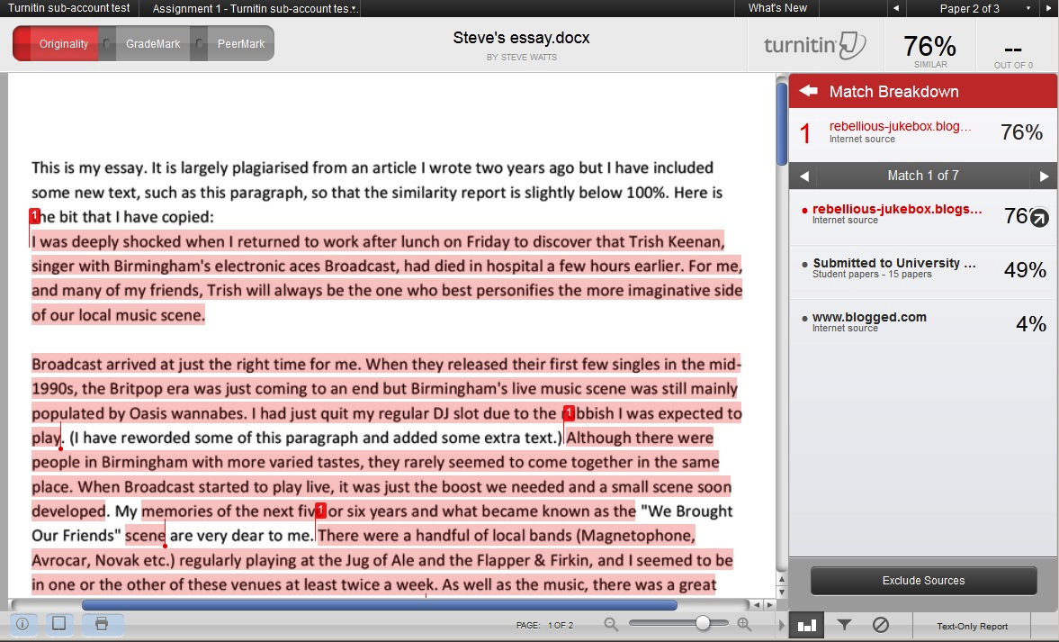
Essay marking

Slide 90
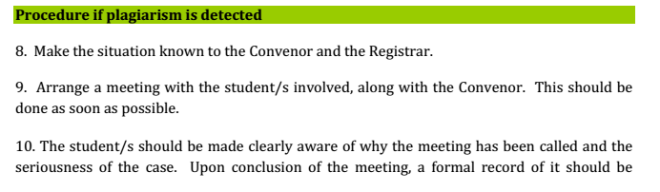
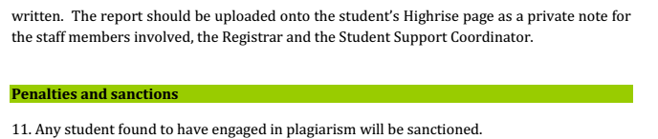
Essay marking

