Slide 1
Lecture 6 Consciousness

Slide 2

Consciousness
A hard problem?

Slide 3
Consciousness
A hard problem?
con with
scire to know
(Latin)

Slide 4
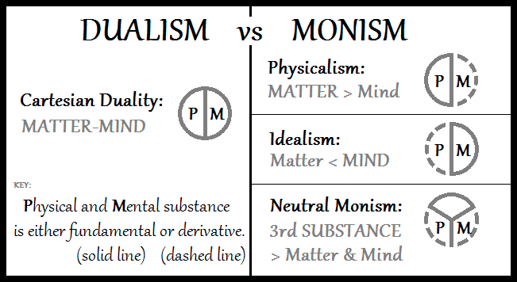
Philosophical positions
Dualism and monism

Slide 5
Philosophical positions
Aside: materialism and physicalism
Materialism vs. physicalism:
in contemporary thought, often interchangeable.
Materialism is a very old term; physicalism was introduced in the 1930s.
There is still debate about whether there is an exact correspondence.
Neurath, O, 1931, ‘Physicalism: The Philosophy of the Vienna Circle’ in R.S. Cohen, and M. Neurath (eds.), Philosophical Papers 1913–1946, Dordrecht: D. Reidel Publishing Company, 1983, pp. 48–51.

Slide 6
Philosophical positions
Realism
Realism concerns itself with the relationship between percepts and the things which cause them.
Naive realism: we percieve things directly, as they really are
Indirect realism: we perceive a transformed version of reality
The contrast between naive and indirect realism is in a way orthogonal from the dualism/monism contrast:
our decision about dualism/monism does not afect our decision about direct/indirect realism.

Slide 7
Consciousness
Many meanings
What can be conscious/unconscious?
A life-form, animal or person
A life-form, animal or person at a particular time
Consciousness is a label for creatures, and a state they can be in at a particular time.

Slide 8
Consciousness
Conscious experience
The process of awareness of things going on in the world around you
and of things happening in your own mind.

Slide 9
Consciousness
Consciousness as a zone
Things may enter our consciousness or, if unconscious, remain outside our consciousness.
Consciousness can be seen as a zone in which thoughts, or at least brain events, may take place.

Slide 10
Consciousness
Consciousness as an inner life
We usually assume that conscious beings have some kind of inner life: private thoughts or feelings which are separate from external behaviours.
The inner life is made up of qualia, which are ineffable.

Slide 11
Consciousness
The components of consciousness
Awareness
The knowledge that something is happening or that a fact is true
Introspection
The ability to investigate one’s own mental state
Agency
The sensation that one’s actions have an effect on the world
Identity
The sensation that the self is a separate part of the world from the environment
Causality
The idea that an event is responsible for another event

Slide 12
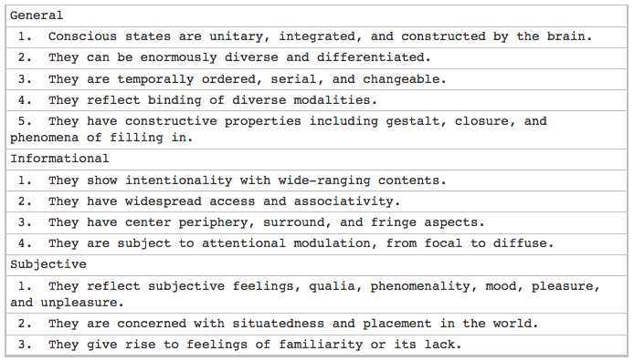
Consciousness
Conscious states
Conscious states
Edelman, Gerald M. "Naturalizing consciousness: a theoretical framework." Proceedings of the National Academy of Sciences 100.9 (2003): 5520-5524.

Slide 13
Consciousness
Conscious states
Consciousness: state or process?

Slide 14
Consciousness
Qualia
What if your experience of the colour red is different from everyone else’s?
Wherever they see red, you see blue.
Would this ever be noticeable?
No.
Thomas Nagel:
When I am in a conscious mental state, there is something it is like for me to be in that state from the subjective or first-person point of view.
Nagel, T. "What is it like to be a Bat?" In Philosophical Review 83: 435-456, 1974.

Slide 15
Consciousness
“The hard problem”
We seek to link
Qualia: internal, private, subjective experience
Measurable states: brainwaves, neural connections, firing patterns, skin conductance...
The difficulty of finding a relationship between the two,
a process which can translate one to the other,
is the so-called hard problem of consciousness.
This is called the explanatory gap.
Levine, Joseph. "Materialism and qualia: The explanatory gap." Pacific philosophical quarterly 64.4 (1983): 354-361.

Slide 16
Consciousness
“The hard problem”
“The hard problem” is orthogonal to the question of exactly how consciousness is implemented. Whether the system is dualist or realist, and however it is eventually discovered to work, qualia will still feel the same.

Slide 17
Consciousness
What do we consider conscious?
Certainly: other people
Perhaps: animals
Certainly not: simple information processing devices
inanimate objects
There are no explicit divisions: consciousness is a continuum.

Slide 18
Consciousness
Altered states of consciousness
Consciousness is not just a continuum between zero and “fully conscious.”
Illness, psychoactive chemicals, brain damage, or cognitive impairment can change the nature of one’s consciousness.

Slide 19
The seagull argument
You have grown up on an island inhabited by nothing but people and seagulls.
Eventually you ask yourself, “what is flight?”
Any definition you come up with will make reference only to seagulls.
Then, for the first time, you encounter a helicopter.
According to your definition, does it fly?
There is no way of knowing.

Slide 20
The seagull argument
The same reasoning applies for intelligence (see the domain of the Turing test) and consciousness.
We build a new, powerful computer, discover an alien race or meet a chimpanzee; is it really intelligent?
Is it really conscious?

Slide 21
Consciousness as a social label
Consciousness is a useful tag for deciding how we treat other creatures.
One has great difficulty causing harm to something one considers conscious.

Slide 22
Consciousness
Consciousness as a metaphor
We often use terms related to consciousness to describe interactions with admittedly non-conscious objects:
the computer wants you to do this
the website thinks you’re not logged in
the components don’t want to fit together properly

Slide 23
Consciousness
Descriptions
We can distinguish two main ways of describing conscious experience:
To others (verbally, linguistically, behaviourally)
To ourselves (remembering past feelings; introspecting)
By definition, the second form of description can never be communicated to another person.

Slide 24
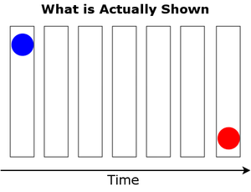
Models
Dennett’s multiple drafts model
The phi illusion:

Slide 25
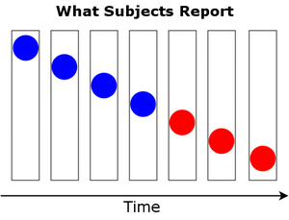
Models
Dennett’s multiple drafts model
The phi illusion:

Slide 26
Models
Dennett’s multiple drafts model
Orwellian explanations:
The observer concludes one thing, then changes it later.
Stalinesque explanations:
The contradiction is resolved before entering consciousness.

Slide 27
Models
Dennett’s multiple drafts model
Cartesian materialism: the view that there is a hard boundary to the zone of consciousness, aka the Cartesian theatre.
The multiple drafts model rejects the Cartesian Theatre.
The world provides us with a variety of sensory inputs, which can be interpreted in different ways. These may happen in parallel or at different speeds.
Percepts do not instantaneously arrive in the mind in their full richness.

Slide 28
Models
Dennett’s three stances
Physical stance: mass, energy, trajectories, atoms, molecules, materials.
Design stance: purpose, function, design.
Intentional stance: belief, volition, intent, thinking, knowing.

Slide 29
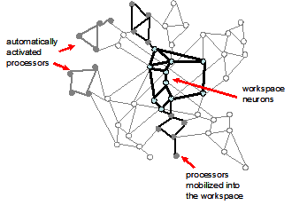
Models
Global workspace theory
Many brain processes have already been well-studied and described:
attention
memory
perception
adaptation
Global workspace theory imagines that consciousness is a global resource which connects these processes together.

Slide 30
Models
Global workspace theory
Is this not the Cartesian theatre?
Baars maintains that it isn’t, because
there’s no viewer
it’s not spatially localised in the brain

Slide 31
Neurophysiology
Consciousness as an integrator
Consciousness seems to be the place where, or process by means of which, information from different senses and different brain processes is integrated and bound into a unified whole.

Slide 32
Neurophysiology
Neural correlates of consciousness
A complex-sounding term, but really just a bridge over the explanatory gap.
Crick F. and Koch C. (1990) Towards a neurobiological theory of consciousness. Seminars in Neuroscience Vol2, 263–275.

Slide 33
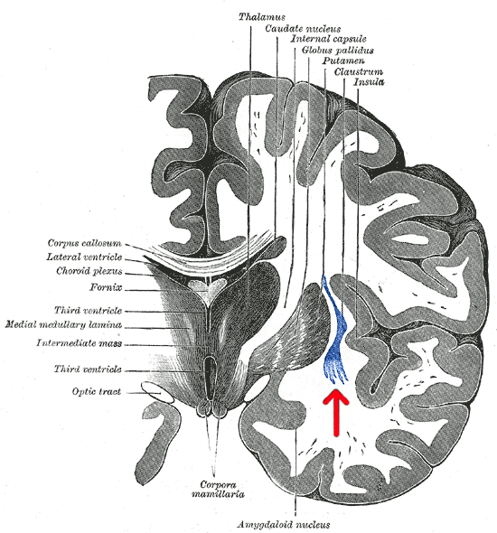
Neurophysiology
Consciousness as an integrator
The claustrum may play this role.

Slide 34
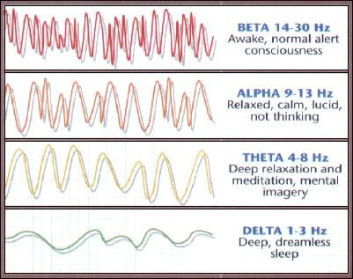
Neurophysiology
Consciousness and brainwaves

Slide 35
Neurophysiology
REM sleep
Dreaming is not full consciousness – but it is close. It is often difficult to distinguish between the two; lucid dreaming is a state with elements of both dreaming and wakefulness.
Dreaming is reliably indicated by rapid eye movement.

Slide 36
Neurophysiology
Coma or vegetative state
Brain activity, detected through MRI or EEG, may show a response to heard language despite the absence of a behavioural response.

Slide 37
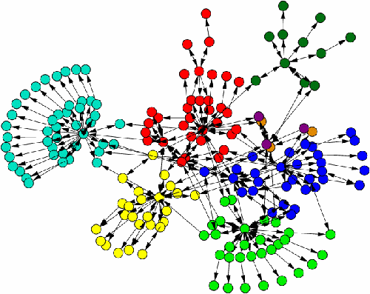
Neurophysiology
Information integration theory

Slide 38
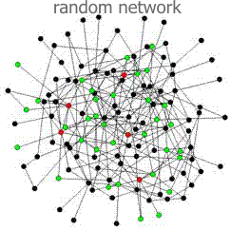
Neurophysiology
Information integration theory

Slide 39
Neurophysiology
Information integration theory
Phi (Φ) is a possible measure of the ability of a system to integrate information.
It has yet to be properly validated.
Giulio (December 2008). "Consciousness as integrated information: a provisional manifesto". The Biological Bulletin 215 (3): 216–242.

Slide 40
Consciousness and language
Sapir-Whorf hypothesis: the qualities of your language affect the qualities of your thoughts.
“The great Eskimo vocabulary hoax”
Pinker’s point of view: thoughts are not expressed just in language, but in propositions and more abstract structures.
There are linguistic details (cadence, assonance, timbre) which are language-specific; however “The fact that you can translate shows that there’s something other than words.” [Pinker]
Do we want to say that beings without language are less conscious?

Slide 41
Artificial consciousness
What needs to be done to produce human-like consciousness in an artificial system?
This depends on the size of the structures important for consciousness; how far down the levels of abstraction they go.

Slide 42
Artificial consciousness
Nation
Group
Person
Brain area
Neuron
Intracellular structure
Molecule
Atom
Quark
Gluon
Strings
?

Slide 43
Artificial consciousness
Can we tell the difference?
Well, obviously a computer does not look like a biological organism.
Suppose we set up an environment where this is not obvious.

Slide 44
Artificial consciousness
The Imitation Game
(Otherwise known as the Turing test.)
Hides the “obvious factors” behind a communication interface.
But all details cannot be hidden: imagine for example a machine that can multiply 7897958 by 676562 in under a second. All you have to do to defeat it is to ask that question.

Slide 45
Artificial consciousness
Identity of indiscernibles
Objects or entities which have all their properties in common, must be the same.
(Leibniz)

Slide 46
Artificial consciousness
The Chinese Room
A person sits in a room; he receives cards through a slot, writes new cards according to a set of rules laid out in a binder, and replies with other cards.
From the outside (if one waits a very long time), it appears that he understand Chinese. However, from his point of view, he does not.
Searle sees this as an incontrovertible demonstration that machines cannot truly understand and think.
Searle, John R. "Minds, brains, and programs." Behavioral and brain sciences 3.03 (1980): 417-424.

Slide 47
Artificial consciousness
The Chinese Room
However, there are problems:
The occupant of the room would have to modify the rules as he went along; they would have to contain instructions for this, too.
Otherwise, a simple test of memory (“what was the last question I asked you?”) would defeat the Room.
If this was done, the identity of indiscernibles (provided we speed the Room up) indicates the Room does understand Chinese.

Slide 48
Discredited theories
Roger Penrose: consciousness depends on nanotubes and quantum effects below the level of the neuron
Quantum effects have proved useful to birds for sensing magnetic fields, but have not been shown to help with information processing.
Holonomic brain theory (Karl Pribram): memories are stored in the form of a hologram (information is distributed and replicated).
Penrose, Roger. The emperor's new mind: concerning computers, minds, and the laws of physics. Oxford University Press, 1999.

Slide 49
An eventual solution
One of three things must happen.
We will never solve the problem of consciousness; our minds are not up to the task. The debate will continue.
“Consciousness” will go the way of phrenology – it will become an outdated metaphor. It may still be useful as a social tool, but science will realise it is misguided.
We will find a precise mapping between what we call consciousness, and obserable structures in the brain – perhaps yet to be discovered.

Slide 50
Free will
Another amorphous and difficult concept.
Intricately related to consciousness.
The idea that you make decisions.
You: the conscious self
Decision: a situation in which you can imagine several possible routes and may only take one of them.

Slide 51
Free will
Free will is related to simulation and agency.
Simulation: imagining different outcomes
Agency: deciding to take one path

Slide 52
Free will
Could we tell the difference between the illusion of free will, and free will itself?

