Slide 1
Lecture 5 EEG

Slide 2

EEG
EEG
electroencephalography

Slide 3
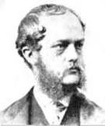
EEG
Richard Caton
1842 – 1926

Slide 4
EEG
Used a galvanometer and two electrodes (one on the cortex, one on the surface of the skull).
Found currents which increased with sleep, and with the onset of death, but ceased after death.
Richard Caton
1842 – 1926

Slide 5
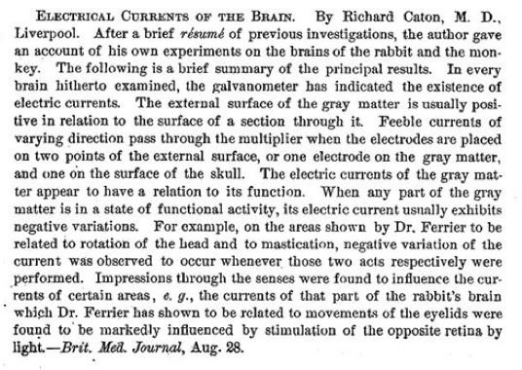
EEG
Richard Caton (October 1875). "Electrical currents of the brain". Chicago Journal of Nervous & Mental Disease 2 (4): 610.

Slide 6
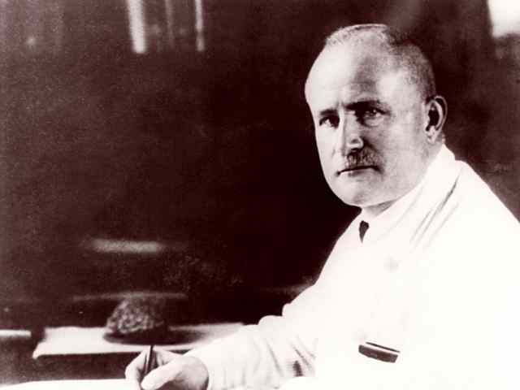
EEG
Hans Berger
1873 - 1941

Slide 7
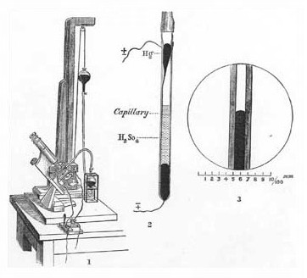
EEG
Lippmann electrometer

Slide 8
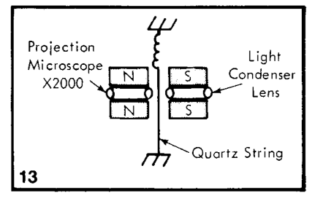
EEG
String galvanometer

Slide 9
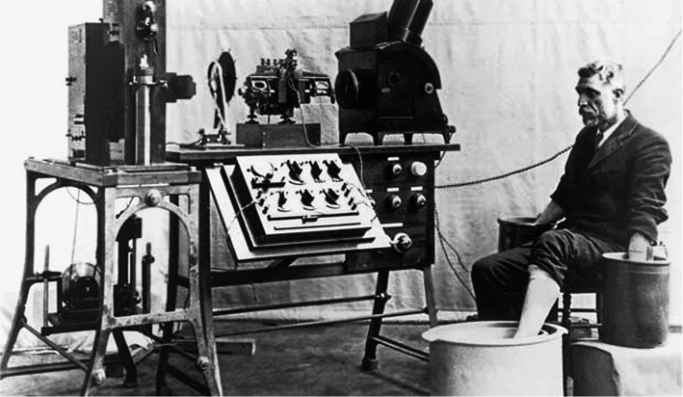
EEG
String galvanometer

Slide 10
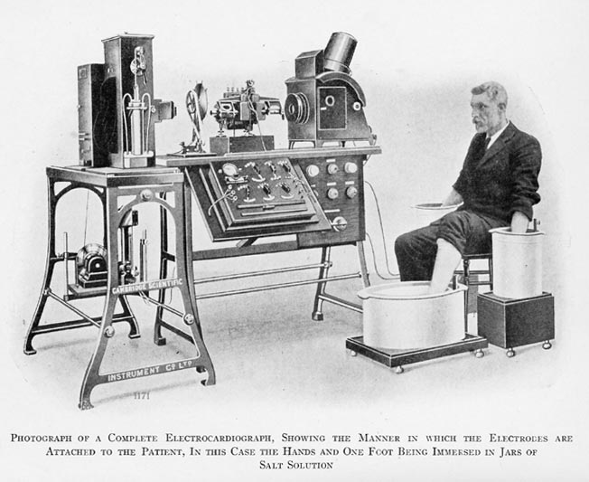
EEG
String galvanometer

Slide 11
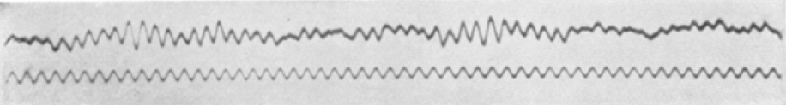
EEG
Elektrenkephalogramm

Slide 12
EEG
“It was a case of spontaneous telepathy in which at a time of mortal danger, and as I contemplated certain death, I transmitted my thoughts, while my sister, who was particularly close to me, acted as the receiver.”
-Hans Berger

Slide 13
EEG
"was not regarded by his associates as in the front rank of German psychiatrists, having rather the reputation of being a crank. He seemed to me to be a modest and dignified person, full of good humour, and as unperturbed by lack of recognition as he was later by the fame it eventually brought upon him. But he had one fatal weakness: he was completely ignorant of the technical and physical basis of his method. He knew nothing about mechanics or electricity.”
-Willian Grey Walter

Slide 14
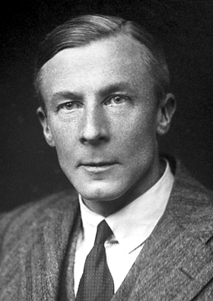
EEG
Edgar Douglas Adrian
1889 - 1977

Slide 15
EEG
The all-or-nothing law of nerve action
Edgar Douglas Adrian
1889 - 1977

Slide 16
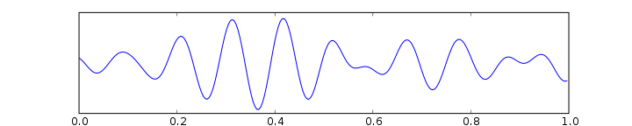
Alpha waves
7.5 – 12.5 Hz

Slide 17
Alpha waves
Strongest EEG signals
Originate from the occipital lobe
Strongest with eyes closed
Suppressed when eyes open or sleeping
Do not appear until three years of age
Trained practitioners of meditation produce more alpha waves

Slide 18
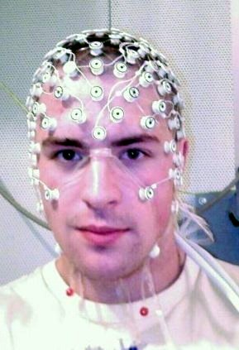
EEG

Slide 19
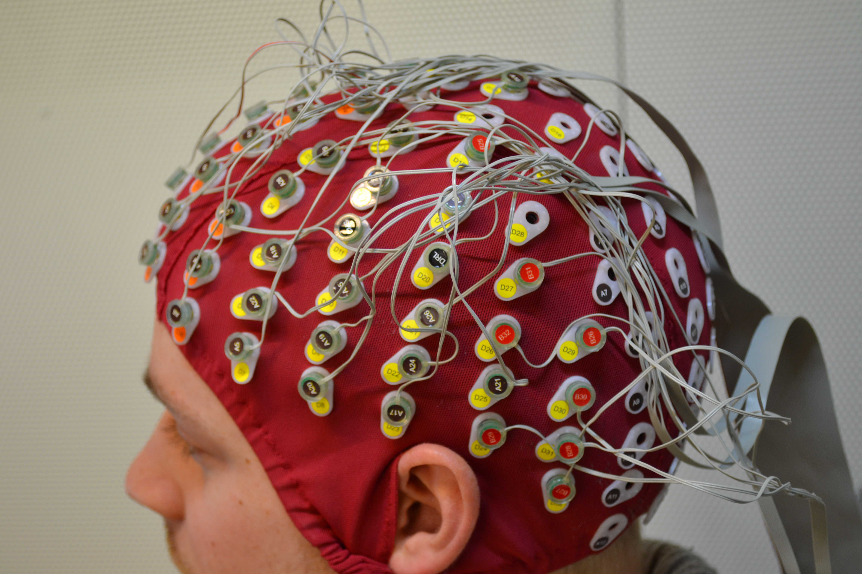
EEG

Slide 20
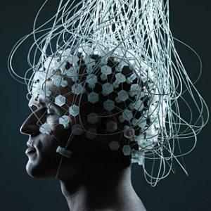
EEG

Slide 21
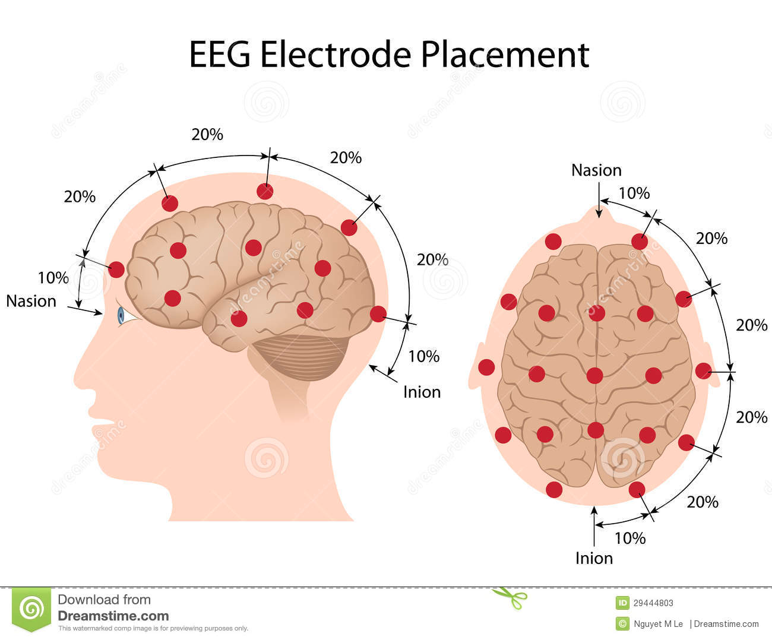
EEG

Slide 22
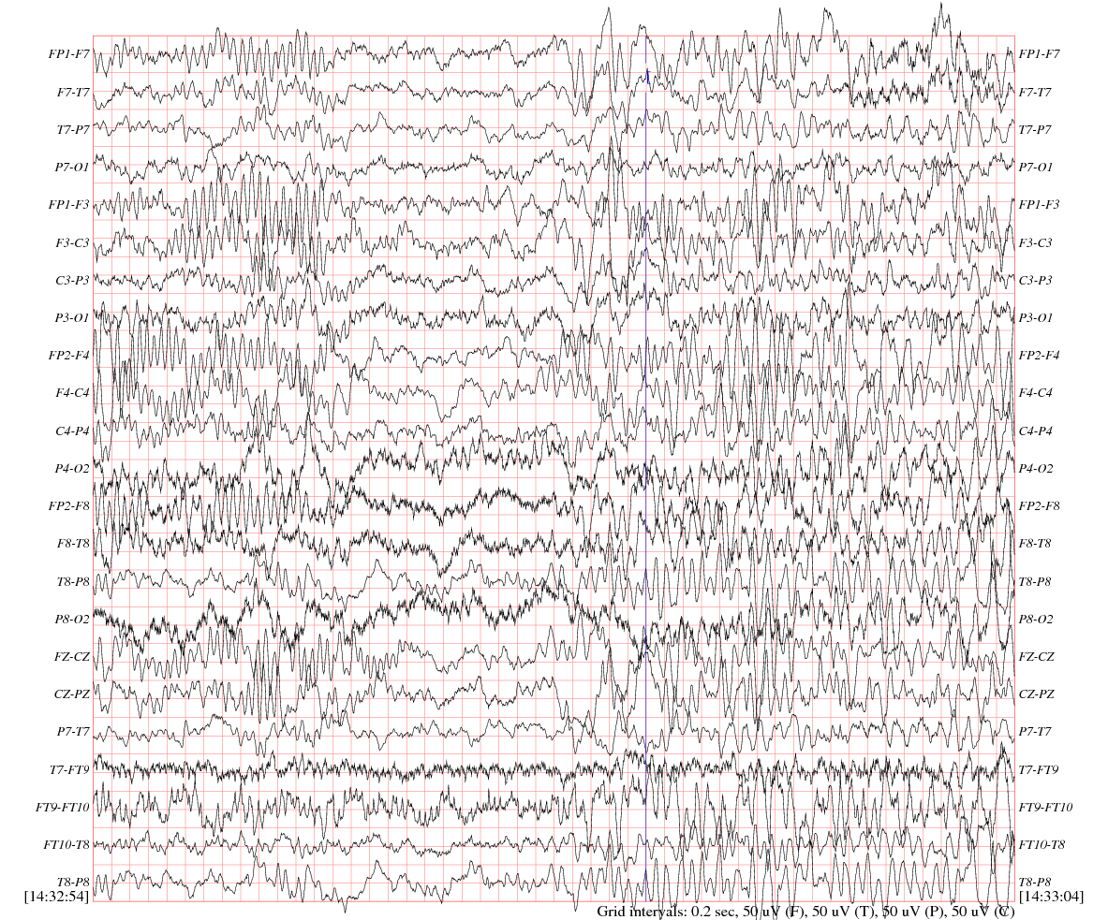
EEG

Slide 23
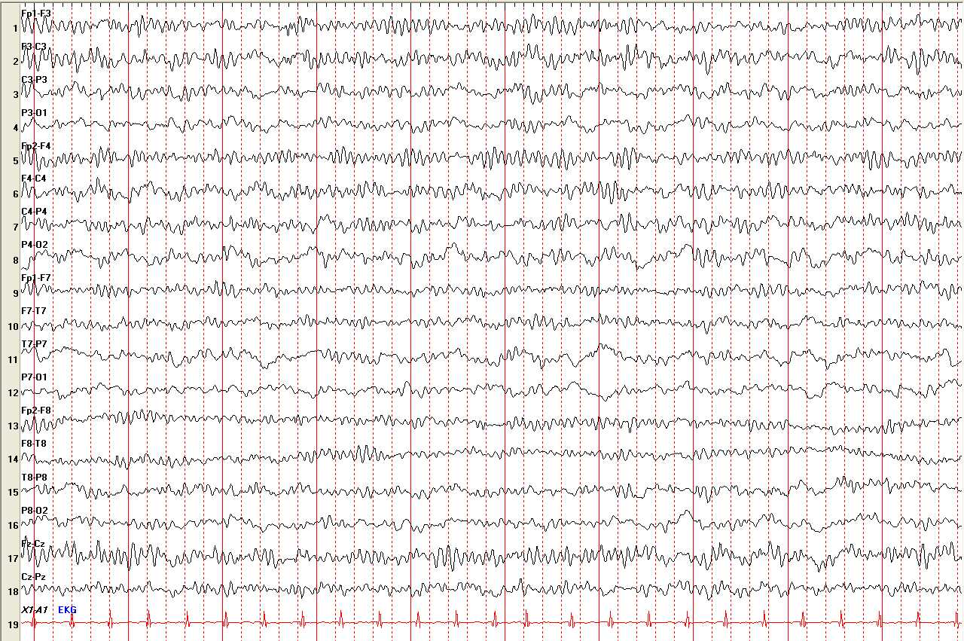
EEG

Slide 24
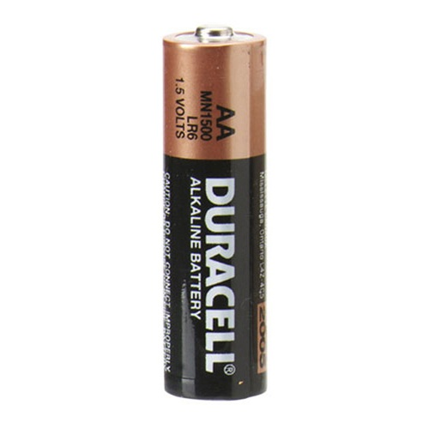
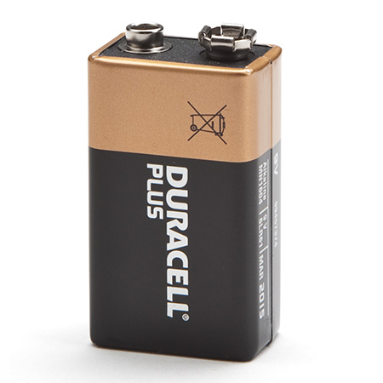

EEG
1.5V 9V 12V

Slide 25
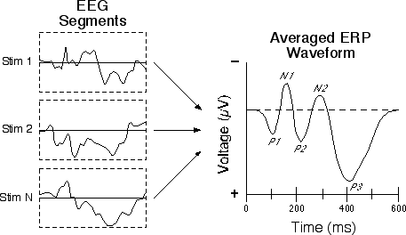
Event-related potentials

Slide 26
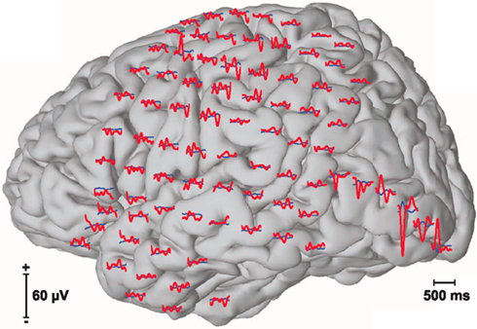
Event-related potentials

Slide 27
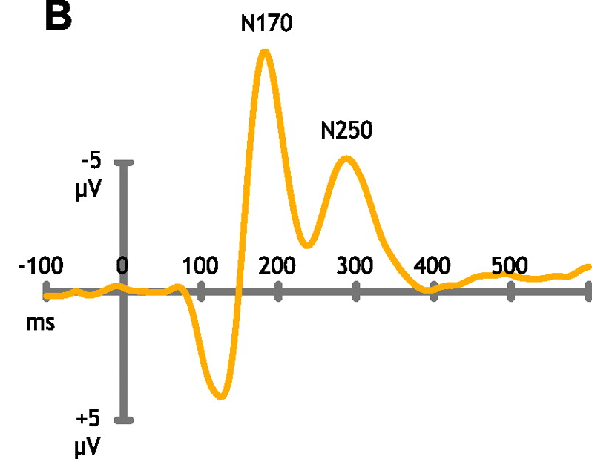
Event-related potentials

Slide 28
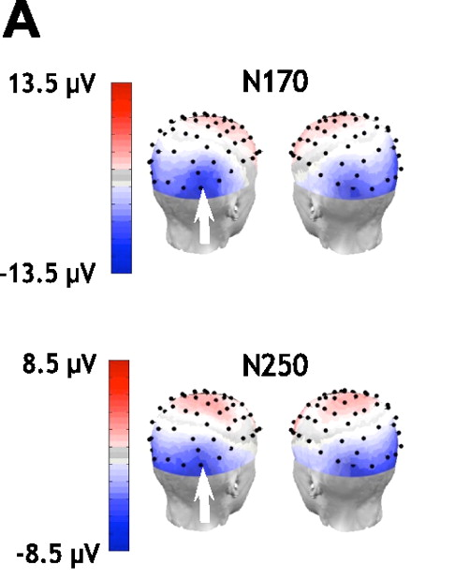

Slide 29
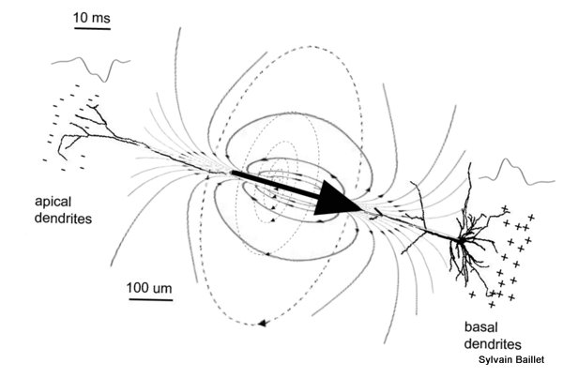
Where do EEG currents come from?

Slide 30
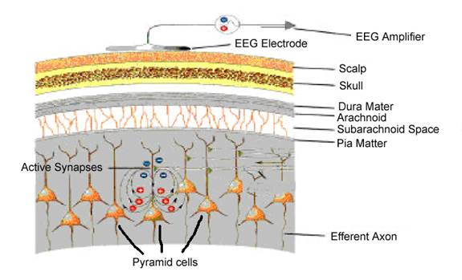
Where do EEG currents come from?

Slide 31
Where do EEG currents come from?
Synchrony

Slide 32
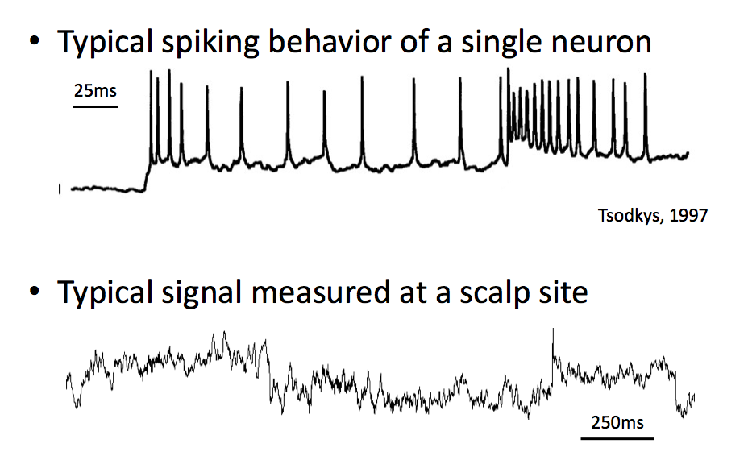
Where do EEG currents come from?

Slide 33
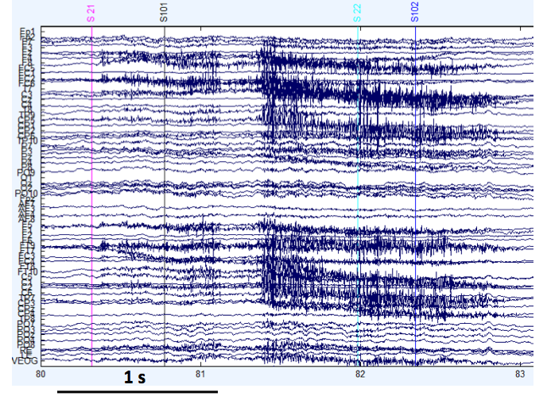
Muscle artifacts

Slide 34
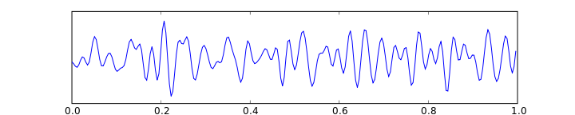
Beta waves
12.5 – 30 Hz

Slide 35
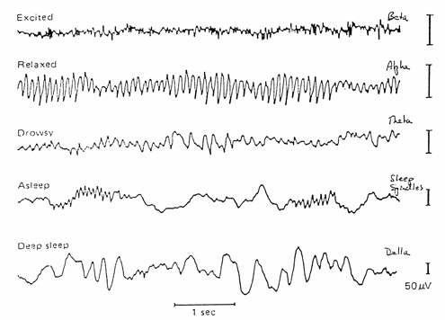
Beta waves

Slide 36
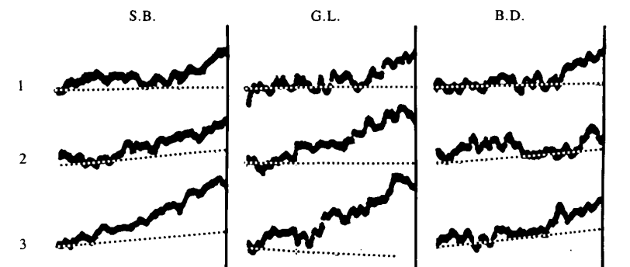
Libet: predicting intentions
Methods

Slide 37
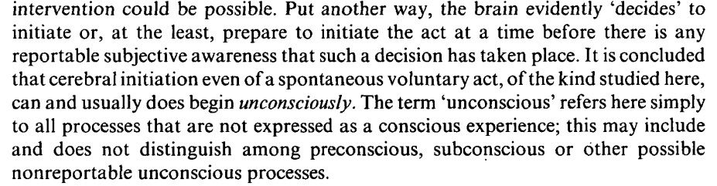
Libet: predicting intentions
Results

Slide 38
Libet: predicting intentions
Conclusions
Introspection cannot tell us the exact time at which we decided to perform a movement.
If we use clock tracing to report the decision awareness time, the clock has always moved too far. There is a delay somewhere in the system (it cannot be in the awareness of the clock motion).
Using EEG, we can detect changes in the brain before the moment the decision becomes conscious.

Slide 39
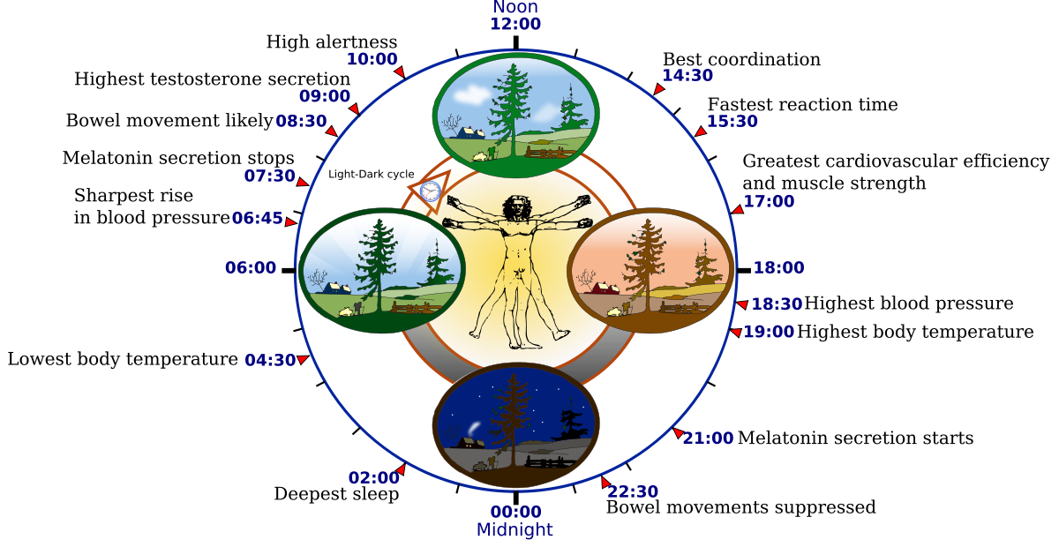
EEG and sleep

Slide 40
EEG and sleep
All animals with well-developed brains sleep
We do not sleep just to save energy: our metabolism only eases off by 5 to 10%
"As far as I know, the only reason we need to sleep that is really, really solid is because we get sleepy.”
-William Dement, founder of the Sleep Research Center, Stanford University

Slide 41
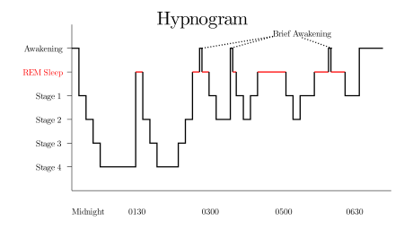
EEG and sleep

Slide 42
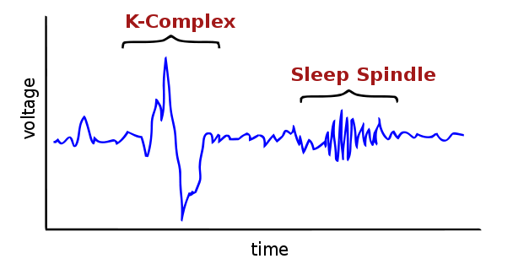
EEG and sleep
Ferrarelli et al, Reduced Sleep Spindle Activity in Schizophrenia Patients. The American Journal of Psychiatry, 164, A62

Slide 43
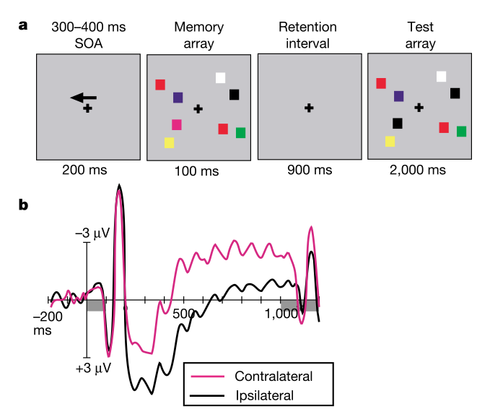
EEG and memory
Vogel, Edward K., and Maro G. Machizawa. "Neural activity predicts individual differences in visual working memory capacity." Nature 428.6984 (2004): 748-751.

Slide 44
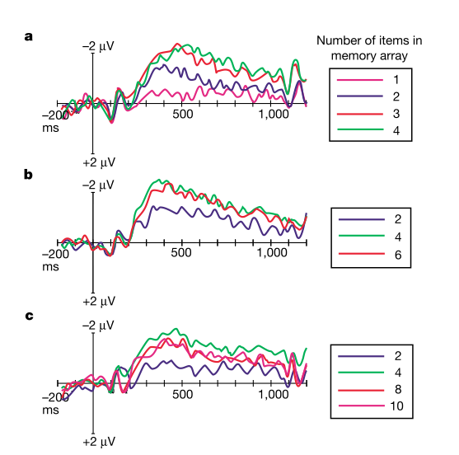
EEG and memory
Vogel, Edward K., and Maro G. Machizawa. "Neural activity predicts individual differences in visual working memory capacity." Nature 428.6984 (2004): 748-751.

Slide 45
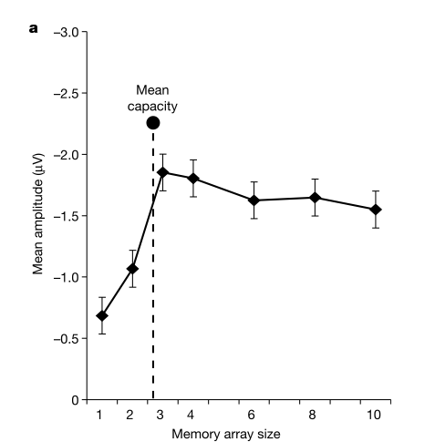
EEG and memory
Vogel, Edward K., and Maro G. Machizawa. "Neural activity predicts individual differences in visual working memory capacity." Nature 428.6984 (2004): 748-751.

Slide 46
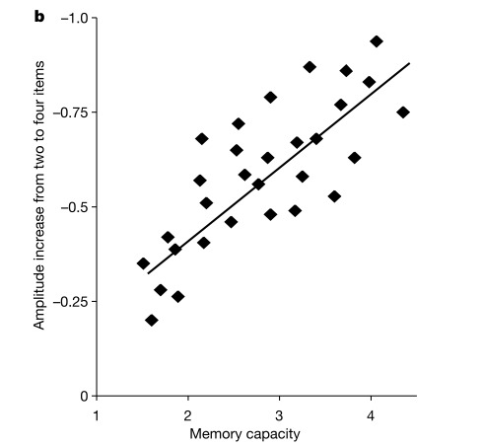
EEG and memory
Vogel, Edward K., and Maro G. Machizawa. "Neural activity predicts individual differences in visual working memory capacity." Nature 428.6984 (2004): 748-751.

Slide 47
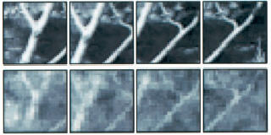
Brain-computer interfaces
Stanley, GB; Li, FF; Dan, Y (1999). "Reconstruction of natural scenes from ensemble responses in the lateral geniculate nucleus". Journal of Neuroscience 19 (18): 8036–42.

Slide 48
Brain-computer interfaces
“Swiftly the brain becomes an enchanted loom, where millions of flashing shuttles weave a dissolving pattern-always a meaningful pattern-
though never an abiding one.”
-Charles Sherrington

Slide 49
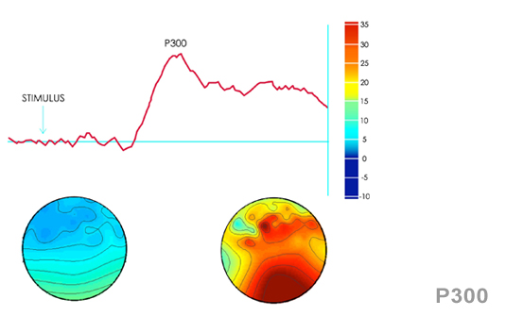
Brain-computer interfaces

Slide 50
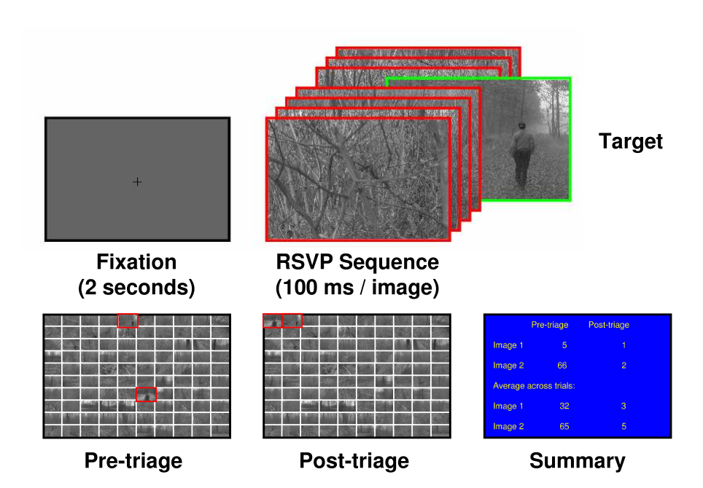
Brain-computer interfaces
Gerson, Adam D., Lucas C. Parra, and Paul Sajda. "Cortically coupled computer vision for rapid image search." Neural Systems and Rehabilitation Engineering, IEEE Transactions on 14.2 (2006): 174-179.

Slide 51
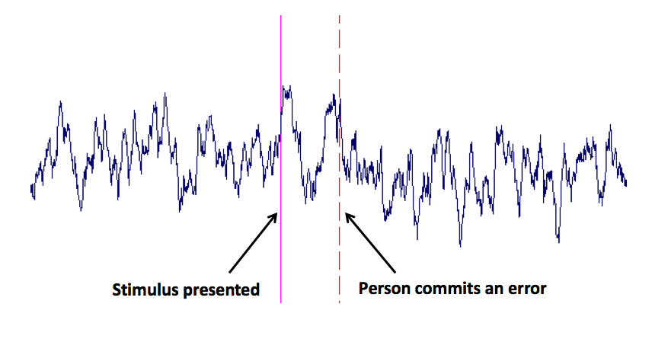
Brain-computer interfaces

Slide 52
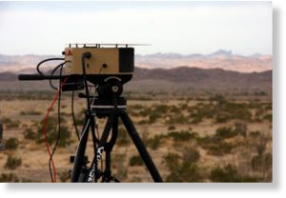
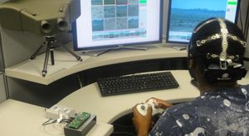
Brain-computer interfaces
DARPA Cognitive Technology Threat Warning System (CT2WS)

Slide 53
Brain-computer interfaces
https://www.youtube.com/watch?v=OOPB5sWtZ1c

