Slide 1
Lecture 5 Memory

Slide 2

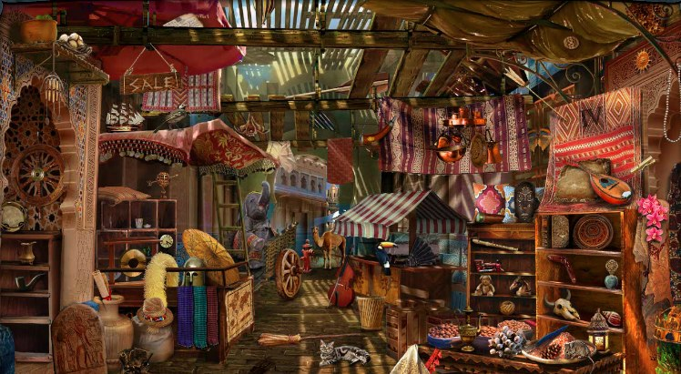
Attention

Slide 3

Attention

Slide 4
Memory
Unlike computer memory
Our memory does not remember everything
If it did, it would be prohibitive

Slide 5
Memory
Hyperthymestia
Greek: hyper (excessive), thymesis (memory)
Extremely detailed autobiographical memory
Bob Petrella, early 60s
Remembers “between a quarter and half of every month since I was five.” phone numbers all his birthdays and New Year celebrations all main Oscar prizes Football game scores
What does this tell us?

Slide 6
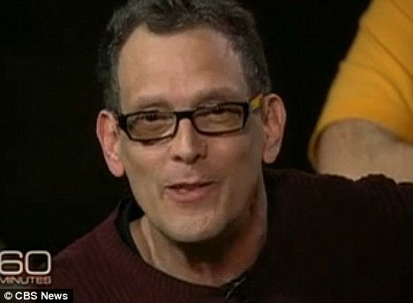
Memory
Hyperthymestia

Slide 7
Memory
Hyperthymestia
Autobiographical memory only

Slide 8
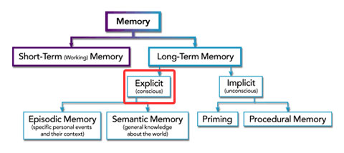
Memory
Types of memory

Slide 9
Memory
Hyperthymesia
Can cause problems:
getting lost in remembering
poor performance in tasks requiring non-autobigraphical memory
“non-stop, uncontrollable and totally exhausting” (patient AJ)

Slide 10
Memory
Hyperthymesia
How do we explain this ability?
Excessive recall (obsessive-compulsive reviewing)
Patient AJ:
enlarged temporal lobe (hippocampus in medial temporal lobe)
enlarged caudate nucleus (linked to procedural memory)

Slide 11
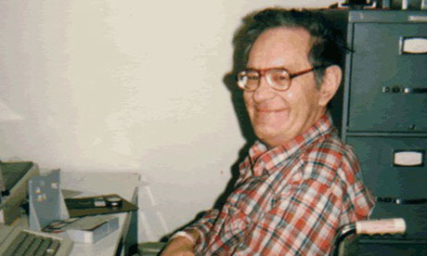
Memory
Amnesia
Henry Molaison
Serious untreatable
1953: bilateral medial temporal lobe resection: hippocampus, amygdaloid complex, entorhinal cortex removed

Slide 12
Memory
Amnesia
Henry Molaison
Severe anterograde amnesia
Could still remember task progress and skills
Personality, language and communication skills intact
Could not remember new facts or events
Crossword puzzles: could only use pre-1953 knowledge to answer clues
"an engaging, docile man, with a keen sense of humour, who knew he had a poor memory and accepted his fate … and hoped that research into his condition would help others live better lives."
HM’s condition provides an example of a dissociation: one function is invalidated, one function remains intact.

Slide 13
Memory
So, there are different types of memory.
What is memory anyway?

Slide 14
Memory
So, there are different types of memory.
What is memory anyway?
“Memory is the process in which information is encoded, stored, and retrieved.”
-Wikipedia
“The mental capacity or faculty of retaining and reviving facts, events, impressions, etc., or of recalling or recognizing previous experiences.”
-Random House dictionary
Perception?
Adaptation?

Slide 15
Memory
We can classify types of memory according to:
duration
type of information held
capacity
information complexity
recognition vs.

Slide 16

Memory
Sensory memory

Slide 17
Memory
Sensory memory
duration: very short (less than a second)
type of information: modality-specific (sense-specific)
complexity: low
volume: high
Once information is lost, it is gone forever.
vision: iconic memory
hearing: echoic memory
touch: haptic memory
Sensory memory is now under top-down control.

Slide 18
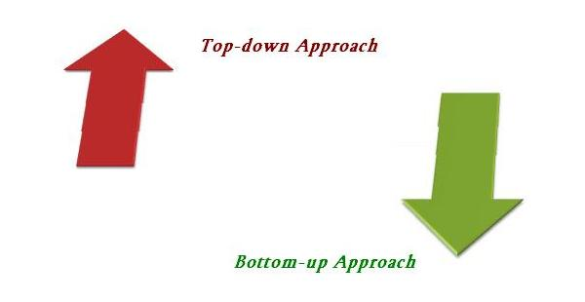
Memory
Top-down and bottom-up processing

Slide 19
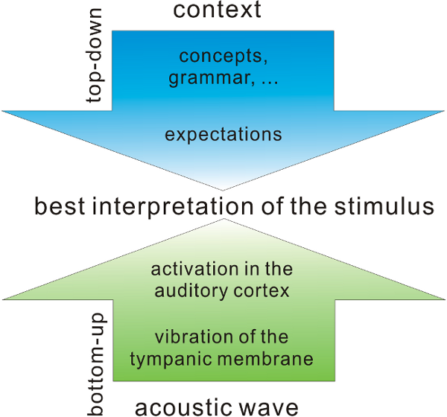
Memory
Top-down and bottom-up processing

Slide 20
Memory
Top-down and bottom-up processing
Meaning 1: from local (bottom) vs global (top) information
Meaning 2: towards consciousness (bottom-up) or from consciousness (top-down)

Slide 21
Memory
Short-term memory
duration: up to a minute (without rehearsal)
type of information: more high-level than sensory memory
complexity: medium
volume: limited
Information may be partially forgotten or suddenly recalled.

Slide 22
Memory
Short-term memory
The Magical Number Seven, Plus or Minus Two:
Some Limits on Or Capacity for Processing Information
George A Miller, 1956
Miller’s Law: working memory can hold 7 ± 2 items
Miller observed that across modalities and across levels of stimulus complexity,
performance decreases rapidly once around seven items are being remembered.

Slide 23
Memory
How do we test memory?
Standard task:
Remember n items
Reproduce them verbally
Recognition:
Remember n items
Identify them in a list of items, all at once or one by one

Slide 24
Memory
Chunking
01604891364
01604 891 364
0207 384 3746
020 7384 3746

Slide 25
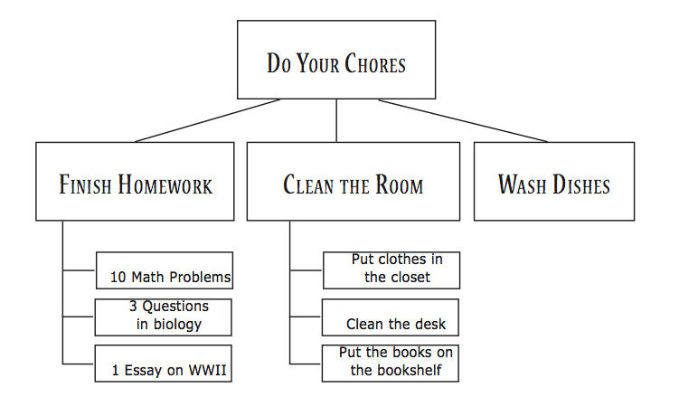
Memory
Chunking

Slide 26
Memory
Rehearsal
Maintenance rehearsal
Elaborative rehearsal

Slide 27
Memory
Coding
Conrad (1964) asked participants to remember a list of six consonants. He then tallied their mistakes.
There were many instances of similarly-sounding letters being mistaken for each other (B and P). THis suggests that there are links between information in STM, and its sound.
STM may code information according to its sound.

Slide 28
Memory
Long-term memory
duration: up to a lifetime
type of information: more high-level than short-term memory; semantic
complexity: medium
volume: unlimited
Information which is not currently being used, but is potentially retrievable.
Spatial information about the world
Physical laws and properties of objects
Beliefs about people and their values and goals
Social norms
Plans and strategies

Slide 29
Memory
Long-term memory coding
Baddeley (1966) asked participants to remember words which were either acoustically or semantically similar.
Acoustically similar words had no effect on recall, whereas semantically similar words were not recalled as well.
However, information corresponding to the other senses can also be stored in LTM.

Slide 30
Memory
Storage and retrieval
Information may be returned from LTM to STM (retrieval), modified, and sent back to LTM.
This is the origin of the idea that “you remember not the event but the last time you thought of the event.”
Retrieval can be a process of construction as opposed to a process of transfer:
De Groot (1966) showed that chess players have very good STM for piece arrangements – as long as pieces are arranged according to the rules.
De Groot, Adriaan D., Fernand Gobet, and Riekent W. Jongman. Perception and memory in chess: Studies in the heuristics of the professional eye. Van Gorcum & Co, 1996.

Slide 31
Models of memory
Constructing a model is a core research activity.
A model is simply a less complex version of a process or phenomenon.
Models may be
cognitive
verbal
mathematical
digital
analogue

Slide 32
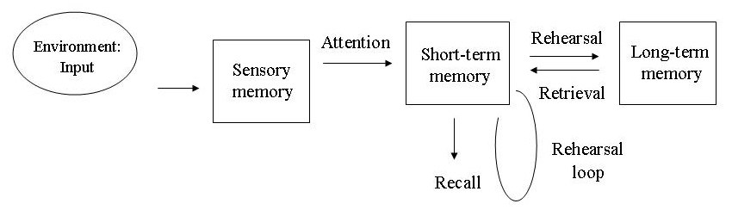
Models of memory
Atkinson-Shiffrin model

Slide 33
Models of memory
Atkinson-Shiffrin model
1968, Atkinson and Shiffrin
Widely seen as insufficiently detailed
If these systems exist, they are connected in more ways than the model allows.

Slide 34
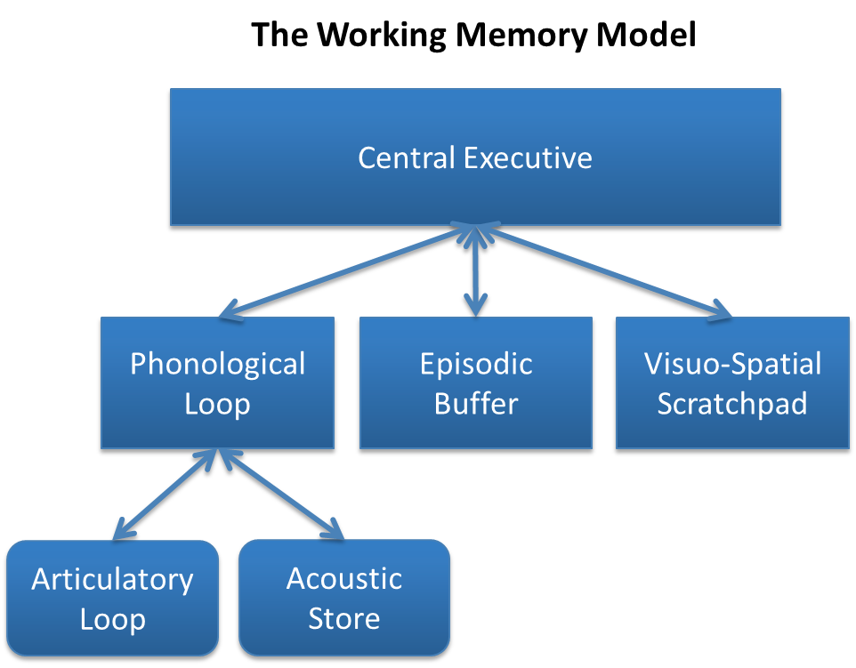
Models of memory
Baddeley and Hitch model

Slide 35
Models of memory
Baddeley and Hitch model
Baddeley and Hitch, 1974
Explores the general concept of short-term memory more fully.
Active maintenance of information

Slide 36
Models of memory
Levels of processing
Craik and Lockhart (1972) introduced the idea that stimuli can be processed in different ways, or on different levels:
Shallow: look at surface features of stimulus (deep or shallow)
Phonetic: process more and generate the sound of the word
Semantic: analyse the meaning of the word
Craik, Fergus IM, and Robert S. Lockhart. "Levels of processing: A framework for memory research." Journal of verbal learning and verbal behavior 11.6 (1972): 671-684.

Slide 37
Models of memory
Forgetting
Jenkins and Dallenbach (1924) asked participants to remember nonsense syllables, then either stay awake or go to sleep.
They found higher retention after sleeping.
Could this be due to a consolidation process taking place during sleep, or simply a lack of interference from new information?
Jenkins, John G., and Karl M. Dallenbach. "Obliviscence during sleep and waking." The American Journal of Psychology (1924): 605-612.

Slide 38
Types of memory
sensory
visual
iconic
visual short-term
echoic
haptic
topographic
flashbulb memories
declarative (explicit)
semantic facts
procedural (implicit)
motor skills

Slide 39
Types of memory
Declarative vs. procedural
Henry Molaison was able to learn a new motor skill (mirror drawing) without remembering that he had practiced the task before.
This showed a dissociation between motor task learning and being aware of past events.
Tasks can change their reliance on declarative and procedural memory.
Fitts’ model (1954):
cognitive phase
associative phase
autonomous phase
Tadlock’s model:
attempt
fail
analyse result (implicitly)
decide how to improve the next attempt (implicitly)

Slide 40
Types of memory
Declarative vs. procedural
To test procedural memory we use motor tasks, often skills:
Mirror tracing
Throwing
Learning an instrument

Slide 41
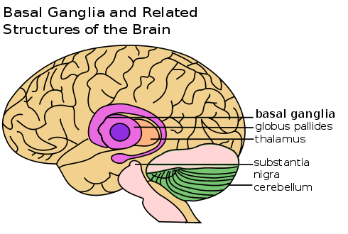
Types of memory
Procedural memory
Structures:
striatum – connected to many brain areas
basal ganglia -
cerebellum – damage prevents motor skill learning

Slide 42
Memory
Challenges to the neuron theory?
Limited research suggests that memory may require structures and processes which are smaller and more complex than neurons.
DNA methylation (modification of molecules attached to DNA)
Prions (proteins which may change in shape)
These theories are still unconfirmed and largely speculative.

Slide 43
Memory
Applications
There are ideal spaced rehearsal intervals for learning
Chunking, novelty and rehearsal can be used to improve memory
Retrieval can be a subsconscious process; you can interfere with it by trying too hard
When trying to remember something, think about its connotations and connections.

Slide 44
Types of memory
Clive Wearing
Previous chorus master of the London Sinfonietta.
Suffered from herpesviral encephalitis (caused by HSV-1 or HSV-2)

Slide 45
Types of memory
Clive Wearing
“Wearing developed a profound case of total amnesia as a result of his illness. Because of damage to the hippocampus, an area required to transfer memories from short-term to long-term memory, he is completely unable to form lasting new memories – his memory only lasts between 7 and 30 seconds.
He spends every day 'waking up' every 20 seconds, 'restarting' his consciousness once the time span of his short term memory elapses (about 30 seconds). He remembers little of his life before 1985; he knows, for example, that he has children from an earlier marriage, but cannot remember their names.
His love for his second wife Deborah, whom he married the year prior to his illness, is undiminished. He greets her joyously every time they meet, either believing he has not seen her in years or that they have never met before, even though she may have just left the room to fetch a glass of water. When he goes out dining with his wife, he can remember the name of the food (e.g. chicken); however he cannot link it with taste, as he has forgotten.
Despite having retrograde as well as anterograde amnesia, and thus only a moment-to-moment consciousness, Wearing still recalls how to play the piano and conduct a choir – all this despite having no recollection of having received a musical education. This is because his procedural memory was not damaged by the virus.”

Slide 46
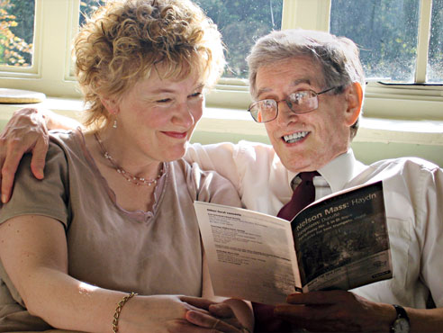
Types of memory
Clive Wearing

Slide 47
Essay guidelines
5PM Friday 7 November, by email
2,500 word limit (not including bibliography!). Nothing beyond 2,750 words will be read.
Late penalty 3% per day, after 5 days capped at 59%, after 14 days 0% (unless of course an Extenuating Circumstance)
You should show that:
you can clearly understand and explain psychological concepts
you can compare and criticise psychological ideas
Feel free to select your own titles, but check with me first.

Slide 48
Research strategy
Sources
Books
Google, Wikepedia (be careful!)
Scholarpedia
Google Scholar
University library website – allows you to access subscription-only journals
Books
Academic papers
Research is a tradeoff between exploration and exploitation.
Don’t go too deep too quickly – use speed-reading, check figures first, skim a stack of books in the library.

Slide 49
Research strategy
Structure
Like a review paper (no methodology or description of experimental results).
Introduction should introduce the area and set up some questions to motivate the reader...
...which should then be answered later in the essay.
It is OK to leave some questions unanswered.

