Slide 1
Lecture 4 Nerves and Neurons

Slide 2

Nerves and neurons
nerve
from Latin nervus: sinew, tendon or cord

Slide 3
Nerves and neurons
nerve
“A fibre or bundle of fibres arising from the brain, spinal cord, or other ganglionic organ, capable of stimulation by various means, and serving to convey impulses (especially of sensation and motion) between the brain, etc., and some other part of the body.”
1606 definition, [Oxford dictionary, 1944]

Slide 4
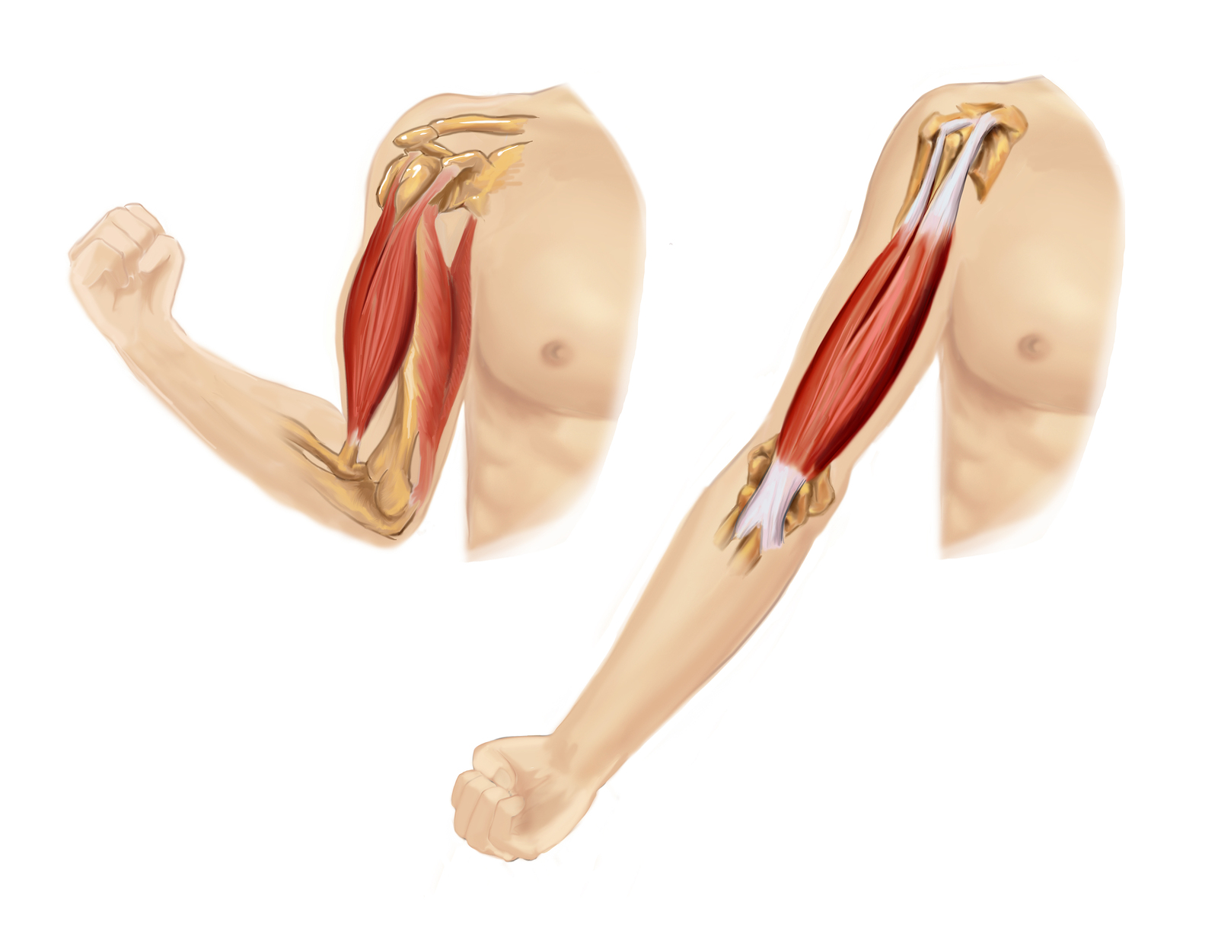
Nerves and neurons

Slide 5
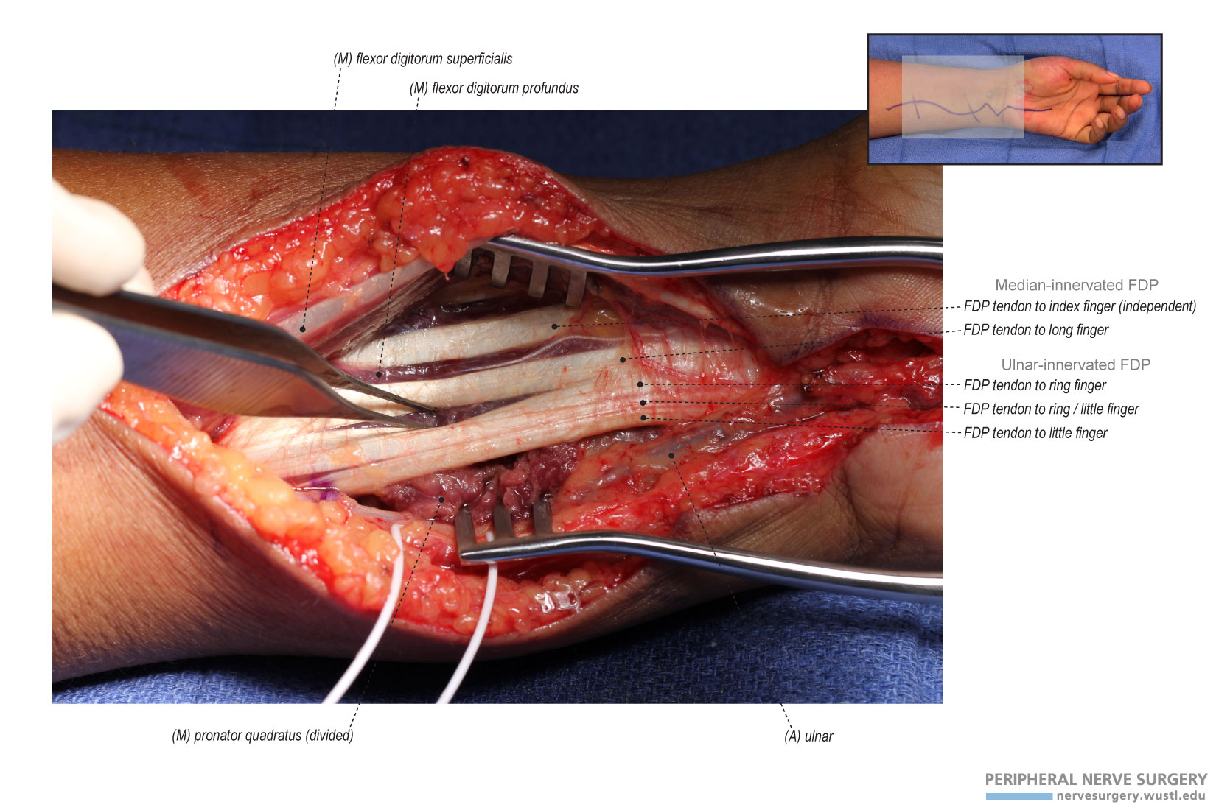
Nerves and neurons

Slide 6
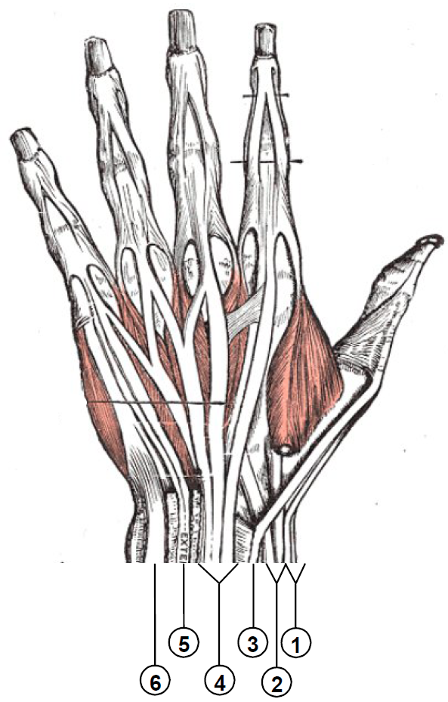
Nerves and neurons

Slide 7
Nerves and neurons
Therefore, the children of Israel may not eat the displaced tendon, which is on the socket of the hip, until this day, for he [the angel of Esav] touched the socket of Ya’akov’s hip, in the hip sinew.
-Bereishit (Torah) 32:33

Slide 8
Nerves and neurons
pneuma (Greeks)
prana (Vedic Indians)
qi (China)

Slide 9
Nerves and neurons
I will put breath into you and you shall live. There was a rustling sound and the bones fitted themselves together. Sinews appeared, flesh appeared and skin covered them but there was no life.
-Ezekiel, 36:2-11

Slide 10
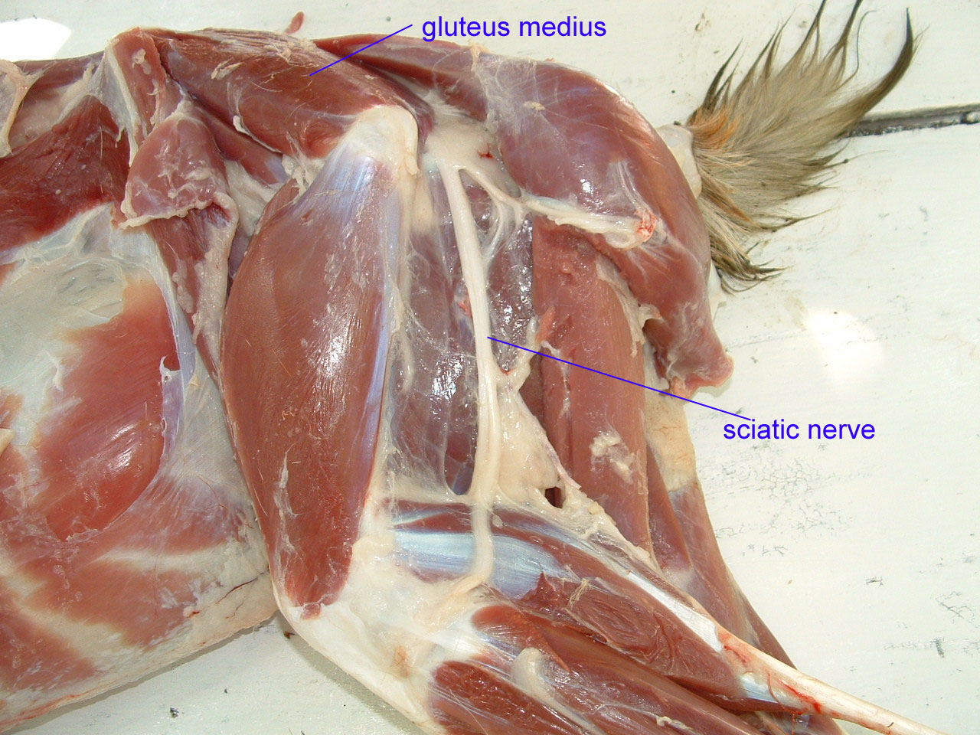
Nerves and neurons
(Goat)

Slide 11
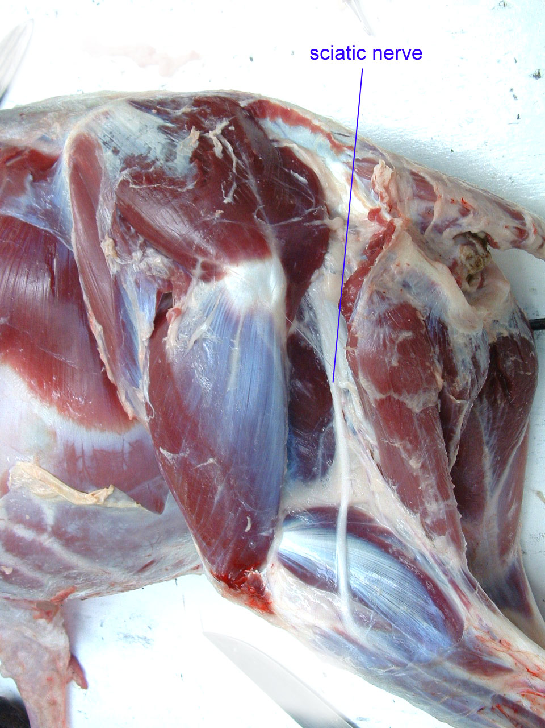
Nerves and neurons
(Sheep)

Slide 12
Nerves and neurons
Porging: the process of removing the sinews, veins, certain types of fat, and the sciatic nerve.

Slide 13
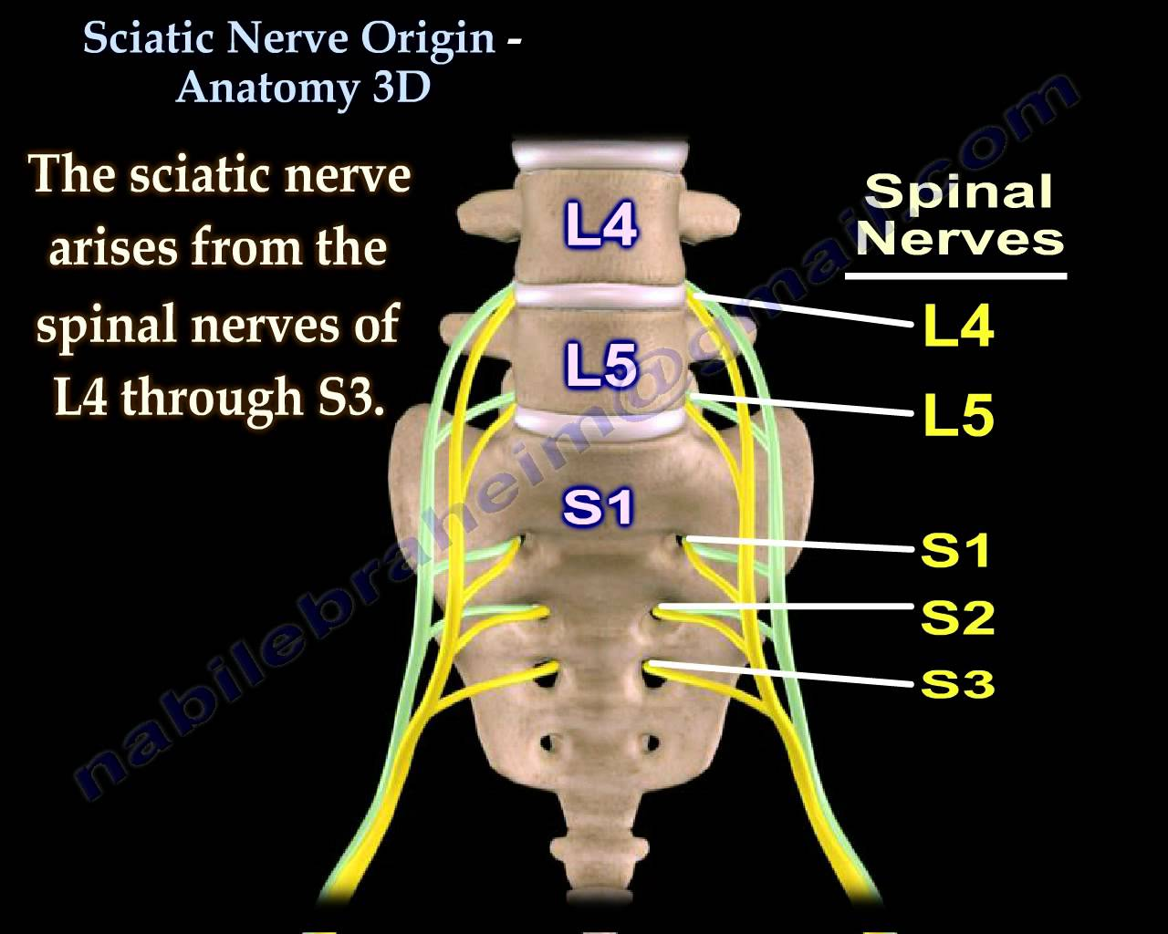
Nerves and neurons

Slide 14
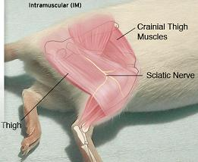
Nerves and neurons

Slide 15
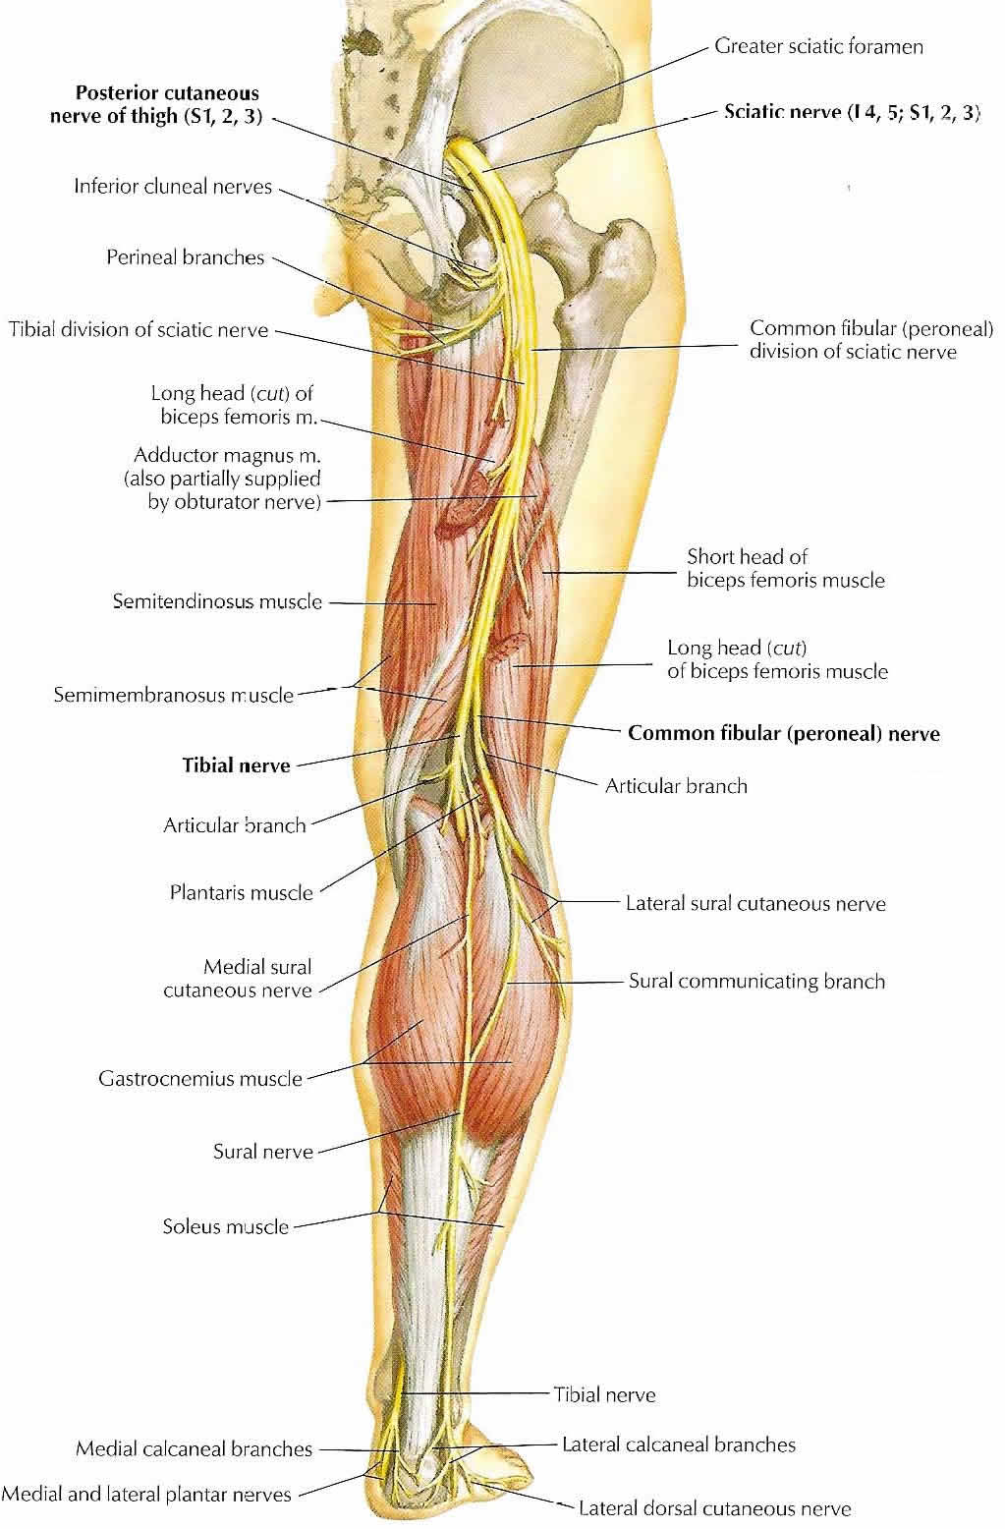
Nerves and neurons

Slide 16
Nerves and neurons

Slide 17
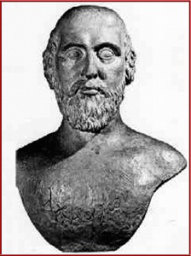
Nerves and neurons
Alcmaeon of Croton
b. approx. 510 BC

Slide 18
Nerves and neurons
Alcmaeon conducted dissections and wrote that nerves were divided:
into sensory and motor nerves
into the different senses
He also dissected bird eggs in various stages of development, noting that the brain was the first recognisable body structure to develop.
Differentiated consciousness from sensation: animals have the latter, but we have a stronger and more capable version of the former.

Slide 19
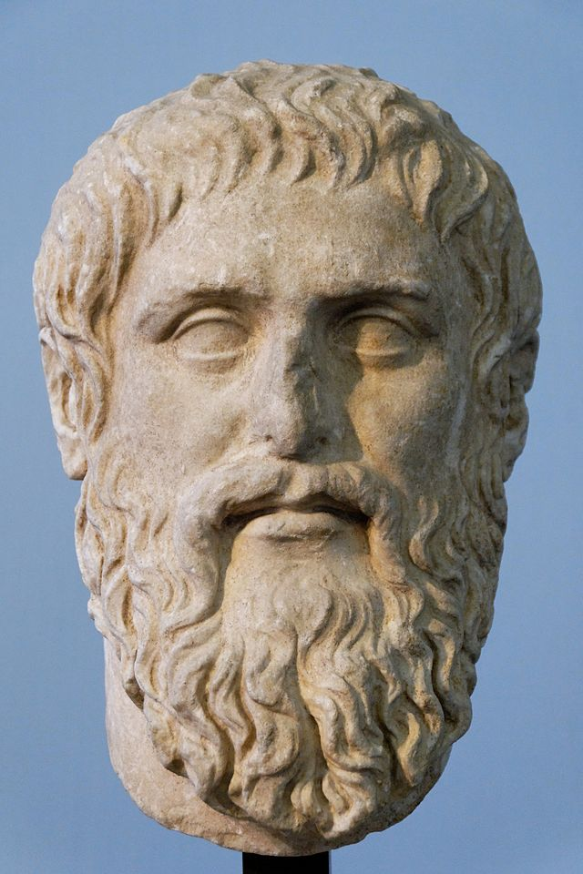
Nerves and neurons
Plato
428 – 348 BCE

Slide 20
Nerves and neurons
“that which was intended to contain the remaining and mortal part of the soul he distributed into figures at once round and elongated, and he called them all by the name “marrow,” and to these, as to anchors, fastening the bonds of the whole soul, he proceeded to fashion around them the entire framework of our body, constructing for the marrow first of all, a complete covering of bone.”
Goes on to describe the placement of the vertebrae.
-Plato’s Timaeus

Slide 21
Epicurean atomism
Everything is made of atoms: these do not change their fundamental properties, but merely rearrange themselves.
sight: simulacra or images, very thin and fast
hearing: a blow that causes atoms to move
smell: small bodies rising off an object

Slide 22
Epicurean atomism
Even at this point, we had a clear idea that the nerves were channels of sensation and action, divided up between the senses.

Slide 23
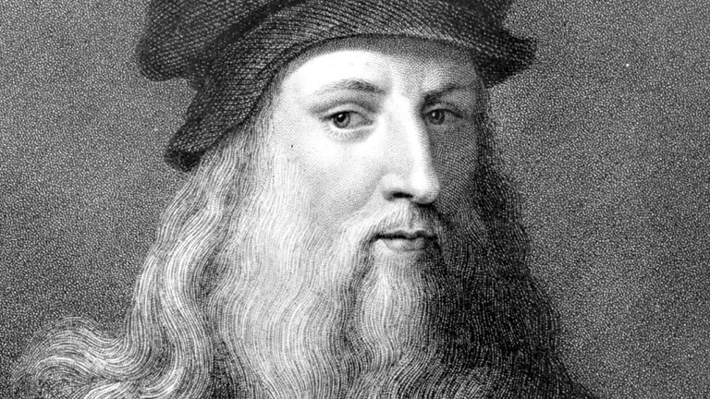
da Vinci
Leonardo da Vinci
1452 – 1592 BC

Slide 24
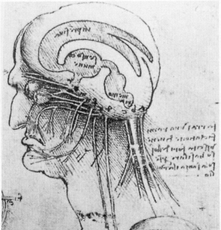
da Vinci

Slide 25
Epicurean atomism
The Nerves are nothing else but productions of the marrowy and slimy substance of the Brain, through which the Animal spirits do rather beam than are transported. And this substance is indeed more fit for irradiation then a conspicuous or open cavity, which would have made our motions and sensations more sudden, commotive, violent and disturbed, whereas now the members receiving a gentle and successive illumination are better commanded by our will and moderated by our reason.
Crooke's Microcosmographia (1631)

Slide 26
Epicurean atomism
“nerves have no perceptible cavity internally, as the veins and arteries have.”
John Moir, lecture notes, 1620

Slide 27
Epicurean atomism
1681: the word neurology is coined, by (of course) Thomas Willis.

Slide 28
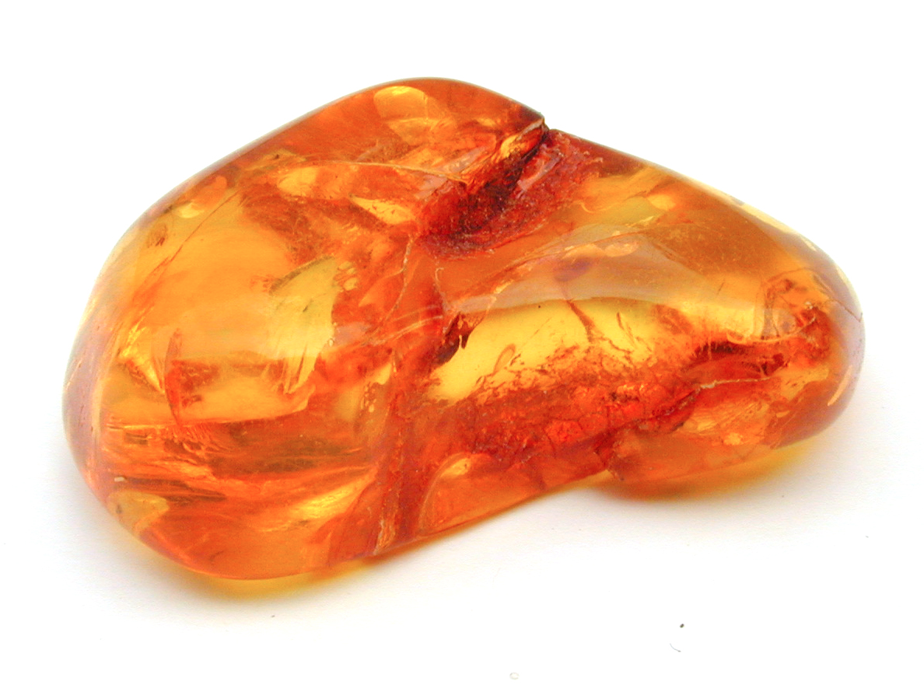
Electricity

Slide 29
Electricity
Amber: fossilised tree resin
electrum (Latin), elektron (Greek)
Latin electricius: of amber

Slide 30
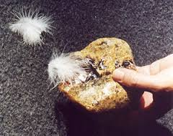
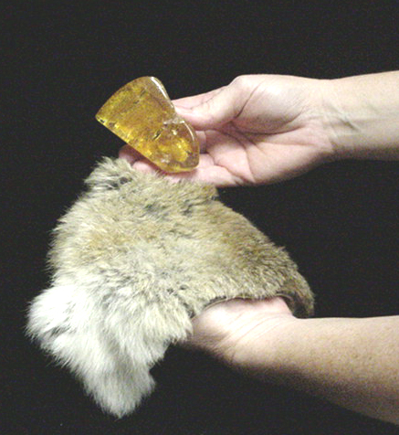
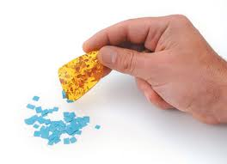
Electricity
Thales observed this in 600 BC

Slide 31
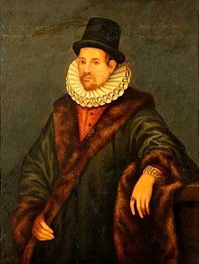
Electricity
William Gilbert
1544 - 1603

Slide 32
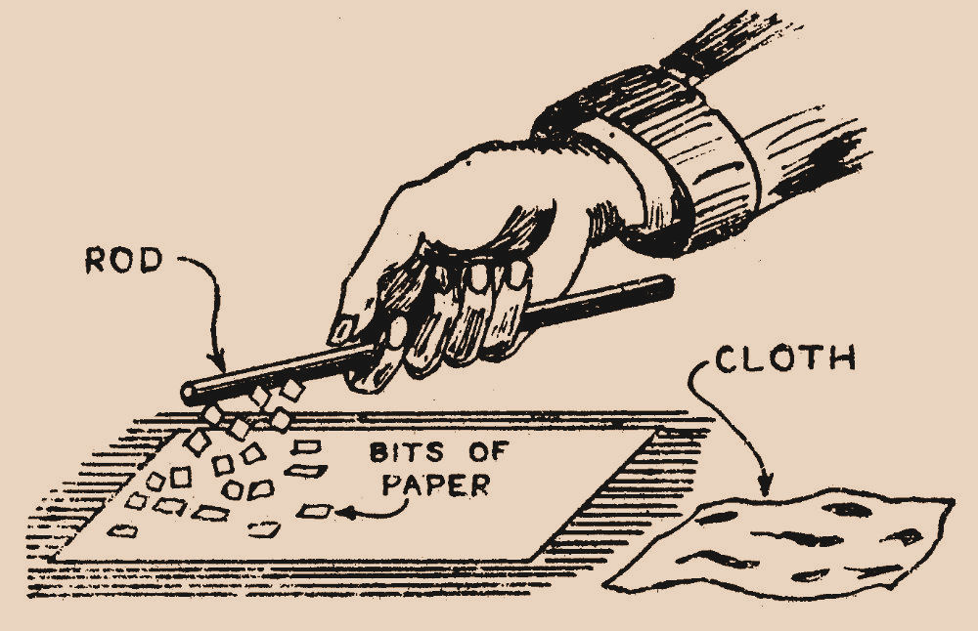
Electricity
Gilbert observed that, by rubbing various objects on each other, one could either
make them attract each other
or
make them repel each other

Slide 33
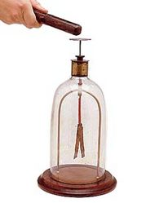
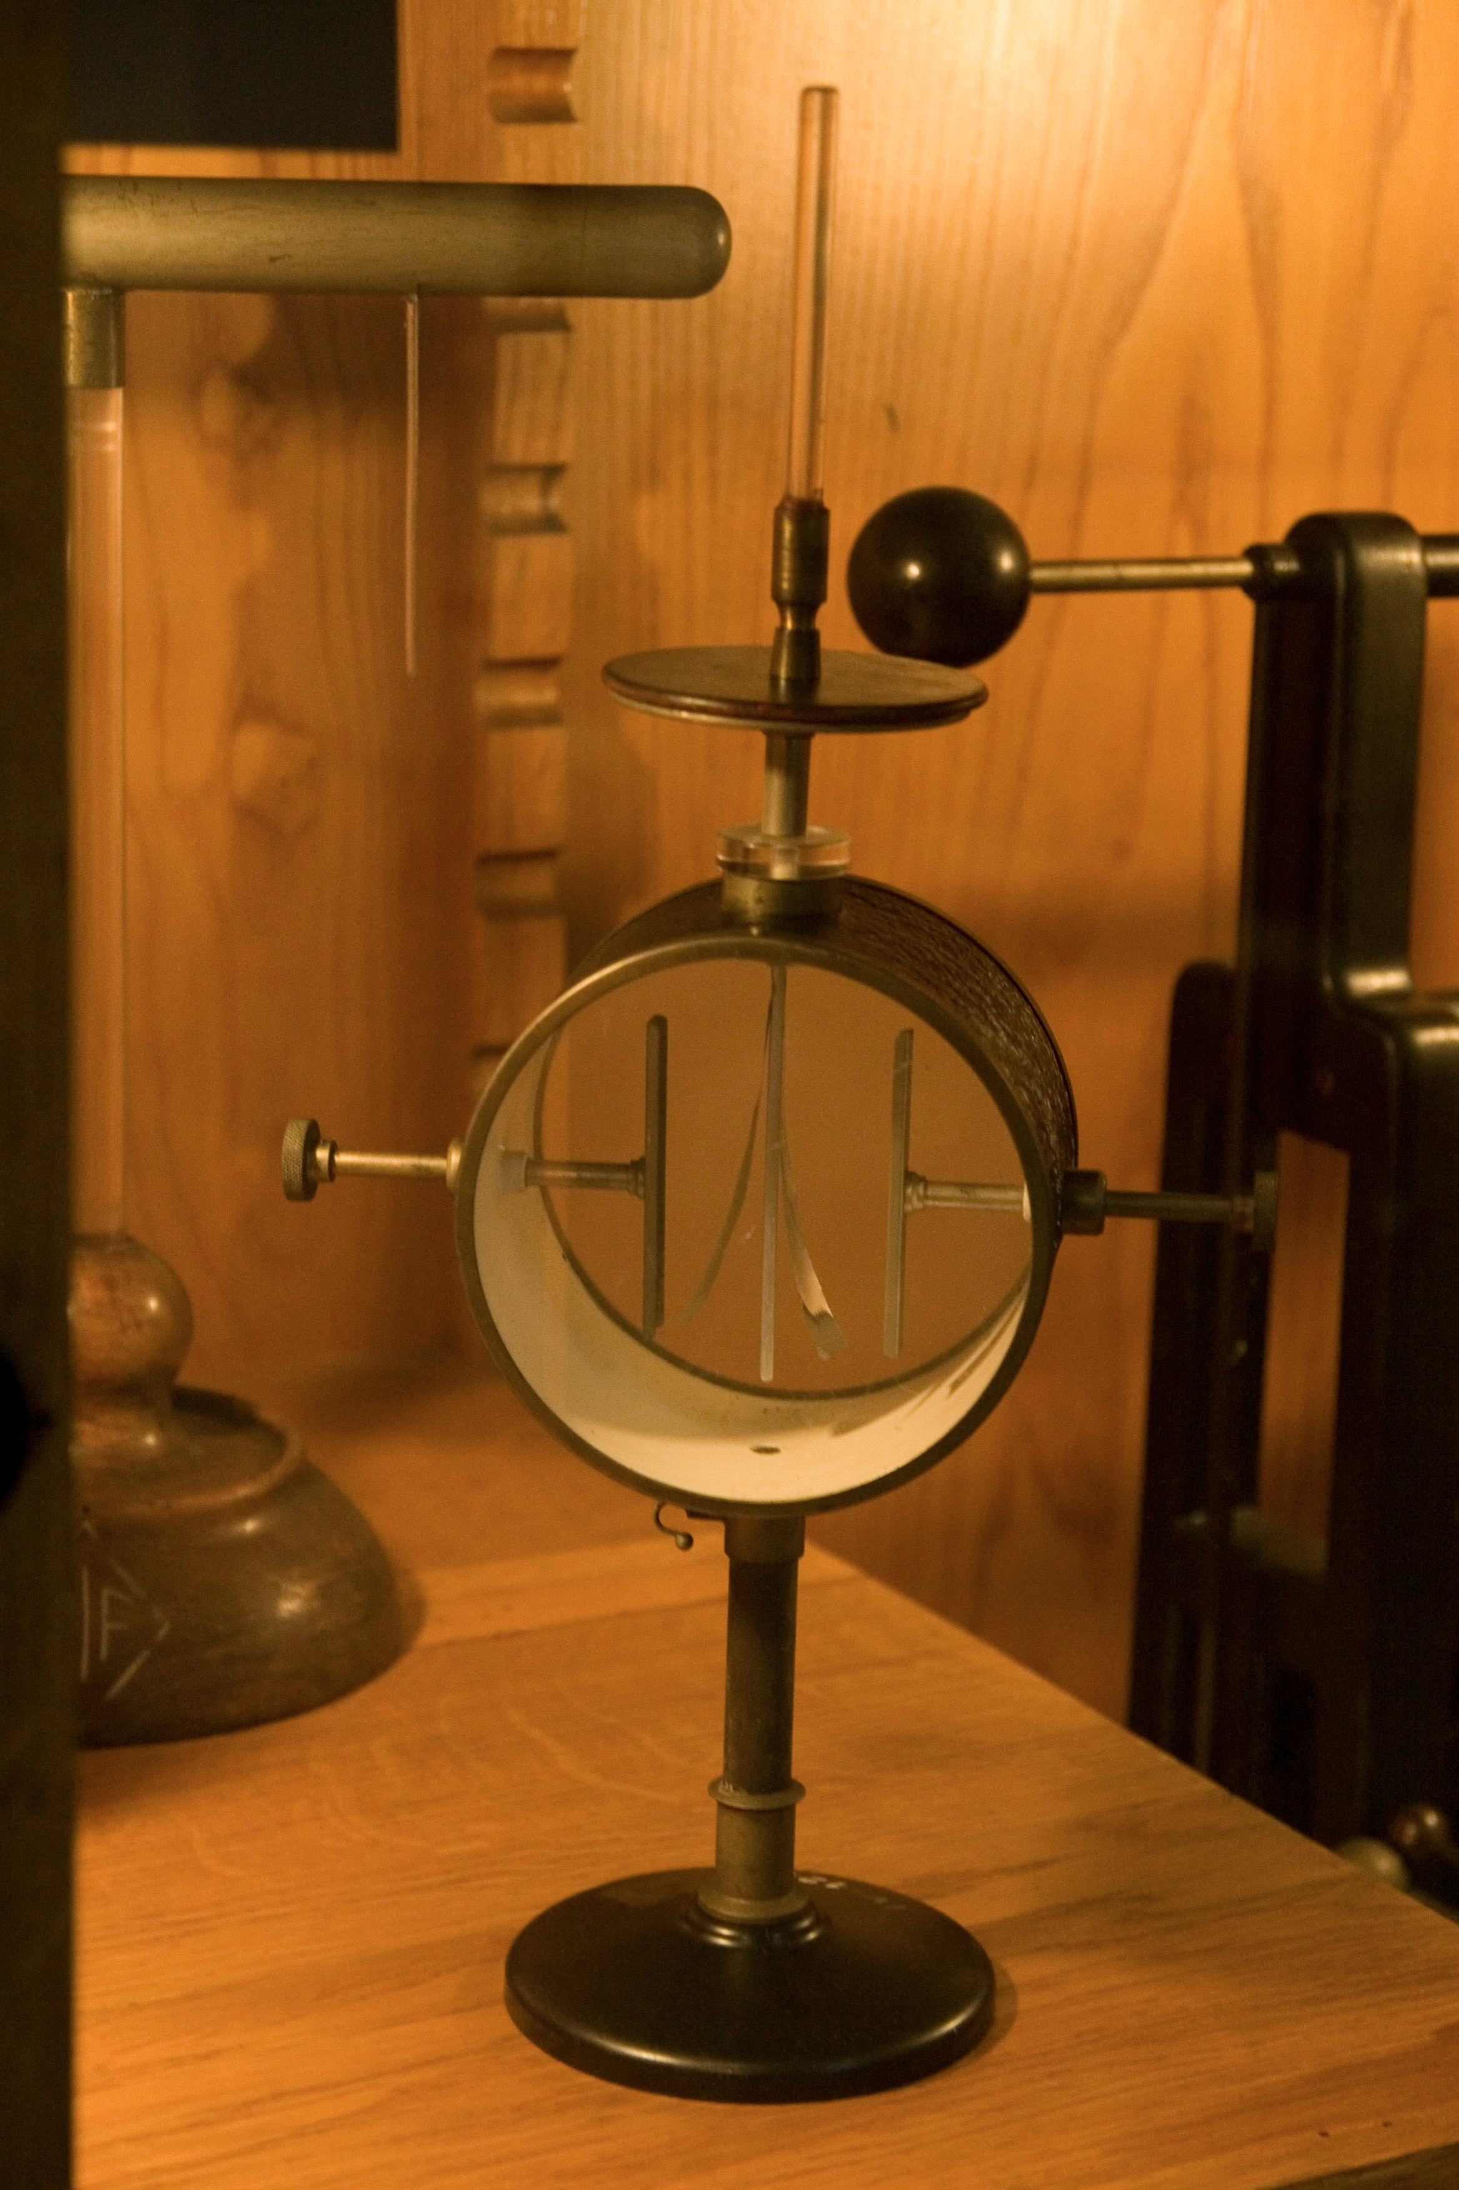
Electricity
The electroscope

Slide 34
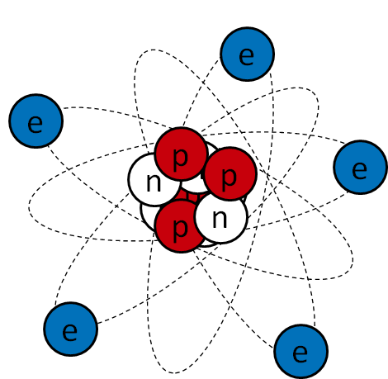
Electricity

Slide 35
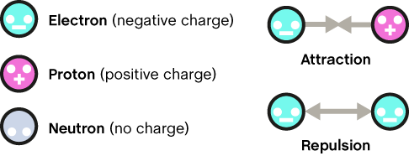
Electricity

Slide 36
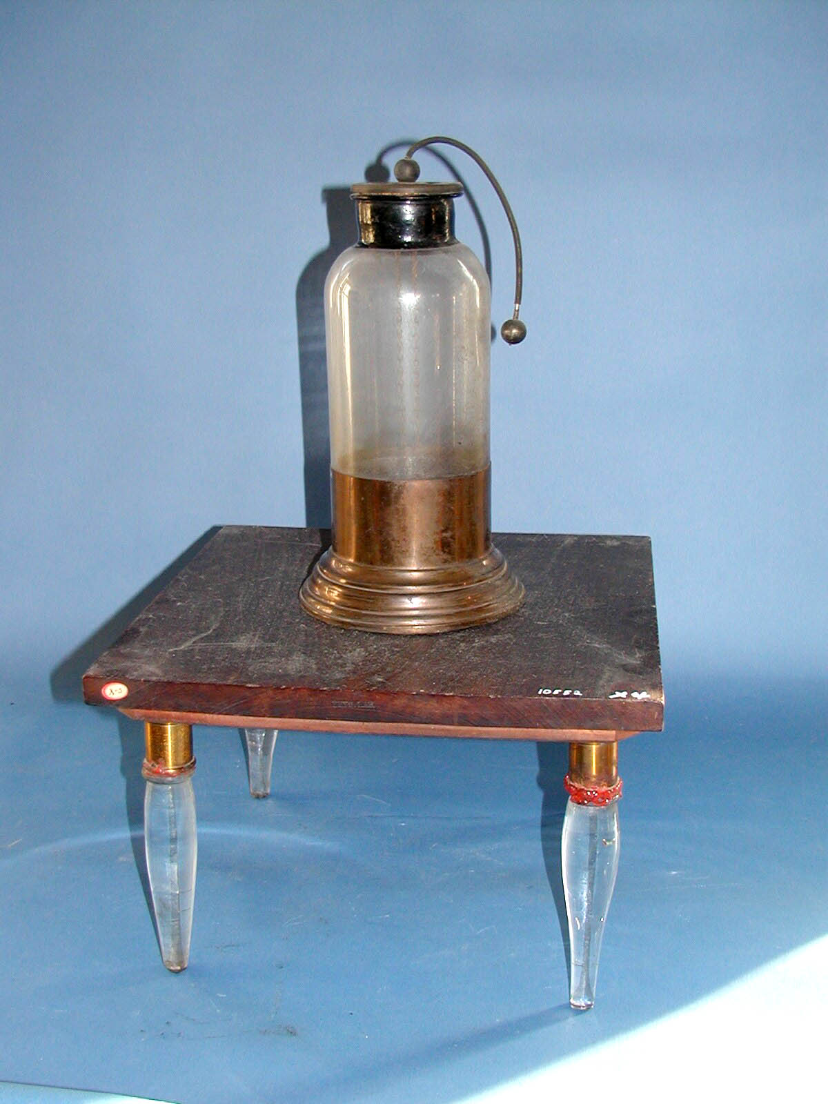
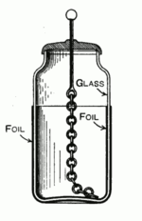
Electricity

Slide 37
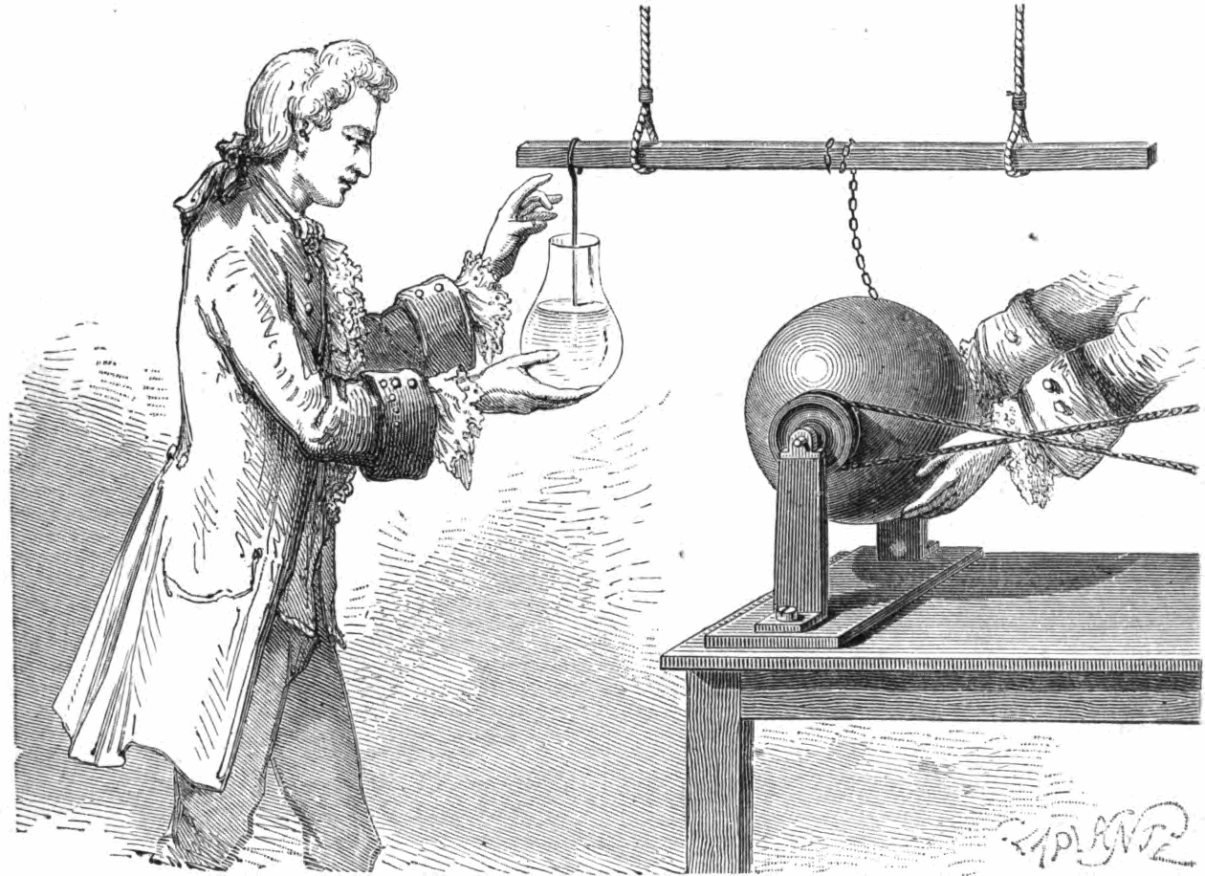
Electricity
Pieter van Musschenbroek, c. 1744, University of Leiden

Slide 38
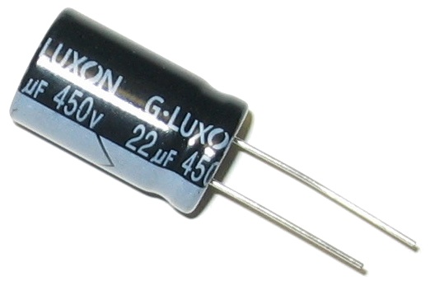
Electricity

Slide 39
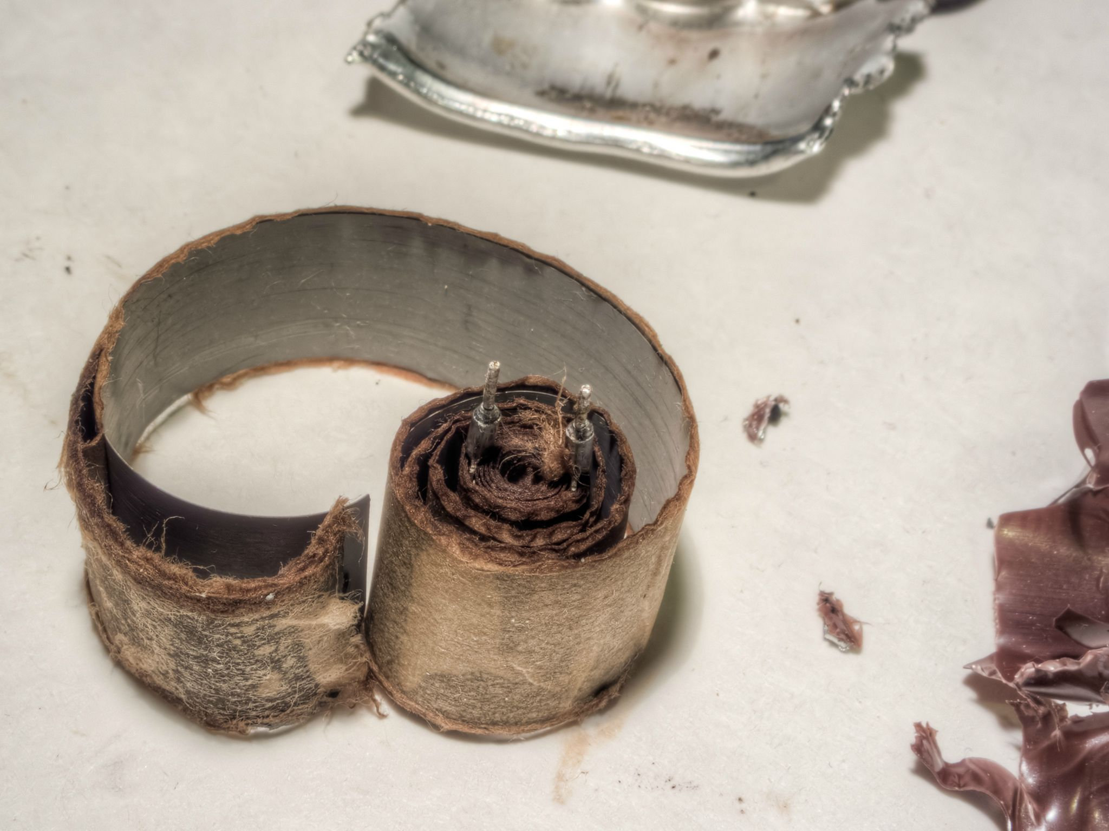
Electricity

Slide 40
Electricity
Touching a charged Leyden jar can make someone convulse and jump.

Slide 41
Electricity
Jean-Antoine Nollet is said to have connected approx. 200 monks into a circle a mile in circumference, using pieces of iron, and shocked them with a battery of Leyden jars.
Observing that they all reacted at the same time, he noted the extremely high speed of electricity.

Slide 42
Electricity
1736: Stephen Hales (1677 – 1761) proposed that electricity could be the long-sought agent of nervous action.
Joseph Priestley: electricity has “an occult power and agreeable to a fluid which was analogised to animal spirits.”

Slide 43
Electricity
Bonnefoy reviews the evidence:
Speed of nerve action: estimates were made from muscle contractions in running animals or rapid speech. Around 19 ft/sec
The blood cannot furnish enough energy to cause muscles to contract for long periods of time. Thus, there must be another system.
The air is a candidate: electricity (which we can see is already present in the environment) is brought in through the lungs.
The brain separates the electricity from the inspired air; in the fine blood vessels of the cerebrum, it is filtered out into the white matter, whence it is carried into the rest of the body.
[Bonnefoy, 1782, De l’application de l’électricite a l’art de guérir, academic dissertation]

Slide 44
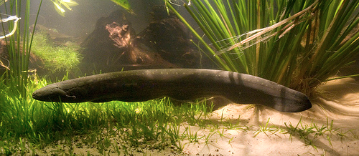
The electric eel

Slide 45
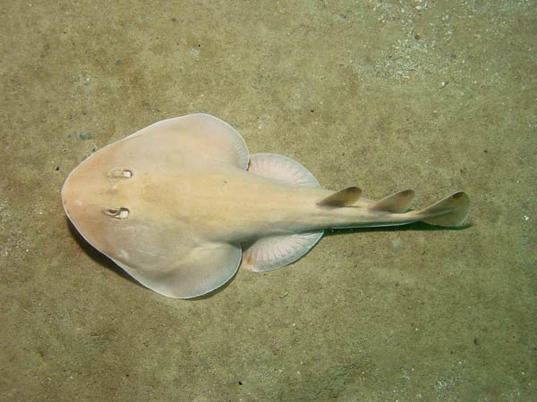
The electric ray

Slide 46
Electric fish
Known since antiquity.
Meno (a young, rich, good-looking student philosopher), to Socrates:
“You are exactly like the flat stingray fish that one meets in the sea. Whenever anyone comes into contact with it, it numbs him, and that is the sort of thing that you seem to be doing to me now. My mind and my lips are literally numb, and iI have nothing to reply to you.”
-Meno (Platonic dialogue), 380 BC

Slide 47
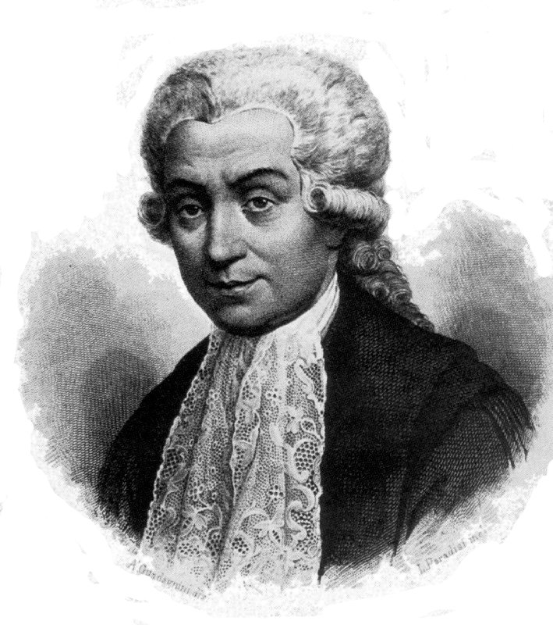
Galvani
Luigi Galvani
1737 - 1798

Slide 48
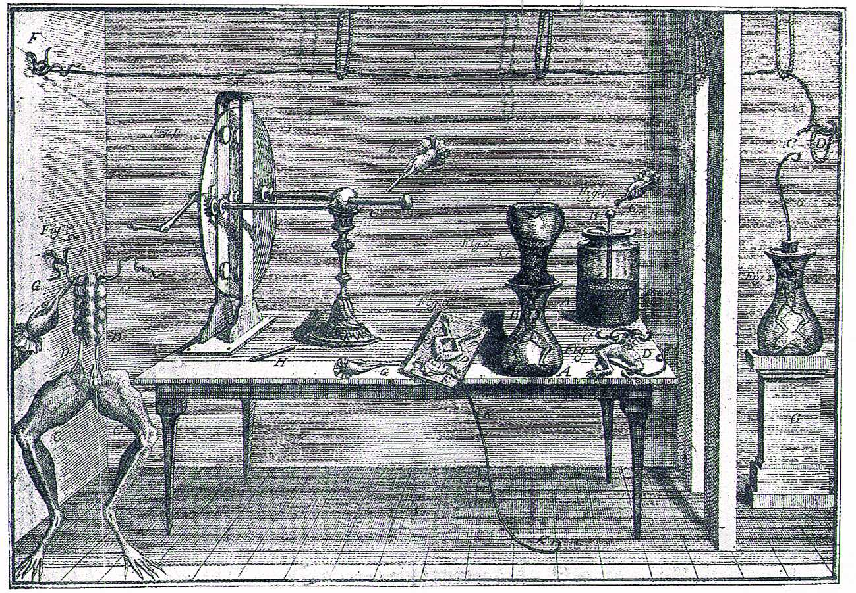
Galvani
De viribus electricitatis in motu musculari, 1792

Slide 49
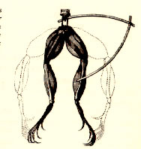
Galvani
“Animal electricity”

Slide 50
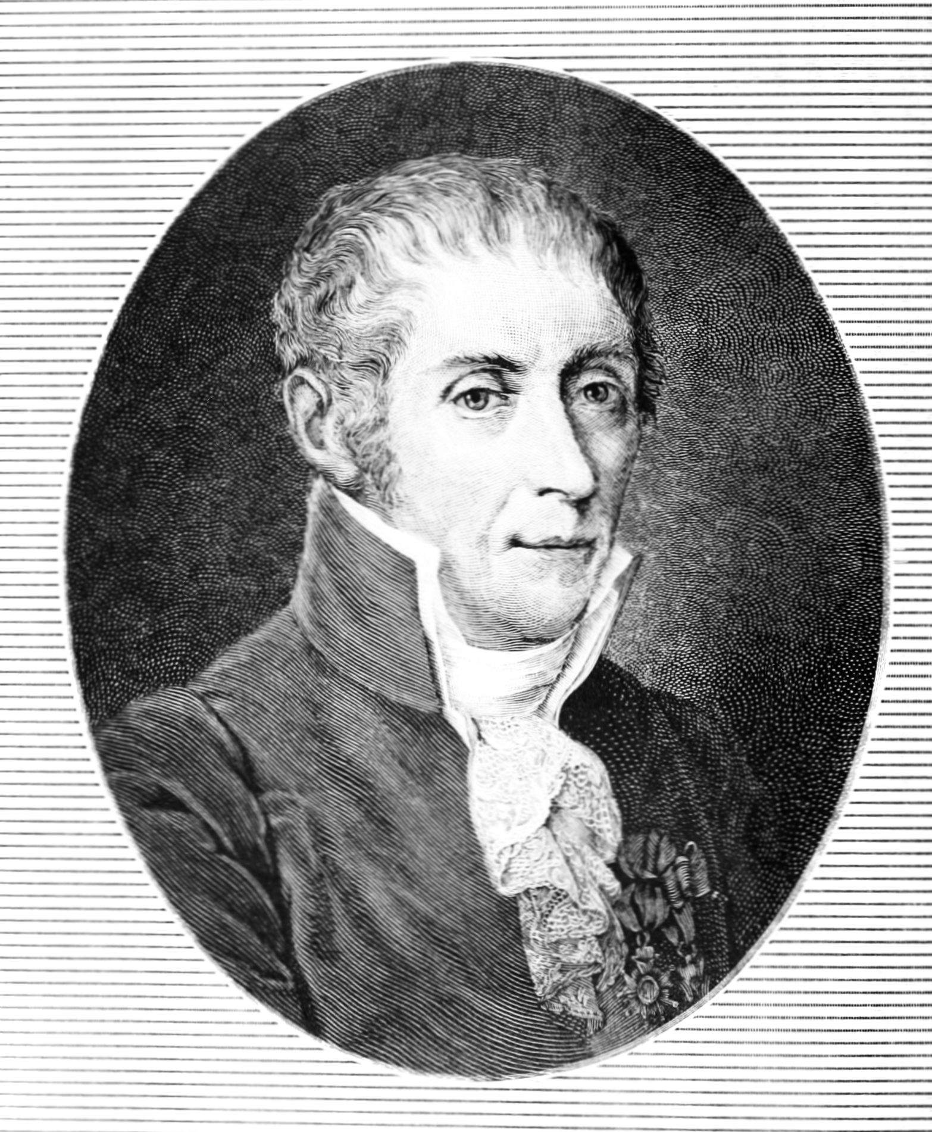
Volta
Alessandro Volta
1745 - 1827

Slide 51
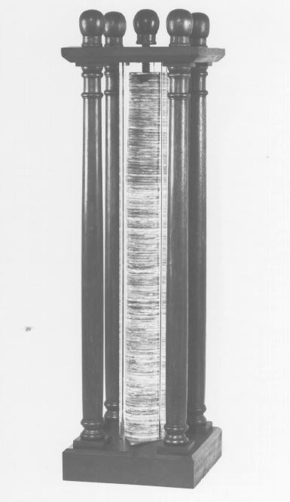
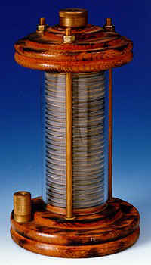
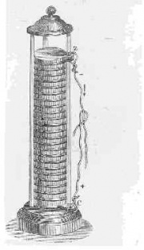
Voltaic piles
Invented 1800

Slide 52
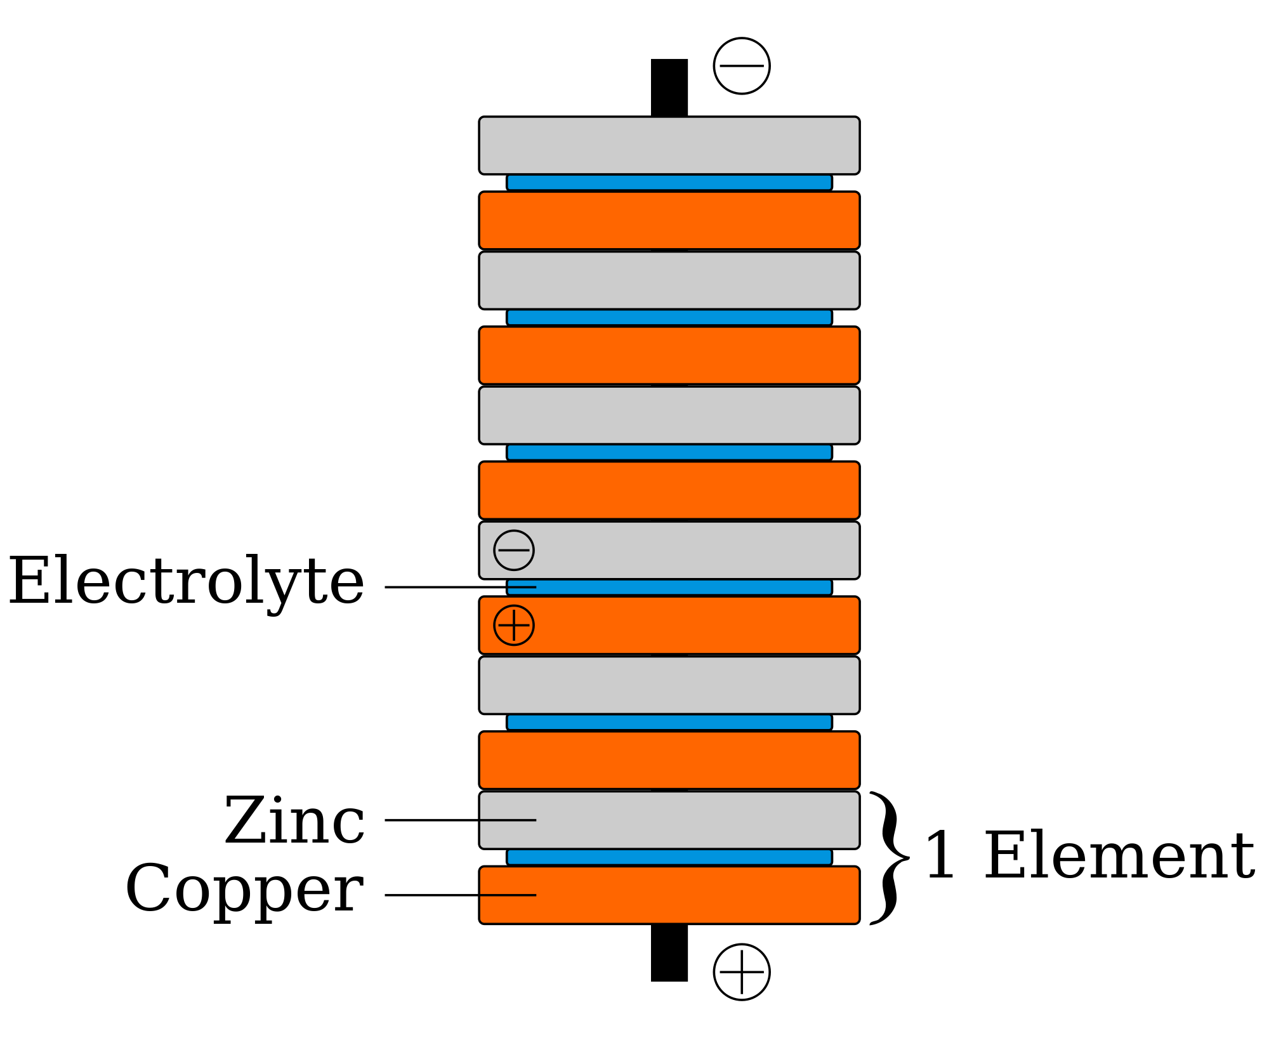
Voltaic piles

Slide 53

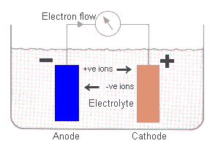

Voltaic piles

Slide 54
Nerve conduction velocity
Emil du Bois-Reymond (1818 – 1896) examined the speed of impulse transmission in nerves using a rheotome.
His estimate was 30 or 40 m/s, which is quite close to the current value.

Slide 55
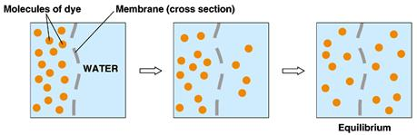
Action potentials

Slide 56
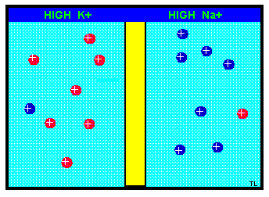
Action potentials

Slide 57
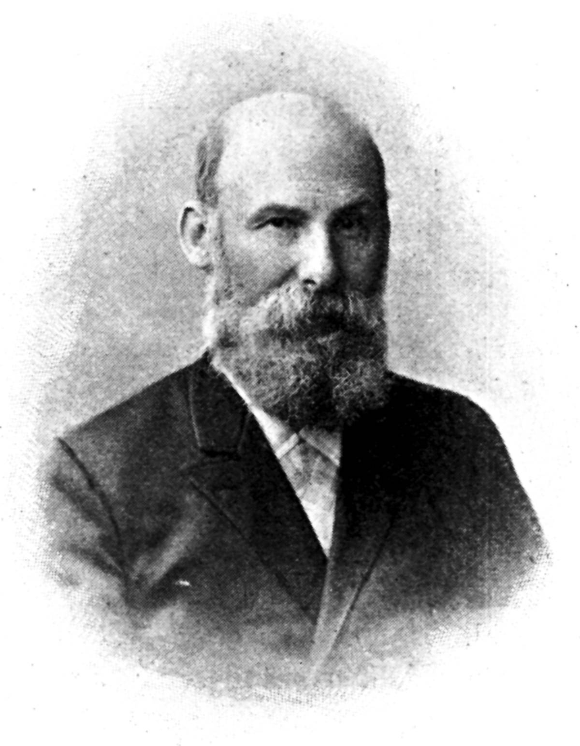
Action potentials
Julius Bernstein
1839 - 1917

Slide 58
Action potentials
Bernstein postulated that an equilibrium potential existed across the membrane enclosing a nerve fibre.
When the membrane is depolarised, a wave of depolarisation flows along the nerve fibre.
The membrane returns to its previous state shortly afterwards.

Slide 59
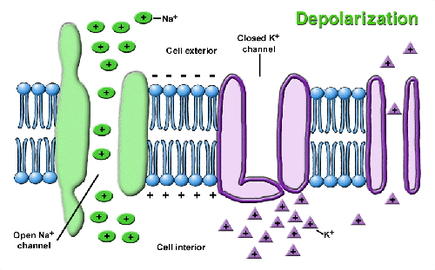
Action potentials

Slide 60
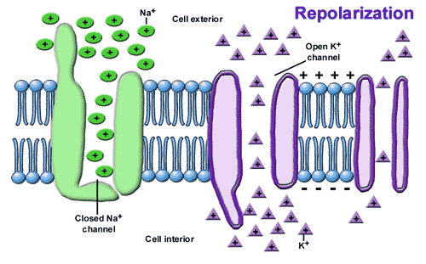
Action potentials

Slide 61
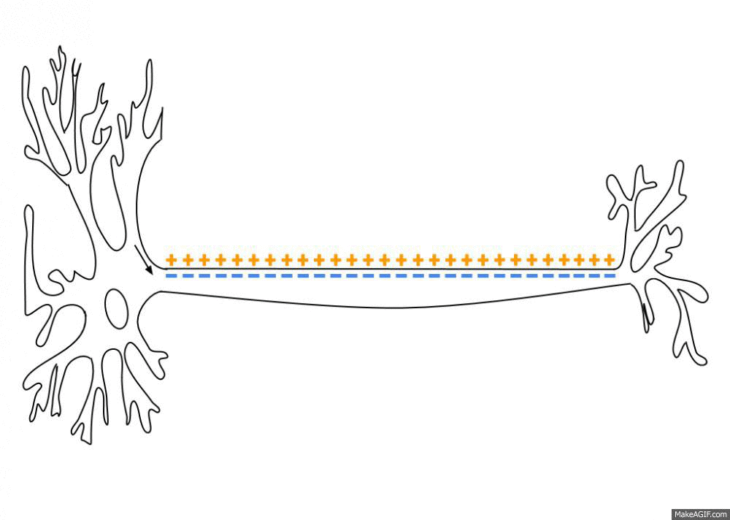

Action potentials

Slide 62
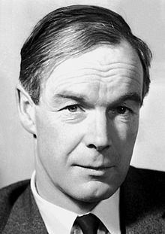
Hodgkin and Huxley
Alan Lloyd Hodgkin
1914 - 1998

Slide 63
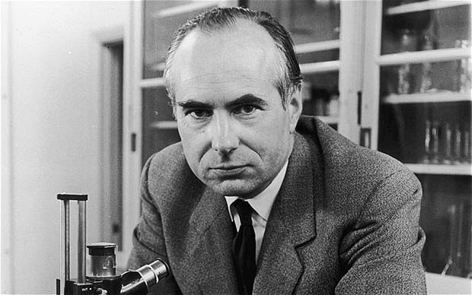
Hodgkin and Huxley
Andrew Fielding Huxley
1917 - 2012

Slide 64
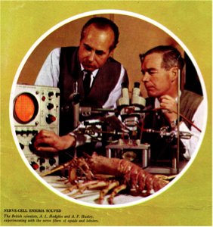
Nerves and neurons

Slide 65
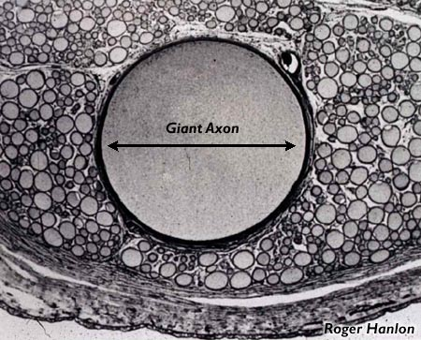
Hodgkin and Huxley
0.5 – 1 mm in diameter

Slide 66
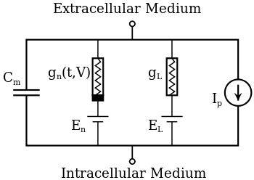
Hodgkin and Huxley

Slide 67
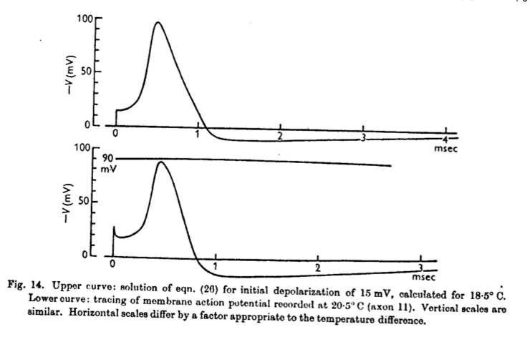
Hodgkin and Huxley

Slide 68

Action potentials

Slide 69

Synapses
John Carew Eccles
1903 - 1997

Slide 70

Action potentials

Slide 71

Action potentials

Slide 72
Action potentials
EPSP: excitatory post-synaptic potential
cell more likely to depolarise
IPSP: inhibitory post-synaptic potential
cell more likely to hyperpolarise

Slide 73

Action potentials
[compoundchem.com]

Slide 74

Action potentials
[compoundchem.com]

Slide 75

Action potentials
[compoundchem.com]

Slide 76

Action potentials
[compoundchem.com]

Slide 77

Action potentials

Slide 78

Nerve cells in the brain
Santiago Ramon y Cajal
1852 - 1934

Slide 79

Neurons in the brain
Santiago Ramon y Cajal
1852 - 1934

Slide 80

Neurons in the brain

Slide 81

Neurons

Slide 82

Neurons

Slide 83
Neurons
What is the nature of such relatively autonomous activities in the cerebrum? We know a great deal about the afferent pathways to the cortex, about the efferent paths from it, and about many structures linking the two. But the links are complex and we know nothing about what goes on between the arrival of excitation at a sensory projection area and its later departure from the motor area of the cortex.
-Donald Hebb, 1950s

Slide 84
Neurons
How do neurons learn?
How do neurons remember?
How do neurons predict?
How do neurons...

