Slide 1
Introduction to programming
Fintan Nagle fintan.nagle.10@ucl.ac.uk

Slide 2
Structure
Session 1: Friday 4 Oct 14:00-16:00
-Computer architecture
-Algorithms
-Complexity
Session 2: Friday 11 Oct 09:00-11:00
-Language tour
-Software design
Friday 18 Oct to Friday 13 Dec
Programming course with Lewis Griffin

Slide 3
Notes
Slides will be available on http://www.ucl.ac.uk/~ucbpfsn/.
They will also be emailed to you.

Slide 4
Computer architecture

Slide 5
What is a computer?

Slide 6
What is a computer?
- Something which computes.

Slide 7
What is a computer?
- Something which computes.
- A machine which computes.

Slide 8
What is a computer?
- Something which computes.
- A machine which computes.
- A machine which computes something useful.

Slide 9
What is a computer?
- Something which computes.
- A machine which computes.
- A machine which computes something useful.
- A machine which computes something useful, fast.

Slide 10
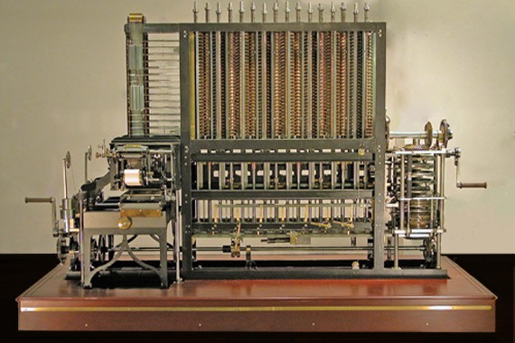
The first computers
Difference Engine: Charles Babbage, 1840s

Slide 11
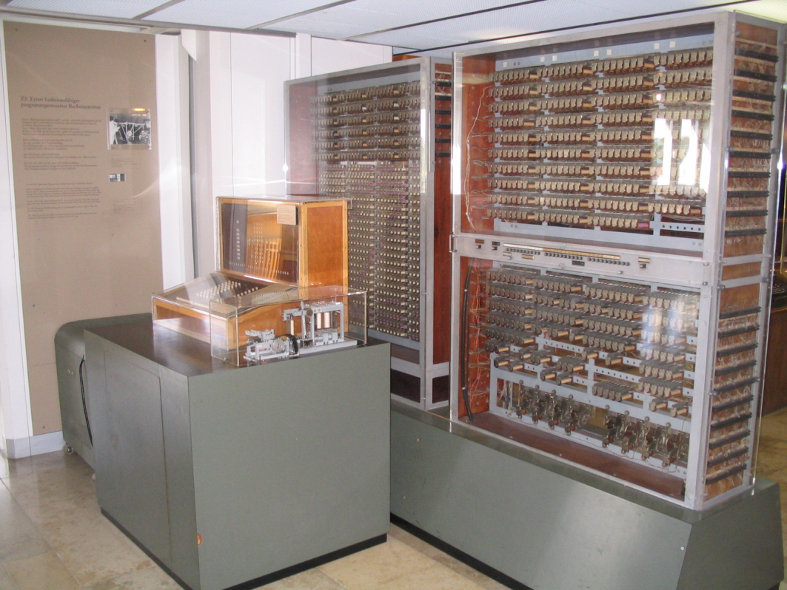
Towards a modern architecture
Konrad Zuse’s Z3, Berlin, 1941
Statistical analyses of wing flutter

Slide 12
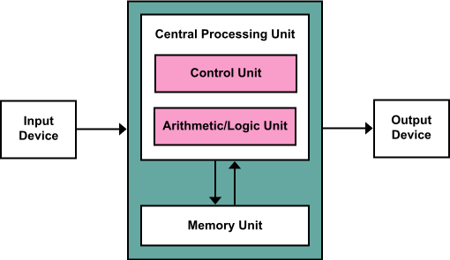
The Von Neumann architecture
Princeton, 1945.
This paradigm seems like second nature now, but was a major development at the time.

Slide 13
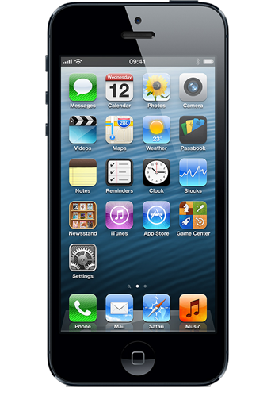
Modern machines

Slide 14

Modern machines

Slide 15
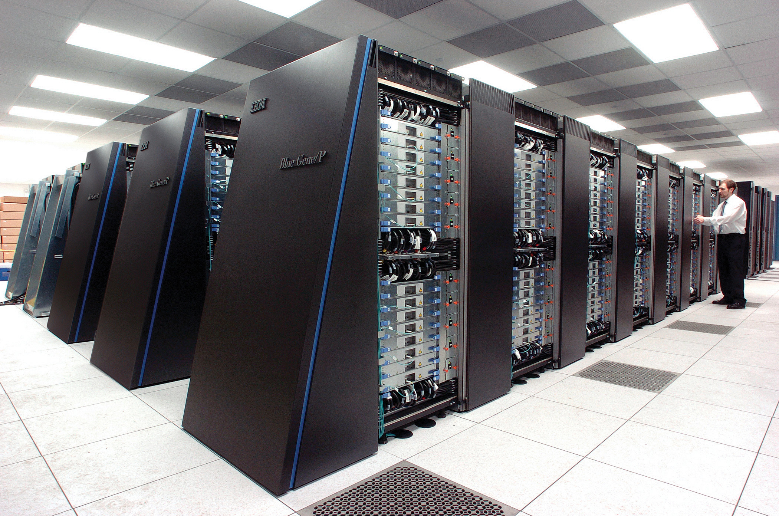
Modern machines

Slide 16
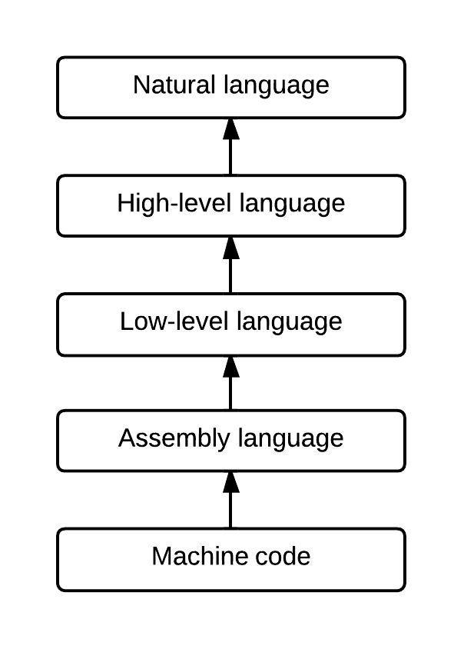
Levels of code
Natural language: English
Fuzzy, vague description of requirements
High-level language: expressive, concise, powerful
Low-level language: less expressive, more specific, closer to the metal
Assembly language: very similar to machine code, but slightly more human-readable
Machine code: the sequence of ones and zeros that actually controls the processor
People used to code in this!

Slide 17
Compilation
When code is compiled, higher-level code is generated.
A typical C program will be compiled to machine code before being executed on the processor.

Slide 18
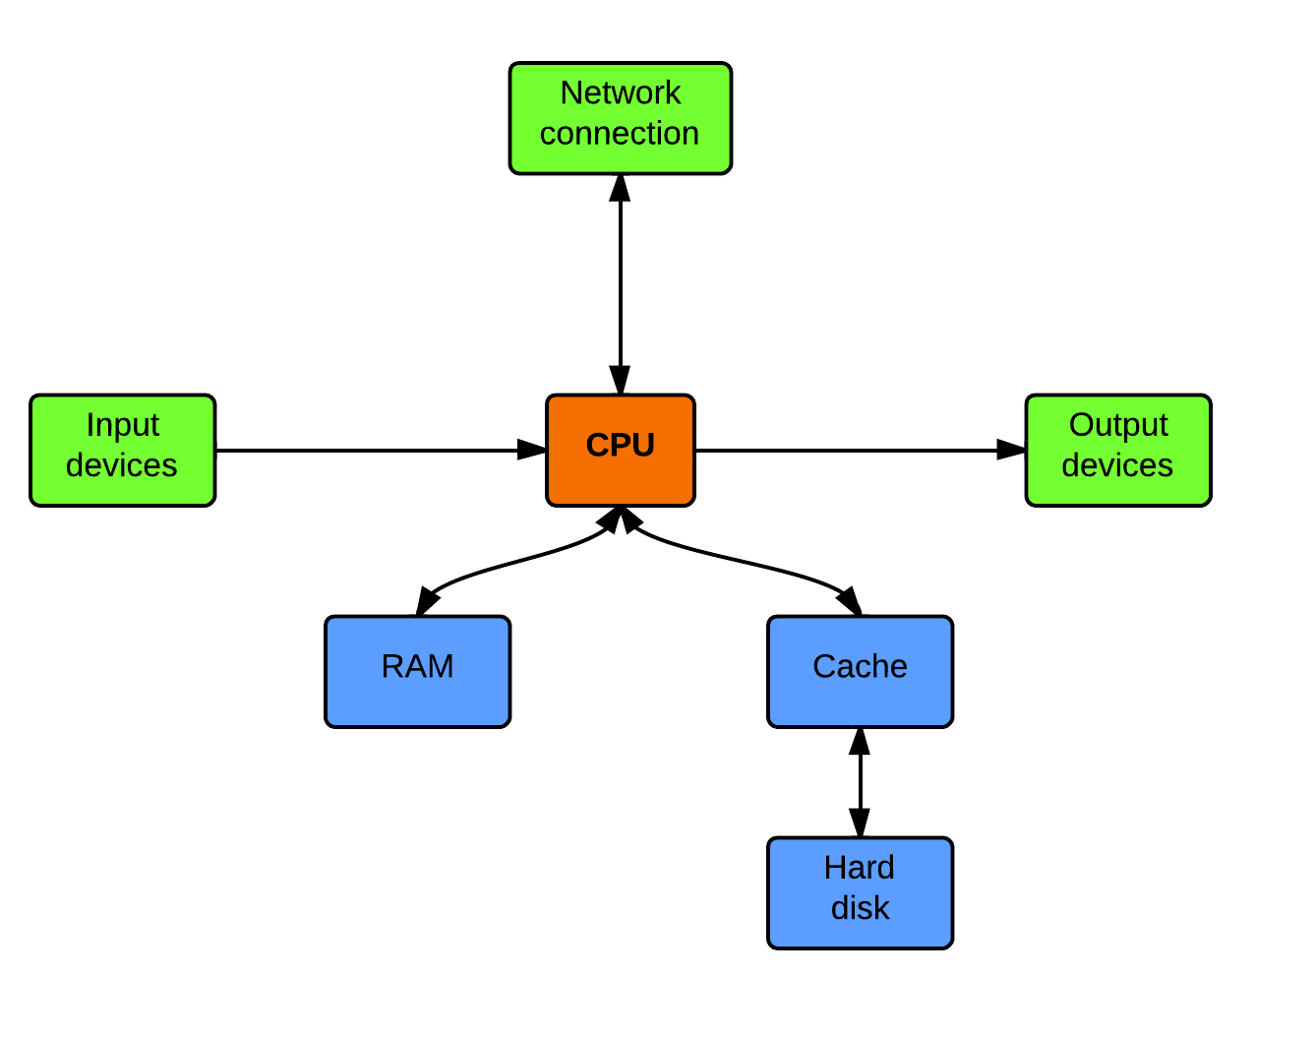
Modern computer architecture

Slide 19
Modern computer architecture
CPU: processing
Hard disk: big and slow storage (10 ms access time). Has locality: it’s quicker to access data just after the data you just accessed, because the head doesn’t have to move.
RAM: very fast memory (10 ns access time – a million times slower), low-capacity, no locality
HD cache: stores frequently requested information (like a frequently used image) in fast RAM-like memory
Input devices: keyboards, mice, electron microscopes
Output devices: monitors, speakers, laser controllers
Network connection: even slower than the HD

Slide 20
Hard disk and RAM speeds
The hard disk is about one million times slower than RAM.
This means that reading and writing from and to disk can be a significant bottleneck in data processing applications.
Try and minimise repeated reads by caching data in RAM.

Slide 21
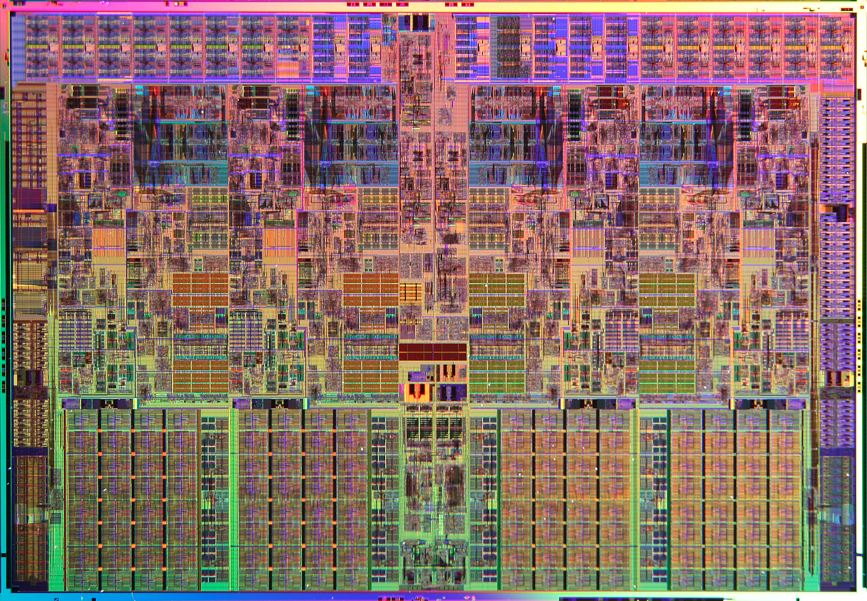
The CPU

Slide 22
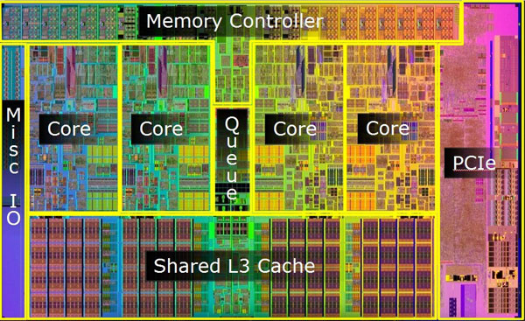
The CPU

Slide 23
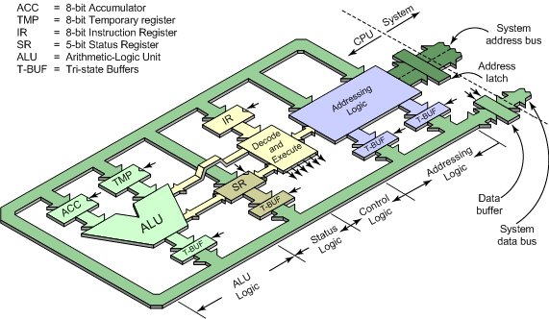
Modern computer architecture

Slide 24
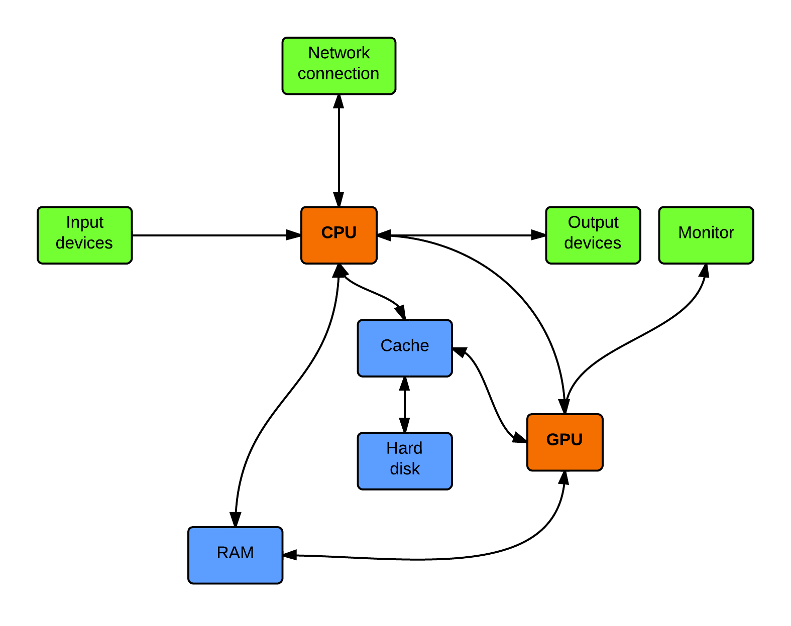
The graphics processing unit (GPU)

Slide 25
The graphics processing unit (GPU)
Graphics is a specialised, highly parallel problem.
Luckily, so is much bioinformatics!
When to use the GPU
There are lots of highly independent operations which need processing at the same time
You need to do graphics.
It is commonplace to speed up your code hundreds of times!
There are special languages and libraries for parallel GPU programming- we will see these in the next session.

Slide 26
The operating system (OS)
Sits on top of the hardware architecture, allowing humans to interact with the computer.
Unix: one of the first real operating systems, dates from 1969
UNiplexed Information and Computing Service
DOS: command line Micro$oft OS
Windows: added a graphical layer to DOS
Linux: more modern and user-friendly version of Unix
Mac OS X: basically Linux underneath, but with a nice-looking interface and enhancements by Apple.
Unix, Linux and Max OS X all use the same command line and very similar kernels.

Slide 27
Human-computer interaction
Comes in two main forms:
Graphical user interfaces (GUIs)
The command line

Slide 28
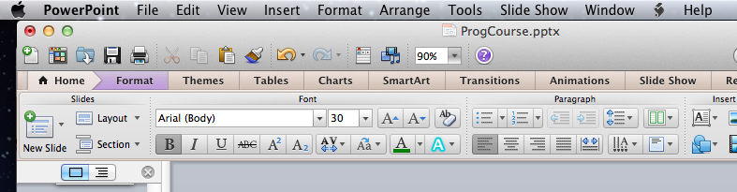
Graphical user interfaces
Good: controls are obvious user-friendly for beginners
Bad: operations take time operations are not scriptable

Slide 29
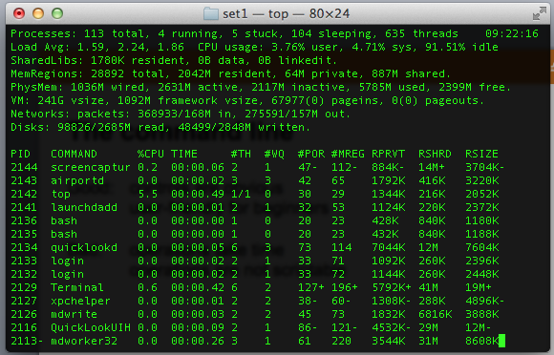
The command line
Good: very fast once you are familar scriptable – any command you can type, you can put in a script
Bad: commands are not obvious commands need to be remembered
2D visual operations are impossible

Slide 30
Using the command line
First you open a terminal window.
1. The command prompt is displayed mylaptop:fintan$
2. You enter a command
3. You hit return
4. Output is written to the terminal window
5. The command prompt is displayed again

Slide 31
Common commands
First you open a terminal window. pwd Show current directory cd Change to home directory cd /this/folder Change to a particular folder ls List items in this folder open file Open this file with its designated handler chmod file Change permissions of a file mv Move a file cp Copy a file top Show active processes ping Ping a remote computer and check for reply man command Show user manual for a command

Slide 32
Permissions
First you open a terminal window.
Each file has permissions associated with it: read write execute
For different users: owner everyone specific permissions for particular users (ACLs, access control lists)
Permissions are added using chmod: chmod +x myprogram allows myprogram to be

Slide 33
Running executables
You can run a command in the current folder by typing
./commandName (the dot means “current folder.”)
If we’re not in the same folder as the command, we can run it using
/users/fintan/commandName.
To save time, there is a variable $PATH (we used $ when accessing variables) which saves common command locations( like the bin folder).
When we type a command (like ls) the shell looks in the locations specified in the path, for a command with that name. Then it runs /bin/ls.

Slide 34
Path problems
If you get a command not found error, it’s probably because the command is somewhere not on your $PATH.
The is easily updated by typing export PATH=/my/new/path:$PATH
This adds the new path to the beginning of the previous path.
This will change the path for the current terminal session only.
To make a permanent change, add that line to the .bash_profile file in your home folder. This gets run whenever you open a terminal window.
You may need to use chmod +x .bash_profile to make .bash_profile executable.
.bash_profile is also invisible in the Finder (due to its leading full stop).

Slide 35
Algorithms

Slide 36
Algorithmics
The study of algorithms and how they operate
(not how they are actually developed – this is software engineering).
Complexity
The study of the solvability, running time and space requirements of problems.

Slide 37
Variables
Allows the program to remember quantities.
Variables are declared (int a = 4;) and then accessed (print(a);).
Variables have types: boolean (1 or 0) 1 bit integer 1 byte floating point number 4 or 8 bytes string any number of bytes

Slide 38
Structures
Allow more complicated variables with multiple parts.
For example, we define a structure dog with parts dog.age integer dog.colour string
We declare an instance like this: dog Fido;
Then we set the structure components:
Fido.age=4;
Fido.colour=‘red’;
Structures are used to hold logically grouped data.

Slide 39
Branching: if statements
Allows the program to make conditional choices.
if microscopeWorking
doSomeScience;
else
goHome;

Slide 40
Repetition: loops
Allow the program to repeat operations.
When executed, loops are unrolled into a final series of operations.
doSomeScience;
doSomeScience;
doSomeScience;
doSomeScience;
doSomeScience;
doSomeScience;
doSomeScience;
doSomeScience;
doSomeScience;
doSomeScience;
doSomeScience;
doSomeScience;
doSomeScience;
doSomeScience;
getSomeSleep;
getSomeSleep;
getSomeSleep;
getSomeSleep;
getSomeSleep;
getSomeSleep;
getSomeSleep;
getSomeSleep;
getSomeSleep;
getSomeSleep;
for i=8:21
doSomeScience;
for i=22:7
getSomeSleep;

Slide 41
Functions
Allow abstraction: a process can be given a name, then called.
This allows that process to be defined in one place and used in multiple places. This means:
No repetition (saves space)
Ease of change (a function can be updated easily) function goToTheShops: leaveHouse; turnLeft; turnRight; buyFood; goHome;
function goHome:
leaveShops;
turnLeft;
turnRight;
enterHouse;
function weekend:
goToTheShops;
eat;
goToTheShops;

Slide 42
Objects
Objects are again one level up from functions.
They group variables and methods (a method is the same thing as a function).
For example, a cat object could have the variables age colour and the methods meow eat sleep
Objects are like structures which can do things (because they have functions). They are a very good match with how we see the world, and object-oriented programming is based around them.

Slide 43
Modules
One level up from functions and objects.
A module is a collection of variables, functions and optionally objects which we can use together.
Libraries (such as image processing, video encoding or gene analysis libraries) are a form of module.
We must import modules before they can be used.
Modules group many objects and functions which are all concerned with a common theme.

Slide 44
Aside: counting in programming languages
Consider a list of items. We want to process items m through n.
How many items do we have to process?

Slide 45
Aside: counting in programming languages
Consider a list of items. We want to process items m through n.
How many items do we have to process?
Imagine you have ten oranges. You want to eat oranges three through seven.
How many oranges will you eat?

Slide 46
Aside: counting in programming languages
Consider a list of items. We want to process items m through n.
How many items do we have to process?
Imagine you have ten oranges. You want to eat oranges three through seven.
How many oranges will you eat?
Instead, you want to eat oranges three through four. How many oranges will you eat?

Slide 47
Aside: counting in programming languages
Consider a list of items. We want to process items m through n.
How many items do we have to process?
Imagine you have ten oranges. You want to eat oranges three through seven.
How many oranges will you eat?
Instead, you want to eat oranges three through four. How many oranges will you eat?
4-3 = 1? No.
4-3 +1 = 2? Yes.
The number of items we have to process is
(n – m) +1
(lastItem – firstItem) +1;

Slide 48
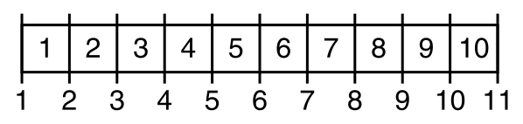
How to think about problems like this
An off-by-one error is a fencepost error.
Always be aware whether you are counting posts or gaps.
Always consider the simplest case: a list of length two or three. If your logic works in the simplest case, it will usually work on a longer list.
To avoid this problem, many programming languages count from zero.
The first item in a list is the zeroth.
Therefore, if you have to process the first 5 items, they are 0,1,2,3,4, not 1,2,3,4,5.

Slide 49
Complexity

Slide 50
Problems and problem spaces
One particular task (like “sort this set” or “simulate this cell”) is a problem instance.
A problem space is a collection of similar problem instances.
A algorithm which “solves a particular problem” can solve all problems in that problem space.
Figure

Slide 51
Time complexity
Larger problems take longer to solve (in terms of instructions processed).
Time complexity measures how running time gets longer in function of problem size.
Problem size?
- Travelling Salesman problem: number of cities to visit
- Sorting: how many items in our list
- Equation solving: how many terms in the formula
- Protein folding: number of atoms in the protein
Time to solve?
- Number of processor instructions (floating point ops, flops) per second
- Number of minutes code takes to run (assuming constant processor speed)

Slide 52
Space complexity
Larger problems take more room to solve (in terms of information we must keep track of during solution).
Space complexity measures how problems take more space in function of problem size.
Space used?
- Megabytes of RAM
- Gigabytes of disk space needed to store intermediate computations

Slide 53
Complexity classes
We measure time complexity using big O notation.
If t(n)=O(f(n)) then running time for problem size n is always less than a constant multiple of f(n). t = O(1) Constant time t = O(log n) Logarithmic time t = O(n) Linear time t = O(n²) Quadratic time t = O(n³) Cubic time t = poly(n) Polynomial time (P) t = 2^{O(n)} Exponential time
These refer to the upper bounds of processing time across the whole problem space, not the average time or the time for a particular problem instance.

Slide 54
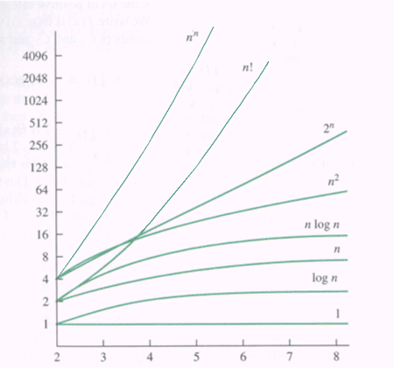
Complexity classes
Time taken
Problem size

Slide 55
Determinism
Deterministic systems always behave in the same way when running from a particular set of initial conditions.
Nondeterministic systems include randomness.
They may evolve in different ways from the same initial conditions.

Slide 56
Nondeterministic machines
Nondeterministic machines are a very powerful imaginary device.
Whenever there is a choice of paths, the nondeterministic machine takes both at once.
It can thus be simultaneously in several states at once.
A nondeterministic machine can explore all problem-solving options at once and stop as soon as one route finds a solution.
A nondeterministic machine can be simulated using a deterministic machine. All NM-computable problem instances are therefore DM-computable. However, they may take much longer.

Slide 57
What kind of machine?
We don’t need to worry about this.
All Turing-complete machines can compute the same set of problems.
The Church-Turing thesis (which can’t be proven, but has near-universal acceptance) says that every effectively calculable function is a computable function.
Alternatively: everything which we know exactly how to compute, can be computed by a machine.

Slide 58
Nondeterministic polynomial time (NP)
NP is a class of problems like P.
Problems in NP can be solved by a nondeterministic machine in polynomial time.
It is proven that if a problem is in NP, and we have a candidate solution, we can check the validity of that solution in polynomial time.

Slide 59
P vs. NP
One of the great questions of computer science.
P: problems which a deterministic machine can solve in polynomial time
NP: problems which a nondeterministic machine can solve in polynomial time. or, problems whose solutions can be verified in polynomial time.
If P=NP, for polynomial problems, it is just as easy to calculate a solution as to verify it (just as easy by a constant factor).
If P=/=NP, for polynomial problems, it is much harder to calculate a solution than to verify one.
This is widely believed to be the case.

Slide 60
Parallel computation
Many processes working at once, either independently (no communication) or message-passing (the problem requires communication to be solved).
Problems which can be attacked using independent processes are embarrasingly parallel.
Lots of biological problems are like this: image processing, gene analysis, running hundreds of separate simulations with different parameters.

Slide 61
The Von Neumann bottleneck
The input-processor-output model is serial (like the high-level cognitive system).
Many problems are not best solved in a serial fashion.

Slide 62
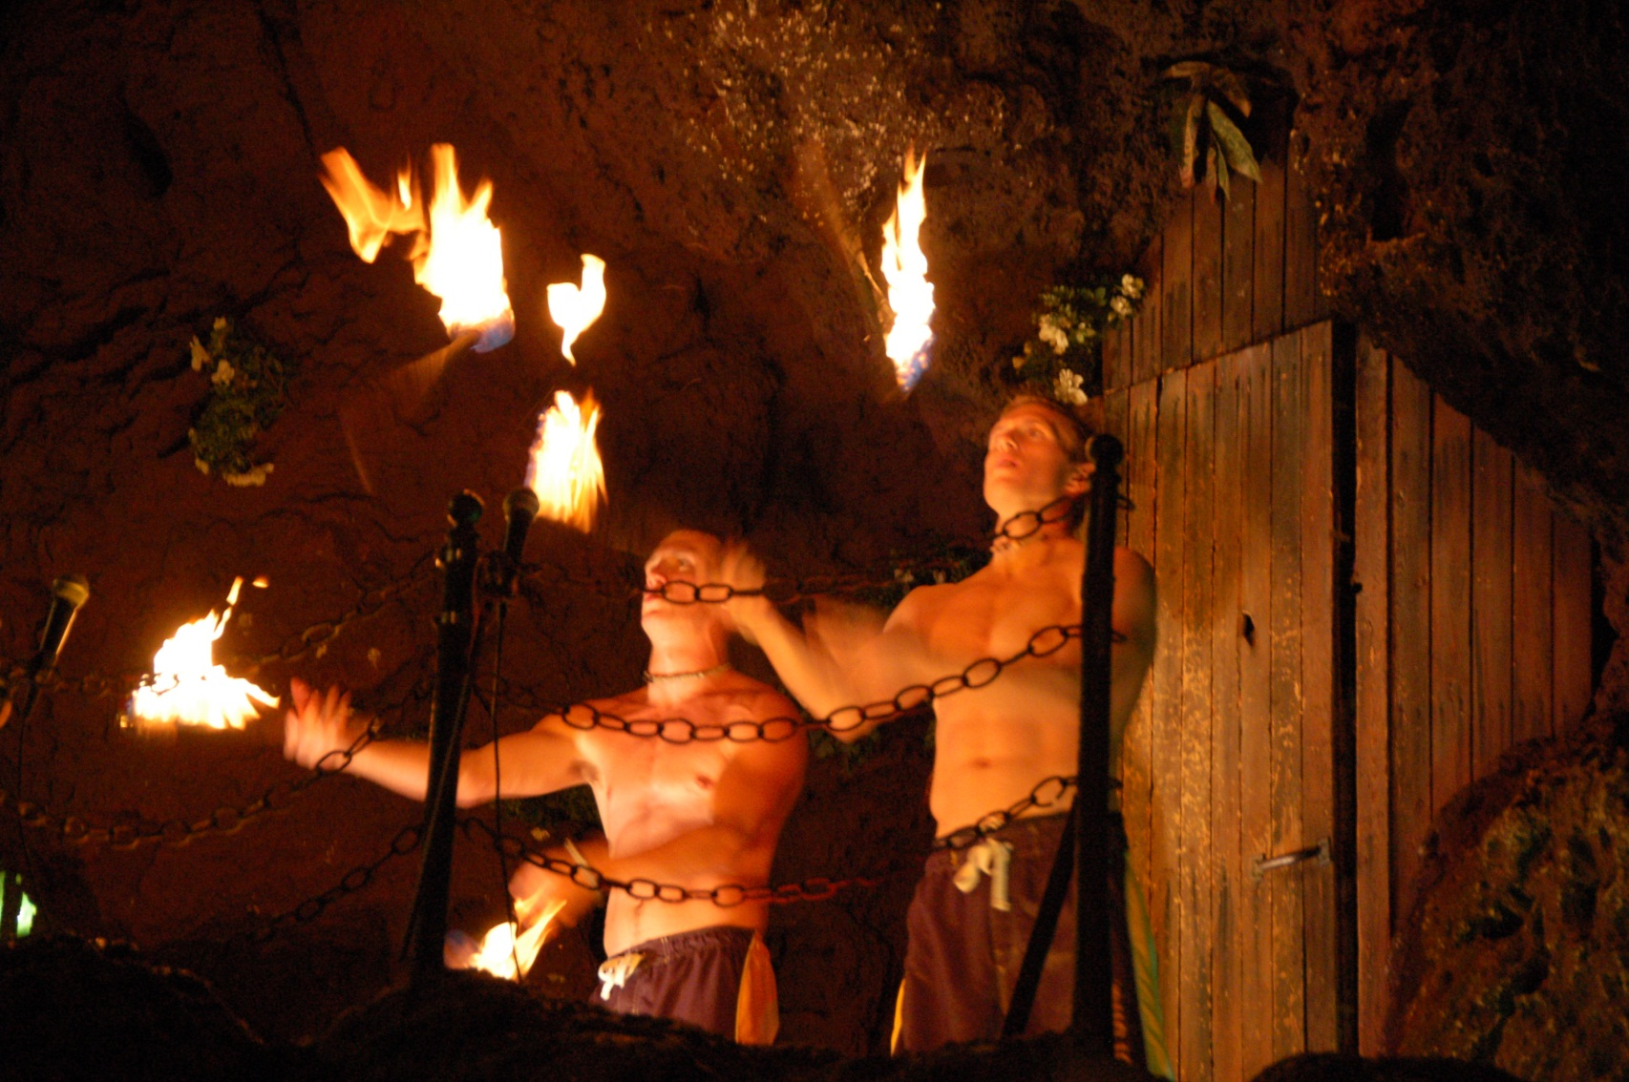
The Von Neumann bottleneck

Slide 63
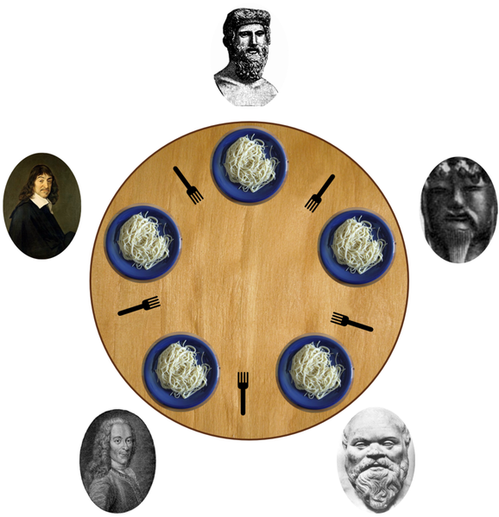
Parallel problems: the dining philosophers

Slide 64
Parallel problems: the dining philosophers
What happens if each philosopher tackles the problem independently?

Slide 65
Parallel problems: the dining philosophers
What happens if each philosopher tackles the problem independently?
We get deadlock.
We need a concurrent algorithm to solve this: one whose agents communicate with each other.

