Slide 1
Software engineering

Slide 2
The software lifecycle Requirements Use cases Specification Design Implementation Testing Deployment Support

Slide 3
The scientific software lifecycle Vague idea Prototype Testing Evaluation Prototype Testing Evaluation Prototype Testing Evaluation Publication!

Slide 4
Different approaches to design Waterfall method Design > requirements > implementation > testing all in one go Agile design Rapid prototyping Iterative development Mistakes are found quickly New designs can be added rapidly

Slide 5
The central tenet of scientific programming You need to be able to change things easily. You must be able to play. Make life good for yourself, not the compiler. Optimise programming time, not running time. Hardware will get faster and faster. Build re-usable components that you can link together easily.

Slide 6
Installing and learning a new library For example: gene data search library, molecular simulation library. Get a working example ASAP. Find a tutorial with some downloadable code. Strip it down to the bare working minimum, then add what you want – it’s much easier than starting from scratch. Get to know the language of the library – read through its documentation and sample code.

Slide 7
Programming style Every language has its own conventions. Indentation Variable naming it’s common to capitaliseLikeThis for variable names and CapitaliseLikeThis() for functions. This makes them easily distinguishable. Bad variable names: myDataCollectorAndPreprocessingStrategyImplementor a data a good variable name: sourceImage

Slide 8
Comments Comments are mainly for your own benefit. You will be amazed at how much you forget about your code, after several weeks or months! It’s good practice to comment the beginning of a file or function, saying what it does, and to comment any difficult or fiendishly clever areas in your code.

Slide 9
Documentation If you are working in a lab, other people will be using your code at some point in the future. Their life will be hell if there is no documentation! Also, they will constantly call you up and ask you to sort out five-year-old code. You will not remember how. What should you document? What each function or module does How to run it Where the input data is What output is produced.

Slide 10
Version control There are tools available which allow you to check in a snapshot of your code. That snapshot is then saved forever (in a compressed way). If you check in every day, you have a complete history of your code going all the way back to the beginning. Others can also check out your code and merge their own changes in, so a whole team can work at once without conflict. This is better than backup. Backups can be accidentally deleted – version history saves every detail. Even if you deliberately rip out a piece of code and then decide you want it back, you will be able to retrieve it. The best version control software is git, written by Linus Torvalds. You need a git server – the best thing is to use a free online service like projectlocker or github. If the servers are in California, another level of safety is provided!

Slide 11
Debugging Traditionally seen as “cleaning up after programming.” Debugging is at least as important as programming! It shows you things you missed or misunderstood. It brings your internal world view closer to reality. Debugging tools will save you phenomenal amounts of time.

Slide 12
Debugging tools Stopping in the debugger: your program is paused at a particular line of execution. Usually, you can execute code to poke around and find out what is wrong. Breakpoints: If you want to stop at a particular place, set a breakpoint there. Debugging-on-error: When your program crashes, you are automatically placed in the debugger at the line just before the crash. This is incredibly useful. Reproducing the error: See if you can automate this rather than having to provoke the error yourself.

Slide 13
Debugging tools Print statements: The poor man’s debugger. Add statements at common points in your program to print out important variables or messages (“I’ve reached line 548 and things are still fine!”) Logging Log files give you definite information about what your program has been doing. log(“I’ve loaded the images!”); Beware of assumptions Most long, frustrating debugging sessions are caused by false assumptions. Re-think everything!

Slide 14
Common errors Forgotten semicolons Equality test: == Assignment: = Undeclared variables Uninitialised variables Accessing parts of an array that don’t exist Accessing forbidden memory: segmentation fault or segfault Pasting copied code and forgetting to change

Slide 15
Testing If code is important, you cannot go without testing. Code that doesn’t work as you think can cost Time Money Academic kudos

Slide 16
The barely acceptable mininum Run a few test data through a function after you’ve written it, and verify that it behaves as expected.

Slide 17
More mature testing strategies Run automated tests to make sure the program still behaves as it did yesterday/last week. Write one test function for each function, covering edge cases special cases random sample of “normal” cases Integration testing Checking that components work together as expected Test-driven development Write the test first. It will, of course, fail. Then write the function that fulfils the test.

Slide 18
Getting help When you are stuck in a programming problem, asking for help can save hours of time. Often a quick comment can give you the insight you need to solve the problem. Sources of advice: The Internet (search for language, problem eg. Matlab add images) Stack Overflow: you can post questions, which are usually answered! Problem-specific fora Documentation Other people’s code Asking someone in the know

Slide 19
Working smart: automation Most mundane tasks can be automated. Especially if they can be performed on the command line. Examples: compiling moving files around uploading to a website downloading data from a microscope signups for experimental subjects If you ever find yourself repeatedly typing the same few lines of code, put them in a function. You will be able to run them instantly.

Slide 20
Working smart: keeping refreshed After a few hours of programming, problems can seem intimidating and insurmountable. This will give you a bad taste in the mouth and put you off programming. If you get fed up, go home, do something else, and come back to it in the morning. Problems which seemed intractable often take five minutes to solve, the next day! Programming is fun, and science is play. Keep it that way!

Slide 21
Programming languages

Slide 22
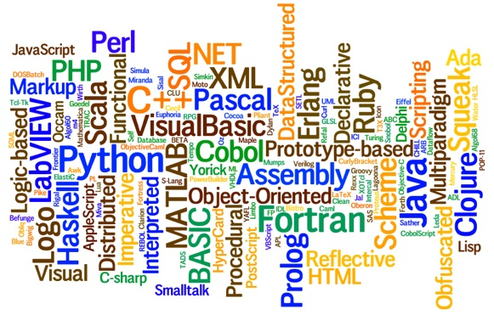

Slide 23
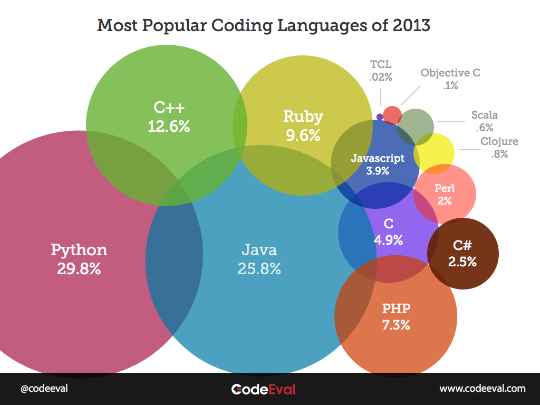

Slide 24
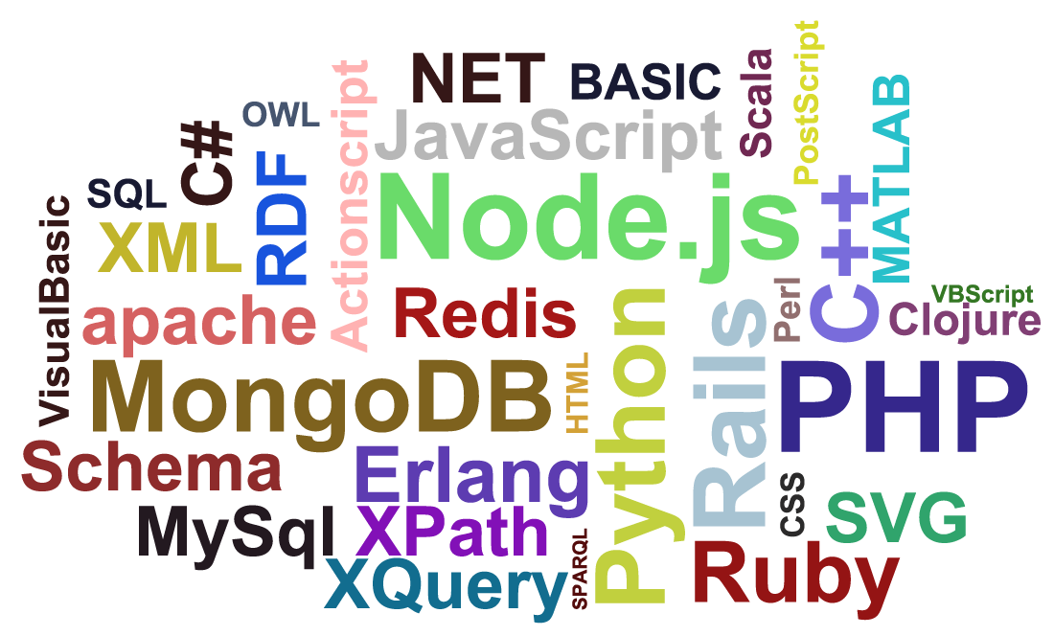

Slide 25
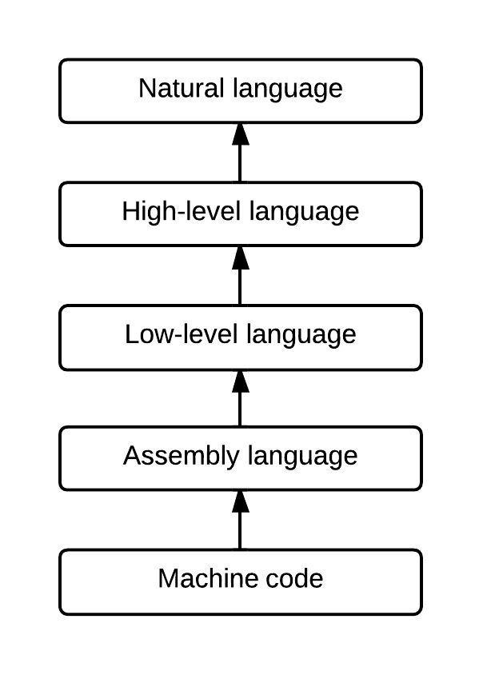
Levels of code Natural language: English Fuzzy, vague description of requirements High-level language: expressive, concise, powerful Low-level language: less expressive, more specific, closer to the metal Assembly language: very similar to machine code, but slightly more human-readable Machine code: the sequence of ones and zeros that actually controls the processor People used to code in this!

Slide 26
High-level vs. low-level High-level Expressive Slower Helpful to the human, not the machine Low-level Not as expressive Much faster More precise Closer to the memory and HD Helpful to the machine, not the human

Slide 27
Compiled vs. interpreted Compiled Source code is translated to machine code all at once before the program is run Wait time while compilation happens Interpreted Source code is translated to machine code instruction by instruction, during program execution. No wait to run program Execution is slower (because of translation)

Slide 28
Declarative vs. functional Declarative You tell the program exactly what to do, one step at a time. Repeated tasks are done by iteration. Functional Everything works through functions: a long, nested stack of functions which call each other. Repeated tasks are done by recursion (functions which call themselves).

Slide 29
Declarative programming The nth Fibonacci number is equal to the sum of the previous two. 1prev=1; 2prev=1; for i=1:n curr=1prev+2prev; 2prev=1prev; 1prev=curr; end

Slide 30
Functional programming The nth Fibonacci number is equal to the sum of the previous two. (define (fib n) (if (<= n 2) 1 (+ (fib (- n 1)) (fib (- n 2))) ) )

Slide 31
Object orientation Objects are a good way of encapsulating properties (member variables) behaviours (methods) Object oriented programming (OOP) is arguably a fad. It is not always needed. It is much slower. It can be confusing. And it features much creative terminology...

Slide 32
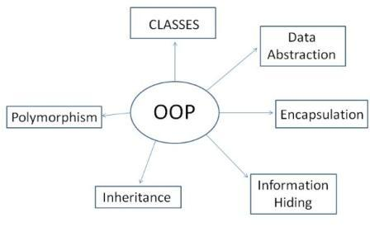
Object orientation Beware of object orientation unless you find you need it.

Slide 33
The language zoo Declarative High-level Matlab C++ Python Low-level C Functional Mathematica Haskell Lisp, Scheme

Slide 34
The language zoo Special-purpose LaTeX R Prolog SQL Bash Parallel MPI Haskell CUDA C/C++

Slide 35
The language zoo Web HTML CSS SQL Perl PHP

Slide 36
Learning a new language Dive into it straight away Get a simple, working program (a “Hello, World!”) Find a good tutorial There are very many bad tutorials. Find one that fits with your learning style. Know where the documentation is You will need to look up a lot of things Play and explore Test out new language features in fun ways Make a cheat sheet One unified place where you can make notes about syntax and language details

Slide 37
Bash The language you use to talk to the terminal in OS X and most Unix/Linux OSs. Anything which you can say to the terminal, can also be placed in a script. Many commands can be executed together this way, with loops, functions and conditionals.

Slide 38
Matlab Developed as an easy-to-use frontend to computer algebra packages. Easy to use High-level Declarative Has OOP (but it’s a slow, little-used add-on) Really good at working with images and matrices Good at plotting and displaying images and video Absolutely stupendous debugger. The language of choice for much of science and engineering.

Slide 39
Aside: Arrays and matrices Lists are one-dimensional sequences of data. Matrices are 2D tables of data. Arrays are tables of any dimensionality. Lists and matrices are arrays. Arrays can also have 3, 4, 5 and more dimensions! Working with arrays is considerable easier than working with their contents separately! You can apply functions to entire arrays (average, sum...) and you can combine arrays (concatenation, addition...).

Slide 40
C Developed as a portable language for writing operating systems and other complex software. Quite low-level. Does not help the user much. This makes it very fast. When programming in C, you have to pay attention or things will bite you.

Slide 41
C++ The object-oriented version of C. Used to write most modern production software. More friendly, includes more helper functions for handling strings etc. g++ hello.c –o Hello chmod +x Hello ./Hello

Slide 42
Python The workhorse of modern scientific computing. Very high-level, takes care of a lot of the work for you (iterating over sets, common operations and coding patterns) No brackets – everything works by indentation. Not as fast as C/C++. Named after...? python hello.py

Slide 43
Mathematica Developed by Steven Wolfram, eccentric pioneer of complexity theory. Functional – lots of nested function calls and brackets. Very pretty indeed – good equation drawing and graph plotting. Slightly steeper learning curve... ...which unleashes remarkable power once tackled. Plot[Sin[x], {x,0,10}]

Slide 44
Lisp, Scheme and Haskell Pure functional languages. Not very widely-used in science. Lots of nested function calls. Brackets everywhere. Again, steep learning curve, and high power. Functions like map allow other functions to be treated as objects – applied to arrays, composited.

Slide 45
LaTeX Special-purpose language with one job: helping you write your PhD thesis, reports, and papers. It manages: Contents page Figures Refs (eg. “on page 55 you will find...”) Part, chapter, section and subsection headings Formatting Graphics drawing And most importantly, the bibliography.

Slide 46
R Developed for statistical processing: lots of built-in plotting functions, statistical tests, distributions... A special-purpose language.

Slide 47
Prolog A logical constraint language. Allows you to specify logical formulae, such as “I will be happy IF my cells are still alive OR if it is Friday.” Then, Prolog will use its logic engine to try and find solutions to the formulae: ways to make them true. This saves a lot of programming effort. Used in the fields of inference and cognitive science.

Slide 48
SQL A special-purpose language exclusively for databases. Doesn’t care what type of data you store in it, but is very good at looking after it. Avoids corruption and consistency problems.

Slide 49
MPI Message-Passing Interface. A set of libraries for C/C++. Developed for interprocess communication, often on supercomputer clusters. Tackles the traditional difficulty of synchronising distributed algorithms, by providing functions for data sharing and cooperation.

Slide 50
C/C++ with CUDA Compute Unified Device Architecture. Gives access to GPU and CPU cores, with parallelism and interprocess communication. Mainly used for embarrasingly parallel problems; MPI is better at concurrency. Developed by Nvidia.

