Slide 1

Evolutionary psychology
A compelling explanation
Behaviours are evolved responses to the environment in which the human species evolved.
There are two levels on which behaviours can be transmitted:
Genetic
Cultural
Timing information can inform as to which level generates a particular behaviour.

Slide 2
Evolutionary psychology
A compelling explanation
We can see the brain as an information processing device, producing outputs (behaviour) from inputs (stimuli).
We can point out adaptive mechanisms shaped by natural and sexual selection.
These are reflected in neural mechanisms evolved for solving problems in humanity’s past.
Evolution requires very long time periods to effect change; modern humans have stone-age minds.
We can find specialised mechanisms in the brain sensitive to different classes of information.

Slide 3
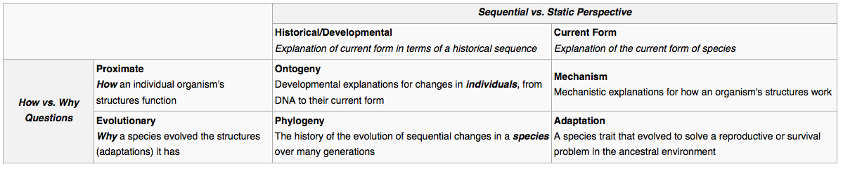
Evolutionary psychology
A compelling explanation

Slide 4
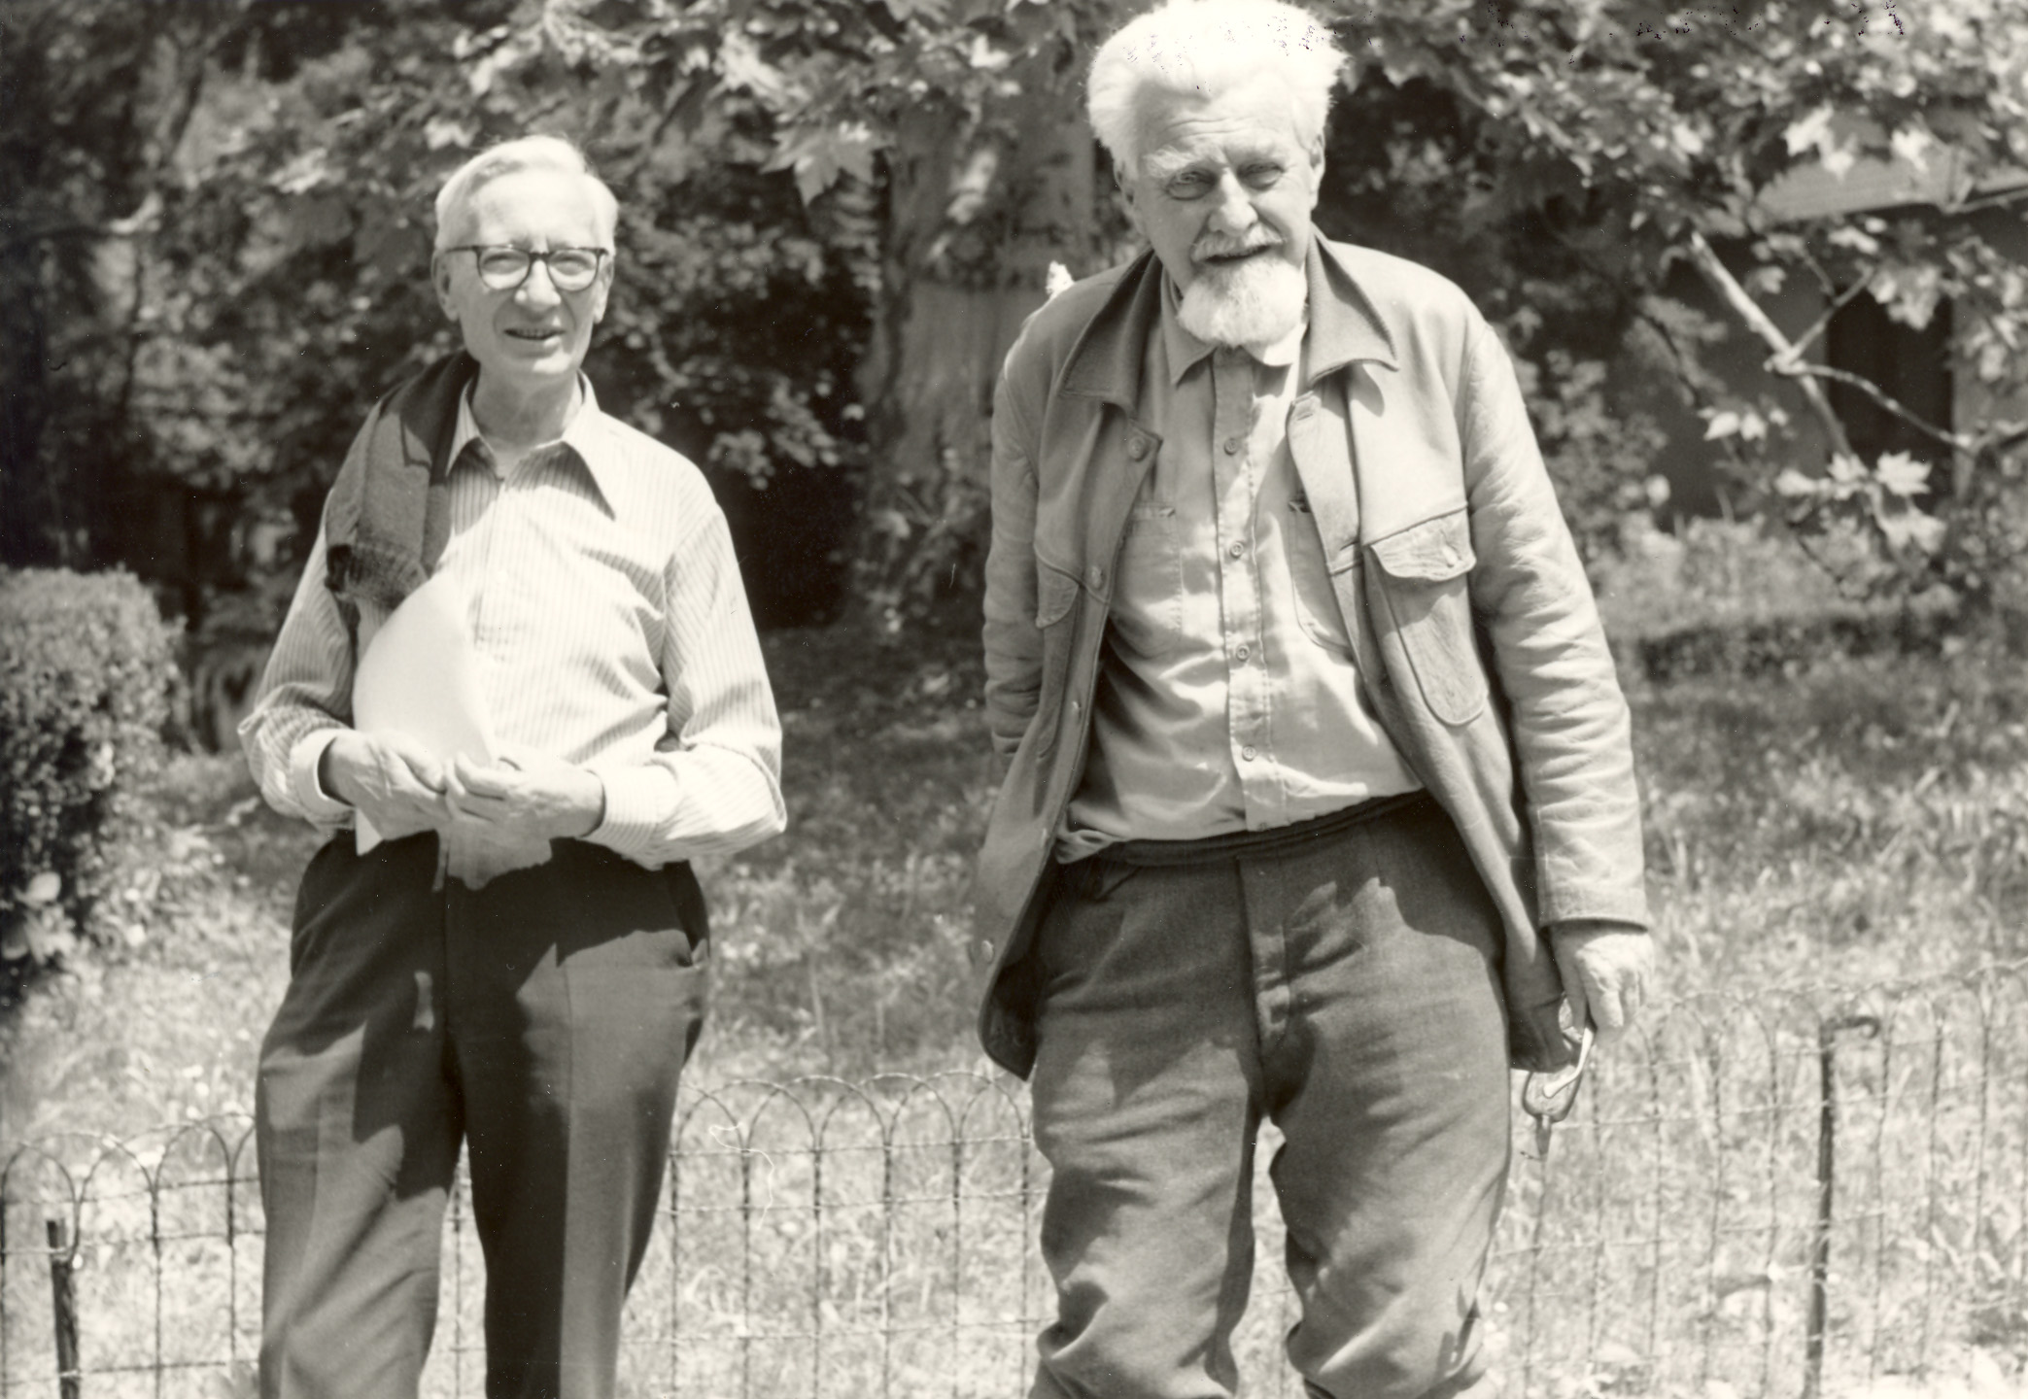
Evolutionary psychology
A compelling explanation
Nikolaas Tinbergen 1907 – 1988 Konrad Lorenz 1903-1989

Slide 5
Evolutionary psychology
Konrad Lorenz
Helped to found ethology, the study of animal behaviour.
Studied imprinting and other instinctice behaviours

Slide 6
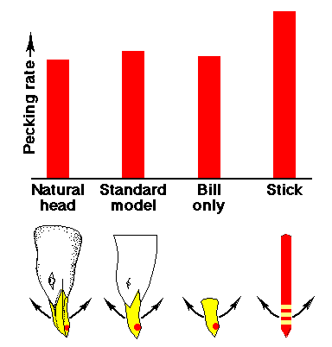
Evolutionary psychology
Nikolaas Tinbergen
Supernormal stimuli

Slide 7
Evolutionary psychology
Trivers-Willard hypothesis
Female mammals are able to adjust offspring sex ratio
Males are more able to exploit good conditions in order to reproduce.
Under good conditions, paents invest more in sons
Under unfavourable conditions, parents invest more in daughters

Slide 8
Evolutionary psychology
In the modern world
Some of our adaptations do not fit so well in the modern world

Slide 9
Evolutionary psychology
Game theory
The Prisoner’s Dilemma

Slide 10
Evolutionary psychology
Altruism
Altruism: caring for the welfare of others.
It is not defined as “doing something which helps someone else but does not help yourself.”
Perhaps “doing something which helps someone else but does not directly help yourself.”
Altruism can be considered a trait: a general, measurable pattern of behaviour.

Slide 11
Evolutionary psychology
Altruism
Evolutionary explanations
Kin selection: by helping others with similar genes, the survival of the gene is secured.
Reciprocal altruism: if reciprocity is supposed, altruism makes sense.
Resource availability signalling: altruism shows that you have resources to spare! (Heroic risk-taking)
Group slection theory: selection works at the level of the group, not of the individual.

Slide 12
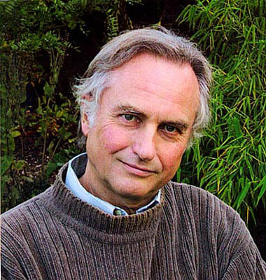
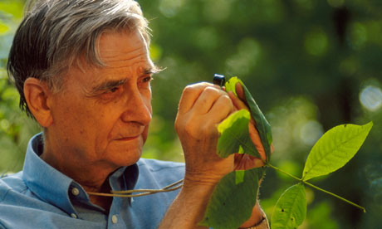
Evolutionary psychology
Altruism
Edward Osborne Wilson 1929 – pres Richard Dawkins 1941 - pres

Slide 13
Evolutionary psychology
Altruism
Original Wilson paper:
Nowak, Martin A., Corina E. Tarnita, and Edward O. Wilson. "The evolution of eusociality." Nature 466.7310 (2010): 1057-1062.
Dawkins rebuttal and Wilson’s reply:
http://www.prospectmagazine.co.uk/science-and-technology/edward-wilson-social-conquest-earth-evolutionary-errors-origin-species
Overview:
http://www.theguardian.com/science/2012/jun/24/battle-of-the-professors

Slide 14
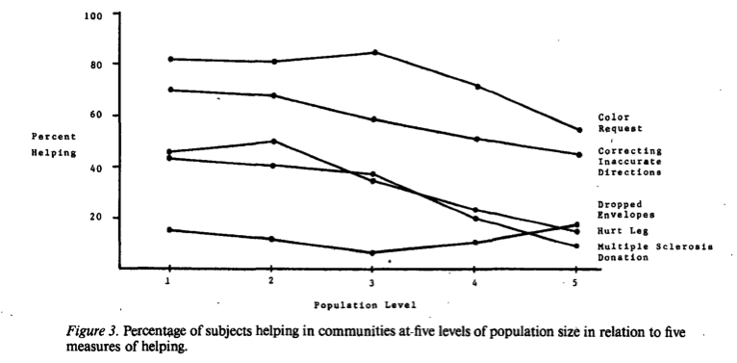
Evolutionary psychology
Social exchange theory
Amato, Paul R. "Helping behavior in urban and rural environments: Field studies based on a taxonomic organization of helping episodes." Journal of Personality and Social Psychology 45.3 (1983): 571.

Slide 15
Evolutionary psychology
Social exchange theory
Amato, Paul R. "Helping behavior in urban and rural environments: Field studies based on a taxonomic organization of helping episodes." Journal of Personality and Social Psychology 45.3 (1983): 571.

Slide 16
Lecture 8 Life as a psychologist

Slide 17
Social psychology
Research
Professonal psychological practice

Slide 18
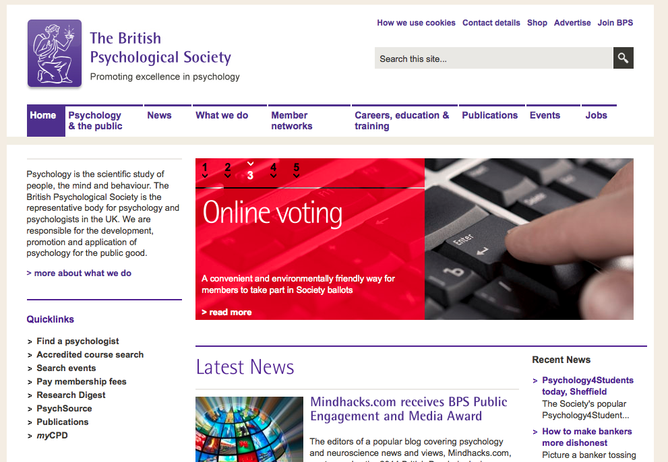
Training

Slide 19

Training
British Psychological Society (BPS)
Founded 1901 at University College London
C. 50,000 members in 2012
Keeps the Register of Chartered Psychologists
Letters: C.Psychol. Fellow: FBPsS
Monthly magazine: The Psychologist
Publishes 11 journals

Slide 20
Clinical psychology
Training
British Psychological Society accredited psychology degree or BPS qualifying examination or accredited postgraduate qualification or accredited conversion course
Work experience: volunteering or assisting
3 years postgraduate study: Doctorate in Clinical Psychology 6:1 applicant to place ratio fully funded by NHS applicant mean age 26
Eligible for Health & Care Professions Council (HCPC) register, which enables you to practice as a clinical psychologist (protected title)

Slide 21
Clinical psychology
Counselling
Course accredited by the British Association for Counselling and Psychotherapy (BACP) No degree/HND required 100 hours supervised counselling practice

Slide 22
Clinical psychology
Psychotherapy
Individual client meetings (30 mins to one hour)
Group sessions
Therapies:
cognitive behavioural therapy
psychoanalysis/psychodynamics
humanistic/integrative psychotherapies
hypno-psychotherapy
Training:
Relevant degree
Masters in psychotherapy
Qualification accredited by the UK Council for Psychotherapy (UKCP) various types
Courses are oversubscribed

Slide 23
Clinical psychology
Neuropsychology
Psychological assessment and therapy of patients with neurological injuries (traumatic brain injury, brain cancer...)
Training:
Doctorate in psychology or neuropsychology
Clinical work experience (clinical portfolio)
Clinical supervisor
BPS Qualification in Clinical Neuropsychology (QiCN)

Slide 24
Practicing psychology
Child psychotherapy
Training:
Honours degree
Considerable experience working with children
Course accredited by the Association of Child Psychotherapists (ACP) Around six years Pre-clinical training (2yrs): infant observation Doctoral-level clinical training scheme (4yrs) in NHS Child and Adolescent Mental Health Services (CAMHS)

Slide 25
Clinical psychology
Forensic psychology
Assessment and treatment of criminal behaviour, mainly within HM Prison Service
BPS-accredited psychology degree or conversion course
BPS-accredted Masters in forensic psychology
BPS Qualification in Forensic Psychology Two years of supervised practice Often completed while working as a trainee forensic psychologist
Fierce competition, work experience required bail hostels (Approved Premises)
drug/alcohol treatment centres
secure hospitals/rehabilitation units
youth offending services
Employers:
HM Prison Service
NHS
police
social services

Slide 26
Practicing psychology
Educational psychology
Training:
BPS-accredited undergrad or conversion
BPS-accredited Doctorate in educational psychology Work experience required Teaching experience allows exemption from part of the doctorate Funding available if you undertake to work for an LEA after graduation
Registration with HCPC (Health and Care Professions Council)

Slide 27
Practicing psychology
Occupational psychology
BPS areas:
Human-machine interaction
Design of work environments
Personnel selection and assessment
Performance appraisal and career development
Counselling and personal development
Training
Employee relations and motivation
Organisational development and change
Training:
BPS-accredited psychology undergrad or conversion course
BPS-accredited Masters in Occupational Psychology
BPS Doctorate in Occupational Psychology (QOccPsych)
Employers:
Industry
Civil Service

Slide 28
Practicing psychology
Continuing development
All practising psychologists must ensure continued professional development by keeping abreast of the field.
Attending conferences, reading clinical and theoretical journal articles.

Slide 29
Research in psychology
Fields
Brain science:
Psychology
Cognitive science
Neuroscience

Slide 30
Research in psychology
Career routes
Psychology undergraduate (not essential)
Masters course
PhD course
Postdoctoral researcher or fellowship
Reader or Lecturer
Senior Lecturer
Assistant Professor
Professor
Tenured Professor (mainly United States)
Along the way:
Research assistant

Slide 31
Research in psychology
Activities
Reading papers
Formulating theories
Performing experiments
Analysing data
Interpreting results
Writing papers
Presenting at conferences
Teaching
Outreach and public engagement
Writing grants
Networking
Much of this applies to other academic fields too...

